Slide 1
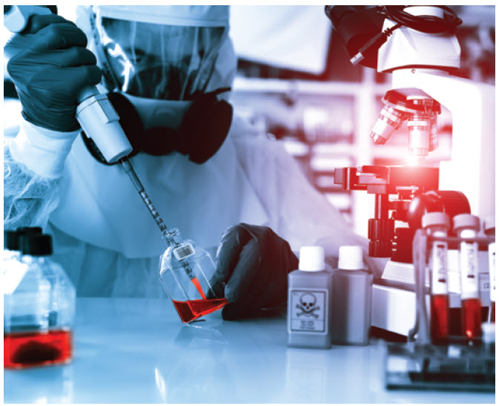
Case 2 – Microbiology Laboratory
By: Riley Ty

Slide 2
Case:
18-year-old Mary has just moved into the dormitory at her university. One day, her roommate finds her lying in bed under her sheets. She is complaining of fever, chills, bad headache and a stiff neck. She is staying under the covers because the light is hurting her eyes. Her roommate calls 911 and an ambulance takes Mary to the local hospital. The emergency room physician asks Mary about her recent vaccinations and she reports that she has not had any since she was in elementary school. The physician documents a fever of 39.2°C and low blood pressure. He sends blood and cerebral spinal fluid to the Microbiology Laboratory. She is started immediately on intravenous antibiotics. Mary’s blood and cerebral spinal fluid grow Neisseria meningitidis and she is diagnosed with meningococcal meningitis.
Topics of Discussion:
Other than the stated bacterial cause, what are the most common bacterial pathogens associated with this type of infectious scenario?
What samples are taken for laboratory testing and how important is the Microbiology Laboratory in the diagnosis of this particular infectious disease?
Explain the tests that will be performed on the samples in order to detect any of the potential bacterial pathogens causing this disease?
What are the results expected from these tests allowing for the identification of the bacteria named in this case?

Slide 3
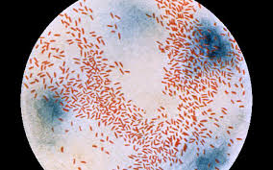
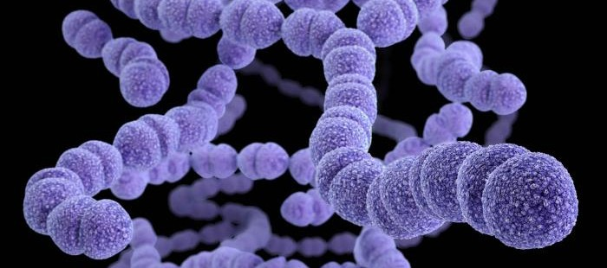
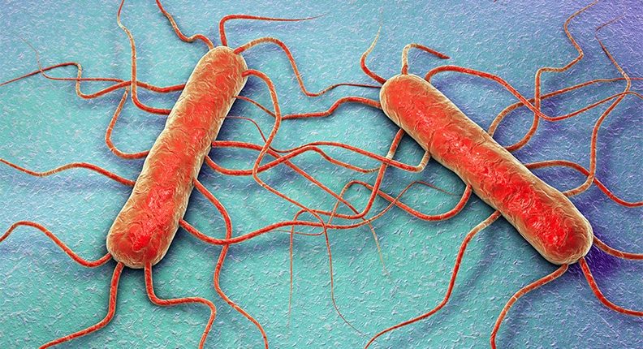
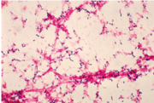
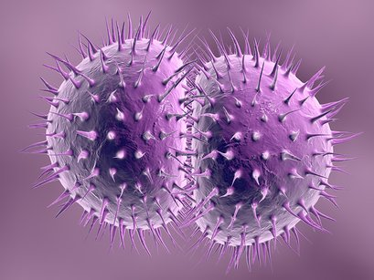
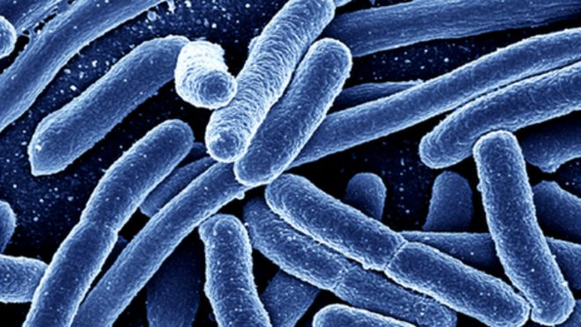
Other Possible Pathogens
Pathogen | Picture | General Info
Haemophilus influenzae |  | Gram (-), coccobacilus shaped, encapsulated or unencapsulated. Symptoms are, but not limited to: Fever, sensitivity to light, confusion/altered mental status, headache, stiff neck, and nausea.
Steptococcus pneumoniae |  | Gram (+), lancet shaped, capsule forming cocci or diplococci. Symptoms: ever, cough, chest pain, stiff neck, confusion, photophobia, shortness of breath, sleeplessness, irritability, and joint pain
Group B streptococcus (GBS) |  | - Gram (+), coccus shaped, distinguished by capsular polysaccharide. - Symptoms (Newborns and babies): fever, irritability, difficulty breathing, difficulty feeding and bluish colour to skin
Listeria monocytogenes |  | Gram (+), rod shaped Symptoms: headache, stiff neck, confusion, fever, muscle aches and loss of balance.
Neisseria gonorrhoeae |  | Gram (-), diplococcus shaped - Symptoms: pain or burning sensation while urinating, sore throat, fever and sharp pain in lowerabdomen.
Escherichia coli |  | Gram (-), rod shaped Symptoms: nausea, vomiting, photophobia and confusion.

Slide 4
Likely Pathogens Based on Age Group
Age Group | Likely Microbes
<6 weeks old | Group B streptococcus, Escherichia coli, Listeria monocytogenes, Other Enterobateriaceae, (Rare) S. pneumoniae, N. meningitidis
6 weeks – 3 months old | S. pneumoniae, N. meningitidis, H. influenzae type B, Group B streptococcus, (Rare) E.coli, L. monocytogenes, other Enterobacteriaceae
Children, adults (18 year old Mary’s group) | S. pneumoniae, N. meningitidis, H. influenzae type B
>50 adults | S. pneumoniae, N. meningitidis, L. monocytogenes, E. coli

Slide 5
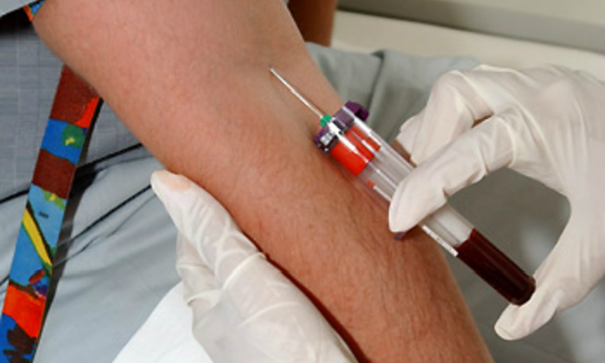
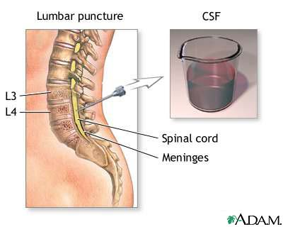
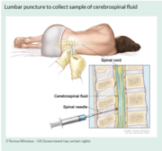
Samples and Diagnostic
Given the dangers of N. meningitis, primarily its ability to cross the blood brain barrier, cause inflammation of the meninges and enter the Cerebrospinal Fluid (CSF), the disease is diagnosed via a lumbar puncture.
The specific process involves inserting a needle into the spinal canal of the lower back, i.e. the lumbar area, and collecting the appropriate fluid sample, CSF.
If a lumbar puncture is unsafe such as when increased pressure in the skull leads to increased risk of brain matter being compressed and pushed towards the spine, a blood sample, which is also helpful in many cases, is used instead.
In this case both CSF and blood were used to be thorough.

Slide 6
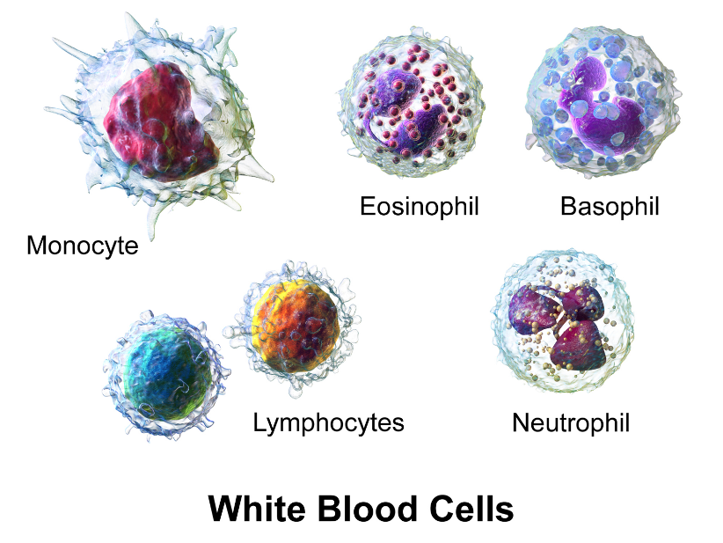
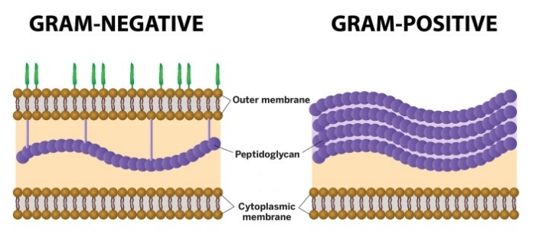
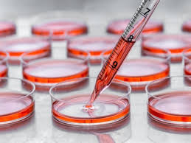
Further usage of CSF sample in Diagnostic Lab Testing(1)
In order to provide specific and effective treatment for Mary, as there are many possible pathogens and multiple corresponding treatments, correct identification of the specific bacterium, via isolated pure cultures, is necessary.
- After treatment, testing can also monitor where the bacteria is still present in the patient making further treatment more effective.
CSF sample undergoes multiple tests to confirm active infection within the host, determine the specific bacterial infection from other etiologies (i.e. viral and or fungal infections) and to identify the specific causative microorganism.
CSF cell count and differentiation level of specific cells, such as increased white blood cells, decreased glucose and presence of certain proteins, may serve as indicators of an active infection. Specific quantities, such as CSF neutrophil count of >1180 neutrophils/mm3 or CSF leukocyte count of >2000 leukocytes/mm3 can rule out viral cause,
supporting a bacterial cause with 99% certainty.
Gram stain can also be used to confirm acute bacterial meningitis, but due to difficulty in staining Neisseria, only 75% of N. meningitidis associated meningitis can yield positive Gram stain results.
As a result, culture is the primary diagnostic of bacterial meningitis as it can identify the specific pathogenic bacteria in 85% of patients.
Due to the delay of 48 hours for culture results, other diagnostic tests such as PCR and latex agglutination are used, but only as a secondary tests in which the Gram Stains are negative and because the tests are limited by cost, availability and the results are not known to be significant when deciding treatment.

Slide 7
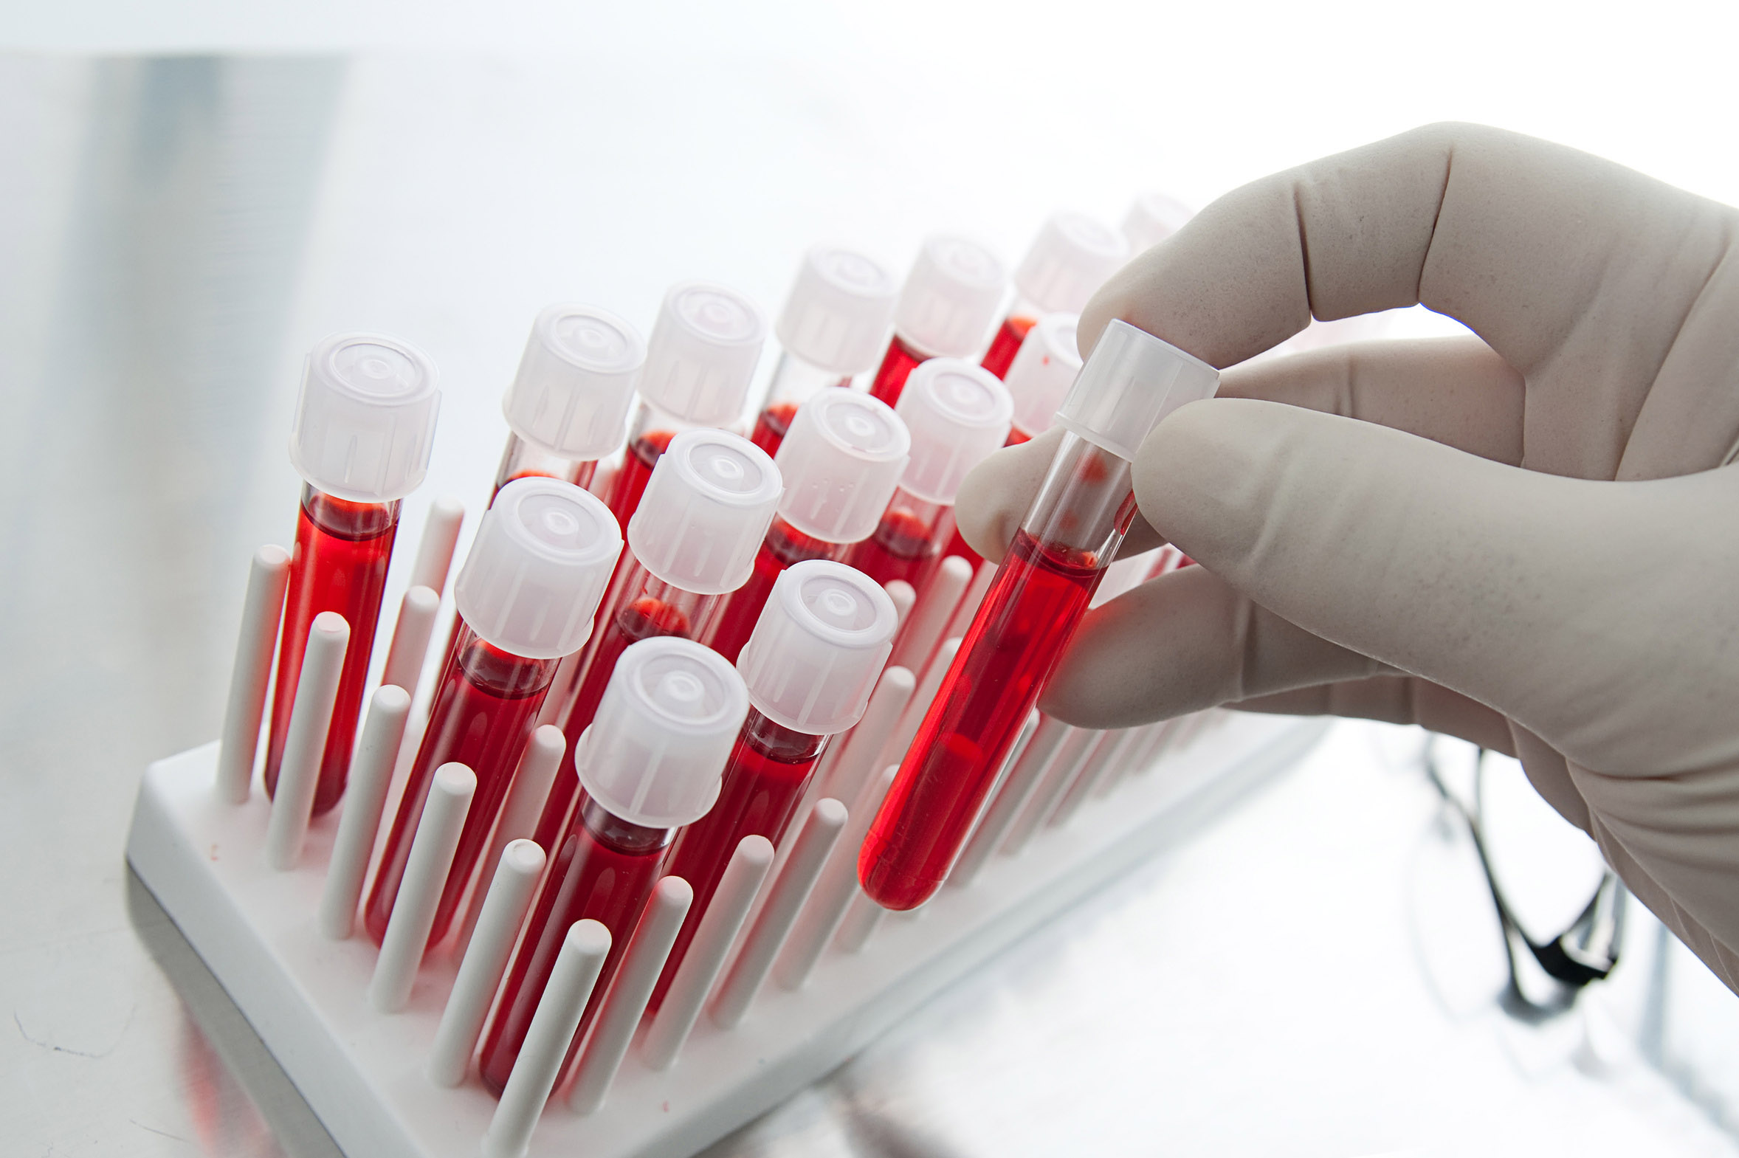
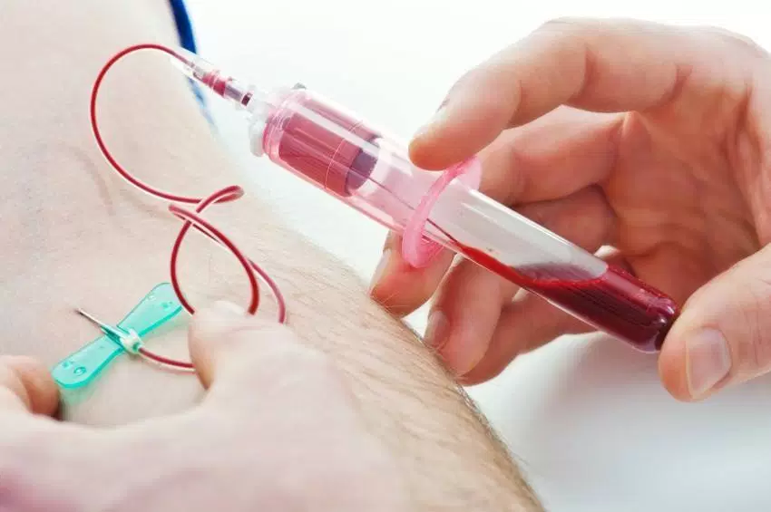
Further usage of Blood sample in Diagnostic Lab Testing (2)
Blood Testing is also important as it can be combined with CSF to diagnose the presence of bacterial meningitis.
For instance, when CSF glucose is measured, blood glucose levels are also measured as the ratio between these two values decreases as a result of bacterial meningitis.
A ratio of <0.4 is highly indicative of bacterial meningitis.
Given meningitis can be a result of infection from other sites in the body, a blood sample can reveal the real cause of the infection, while a CSF sample may not.
Blood cell count and the differentiation of cells within the blood, can also confirm an active infection (example leukocyte count within blood).

Slide 8
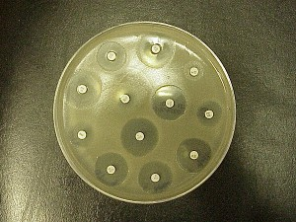
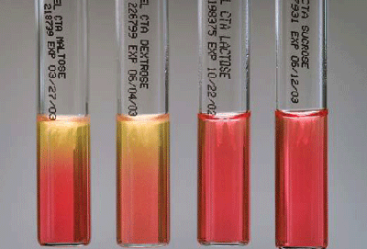
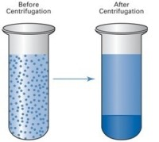
Pathogen Detection via testing of blood and CSF samples(1)
Culture: primary method for diagnosing bacterial meningitis and identifying causative pathogen.
Begins with CSF sample being concentrated via centrifugation, media is then warmed to 370ºC and the sample is cultured on solid media (usually chocolate peptone-blood base agar plate).
Plate is cultivated in a moist chamber (5-10% CO₂), allowing bacteria to grow.
Specific media, such a Thayer Martin medium, contains antibiotics (ex. Vancomycin, anisomycin and sulfamethoxazole-trimethoprim) to inhibit growth of most other bacteria aside other than N. meningitidis.
Sensitivity: Once enough bacteria has grown, sensitivity tests are conducted to confirm the identity of the pathogen in question.
Following a positive Kovac’s oxidase test, a carbohydrate utilization test, in which the sample is placed in 4 separate test tubes of glucose, maltose, lactose and sucrose, is also performed.
If acid is produced in the glucose and maltose tubes it confirms N. meningitdis.
Timing is also crucial as CSF can yield false results after antibiotic treatment.

Slide 9
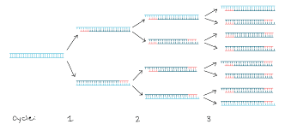
Pathogen Detection via testing of blood and CSF samples(2)
Gram Stain: preliminary step in identification as confirmation is rapid and will tell the difference between Gram (+) and Gram (-) bacteria.
After centrifugation, bacterial sample is put on slide and stained with crystal violet dye for 30 second, then rinsed and counter stained safranin for an additional 30 seconds.
Gram (+) bacteria will retain purple color of crystal violet dye due to its thick, impermeable cell wall with high peptidoglycan (PG) content, making it resistant to decolourization and rinsing.
Gram (-) bacteria, such as Nesisseria, will be pink/red colour because of thin PG cell wall making it susceptible to decolourization and rinsing.
Note: results can vary due to human error, pathogen and the amount of bacteria in CSF or blood samples.
Polymerase Chain Reaction (PCR): Amplification of small genetic segments, used to differentiate between segments of different microbes.
Complementary strands of DNA form from a pair of primers and the DNA polymerase enzyme elongates the strands to make a copy of the DNA.
For N. meningitidis the crA gene is amplified and compared to the amplified lytA and bexA genes of S.pneumoniae and H.influenza, respectively, to distinguish between the bacteria.
This same method can used to differentiate between the B,C, Y and W135 groups of N. meningitidis via the siaD gene and mynB gene in group A.
Remains a secondary method of detection, used only when gram stain is negative due to high cost, limited availability and lack of clinical importance.

Slide 10
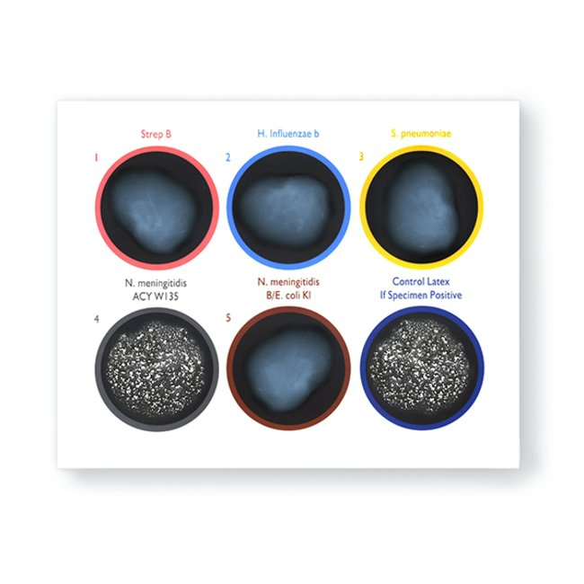
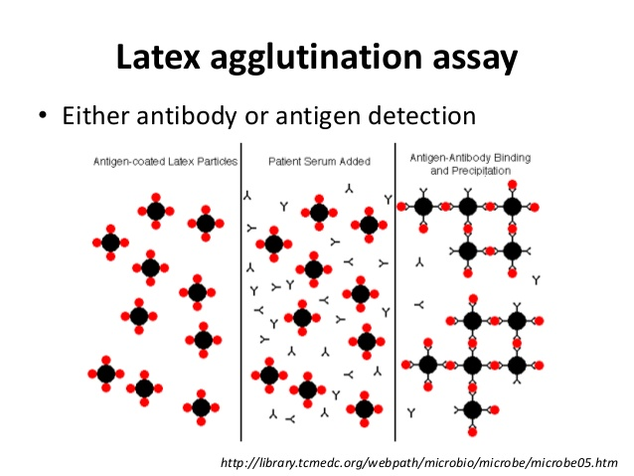
Pathogen Detection via testing of blood and CSF samples(3)
Latex Agglutination: Determines serogroup via reaction between capsular antigen of pathogen and specifically designed serogroup antibody.
Rapid identification within 15 minutes and high specificity for bacterial meningitis.
Results can vary due to the origin of the antibody, design of antigen in CSF sample and specific pathogen being tested.
Evidence also suggests that results are not a major factor in clinical decision for bacterial meningitis, therefore it remains a secondary method of detection, used when gram stain is (-).

Slide 11
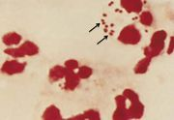
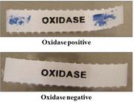
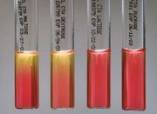
Expected Results for Identification (1)
Culture Results: When Mary’s blood and CSF samples were sent to the lab, a portion of these samples were allocated for growth on culture.
Only fungal or bacterial causes of meningitis will grow on the plate, viral causes will not.
Blood and Chocolate plates are typically used, as they can determine whether the cause is N. meningitidis, S. pneumoniae, or H. influenzae.
Since H. influenzae is unable to lyse red blood cells only N. meningitis and S. pneumoniae will grow on blood plates.
If the case is Neisseria specific then Thayer-Martin plates can be used to eliminate other bacteria and fungi via antibiotics and fungicides respectively.
Gram Stain Results: To determine whether the cause is N. meningitidis or S. pneumoniae, a gram stain will be conducted.
N. meningitis will stain pink/red, gram (-), while S. pneumoniae will stain purple, gram (+).
Sensitivity Results: After these initial tests, sensitivity testing is conducted to confirm treatment.
Usually a Kovac’s Oxidase test is conducted to determine if the bacteria produces cytochrome C oxidases and can therefore be involved in aerobic respiration.
If the reagent turns purple and is administered after the previous tests, the results are positive for an aerobic microorganism that belongs to the Nesseria genus.
A carbohydrate utilization test is then conducted to confirm whether the bacteria can ferment specific carbohydrate substrates as different Nesseria species utilize different sugars.
When placed in 4 separate test tubes of glucose, maltose, lactose and sucrose N. meningitidis will cause only the maltose and glucose tubes to turn from red to yellow, since the bacteria utilizes these to produce fermentation acid.

Slide 12
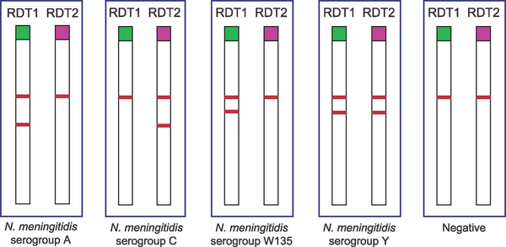
Expected Results for Identification (2)
PCR Results: The other portion of blood and CSF samples can be used for PCR amplification as it can test for different cause all at once.
- If positive for N. meningitidis the crgA gene will be only amplified product.
Assuming the meningitis in question is only caused by one bacteria.
PCR can also differentiate between the B,C, Y and W135 groups of N. meningitidis via amplification of the siaD gene and mynB gene in group A.
Latex Aggulation Results: If all the tests indicate N. meningitidis the next step would be to identify the specific strain that has infected Mary.
A positive results is when a sample reacts with the antigen specific antibody to produce an obvious precipitation pattern.
Only a precipitation pattern at +3 or +4 rating and no saline reaction indicates a positive result, all other are undetermined.
Rapid Diagnostic Tests (RDTs): can directly test CSF for N. meningitidis.
Although quick and simple as they do not require processing, it also means they are not as sensitive or specific as the previous methods.
Used in the field, but not the hospital.
Two RDTs are capable of detecting N. meningitidis serotypes A and W135/Y and serogroups C and Y, respectively.
A positive result is when two lines appear on the RDT paper stick (image on the right), while a negative results only has one line.
Second line determines the specific serogroup.

