Slide 1
Designing for 3D Printers
Part 1: Know your printer

Slide 2
Quick overview
Important features of printers
Build volume & area
Nozzle diameter
Resolution
Materials
Previously printed parts
Notes:
The goal of the presentation is to cover the most important features of a 3D printer, and how they impact the function of the printer.

Slide 3
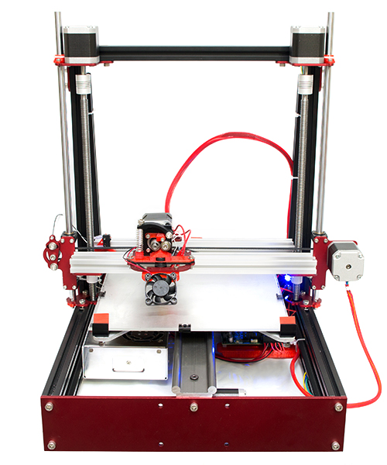
Build area and volume
Know how big your printer is.
The build area is the maximum footprint your part can have
The build volume will tell you how tall your part can be
Height
Length
Width
Image source: http://www.makerstoolworks.com/products/mendelmax-2-0/

Slide 4
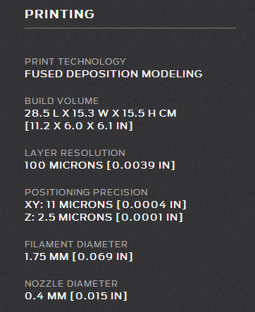
Build area and volume
Know how big your printer is.
The build area is the maximum footprint your part can have
The build volume will tell you how tall your part can be
Image source: http://store.makerbot.com/replicator2

Slide 5
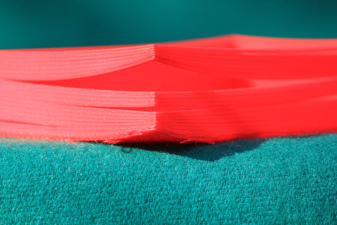
Build area and volume
If you need to print a larger part, split it into multiple pieces and join them together afterwards
Larger parts will be more difficult to print: they will be more prone to warping and the bed will have to be more level for them to be successful
Warping
Lift
Image source: http://www.deelip.com/?p=7151

Slide 6
Nozzle diameter & resolution
The nozzle diameter and resolution of your printer determine how close your part will look to what you designed
The nozzle diameter also determines how much plastic will flow from the nozzle per second.
Image source: http://store.makerbot.com/replicator2

Slide 7
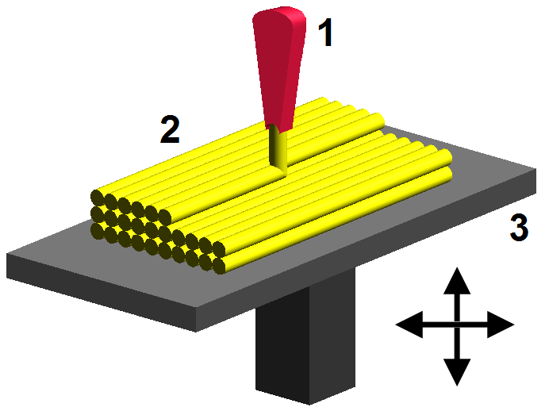
Nozzle diameter & resolution
A small-diameter nozzle will produce higher-quality parts, but take much longer.
The smallest increment of movement of the x- and y-axis are not significant measurements: when plastic is extruded, it spreads out much more than any positional error
3D printed models don’t look like this: the plastic spreads out as it’s extruded
Image source: Wikimedia Commons

Slide 8
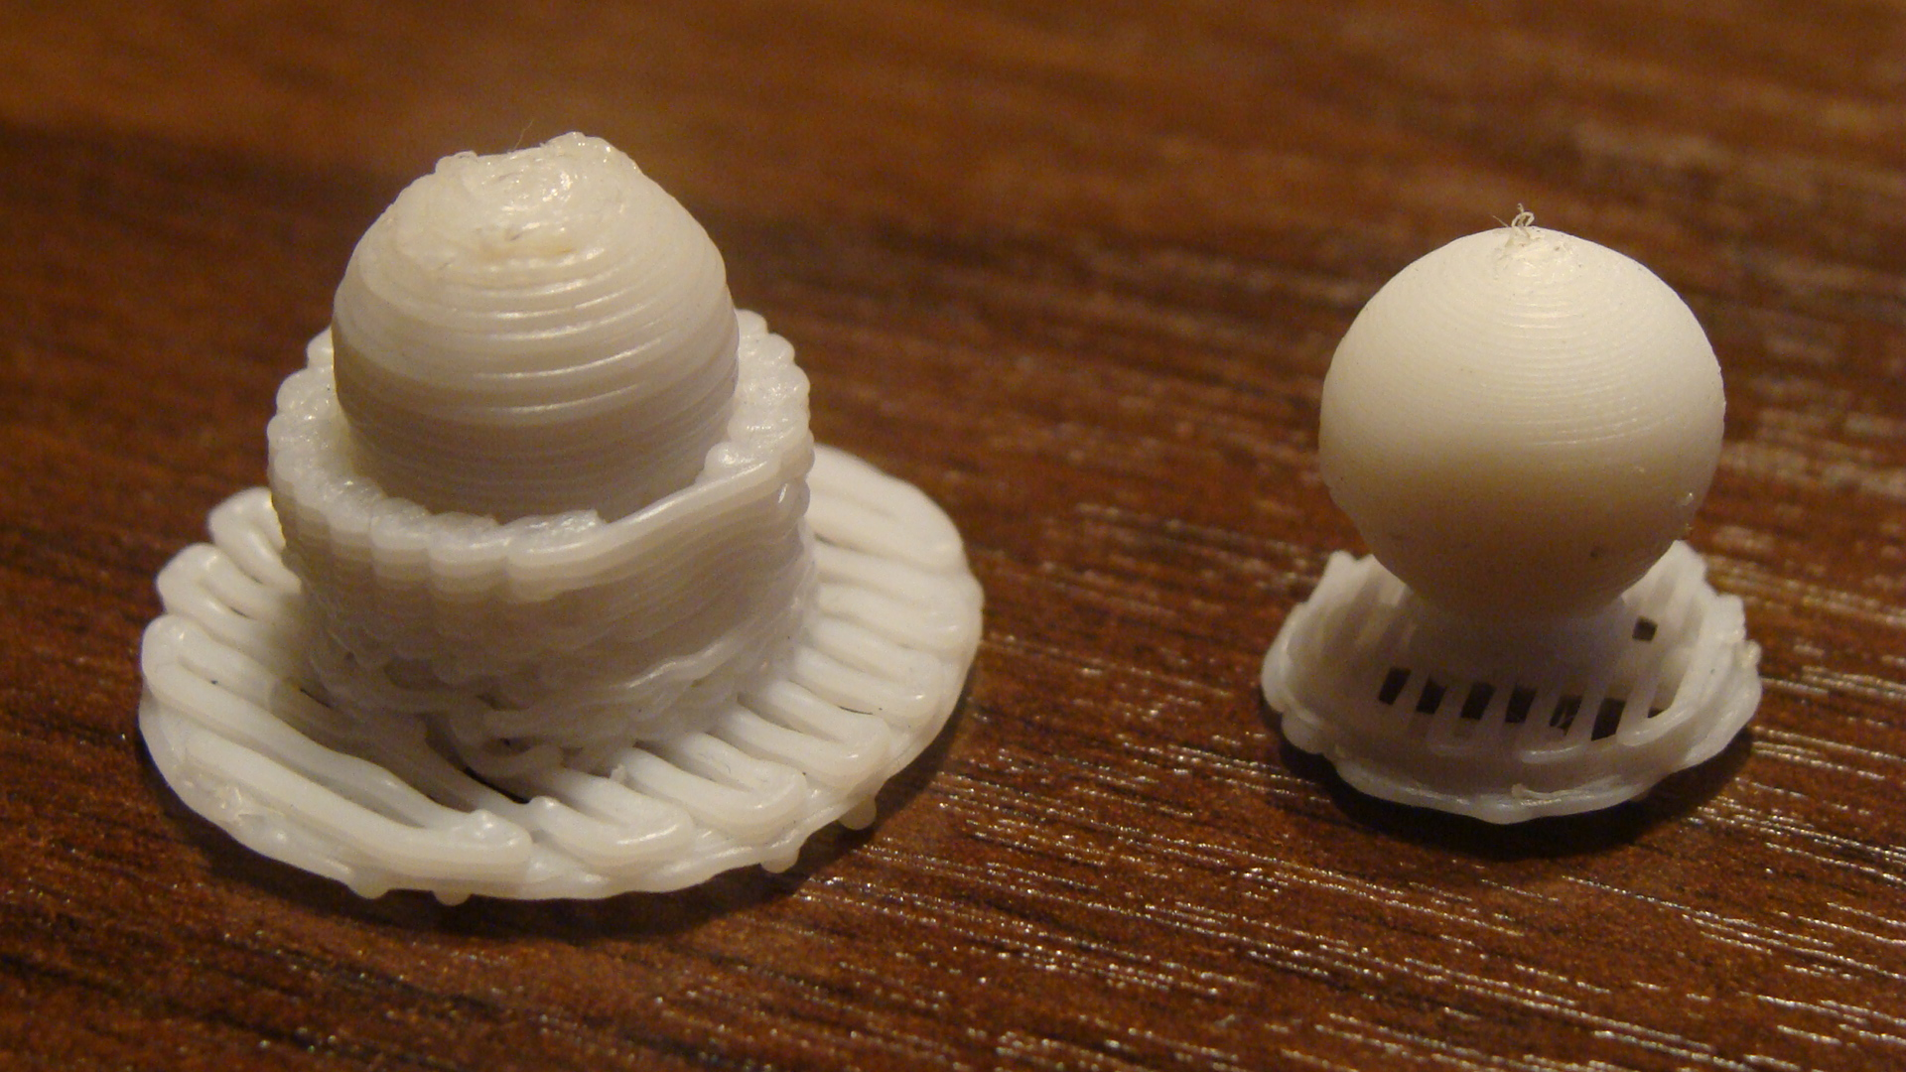
Nozzle diameter & resolution
The resolution of a 3D printer refers to the smallest increment of movement of the z-axis
This number impacts the layer height of the model, which can be different for each print
It should be greater than the resolution and less than the diameter of the nozzle
The part on the right used a higher resolution (smaller layer height) than the part on the left. As a result, the spherical section looks smooth. Image source: http://academy.cba.mit.edu/2013/students/
torres.ricardo/3D%20Scanning%20and%20printing.html

Slide 9
Nozzle diameter & resolution
If you have small features, make sure that the resolution is set so that it’s a multiple of the thickness of those features
What layer height should you use for a model with features that are 0.2mm, 0.4mm, and 1mm thick, with a 0.4mm nozzle? What about a 0.2 mm nozzle?
Answer: 0.2mm for the 0.4mm nozzle, and 0.1mm for the 0.2mm nozzle.
All features are evenly divisible by the layer heights. Using a layer height that’s the same as your diameter is risky: the layers might not adhere.
Image source: http://store.makerbot.com/replicator2

Slide 10
Materials and previous parts
Know what materials your printer can use, and which one of them to use
ABS is strong and can be vapour-smoothed, but it tends to warp and your printer will need a heated bed.
PLA is weaker than ABS, but doesn’t warp as much, and doesn’t need a heated bed.
If you want to use an exotic material, like a nylon or another polymer, look online for recommended uses and settings

Slide 11
Materials and previous parts
The best way to determine if a printer is capable of printing your model is to look at similar parts it has printed
Look at parts with similar features. Are they the right size? Are they warped? Are they strong enough?
Be careful about looking online for previous parts: your machine will have its own quirks
Avoid manufacturer websites, and see what hobbyists have done. Manufacturers will only post the best pictures, and they know their printers very well

Slide 12
Review
How big is your printer? How big is your part? Can you make it smaller?
How finely can your printer print? Can you use a smaller nozzle?
What material do you want to use?
What parts has this printer previously made? Are you satisfied with that quality?

