Slide 1

Chronic Pain with Mary Jane:
A Deeper Look into Medical Marijuana
Melanie Sunderland BScPharm, ACPR
Doctor of Pharmacy Student, Class of 2014
PharmD Seminar
January 23, 2014

Slide 2
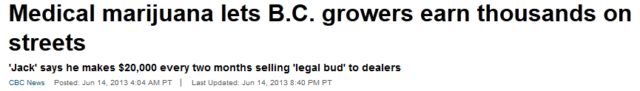
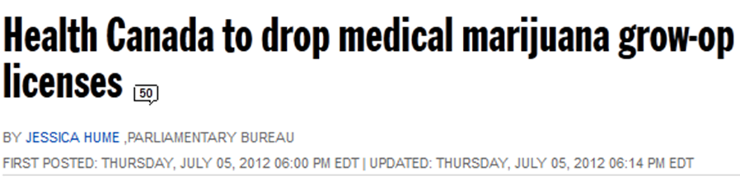


Slide 3
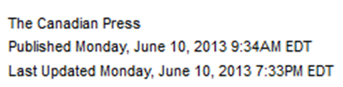
Headline:
“In previous versions of the regulations, pharmacies were to distribute the product just like other medications, provoking concern from pharmacists, who expressed concerns about dispensing a product without sufficient research.”
“Physicians and pharmacists alike questioned the regulatory changes, saying there is little evidence that medical marijuana is either effective or safe.”
Read more: http://www.ctvnews.ca/health/health-headlines/canada-s-new-medical-marijuana-rules-cut-homegrowers-pharmacists-out
Notes:
Read more: http://www.ctvnews.ca/health/health-headlines/canada-s-new-medical-marijuana-rules-cut-homegrowers-pharmacists-out

Slide 4


Slide 5
History of Marijuana
Marijuana (Cannabis)
  Crude preparation obtained from Cannabis sativa
  Timeline
Used for millennia as a recreational psychoactive drug and as a therapeutic agent
1960’s- systematic study of cannabinoids
1980’s- isolation, synthesis, metabolism, pharmacology and physiology effects of cannabinoids studied
1990’s- identification and cloning of cannabinoid receptors and identification of location
Late 1990’s- development of synthetic agonists and antagonists
Curr Opin Chem Biol. 1999 Aug;3(4):418-25
Notes:
1960s reseach was initiated due to serious social implications of marijuana.-

Slide 6
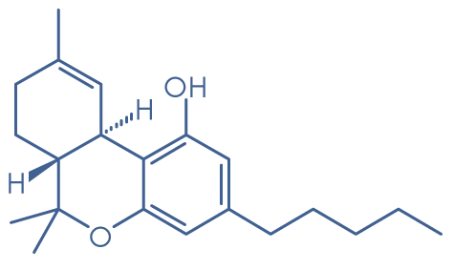
Medicinal Chemistry
Cannabis (endogenous)
  Components
    THC (Delta-9-tetrahydrocannabinol)
    Cannabinol
    Cannabidiol
    Cannabiolic acid
Neuro Endocrinol Lett. 2004 Feb-Apr;25(1-2):14-23.
Curr Opin Chem Biol. 1999 Aug;3(4):418-25.
Notes:
picture/split

Slide 7
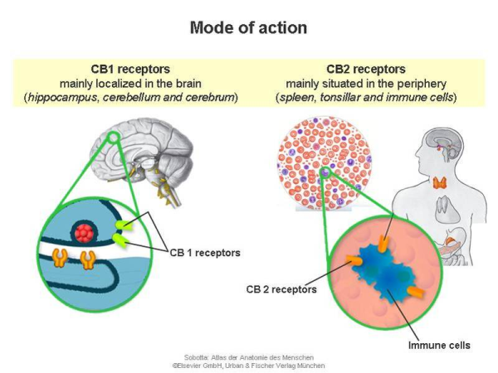
Pharmacology
THC
  Main psychotropic component of cannabis
  Agonist at cannabinoid receptors (Type 1 and 2)
    Central nervous system
    Periphery (spleen, leukocytes, reproductive tract, urinary and gastrointestinal tract, endocrine system, heart and arteries)
Elsevier and Technische Universitat Munchen
Neuro Endocrinol Lett. 2004 Feb-Apr;25(1-2):14-23.

Slide 8
Pharmacology
Cannabinoid receptors (Type 1 and 2)
  Modulate GABAergic neurons
  Intimately involved in transmission and modulation of pain signals
  Disrupt ion channels
Neuro Endocrinol Lett. 2004 Feb-Apr;25(1-2):14-23.

Slide 9
Pharmacokinetics: Smoked vs Oral
PK Parameter | Smoked THC | Oral THC
Absorption | Up to 50% | > 95%
Systemic bioavailability | Up to 50% | 10- 20%
Onset of action | Within seconds | 30-60 min
Duration of action | 2-3h | 5-8h
Smoked cannabis: rapid and efficient delivery of THC to brain
Handb Exp Pharmacol. 2005; (168):657-90.
Adapted from Grotenherman. 2001

Slide 10

Proposed Therapeutics and ADRs
Possible Therapeutic Uses | ADRs
Pain | Neurotoxicity (psychosis, decreased sleep, fatigue, inattention)
Nausea | Increased susceptibility to infection
Diabetes | Hypertension
Glaucoma | Tachycardia
Multiple Sclerosis | Reduce salivation and thirst

Slide 11
PICO
Patient
In patients with chronic neuropathic pain does smoked medical marijuana decrease pain intensity?
Notes:
Clinical question

Slide 12
Search Strategy
Search Strategy | Pubmed, Google Scholar, Medline, IPA, Cochrane Review, Marijuana Clinical Studies and Case Reports
Keywords | Chronic pain, medical marijuana, marihuana, cannabinoids, cannabis
Limits | Humans, adults, English, controlled trials
Exclusions | Non- smoked cannabinoids, synthetic cannabinoids, HIV neuropathic pain, multiple sclerosis
Results | 2 RCTs

Slide 13
Notes:
citation

Slide 14
Ware et al.
Design | 4 period crossovers, DB, PC, RCT
Patient | N= 21 Adults 18 to 70 with at least 3 month history of neuropathic pain
 | Inclusion Neuropathic pain secondary to surgery or trauma Average pain > 4cm on visual analogue scale Stable analgesic regime with no marijuana use in the past year Normal renal and liver function Normal hematocrit | Exclusion Cancer related pain Nociceptive pain History of cardiac or pulmonary disease History of psychiatric illness Currently pregnant or breastfeeding
Intervention | Smoked cannabis TID X 5 days, then 9 day washout period THC (2.5%, 6%), 9.4%
Comparator | Placebo ( THC 0%) TID X 5 days, then 9 day washout period
Outcome | 11 point numeric rating scale for pain Primary outcome: average pain intensity score over the 5 days Secondary outcome: reported ADRs
Duration | 14 day treatment periods
CMAJ 2010; 182: 1515–21.

Slide 15
Patient Recruitment and Flow
CMAJ 2010; 182: 1515–21.

Slide 16
Baseline Characteristics
Age, yr [Mean (SD)] | 45.4 (12.3)
Female [%] | 52.2
Concomitant Medications Opioids [%] Antidepressants [%] Anticonvulsants [%] NSAIDs [%] | 61 52 43 43
Current Smokers [%] | 39.1
Average Daily Pain at Baseline [Mean (SD)] | 6.89 (1.37)
CMAJ 2010; 182: 1515–21.

Slide 17

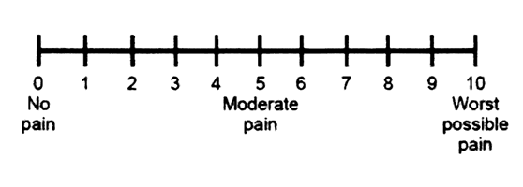
Primary Outcome
Average pain intensity of 5 daily scores
Pain intensity | 0 | 2.5 | 6.0 | 9.4
Average daily pain | 6.1 (1.6) | 5.9 (1.9) | 6.0 (1.8) | 5.4 (1.7)
CMAJ 2010; 182: 1515–21.

Slide 18
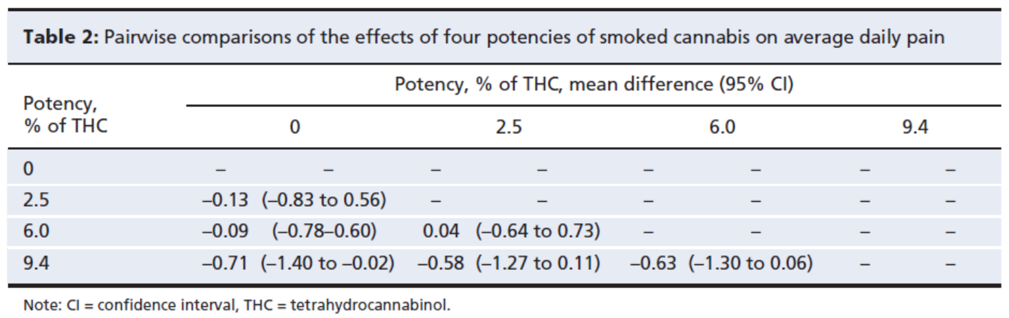
Primary Outcome
CMAJ 2010; 182: 1515–21.

Slide 19
Percentage of Notable ADRs
ADRs | THC 0% (n=21) | THC 2.5% (n=22) | THC 6% (n=21) | THC 9.4% (n=22)
Headaches | 3 | 3 | 7 | 4
Dizziness | 2 | 3 | 4 | 4
Tiredness | 1 | 1 | 1 | 0
Dysphoria | 0 | 0 | 0 | 2
Feeling High | 0 | 0 | 1 | 0
Euphoria | 0 | 1 | 0 | 1
Lack of Concentration | 1 | 2 | 2 | 2
Foggy Mental State | 0 | 0 | 1 | 1
Paranoia | 0 | 0 | 0 | 1
Racing Thoughts | 0 | 0 | 0 | 1
Total Number of Psych ADRs | 1 | 5 | 5 | 12
CMAJ 2010; 182: 1515–21.

Slide 20
Conclusions
Reduction in pain (placebo vs 9.4% THC)
  Trials for other medications in neuropathic pain have shown greater reduction
  Patient populations may be different as these were refractory individuals
Further studies required to study higher doses and more long term effects
CMAJ 2010; 182: 1515–21.

Slide 21
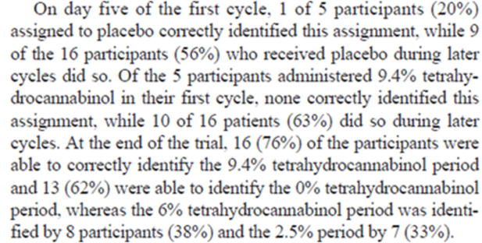
Critique
Strengths | Limitations
Simple medication design (patients were highly compliant with regime) | Low dose used that may not be adequate for pain reduction
RCT, PC, crossover design | Short duration
Urinary screen to ensure no extra use of cannabinoids | Unblinding (due to psychotropic effects)
Low dose THC to reduce unblinding | Clinical relevance of 0.7 reduction of pain
Adequate washout period
Sample size calculation included
Sequence effects assessed
Methods to assess preservation of blinding
Notes:
3 episodes of psychotropic events

Slide 23
Wilsey et al
Design | 3 period crossovers, DB, PC, RCT
Patient | N=38 Adults with complex regional pain syndrome, spinal cord injury, peripheral neuropathy and nerve injury
 | Inclusion Previous marijuana use Average pain > 30mm on 100 mm visual analogue scale (VAS) No marijuana use in the past 30 days | Exclusion History of psychiatric illness (bipolar, schizophrenia, major depression) Uncontrolled hypertension Cardiovascular disease Asthma COPD Active substance abuse
Intervention | Smoked cannabis cigarette over 6 hour experiment session THC 3.5%, 7%
Comparator | THC 0% placebo cigarette over 6 hour experiment session
Outcome | Primary Outcome: Intensity of pain using 100mm VAS Secondary Outcomes: Feelings high, feeling impairing using VAS & Neuropsychological Testing
Duration | 3 X 6 hour experiment sessions spread out greater than 3 days for washout
J Pain 2008; 9: 506–21.

Slide 24
Experimental Procedures
J Pain 2008; 9: 506–21.

Slide 25
Baseline Characteristics
Age, yr (median) | 47
Female (%) | 47
Concomitant Medications Opioids (%) Antidepressants (%) Anticonvulsants (%) NSAIDs (%) | 82 50 58 24
Pain Type CRPS (%) Spinal cord injury (%) Multiple sclerosis(%) Diabetic neuropathy(%) Neuralgia (%) Plexopathy (%) | 58 16 11 8 5 3
J Pain 2008; 9: 506–21.

Slide 26
Primary Outcome
J Pain 2008; 9: 506–21.

Slide 27
Primary Outcome
Statistically significant analgesia
  0.0035 reduction in VAS pain intensity compared to placebo (-0.0063, -0.0007)
    Use linear mixed modelling
  At 240 min placebo and treatment points significantly diverge (p=0.02)
    Using categorical effects of time modelling
Ceiling effect noted
  Equal pain reduction at every time point between 3.5% and 7% groups
J Pain 2008; 9: 506–21.
Notes:
No significant difference between groups at baseline

Slide 28
Secondary Outcomes
J Pain 2008; 9: 506–21.

Slide 29

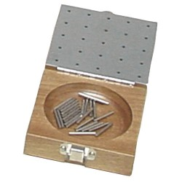
Secondary Outcomes
Grooved Pegboard Test
Hopkins Verbal Learning Test

Slide 30
Secondary Outcomes
*
**
T score > 40= no impairment
T score < 20= severe impairment
* 7% vs placebo using linear mixed modelling statistically significant
** 7% vs placebo and 3.5% vs placebo using linear mixed modelling statistically significant
J Pain 2008; 9: 506–21.

Slide 31
Secondary Outcomes
7% vs placebo using linear mixed modelling statistically significant

Slide 32
Conclusion
A statistically significant reduction in pain was noted using the linear mixed model
  Clinical significance of this reduction unclear
ADRs clearly noted regarding cognitive impairment and psychotropic effects
  Overall patients found the benefits outweighed the ADRs as they rated the drugs as having “good drug effects” and there were no withdrawals from the study
J Pain 2008; 9: 506–21.

Slide 33
Critique
Strengths | Limitations
Simple medication design | Short duration
RCT, PC, Crossover design | Risk of unblinding due to psychotropic effects
 | Clinical significance of 0.0035 decrease in pain intensity per minute
 | Underpowered to detect crossover or order effects
 | No adjustment for multiple statistical tests performed

Slide 34
Overall Conclusions
Some RCT data to support the use of smoked cannabis for refractory neuropathic pain
  Evidence limited to short duration, small studies
ADRs always must be considered and were significantly present in the studies
Logistics of administration (smoking) and prescribing challenging

Slide 35
Recommendations
Very difficult to recommend the use of smoked cannabis due to limited duration of trials and risk of unblinding leading to bias
  Would not recommend inhaled cannabis at this time

Slide 36

Questions??

Slide 38
Ellis et al.
Design | 5 phase crossover, DB, PC, RCT
Patient | N =28 Adults with HIV and neuropathic pain refractory to at least 2 agents
 | Inclusion Pain intensity score > 5 on the subscale of the Descriptor Differential Scale | Exclusion Active substance abuse History of cannabis dependency Concurrent use of alternative cannabis products Positive cannabinoid screen during 1 week washout period Serious medical conditions that might impact safety
Intervention | 4% cannabis titrated to a balance of minimal ADRS and maximal effects
Comparator | Placebo
Outcome | DDS pain intensity score
Duration | 7 weeks: 1 week washout, 5 day treatment/placebo, 2 week washout period, 5 day crossover to treatment/placebo, 2 week washout

Slide 39
Baseline Characteristics
Age, yr [Mean (SD)] | 48.8 (6.8)
Female [%] | 0
Concomitant Medications Opioids [%] Antidepressants [%] Anticonvulsants [%] NSAIDs [%] | 64 29 64 36
Previous Exposure to Cannabis [%] | 96
TNS score (Mean) | 16

Slide 40
Experimental Flow

Slide 41
Primary Outcome
Difference in Subscale Descriptor Differential Scale
  24 words describing pain intensity and unpleasantness
  0-20 summary pain scale
    Significantly greater with cannabis compared to placebo (mean difference in pain reduction = 3.3, p= 0.0020)
No significant evidence sequence effects (p=0.13)
Notes:
Add not about subscale

Slide 42
Conclusions
Smoked cannabis at maximally tolerated doses significantly reduced neuropathic pain in HIV patients compared to placebo when added to established pain regimes
Cannabis may be an option for intractable neuropathic pain in HIV patients
  The ADRs and logistical challenges of administration must be considered

Slide 43
Critique
Strengths | Limitations
DB, PC, RCT | Unblinding
Adequate washout period | Short duration
Sequence effects assessed
Titration regime to allow for individualization
Methods to assess preservation of blinding
Notes:
Patients were generally able to guess their group after the second treatment/placebo

Slide 44

Health Canada Changes
By April, 2014:
Full implementation of new Marijuana Medical Access Program
  Health Canada no longer producing or selling marijuana
  Access to marijuana for medical purposes must be obtained from a licensed producer
    competitive industry
    set own prices
    sell a variety of strains
    subject to security requirements and inspections
    must adhere to good manufacturing practices
Health Canada. Backgrounder - Proposed Marihuana for Medical Purposes Regulations - Transitioning to a New System
http://www.hc-sc.gc.ca/ahc-asc/media/nr-cp/_2012/2012-193bka-eng.php

