Slide 1
Case 3 Summary
The Microbiology Laboratory
Created by Christy Hui

Slide 2
Most common bacterial pathogens associated with infectious scenario are:
Streptococcus pneumoniae
Haemophilus influenza
Mycobacterium tuberculosis

Slide 3
Streptococcus pneumoniae
Gram positive, non-spore forming, non-motile cocci bacteria
Alpha hemolytic: able to break down red blood cells via hydrogen peroxide
Also causes damage to DNA and host cells
Transmitted via direct contact with respiratory secretion such as mucus or saliva
Community acquired pneumonia (CAP) is acquired outside of hospitals and healthcare settings
Induces high fever, difficulty breathing, and rust-coloured sputum
If left untreated, it can lead to chronic fever, pleuritic pain, arthritis, sinusitis, and septicemia

Slide 4
Haemophilus influenza
Opportunistic bacteria that results in pneumonia, epiglottitis, osteomyletis and bacteremia
Six type of encapsulate H. influenza (a, b, c, d, e, f)
Most common being type B (Hib)
Transmission occurs via direct contact with respiratory fluids
Capsule has been shown to resist phagocytosis and complement-mediated lysis
Adherence is mediated by trimeric auto-transporter adhesins found on the outer bacterial membrane
Induces low-grade fever, wheezing, and grey or cream-coloured sputum

Slide 5
Mycobacterium pneumoniae
Non-spore forming, non-motile, rod shaped aerobic bacteria
Infection occurs via tiny droplets released into the air by sneezing, coughing, speaking or singing
Two phases: latent and active
Latent: bacteria remains in host in an inactive state, does not cause disease
Active: bacteria multiples and causes infection; may follow latent phase
Protein A promotes adherence while protein D inhibits phagocytosis
Symptoms include coughing, chest pains (while breathing), fever, night sweats, chills, loss of appetite, weight loss, fatigue

Slide 6
Sampling methods used in diagnosing Tuberculosis:
Sampling methods used in diagnosing pneumonia:
TB Skin Test
TB Interferon-gamma Release Assays (IGRAs)
Sputum smear microscopy
Gastric aspiration or washing
Chest X-Ray or Radiograph
Mantoux skin test
Interferon-gamma Release Assays (IGRAs)
Sputum smear microscopy
Bronchoalveolar lavage
Gastric aspiration or washing
Pleural fluid
Urine test

Slide 7
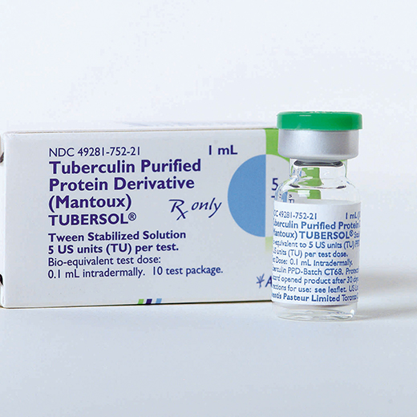
Tuberculosis Skin Test
Mantoux tuberculin skin test
Can be used to test for TB or pneumonia
Injects tuberculin fluid into the skin of the arm
If area of injection is raised and swollen, it is likely the individual is infected with tuberculosis
Skin test has low specificity, it may produce false positives
BCG, a vaccination against TB, may also false positive

Slide 8
Interferon Gamma Release Assays (IGRAs)
Blood tests used to measure the immune response to infection
Detects the levels of interferon gamma (IFN-γ), which are only present during infection
Only used to test latent TB
A quick blood test done in a single visit

Slide 9
Sputum Smear Microscopy Test
Sputum is a thick fluid buildup in the lungs as a response to pathogens in the respiratory track
Collected by the patient coughing into a sterile cup
Collected sputum is smeared onto a glass slide and examined under the microscope for signs of mycobacterium.
Quick, efficient, cost-effective method of testing for TB
Low sensitivity in testing, false positives may be produced
Fluorescent microscopy can improve the accuracy
However, this method is less cost efficient

Slide 10
Bronchoalveolar lavage (BAL)
Two types of BAL:
Non-bronchoscopic: requires catheters insert through an endotracheal tube
Bronchoscopic: uses a flexible bronchoscope to instill and withdraw saline solution
Separation of mucus and BAL fluid (BALF) must take place through a filter of sterile cotton gauze or nylon mesh
Cellular components are then identified
BALF can also be centrifuged for direct identification of pathogens
BALF can be prepared two ways for analysis:
Cyto-spin preparation of whole BALF
Re-suspension of specimen in a small amount of medium, then centrifuged

Slide 11
Gastric Aspiration or Washing
Alternative method to collecting sputum from patients who are unable to cough up an adequate amount (i.e. children)
A tube is used to suck up the sputum swallowed into the stomach after coughing into the throat
Procedure is done in the morning, over a span of three days, prior to breakfast to receive optimal samples

Slide 12
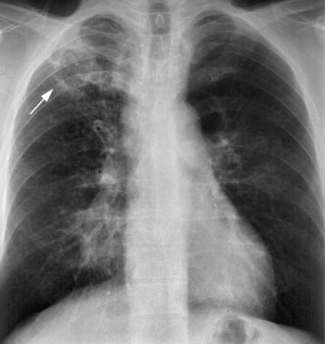
Chest X-Ray or Radiograph
A diagnostic test used to visualize the inflammation of the lungs
Abnormal shadow may be visible in the x-ray
Lesions may also been seen
These abnormalities normally occur in the apical and posterior region of the upper lobe or the superior segments of the lower lobe
Likely signs of TB infection based on lesions such as mixed nodular and fibrotic lesions, which indicate a site of tubercle bacilli colonization and multiplication
False positives may occur when not combined with genetic molecular testing or bacterial cultures
This method may be expensive in less economically developed countries
Arrow indicates lesion in the lungs

Slide 13
Pleural fluid & Urine test
Pleural fluid
Urine test
Pleural fluid should be collected anaerobically using a balanced heparinized blood gas syringe
A first morning sample (up to 40mL) should be collected over a span of three consecutive days.
Samples should be refrigerated until processed.

Slide 14
General tests are performed to narrow down the pathogenic species:
Catalase test
Pleural fluid test
Antibiotic sensitivity test
Gram stain
Oxidase test
Agglutination

Slide 15
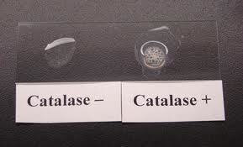
Catalase test
Catalase is produced by aerobic bacteria, used to breakdown hydrogen peroxide into water and oxygen.
In order to determine if the bacteria colony is catalase positive, 3% hydrogen peroxide is added to the culture
If catalase is present, bubbling with occur

Slide 16
Pleural Fluid Test
Pleural fluid can be used to determine if an infection is present
Exudate fluid indicates an infection
If infected with M. tuberculosis, pleural fluid will be a serous exudate
If infected with S. pneumoniae, pleural fluid will be clear
If infected with H. influenza, pleural fluid will be clear

Slide 17
Antibiotic Sensitivity Test
This test is used to determine the appropriate antibiotic treatment
Antibiotics are added bacteria cultures, then incubated for 18 hours
Zone of inhibition is then measured, indicating the bacteria sensitivity to antibiotic

Slide 18
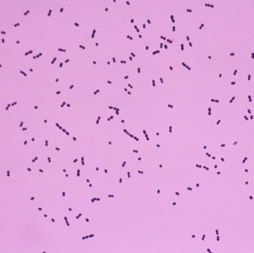
Gram Stain
This test is used to determine whether a bacteria is gram positive or gram negative
Bacteria is fixed onto a microscope slide, then applied with a primary stain
Crystal violet stains the cells a purple or blue colour
Organic solvent is then added to extract the blue dye from the cells
Gram negative bacteria is decolourized, while gram positive bacteria remains blue
Safranin counterstain is applied to colour gram negative cells red/pink, while gram positive cells remain blue

Slide 19
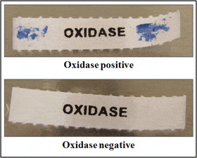
Oxidase Test
Used to determine the presence of cytochrome oxidase in bacteria
This enzyme is used for electron transport chain
Filter paper is soaked with tetramethyl-p-phenylenediamine dihydrochlorine and moistened with sterile distilled water
The bacteria of interest is then smeared onto the paper
If it is oxidase positive, the area will become purple as the electron donor is oxidized

Slide 20
Agglutination
Saline solution is dropped onto a microscope slide
A homogenous suspension is made with bacterial colony
A specific anti-serum is then added
Visible clumping indicates a positive test

Slide 21
Streptococcus pneumoniae specific testing
Streptococcus pneumoniae culture
Optochin sensitivity test
Bile solubility test
Urinary antigen test

Slide 22
Streptococcus pneumoniae culture
Streptococcus pneumoniae can be cultured on blood or chocolate agar plates in 5-10% CO2 environment
Plates should be incubated at 37°c for 24-48 hours

Slide 23
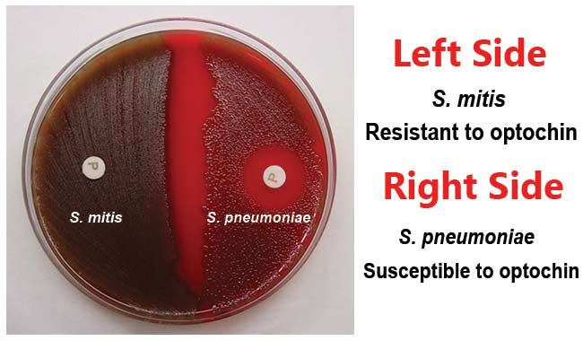
Optochin Sensitivity Test
Growth of S. pneumoniae can be inhibited in the presence of optochin
Blood agar plate is inoculated with alpha-hemolytic isolates
Optochin discs are applied to the plate and incubated at 37°c with 5-10% CO2 for 18-24 hours
Zone of inhibition are then measured
14mm or greater confirms the presence of S. pneumoniae
Zones between 9mm and 13mm requires further testing using bile solubility

Slide 24
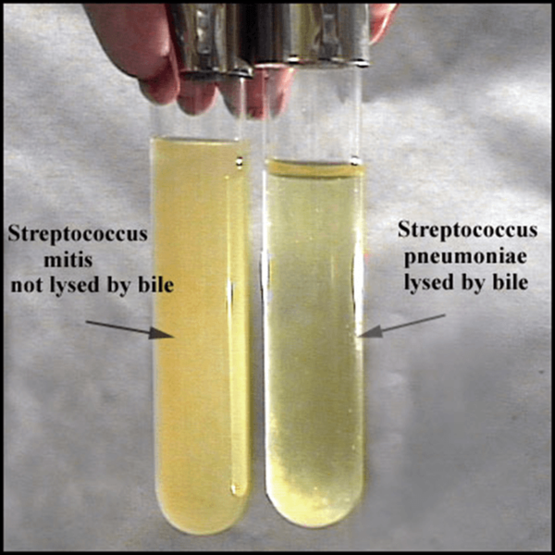
Bile Solubility Test
S. pneumoniae is lysed by bile
Saline suspension of bacteria grown from blood agar is prepared and transferred into two tubes
Turbidity should be 0.5 McFarlan standard
0.5mL of 2% sodium deoxycholate is added to one tube, 0.5mL of saline is added to the other
The tubes are shaken and incubated for 2 hours
If S. pneumoniae is present, the tube will become clear or lose turbidity

Slide 25
Urinary Antigen Test
S. pneumoniae has a polysaccharide capsule that is detectable in the urine using an immunochromatographic membrane assay
Test cards are prepared rabbit antibody specific for S. pneumoniae
It is then combined with a membrane that has a rabbit-specific S. pneumoniae and left to equalize
A urine swab is inserted to the hole on the card. Another reagent is added to another hole in the test card
If S. pneumoniae is present, two pink or purple lines appear

Slide 26
Mycobacterium tuberculosis specific testing
Mycobacterium tuberculosis culture
Acid-fast smear
IFN-gamma release assay
Niacin test
High-performance liquid chromatography

Slide 27
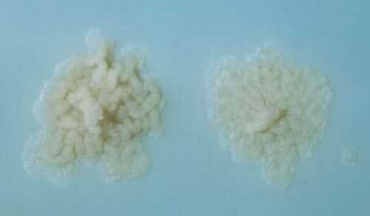
Mycobacterium Tuberculosis Culture
M. tuberculosis can be cultured on Lowenstein-Jenson medium or Middlebrook medium
These mediums contain inhibitors to prevent bacteria other than M. tuberculosis from growing
Colonies require 3-6 weeks to be visible

Slide 28
Acid-Fast Smear
M. tuberculosis can be stained after an acid wash
Sodium hypochlorite is added to bacteria sample
8mL water is added and sample is centrifuged
Remaining sediment is transferred to microscope slide and left to dry
Finally the slide is stained using the Ziehl-Neelsen technique
If M. tuberculosis is present, stain will turn the bacteria red

Slide 29
IFN-gamma Release Assay
This test measures a patient’s immune response to Mycobacterium using IFN-γ as biomarkers
A blood sample is collected and tested for the specific lymphocytes
Previous vaccination of BCG does not interfere with test results
Can be used in conjunction with the tuberculin skin test to diagnose Tuberculosis

Slide 30
Niacin Test
Niacin is a metabolic by-product of M. tuberculosis
Bacteria culture is swabbed onto filter paper with cyanogen bromide.
If M. tuberculosis is present, the filter paper will become yellow

Slide 31
High Performance Liquid Chromatography
This test is used to determine different species of the Mycobacterium based on cell wall composition
Generated elution spectrums are observed
M. tuberculosis is diagnosed with the presence of mycolic acid

Slide 32
Haemophilus influenza specific testing
Haemophilus influenza culture
X and V factor test

Slide 33
Haemophilus influenza culture
H. influenza can be cultured on blood agar plates, incubated in 5-10% CO2 at 37°c for 24048 hours

Slide 34
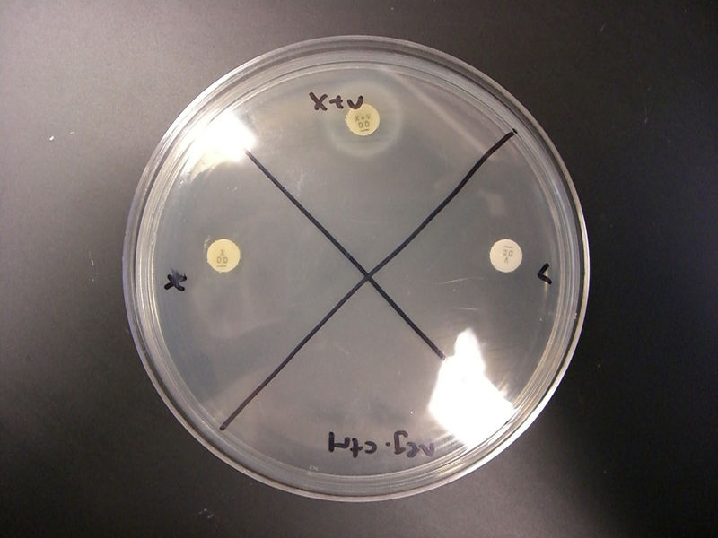
X and V Factor Test
Bacterial colony is cultured on a Mueller Hinton agar plate
X, V, and XV factor discs are placed onto the plate and incubated
H. influenza will only grow around the XV disc.

Slide 35
Expected Results of M. tuberculosis
General Tests | Results
Catalase test | Positive
Pleural fluid test | Serous exudate
Gram Stain | N/A
Oxidase test | Negative
Bacteria Specific Tests | Results
Niacin test | Yellow
Acid-fast smear | Red
IGRA | Positive
High Performance Liquid Chromatography | Presence of mycolic acid indicates positive for M. tuberculosis

Slide 36
Expected Results of S. pneumoniae
General Tests | Results
Catalase test | Negative
Pleural fluid test | Clear exudate
Gram Stain | Positve
Oxidase test | Negative
Bacteria-specific Tests | Results
Optochin Sensitivity Test | Positive if < 14mm zone of inhibition Bile solubility test required if zone of inhibition is 9mm-13mm
Bile Solubility Test | Clear
Urinary Antigen Test | 2 pink lines

Slide 37
Expected Results of H. Influenza
Tests | Results
Catalase test | Positive
Pleural fluid test | Clear exudate
Gram Stain | Negative
Oxidase test | Positive
X & V factors | Grows only on XV area

