Slide 1
Nicole Ronan (she/her), Educational Consultant, Learning Design, CTLT John Cheng (he/him), Educational Consultant, Learning Design, CTLT

Slide 3
Outline
What we already know: tidbits from UBC Academic Experience Survey
How student feedback is collected
Poll/discussion around what folks are currently doing, sharing ways folks currently get feedback
Students as Partners
Overview
Activity or reflection - where are you on the ladder?
Examples (videos)
Examples of Student Voice in Course Design
Sharing Student Voices
Discussion

Slide 4
Today's session
Outline what we know already from students here at UBC
Reflect on how we collect student feedback, methods etc.
Explore the Ladder of Participation
Explore course designs that have incorporated the student voice
Discuss ways of incorporating more student voices into your course design process
🥅 Goal for the session is to inspire you to move up the Ladder of Participation!

Slide 5
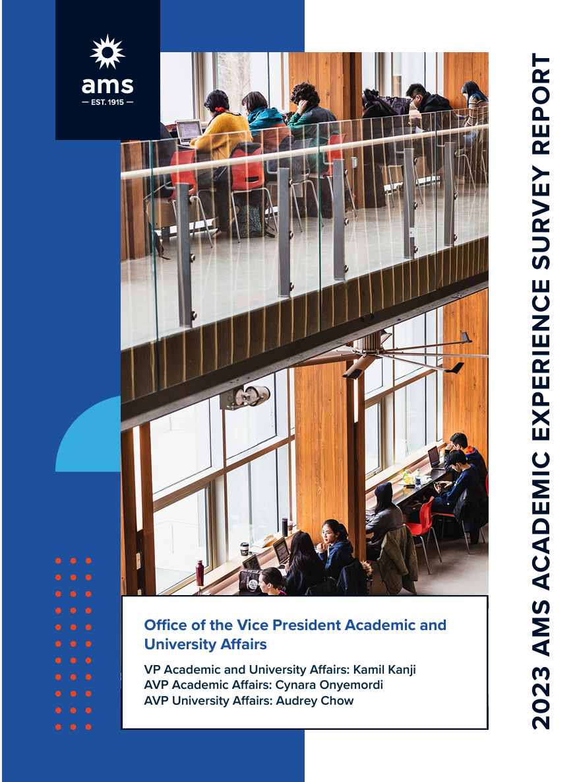
Student feedback from UBC
Interesting tidbits from
2023 Academic Experience Survey Results
3,413 student responses from UBC-V
The classroom was the most common site of discrimination on campus. [p. 14]
inclusiveteaching.ctlt.ubc.ca
Foundational content along with tips on creating an inclusive classroom environment, having difficult conversations and microaggressions in the classroom
Professional development events

Slide 6
Student feedback from UBC
More from 2023 Academic Experience Survey Results
More than half of students (51%) indicate that they would prefer if courses provided more flexibility in terms of assessment, with weighting of assessments, variety of methods, and flexibility of due dates being the most pertinent types.
Consider allowing options for assessment, with a framework and guidance
Alternative/Authentic Assessment
Flexible deadline policy (proactive) vs reactively responding to requests

Slide 7
Student feedback from UBC
Last tidbit from 2023 Academic Experience Survey Results
56% of respondents believe that they receive grades for their coursework in a timely manner prior to final examinations
Set clear grading timelines
use tools to help, like Speedgrader and Rubrics
encourage peer feedback
"Regular feedback helps learners efficiently direct their attention and energies, helps them avoid major errors and dead ends, and keeps them from learning things they later will have to unlearn at great cost. It also can serve as a motivating form of interaction between teacher and learner, and among learners. When students learn to internalize the voice of the 'coach,' they can begin to give themselves corrective feedback" (Angelo, 1993, p. 6).

Slide 8
Getting your own feedback
Student Experience of Instruction (SEI)
Breakdown of instructor dashboard: https://www.youtube.com/watch?v=QVg1Df0nejQ
Mid-course feedback
https://midterm.teacheval.ubc.ca/
Informal opportunities for feedback
One Minute Paper, Ticket out the Door, etc. for formative assessment data, self-analysis, open communication with instructor
Help students help you
Give them tips on providing effective feedback (SEI website)

Slide 9
Discussion
Did any of the survey results surprise you?
How are you currently including student feedback in your course? What methods do you use?

Slide 10
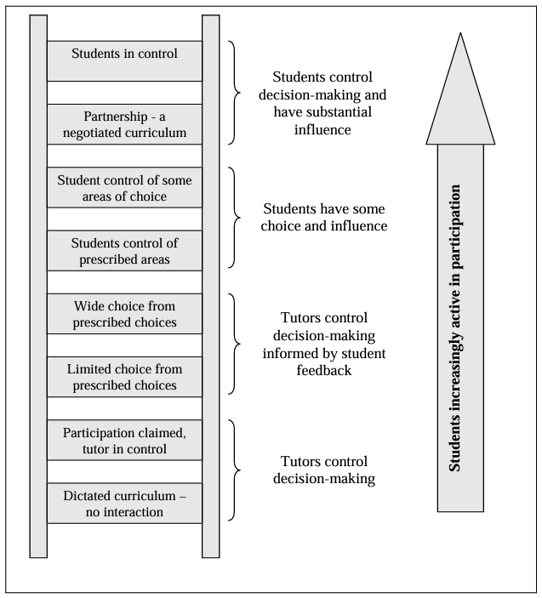
Ladder of Participation
Bovill and Bulley’s (2011) ladder of student participation in curriculum design, an adaptation of Sherry Arnstein's Ladder of Citizen Participation
🧐

Slide 11
Students as Partners - what, why
A reciprocal process through which all participants have the opportunity to contribute equally, although not necessarily in the same ways, to curricular or pedagogical conceptualization, decision-making, implementation, investigation, or analysis (Bovill, Cook-Sather and Felten, 2014, p. 6-7)
Goal is process oriented, not outcomes-driven ; “(radically) open to and creating possibilities for discovering and learning something that cannot be known beforehand” (Healey et al., 2014)
Benefits:
Students discovering ‘the depth of faculty commitment to their learning’ (McKinney et al. 2010: 89), and enhanced knowledge about their discipline and the learning process, with increased confidence to express their views in academic settings (Delpish et al, 2010).
Others report enhancements to group cohesion, collective responsibility, and student performance in assessments, as well as staff reports of transformed teaching practices (Bovill et al. 2011).

Slide 12
Amplifying the student voice – Examples from SaP teams
FREN 101/102
Caroline Lebrec,
Savindya Mudadenniya,
Shreya Diwan,
Andie Sturgess

Slide 13
Amplifying the student voice – Examples from SaP teams
MATH 220
Nahid Walji,
Al Rahim Hossain,
Mila Micovic,
Nia Tzvetkova

Slide 14
Amplifying the student voice – Examples from SaP teams
HIST 353A
Sara Ann Knutson,
Jason Izadi,
Laila Shaheen

Slide 15
Amplifying the student voice – Examples from SaP teams
FNH 473
Gail Hammond,
Amber Brideau,
Lucy Hoang

Slide 16
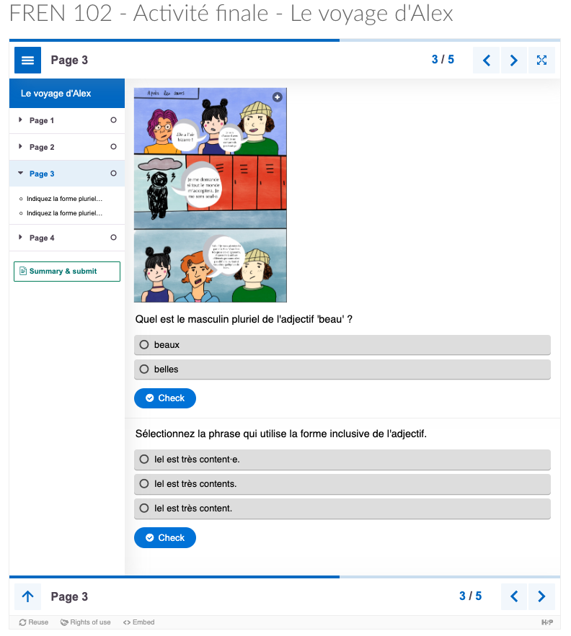
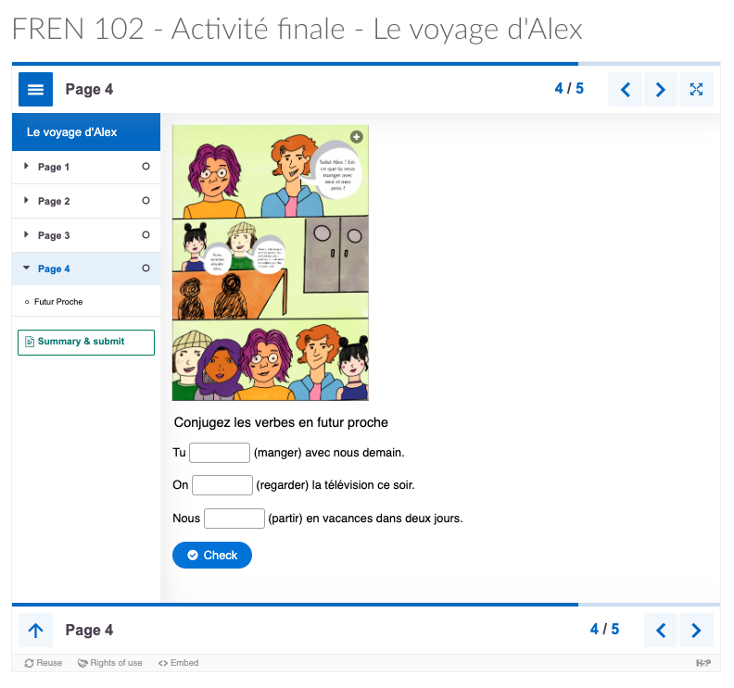
Examples of student voices in course design
FREN 101 102 – Shreya Diwan, Savindya Mudadeniya, Caroline Lebrec (Assistant Professor of Teaching | Language Program Director of French)
Shared with permission © Carolyn Lebrec, UBC, 2024

Slide 17
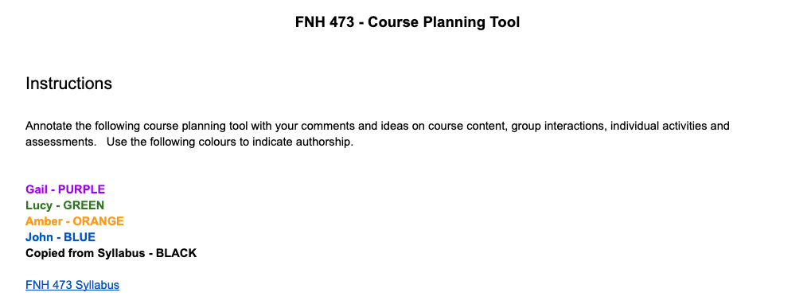
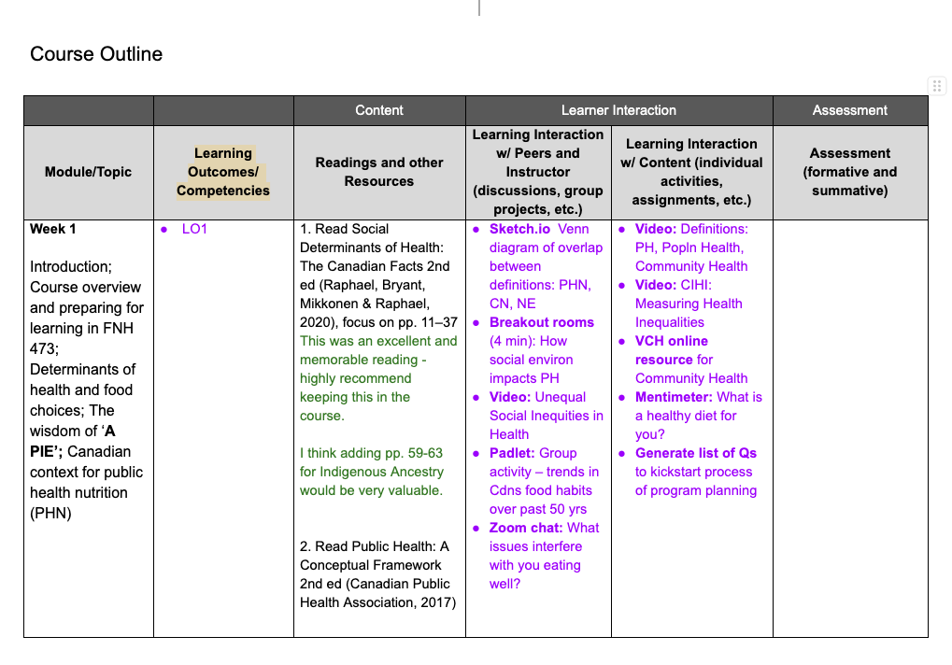
Examples of student voices in course design
FNH 473 - Amber Brideau, Lucy Hoang, Gail Hammond (Associate Professor of Teaching in Food, Nutrition and Health)
Shared with permission © Gail Hammond, UBC, 2024

Slide 18
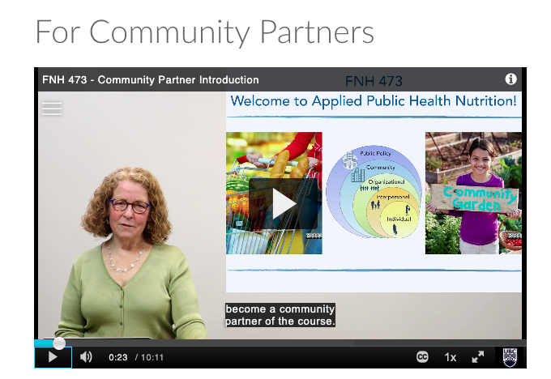
Examples of student voices in course design
FNH 473 - Amber Brideau, Lucy Hoang, Gail Hammond (Associate Professor of Teaching in Food, Nutrition and Health)
Shared with permission © Gail Hammond, UBC, 2024

Slide 19
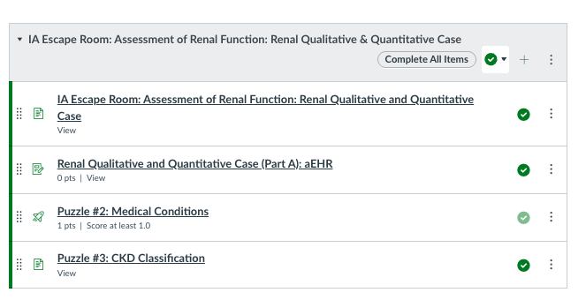
Examples of student voices in course design
PHRM 212 Dr. Fong Chan, BSc(Pharm), ACPR, PharmD Alyssa Azote, E2P PharmD Candidate 2024 Patricia Chang, E2P PharmD Candidate 2024 Irene Luong, E2P PharmD Candidate 2025 Mina Rim, E2P PharmD Candidate 2026
Shared with permission © Fong Chan, UBC, 2024

Slide 20
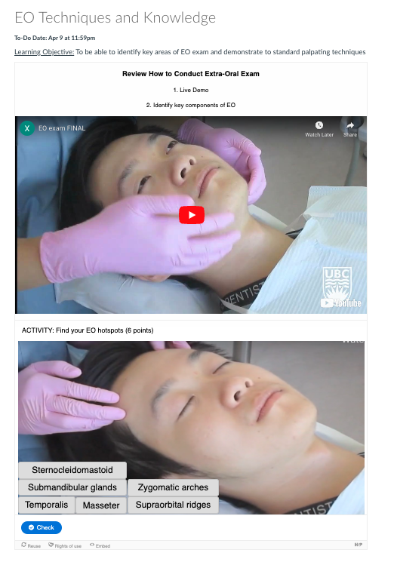
Examples of student voices in course design
DHYG 210 - Xuan Nguyen, Jelena Karan (Lecturer Year 2 Coordinator, Dental Hygiene Degree Program)
Shared with permission © Jelena Karan, UBC, 2024

Slide 21
Student Voices
Rohil Sharma: SaP coordinator; former student partner in course design work
Bringing a contemporary student perspective to the partnership, addressing common concerns, opinions, and learning needs of the student body; bridging gaps in understanding between students and educators
Course redesign goals: enhance transformative pedagogy and engage students with their social agency
Critical hope: moving away from a damage-centric framework and empowering students to mobilize their networks for actionable social change.
Getting feedback from students enrolled in the course as a peer and representative of the student body
Two-minute memo forms to gather reflective feedback, emphasizing students' personal connections to course content and experiences.
E.g., Describe how sharing your personal connection to course content in small groups affected your feelings toward achieving critical hope.
Praxis of the Students as Partners initiative: questions prompting student feedback were around lived experience and positionality in relation to course themes

Slide 22
Student Voices
“The SaP partnership was such a great way to work towards dismantling the professor-student hierarchy and make learning much more collaborative.”
~
“It's a very interesting concept that I really like the idea of designing an undergraduate course and having student input. So I don't know of any other universities that have come up with this idea. But that was definitely one concept that pulled me into the SAP project”

Slide 23
Student Voices
“The experience was fantastic. I learned a lot of skills, especially in survey design and analyzing survey results. Having the funding for this project was another significant benefit, as it counted as formal work experience, which is great to have throughout the year.
~
“I've gotten the opportunity to talk to many members, like the tech team in pharmacy, about managing Canvas for our activities. Engaging with John from the SAP side has been interesting because there's always unexpected ideas that work perfectly for us. These interactions have taught me a lot about working and communicating with different teams, which is a crucial skill for any job, workplace, or project.”

Slide 24
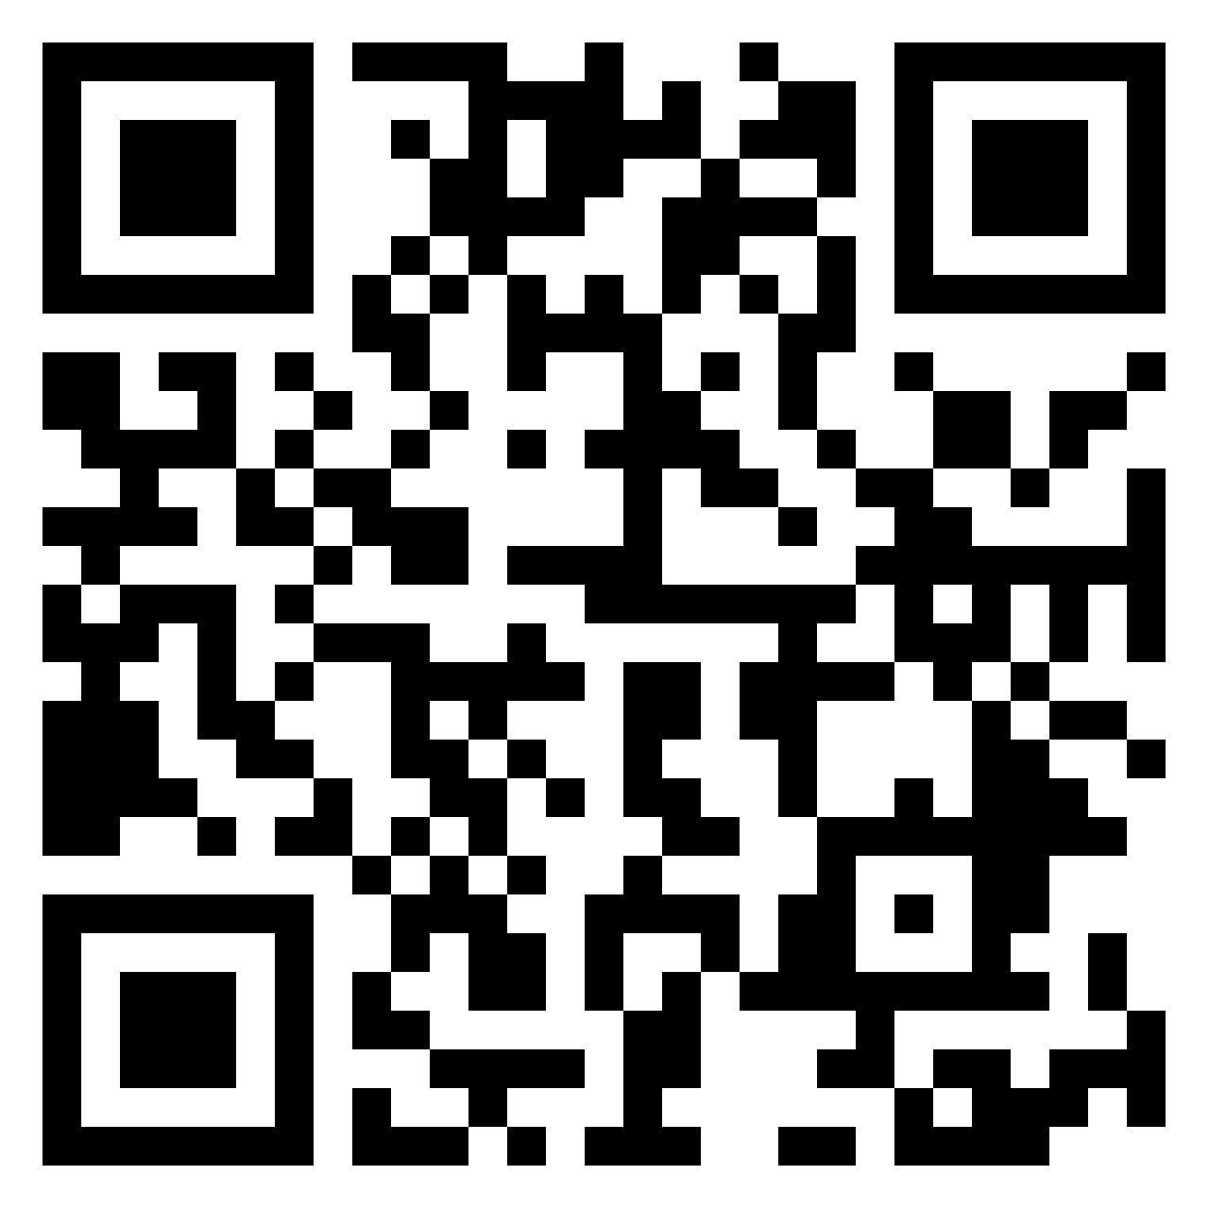
Discussion
Think about your own teaching practice and the courses you design.
Reflect on today's discussion about including student voice in course design.
How might you incorporate more student voices into your own course design process? Share your thoughts, ideas, or any challenges you anticipate.
https://shorturl.at/0bNQb

Slide 25
Learning Design Consultation
learning.design@ubc.ca
Nicole Ronan - nicole.ronan@ubc.ca
Manuel Dias - manuel.dias@ubc.ca
John Cheng - john.cheng@ubc.ca

Slide 26
Acknowledgements
To all of our Students as Partners teams and contributors
SaP Team
Rohil Sharma
Marissa Hall
Roselynn Verwoord

