Slide 1
Case #1 Bacterial Pathogenesis
PATH 417
Frank Lam

Slide 2
1. Encounter

Slide 3
Geographic Habitat
Staphylococcus aureus
Streptococcus pyogenes
Found worldwide
Able to tolerate environments without oxygen (facultative anaerobe) ²
Found worldwide, more common in tropical regions
Able to tolerate environments without oxygen (facultative anaerobe) ²

Slide 4
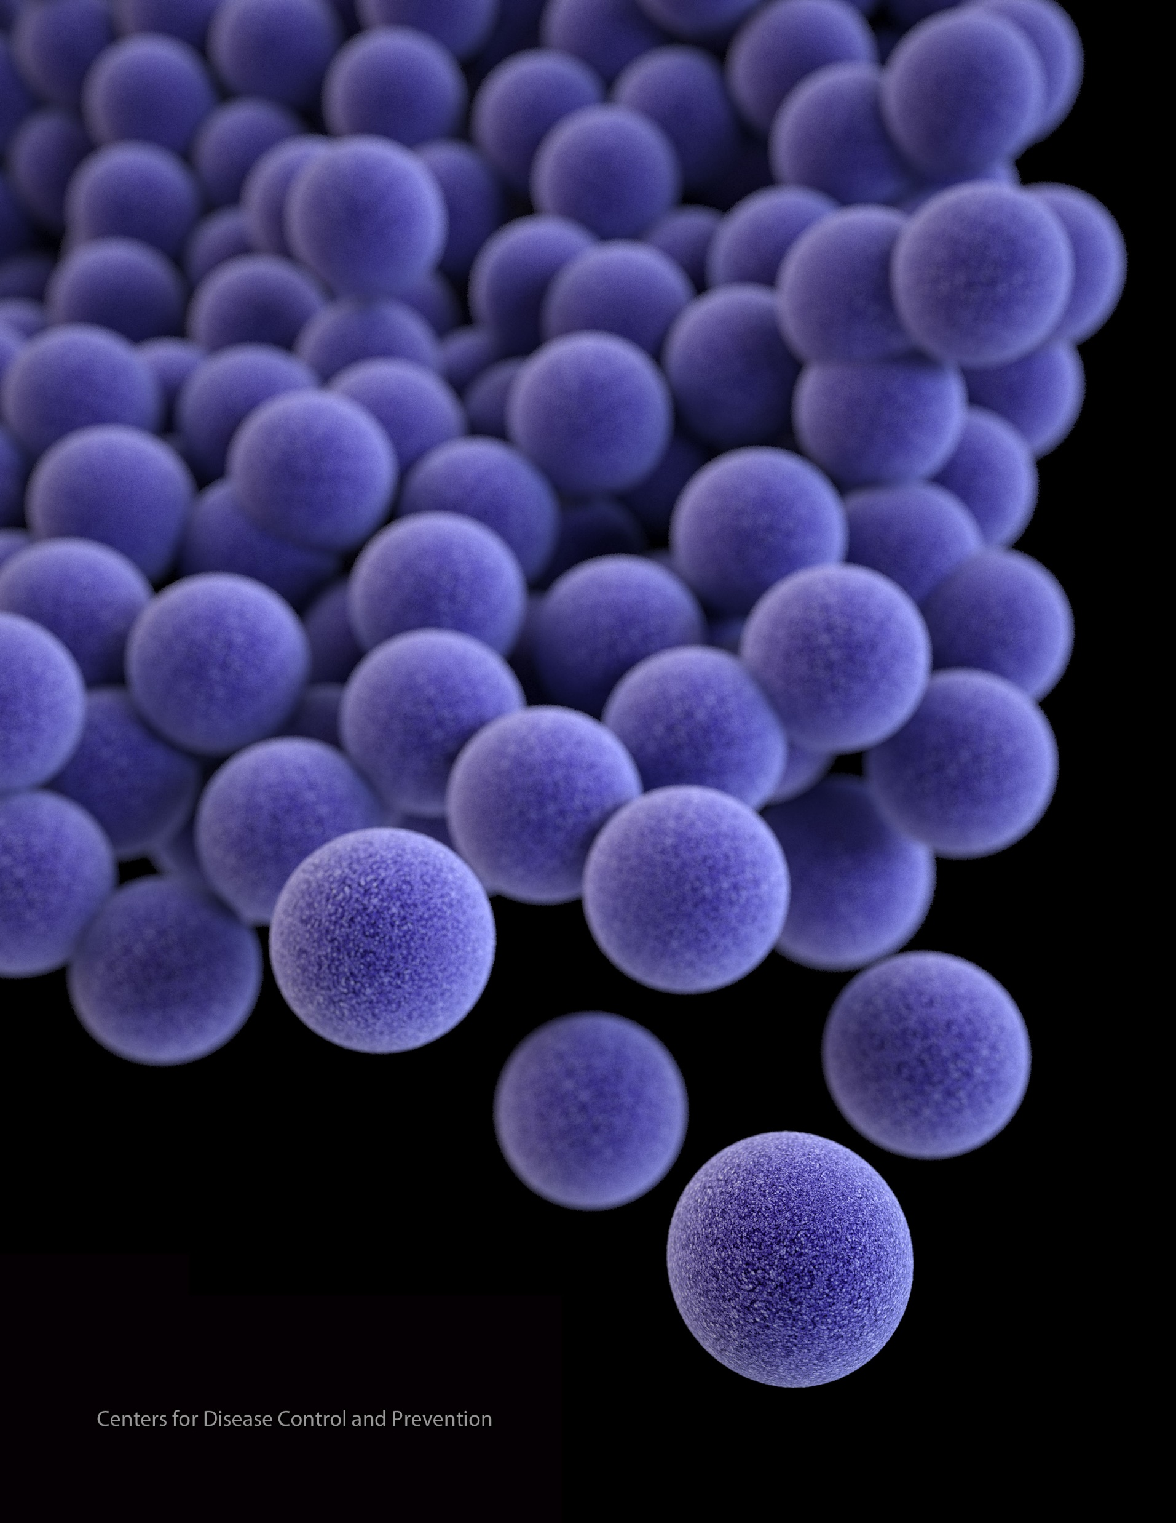
Host Habitat
Characteristics²
Optimal growth temperature is the same as human body temperature, 37° C
Temperature growth range is 7-48°C and pH growth range is 4.0-10.0 pH
Resilient to freezing temperatures down to -20°C, and tolerant to high saline environments
Able to persist in adverse conditions such as food and dry wounds, increasing chance of infecting host
Can survive in a aerobic and anaerobic environment
Naturally colonizes the anterior nares in 10-30% of the human population
Part of the natural skin flora
Also found on the skin, respiratory tract, mouth lower GI and vagina
Staphylococcus aureus

Slide 5
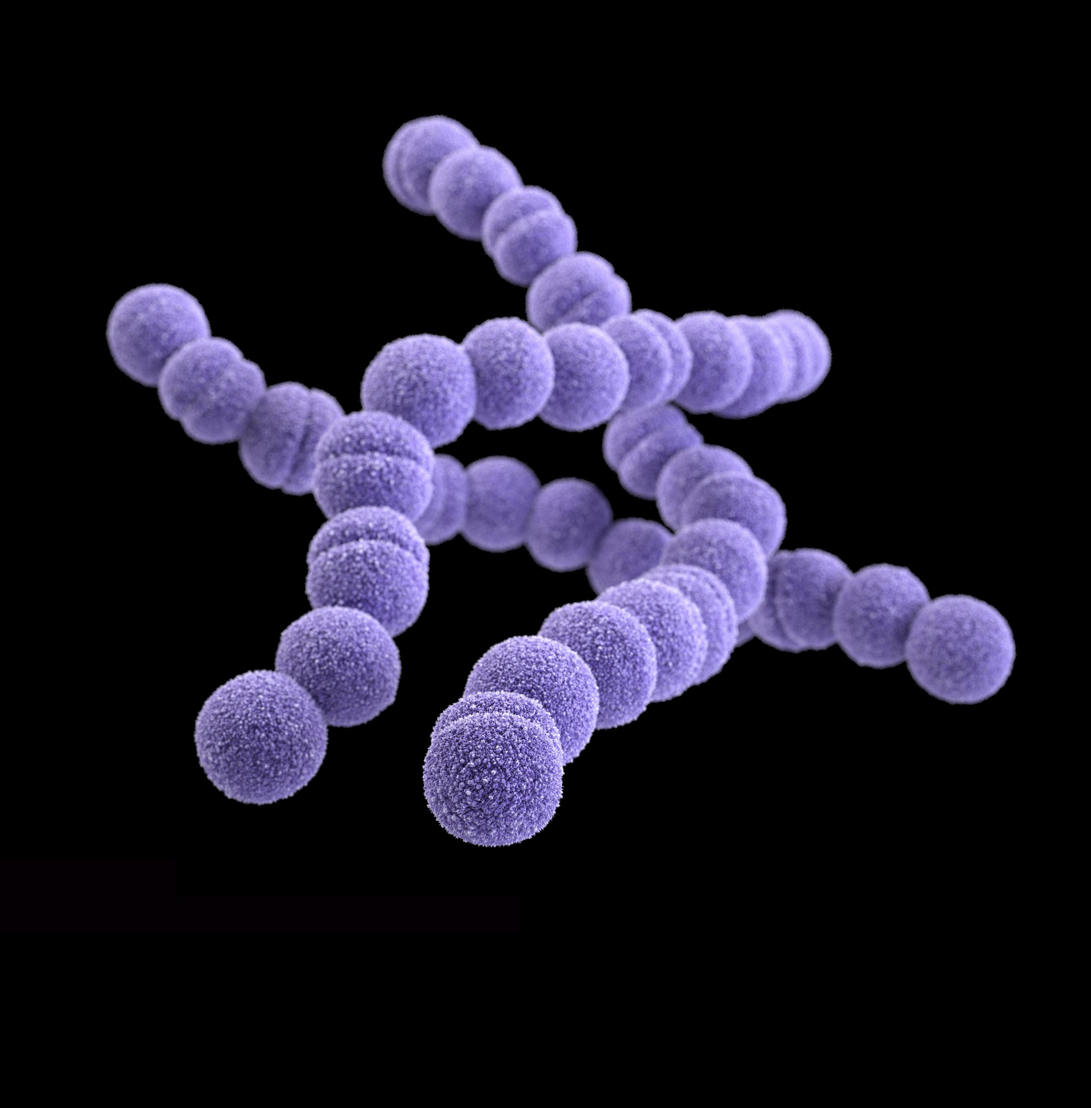
Host Habitat
Characteristics²
Can survive in a aerobic and anaerobic environment
Naturally colonizes the nasopharyngeal mucosa and skin
Part of the natural flora
Also found in the mouth, lower GI and vagina
Streptococcus
pyogenes

Slide 6
How did Stephanie get infected?
?
Compromise of epidermis
Stephanie may have scratched the skin around her nose and/or mouth while wiping her face, playing or being bitten by an insect
This creates a break in the physical skin barrier, allowing the commensal bacteria she is carrying to adhere, colonize and infect
External transmission
Stephanie may have contacted another host or object that was colonized with S. aureus, as they are highly resilient and able to survive on a wide variety of environments
Poor handwashing practices would increase the chances of infection as this is the main method of prevention

Slide 7
2. Entry

Slide 8
Staphylococcus aureus

Slide 9
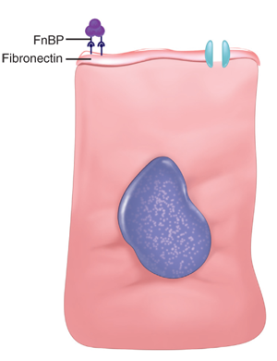
Staphylococcus aureus
Entry
Compromise of epidermis allows S. aureus access to localized tissues
Fibronectin is common on mucosal surfaces
Fibronectin connecting proteins (FnBPs) expressed by S. aureus on its cell surface bind to fibronectin, adhering S. aureus to the epithelial cell²
Surface clumping factors (Clf) also bind to fibrinogen²
Collagen receptors on S. aureus help in binding to the exposed collagen on the host cell’s extracellular space²
Host Cell

Slide 10
Streptococcus pyogenes

Slide 11
Streptococcus pyogenes
Lipotechoic Acid (LTA)
Binds to fibronectin in host epithelial cell
Fibronectin-binding proteins (protein F)
Adheres to the amino terminus of fibronectin on host epithelial cells, aiding
M Protein
Complexes with LTA to aid in adhesion
Entry²
Compromise of epidermis allows S.Pyogenes access to localized tissues
Fibronectin is common on mucosal surfaces
3 main interactions help S.Pyogenes adhere to epithelial cells
Lipotechoic Acid (LTA)
Fibronectin-binding proteins (protein F)
M Protein

Slide 12
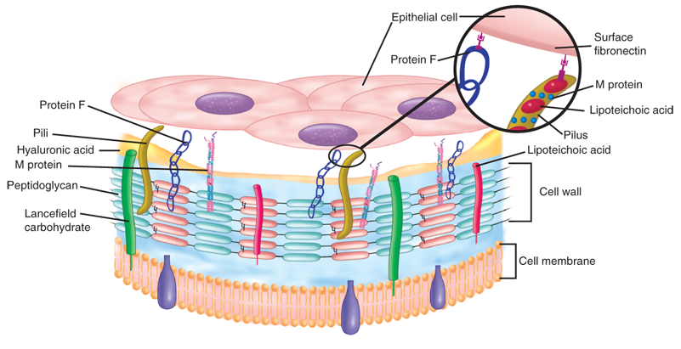
Streptococcus pyogenes
Adhesion to host cell with Protein F, M protein and LTA

Slide 13
3. Multiplication and Spread

Slide 14
Staphylococcus aureus

Slide 15
Staphylococcus aureus
Does S. aureus spread beyond the initial site?
Initial site
Secondary Site
Usually infection remains localized at the entry site and does not spread
In some cases where lesions combine to form a carbuncle, S. aureus may penetrate into the bloodstream and spread to secondary sites
The bloodstream can carry S. aureus to secondary sites such as the kidneys, heart, lungs, meninges and skeletal muscles

Slide 16
Staphylococcus aureus
Is it intracellular or extracellular?
Survival mechanics
Extracellular
Several mechanics exist which help S. aureus survive intracellularly
Some S. aureus express staphylokinase, which can complex with plasminogen and dissolve fibrin clots
Fibrin clots may aid in keeping S. aureus localized, and dissolving them could be a factor in spreading to secondary sites
By expressing mimic endogous ligands on its cell surface, S. aureus can trigger a signal cascade in the host cell and initiate receptor mediated endocytosis
FnBPs mentioned earlier aid in internalization of S. aureus
S. Aureus is able to escape lysosomal killing from immune cells by compromising the lysosome membrane allowing it to exist in the cell cytoplasm
Growth and persistence is not guaranteed and varies depending on host susceptibility and strain variance
Primarily extracellular
Intracellular
Can also be a facultative intracellular pathogen – able to survive intracellular inside host cell and immune cells

Slide 17
Streptococcus pyogenes

Slide 18
Streptococcus pyogenes
Does S. pyogenes spread beyond the initial site?
Initial Site
An initial infection of the upper respiratory tract can spread to the sinus, middle ears, lungs which can cause sinusitis, otitis and pneumonia, although this is not common
S. pyogenes can also enter the bloodstream via bacteremia and infect the meninges
Entry into the bloodstream can also facilitate streptococcal toxic shock syndrome (STSS)
Initially infects and colonizes the skin, causing superficial infections such as impetigo and cellulitis
Secondary Site
Secondary site infection can occur if the initial infection is not resolved

Slide 19
Streptococcus pyogenes
Is it intracellular or extracellular?
Extracellular
macrophages and polymorphonuclear neutrophils, they are able to survive and multiply in the cell cytoplasm
2. Using their new host cell as a trafficking system, allowing unhindered secondary site infection
Generally extracellular
Intracellular
Some strains are able to avoid the host’s immune system and survive intracellularly
Examples:
1. By breaching phagocytic vacuoles in

Slide 20
4. Host Damage

Slide 21
Staphylococcus aureus

Slide 22
Staphylococcus aureus
Host Damage
Direct
S. aureus can cause direct damage via toxins that forms pores in the cell membrane
The main toxins involved in this process are α, β, δ, γ-toxins, and leukocidins
α-toxins insert directly into the lipid bilayer of the host cell and forms a transmembrane pore, which causes vital molecules and ions to exit and kill
the cell
Staphylokinase expressed by S. aureus can form plasmin by complexing with plasminogen. This causes the fibrin clot to dissolve, allowing for ease of secondary site infection
Collagenase is able to break down collagen found in the extracellular matrix of epithelial cells, which can lead to a breakdown of the cell

Slide 23
Staphylococcus aureus
Host Damage
Indirect
Superantigens (SAgs) are proteins expressed by S. aureus that can cause systemic effects
Include staphylococcal enterotoxins and Toxic Shock Syndrome toxins
These can bind with MHC-II on T-tells and antigen presenting cells, which trigger a large cytokine release
Cytokine release can cause inflammation at the site of infection

Slide 24
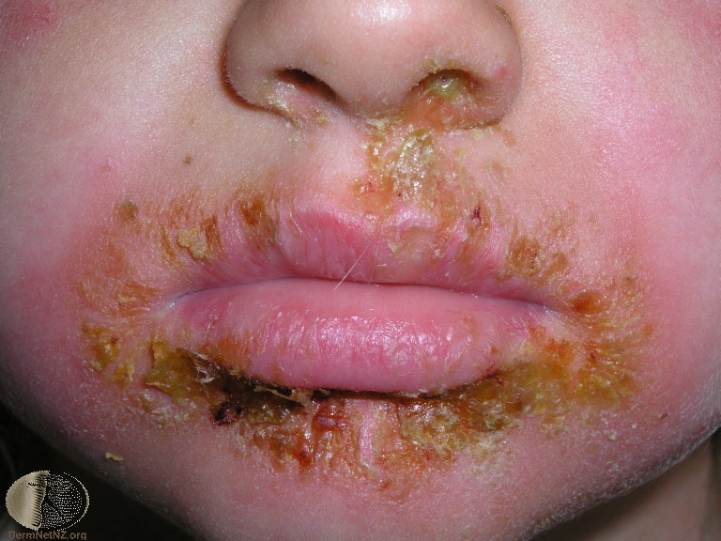
Staphylococcus aureus
Stephanie’s signs and symptoms
Red sores that are indicative of impetigo are likely caused by collagenases and proteases that have damaged or weakened the cells around the nose and mouth
SAgs would result in inflammation and reddening of the area
Toxins such as α-toxins may have killed the cells in the area by forming pores
Stephanie’s immune response may have released radicals that caused damage to her own cells

Slide 25
Streptococcus pyogenes

Slide 26
Streptococcus pyogenes
Host Damage
Direct
Streptolysin O is a leucocidin that functions like the α-toxin of S. aureus, inserting itself in the lipid bilayer of a wide range of cells and causing the cell contents to leak
Streptolysin S is also leucocidin that targets immune cells and disrupts them using the same mechanism
Streptodornase A-D act as a deoxyribonuclease and degrades DNA
Streptokinases can complex with plasminogen and dissolve fibrin clots

Slide 27
Streptococcus pyogenes
Host Damage
Indirect
Streptococcal pyrogenic toxins A, B, C, F are SAgs expressed by S. pyogenes that can trigger the same cytokine release as S. aureus, causing inflammation and rashes

Slide 28
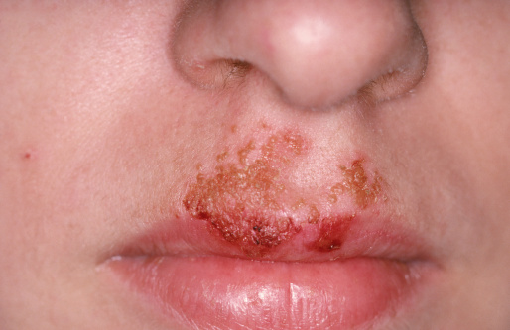
Streptococcus pyogenes
Stephanie’s signs and symptoms
The protease activity of enzymes such as streptodornase and streptolysin can damage and destroy the cells at the site of infection, causing blisters, rashes and lesions that may be filled with pus
Exotoxin activity may cause inflammation in the area resulting in redness

Slide 29
References
1. Baron S, editor. Medical Microbiology. 4th edition. Galveston (TX): University of Texas Medical Branch at Galveston; 1996. Available from: https://www.ncbi.nlm.nih.gov/books/NBK7627/
2. Levinson, W. (2010). Review of medical microbiology and immunology.
3. Ryan, K. J., & Ray, C. G. (2014). Sherris Medical Microbiology

