Slide 1
Summary of
Immune Response Questions
Case 4 week 3
- Brian Black

Slide 2
Objectives:
What are the signs and symptoms of mastitis.
Which body system is effected. How is the normal physiological functioning of this area of the body been disturbed by the infection?
How is this condition prevented is the patient at risk of being similarly infected in future instances of breastfeeding?
What is/are the antibiotic(s) of choice to treat mastitis and how do they work to rid the body of the organism? Can breast feeding continue during antibiotic therapy.

Slide 3
Case:
A New Baby
Elizabeth’s pregnancy and the birth of Amanda had gone well however, Elizabeth and Amanda were now struggling with breastfeeding. Elizabeth was aware from her prenatal classes of the various reasons why breastfeeding might be difficult. On the advice of a friend she made arrangements for a lactation consultant to visit her at home. She continued trying to ‘latch’ and feed Amanda in the days leading up to the visit but stopped when she began to experience breast pain and noticed that her right breast was red all around the nipple. She was feeling stressed and tired, along with a feeling of general malaise that she attributed to the stress associated with trying to breastfeed her newborn baby. Based on Elizabeth’s symptoms, the lactation consultant made a preliminary diagnosis of mastitis and suggested that Elizabeth see her doctor for a full diagnosis and possible antibiotic treatment. Do the symptoms that Elizabeth is experiencing concur with the preliminary diagnosis? What is the most likely bacterial cause and what are the antibiotics of choice to treat it?

Slide 4
Overview
Our patient is experiencing an episode of lactational mastitis, an infection of the mammary glands which presents with localized pain, warmth, erythema, swelling over the breast in the setting of breast feeding. The most likely bacterial cause is Staphylococcus aureus.
The antibiotic of choice depends upon the clinical scenario. For non-severe infection with no risk factors for MRSA, dicloxacillin or cephalexin would be appropriate. For non-severe infection with risk factors for MRSA, trimethoprim-sulfamethoxazole (beyond the newborn period) or clindamycin would be appropriate. Severe infection can be treated with vancomycin.

Slide 5
Question 1: What are the signs (objective characteristics usually noted/detected by a healthcare professional) and symptoms (subjective characteristics experienced by the patient).

Slide 6
Signs and Symptoms
Pain, erythema – often in wedge shape around nipple, swelling, warmth, abnormal discharge.
Possibly fever, malaise.

Slide 7
Question 2: Which body system is effected. In what way has the normal physiological functioning of this area of the body been disturbed by the infection. What made Elizabeth susceptible to this infection?

Slide 8
The main organ affected by the infection is the integumentary system of the breast.
The integumentary system includes skin, hair, nails and glands which act as a physical barrier to protect the body from pathogens.
Within the breast, there are mammary glands which secretes milk to nourish infants.

Slide 9
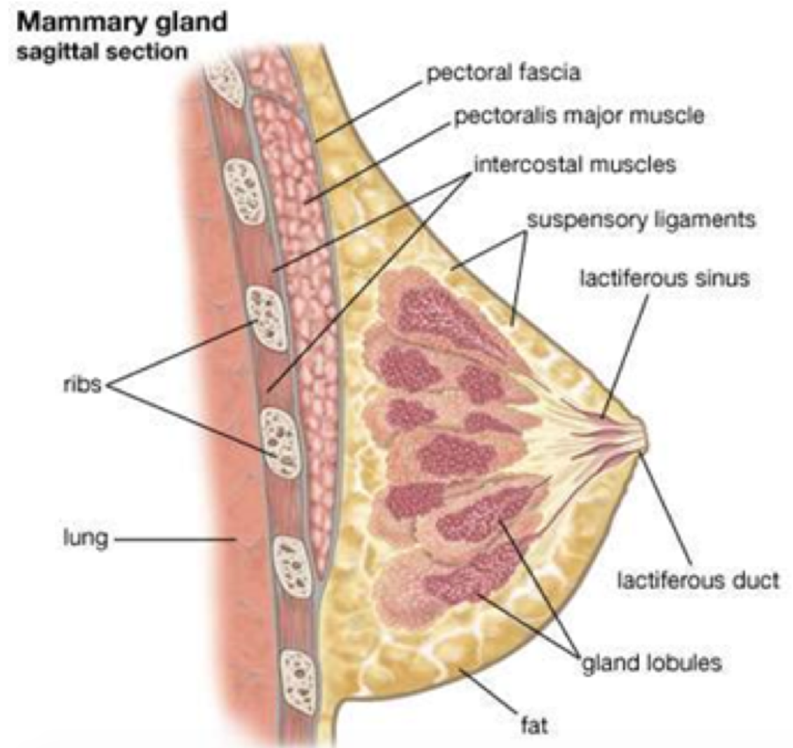
The breast and mammary glands

Slide 10
Disturbance of Normal Physiological Function
During a bout of mastitis, S. aureus, gains entry to breast tissue;
It forms a biofilm to initiate its replication.
In response, the host immune initiates the inflammatory response, leading to expression of transcription factor NF-κB.
NF-κB causes transcription of inflammatory cytokines TNF-α and Interleukins 1 and 6.
These inflammatory cytokines cause the endothelial cells in the vasculature in the breast to become “stick and leaky”;
Immune cells such as neutrophils and dendritic cells attach to “sticky” sites and enter the site of infection.
Edema and swelling results from fluid movement through “leaky” vessels.
The breast tissue therefore becomes inflamed, and the drainage of milk towards to areola region will be clogged.
Reduced milk flow and altered nutrient composition leads to insufficient nutrients delivered to the nursing infant.

Slide 11
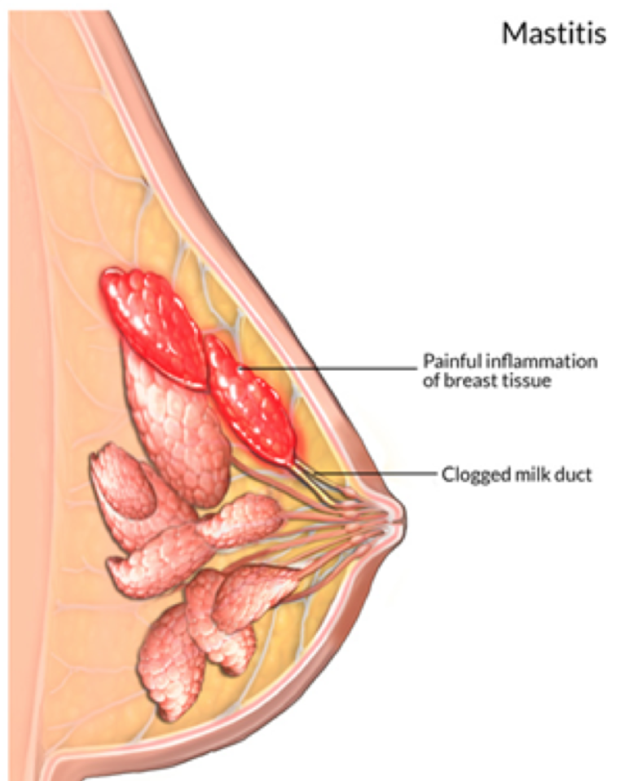

Slide 12
Risk factors for mastitis
Baby with a cleft lip or palate
Cracked nipples
Infant attachment difficulties
Milk Stasis
Missed feeding
Nipple Piercing
Plastic backed breast pads
Poor maternal nutrition
Previous mastitis
Restriction from a tight bra
Short frenulum in infant
Sore nipples
Use of manual breast pump
Yeast infection
Maternal stress and fatigue

Slide 13
In this case, missed feedings, irregular nursing and maternal stress would be major precipitants.

Slide 14
Question 3: Was there anything that Elizabeth could have done to prevent acquiring this infection and is she at risk of being similarly infected in future instances of breastfeeding?

Slide 15
Prevention:
Consultation with lactation specialist;
Learning breastfeeding techniques;
Ensuring proper latching of the baby;
Fully draining the milk from her breasts while breastfeeding,
Allowing the baby to completely empty one breast before feeding on the other breast,
Regularly breastfeeding (up to 8-12 times per day)
Not allowing milk to accumulate within breasts;
Using warm compresses with a clean towel.
Adequate skin and nipple care.

Slide 16
Future risk
Subsequent episodes of mastitis are possible if a breach in the nipple areola complex, a cracked nipple, or milk stasis occurs.

Slide 17
Question 4: What is/are the antibiotic(s) of choice to treat this infection how do they work to rid the body of the organism? Should Elizabeth continue breastfeeding if on antibiotics and, if so, how will the antibiotics affect Amanda ?

Slide 18
Treatment
Management of nonsevere mastitis includes nonsteroidal inflammatory agents, cold compresses and complete emptying of the breast via breastfeeding, pumping, or hand expression.
Management of mastitis with persistent symptoms beyond 12 to 24 hours or with fever includes previous measures and administration of antibiotic therapy with activity against S. aureus.

Slide 19
Oral antibiotics are prescribed for 10-14 days.
Erythromycin, Flucloxacillin, and Dicloxacillin are penicillinase-resistant penicillin antibiotics are effective against S. aureus
Cephalexin and Clindamycin are alternatives that can be prescribed, if the mother is allergic to penicillin.
Antibiotics deemed safe for breastfeeding mothers include amoxicillin, cephalosporins, aminoglycosides, and trimethoprim-sulfamethoxazole

Slide 20
References
Barbosa-Cesnik C, Schwartz K, Foxman B. Lactation Mastitis. JAMA. 2003;289(13):1609-1612. doi:10.1001/jama.289.13.1609 Mayo Clinic Staff. (June, 2015). Mastitis. Retrieved from: https://www.mayoclinic.org/diseases-conditions/mastitis/symptoms-causes/syc-20374829 World Health Organization. (2000). Mastitis: causes and management. Retrieved from: http://apps.who.int/iris/bitstream/handle/10665/66230/WHO_FCH_CAH_00.13_eng.pdf;jsessionid=C345965A84CF94676DDAC1F06B675F1C?sequence=1
Sherrwood, L. (2016). Human physiology: from cells to systems. Boston, Mass: Cengage Learning.
Parham, P. (2015). The immune system. New York, NY: Garland Science.
Say, B., Dizdar, E. A., Degirmencioglu, H., Uras, N., Sari, F. N., Oguz, S., & Canpolat, F. E. (2016, July). The effect of lactational mastitis on the macronutrient content of breast milk. Retrieved March 24, 2018, from https://www.ncbi.nlm.nih.gov/pubmed/27341630
Britannica, T. E. (2016, August 17). Mammary gland. Retrieved March 24, 2018, from https://www.britannica.com/science/mammary-gland
Mastitis. (n.d.). Retrieved March 24, 2018, from https://www.webmd.boots.com/children/baby/guide/mastitis
Toumi, H., & Best, T. M. (2003, August 01). The inflammatory response: friend or enemy for muscle injury? Retrieved March 24, 2018, from http://bjsm.bmj.com/content/37/4/284
World Health Organization, Department of Child and Adolescent Health and Development. Mastitis Causes and Management. [internet] Peru; 2000 [cited mar 24, 2018]. Available from http://apps.who.int/iris/bitstream/handle/10665/66230/WHO_FCH_CAH_00.13_eng.pdf?sequence=1
Spencer JP, MD. Management of Mastitis in Breastfeeding Women. American Family Physician 2008;78(6):727-732.
Lisa A. ABM Clinical Protocol #4: Mastitis, Revised March 2014. BREASTFEEDING MEDICINE [internet]. 2014 [cited Mar 24, 2018]; 9[5]. Available from https://www.liebertpub.com/doi/pdf/10.1089/bfm.2014.9984
Preventing Mastitis. HealthLinkBC. 2017 March. Available from: https://www.healthlinkbc.ca/health-topics/tn8011 Mastitis. Causes and Management. World Health Organization. 2000. Available from: apps.who.int/iris/bitstream/handle/10665/66230/WHO_FCH_CAH_00.13_eng.pdf;jsessionid=458B0A76D4A4A7A665E7D011ADBFE8B2?sequence=1 Mastitis. Mayo Clinic. 2015. Available from: https://www.mayoclinic.org/diseases-conditions/mastitis/symptoms-causes/syc-20374829 Spencer JP. Management of Mastitis in Breastfeeding Women. American Family Physician. 2008 Sep 15; 75(6).
Auerbach, K. G. (1999). Breastfeeding Maternal Medication Use. Journal of Obstetric, Gynecologic & Neonatal Nursing, 28(5), 554-563.
Mathew, JL. (2004). “Effects of maternal antibiotics on breast feeding infants.” Postgraduate Medical Journal. 80:196-200
Miller, E. L. (2002). The penicillins: a review and update. Journal of Midwifery & Women’s Health, 47(6), 426-434.
Noonan, M. (2010). Lactational mastitis: Recognition and breastfeeding support. British Journal of Midwifery, 18(8), 503-508. 10.12968/bjom.2010.18.8.49321
Kohanski, Michael A., et al. (2010). “How Antibiotics Kill Bacteria: from Targets to Networks.” Nature Reviews Microbiology. 8(6): 423–435., doi:10.1038/nrmicro2333.

