Slide 1

Alchemy
A solution to a pedagogical customization problem
Russ Algar, Jane Maxwell, et al.
Department of Chemistry, University of British Columbia
algar@chem.ubc.ca

Slide 2


A Custom Resource is Needed
Textbook Model
✗ Concepts appear disconnected
✗ Pattern recognition, plug & chug
✗ Misconception: only one answer
✗ No feedback
✗ Much of content is unused

Slide 3


A Better, More Flexible Fit
Questions that reflect our course tests and exams.
Molds to our syllabus/
course content.
Addresses the difficulties of our students.
Conveniently and freely available to students.
Mimics our instructor feedback to students.

Slide 4

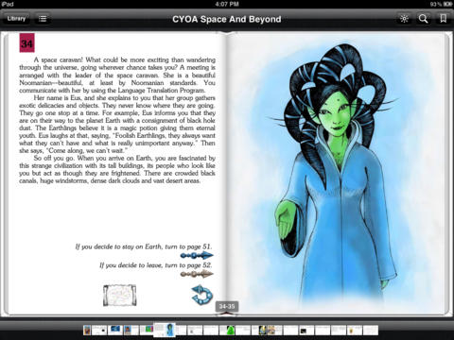


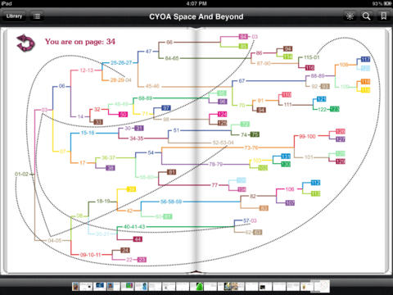

Inspiration: CYOA Books
If you decide to stay on Earth, turn to page 51.
If you decide to leave, turn to page 52.

Slide 5

Design Criteria for our Custom Resource
Student Use
Online resource
Point-and-click through decision trees with text graphics
Enroll in a class
Complete assignments for grades and for extra practice
Instructor Use
Online resource
Point-and-click construction of decision trees with text and graphics
Add co-instructors and organize decision trees by class
Assign practice assignments and graded assignments with due dates
Record and view student results

Slide 6
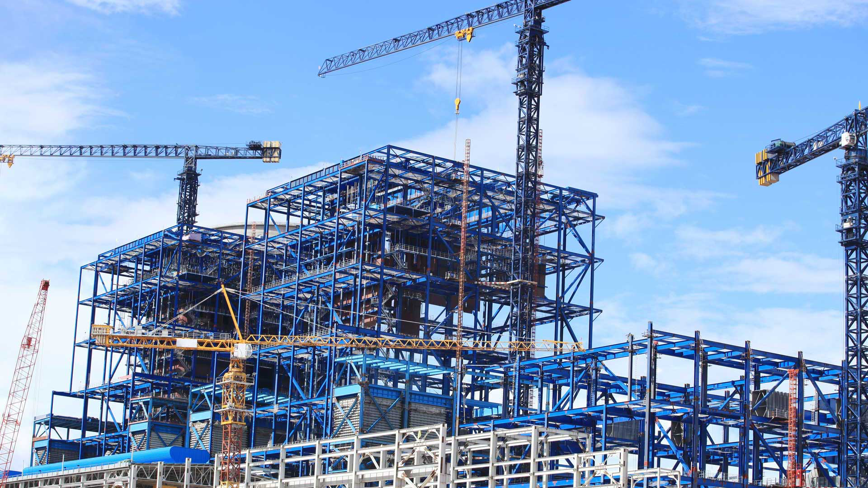

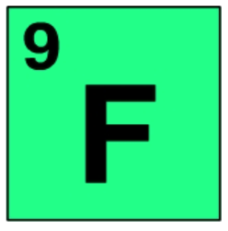

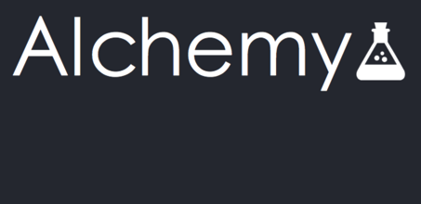


Resource Development
CPSC 319 Software Engineering Project
Third-year computer science course
Students formed into teams that a functioned as a mock software company
Developed a project from start to finish
Competition between different teams
We served as clients and chose a winning software product.

Slide 7
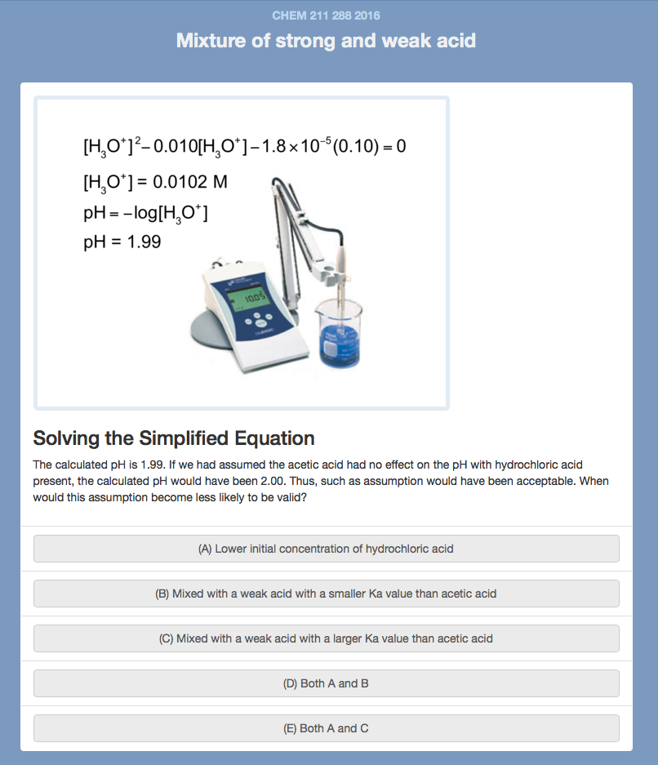
Decision Node (Student)

Slide 8
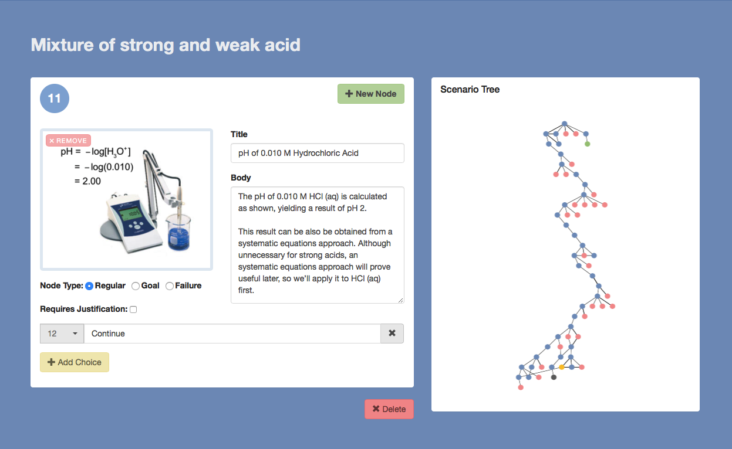
Tree Builder (Instructor)

Slide 9
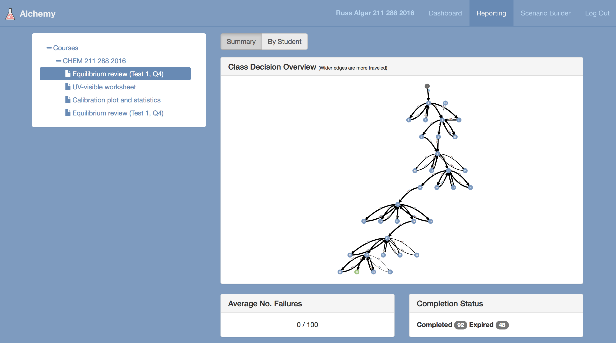
Class Results (Instructor)

Slide 10

Implementation in CHEM 211
Course
CHEM 211: Introduction to Chemical Analysis
~150 students
Delivered Content
De novo scenarios
Interactive answer key to a difficult test question
Interactive homework worksheet
Student Participation
Participation mark earned (up to 2% of course grade)
73% of class earned non-zero participation mark
84% of non-zero grades were a full participation mark

Slide 11
Student Feedback
#1 student comment: More content in Alchemy!

Slide 12

Prospectus
Software upgrades
Extensive content development
Full integration into CHEM 211
Pilot in other courses

