Slide 1
Bacterial Pathogenesis of Staphylococcus aureus
Case 4 Summary
Chris Cheng (#32929144)

Slide 2
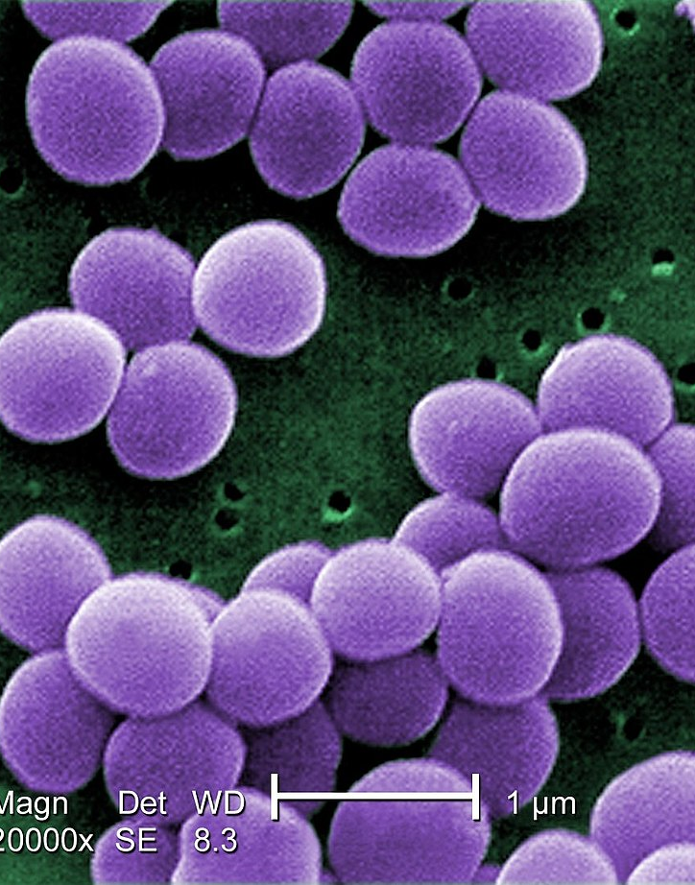
Staphylococcus aureus
Gram positive cocci aerobic organisms
Can cause Mastitis, pneumonia, endocarditis and osteomyelitis
Can normally be found on the skin and mucous membranes
Multidrug resistant
Can survive for an extended period of time in a diverse environment

Slide 3
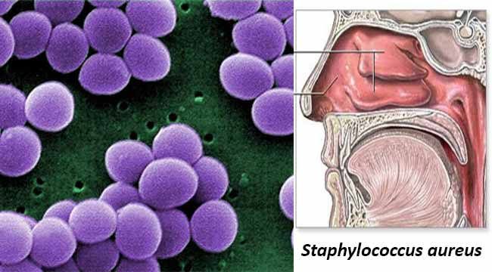
Where can you find
Staphylococcus aureus?
Nasal: able to resist the attacks from nasal secretion-based defensins and cathelicidins
Other Skin/body surfaces: Can colonize the nipples
Inanimate surfaces: Can form biofilms on a variety of surfaces at the hospital or in the home
Other animals: staphylococcus aureus can colonize the fur of canines
Respiratory tract: nasal passages and the pharynx by binding to cilia and mucin
Human Milk
Digestive tract: bind to intestinal mucus and formation of biofilms
vagina

Slide 4
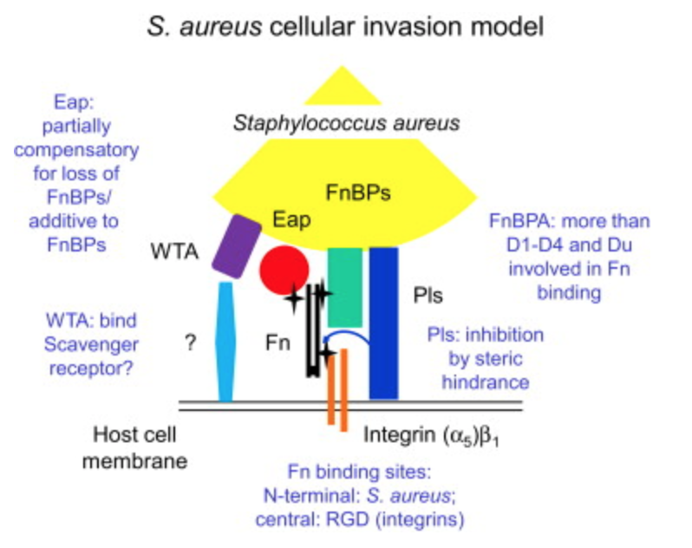
Microbial Surface Components Recognizing Adhesive Matrix Molecules (MSCRAMMs)
Adhesins that bind to human epithelium
Three domains: a bacterial-surface binding domain, a membrane spanning domain, and a extracellular binding domain
Mediated by sortase enzymes
Colonize host nipples by utilizing fibronectin-binding-proteins(FnBP’s)
Clumping factors allow for adhesion to the host epithelium

Slide 5
Accessory Gene Regulator
Promotes adhesin production during infection
Regulates fibronectin binding protein production
FnBP knockout causes 40% decrease in ability to bind to cultured epithelial cells
Encodes for 2 operons
  P2 Operon: encodes for ArgC(receptor) and ArgA (response regulator)
  RNAIII: Downregulate adhesins and upregulate toxin production
    encodes for ∂-hemolysin (∂-toxin), a 26-amino acid protein able to lyse erythrocytes

Slide 6
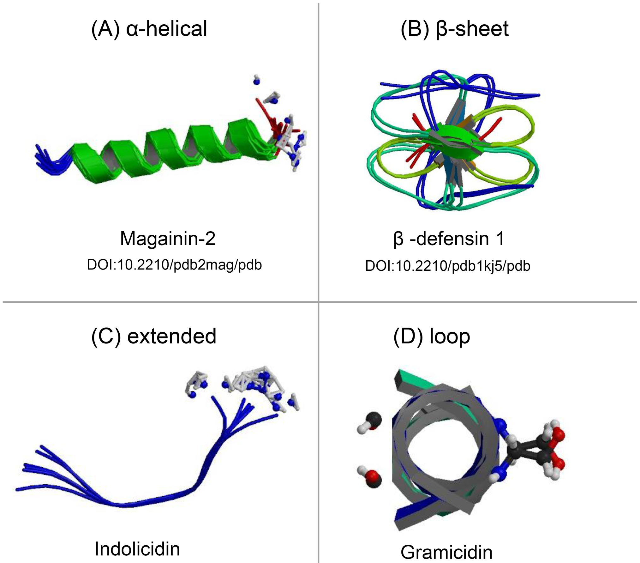
Antimicrobial peptides (AMPS)
wide range of activity against pathogens (bacteria, fungi and viruses)
secreted by keratinocytes, hair bulb cells, sebocytes and eccrine sweat glands
expressed in proforms which require post-secretional activation to become activity
bind to the bacteria’s anionic surface structures, such as lipopolysaccharide, and prevent adherence to the skin

Slide 7
Evasion of Host Immune Responses
Leukocidin: Pore forming toxin that acts specifically on the membranes of polymorphonuclear (PMN) leukocytes, resulting in their destruction
Microcapsule: surface polysaccharides of either serotype 5 or 7 and prevents phagocytosis
Protein A: binds to Fc receptor of IgG, preventing it from opsonizing the bacteria
Staphyloxanthin: antioxidant which prevents death by reactive oxygen species
Biofilm: phagocytosis resistance
PIA/PNAG and poly-γ-glutamic acid: inhibit phagocytosis
SepA: degrades bactericidal AMPs

Slide 8
Factors affecting Bacterial Replication, Invasion, and Spread
Coagulase: binds to prothrombin to form an active protease complex called staphylothrombin and converts soluble fibrinogen into insoluble fibrin
  Fibrin production is used to form clots which acts as a physical barrier
Staphylokinase: causes the dissolution of fibrin clots
  Works with coagulase to enhance replication and spread
Alpha Hemolysin (Membrane Damaging toxin)
  Causes osmotic lysis of nearby cells by forming heptameric rings with a central pore through which cellular contents leak out
PIA/PNAG and the ica Gene Cluster
  Required for formation of the extracellular biofilm matrix
Phenol Soluble Modulins:
  antimicrobial activity against other organisms and contribute to biofilm maturation

Slide 9
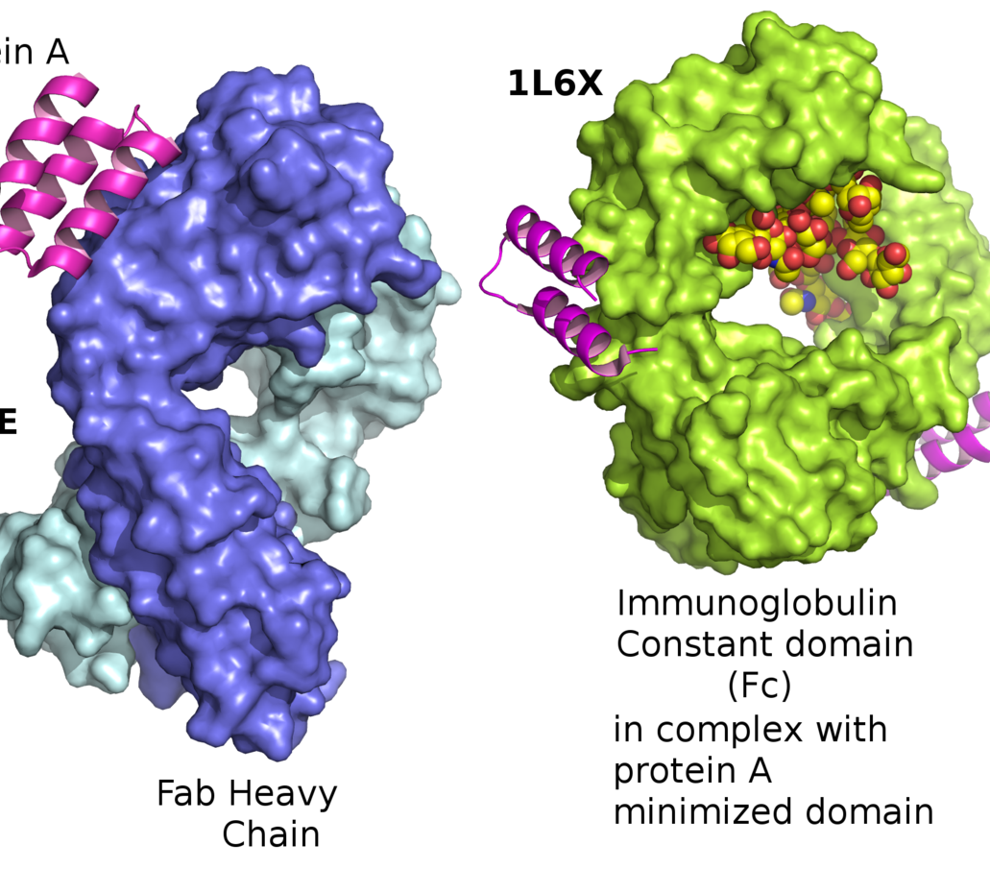
Bacterial Damage
Protein A (SpA):
  activates tumor necrosis factor-alpha 1 (TNFR1) signalling,
  induces the release of pro-inflammatory chemokines and cytokines toward the site of injury
staphylococcal binding immunoglobulin protein (Sbi)
  Contributes to the inflammatory response
Membrane damaging toxins
  cause pore formation in the host membrane, and lead to the leakage of nearby molecules

Slide 10
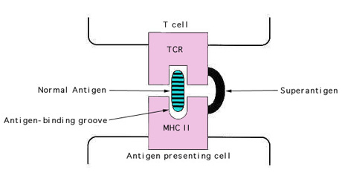
Bacterial Damage Continued
Enterotoxins: superantigen that activates T cells without antigen recognition, through non-specific interactions
Toxic shock syndrome toxin (TSST-1)
  lead to the production of IL-1, IL-2, TNF-alpha and other cytokines, and may lead to fatality
Enzymes: proteases, lipase, DNase, and FAME/fatty acid modifying enzyme
  Function in regards to host damage is unknown

