Slide 1
Developing Course Goals and Learning Objectives
Course Design Intensive
June 2015
University of British Columbia, Centre for Teaching, Learning and Technology
Marie Krbavac, MA
Isabeau Iqbal, PhD
This work is licensed under the Creative Commons Attribution-NonCommercial 4.0 International License. To view a copy of this license, visit http://creativecommons.org/licenses/by-nc/4.0/. Many people have contributed to these slides: they include the facilitators listed above, as well as Roselynn Verwoord and Janice Johnson.

Slide 2
Learning-centered approach to integrated course design (Fink, 2013)
“The heart of this approach is to decide what students can and should learn in relation to the subject and then figure out how learning can be facilitated.”

Slide 3
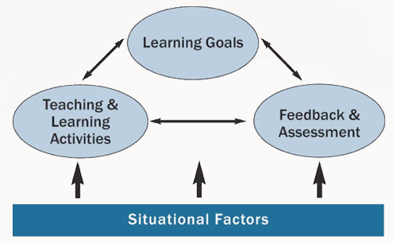
A model of integrated course design (Fink, 2013)

Slide 4
Session learning objectives
By the end of this session, you will be able to:
Explain the DACUM process for course design
Articulate the difference between a course goal and learning objective
Create 2-3 course goals for your course
Write at least two learning-centred learning objectives using Bloom’s Taxonomy of Educational Objectives

Slide 5
DACUM
“Developing a Curriculum”
Process for developing course content/curriculum
Have you heard of this? What do you know about it?
Notes:
DACUM history (get information)

Slide 6
Brainstorm
Organize
Reflect
Consolidate

Slide 7
Students will be able to (SWBAT) drive a car effectively and safely
Form a small group (four people)
Individually brainstorm everything you can think of that relates to the topic
Write each idea on a separate sticky 2” x 2” note
Stick them randomly on table/wall

Slide 8
SWBAT: drive a car effectively and safely
Working in your group, organize the sticky notes into clusters of related items.
Remove duplicates

Slide 9
SWBAT: drive a car effectively and safely
Once you agree on your clusters, develop a general statement/goal that relates to each cluster
Consider: What is this cluster about? E.g., safety? Mechanics?
Write each goal on a large sticky note
Set your chart up as a DACUM (on flipchart paper)

Slide 10
SWBAT: drive a car effectively and safely
Within each course statement/goal (the large stickies), organize your learning topics/concepts (the small stickies) in some logical fashion
Simple -> complex
General -> specific, or vice versa
Chronological
Concrete -> abstract, or vice versa

Slide 11
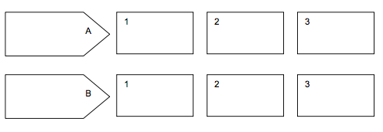
DACUM chart: Two components
Course goals
Learning objectives

Slide 12
Course Goals & Learning Objectives
Course goals:
General statements (typically 4-5) that describe what you want your student to know/do as a result of taking this course
Should be consistent with program/Faculty goals and the institutional mission
Sometimes written from the instructor’s point of view
Notes:
Examples:
https://teachingcommons.stanford.edu/resources/course-preparation-resources/course-design-aids/course-goals-examples

Slide 13
Cross-cultural dance studies course goals (example)
Course Goals:
To appreciate dance as a cultural practice that occurs universally and with infinite variety
To recognize, reflect upon and be able to articulate the essential components of dance movement
To understand that dance is a form of human expression as well as a means of communication
(Source: http://www.washington.edu/students/icd/S/dance/250bcoop.html)

Slide 14
Computer programming course goals (example)
Course Goals:
To teach basic programming-in-the-small abilities and concepts, with procedural/functional abstraction and simple built-in datatype manipulation the highlights.
To teach basic abilities of writing, executing, and debugging programs.
(Source: http://www.cs.washington.edu/education/syllabi/142.html)

Slide 15
Learning objectives
Learning objectives articulate the knowledge, skills and/or attitudes you want students to acquire by the end of the class or after completing a specific assignment
Describe an intended result of instruction, rather than the process of instruction itself

Slide 16
Course Goals | Learning Objectives
General statements (typically 4-5) that describe what you want your student to know/do as a result of taking this course. | Articulates the knowledge, skills and/or attitudes the learner is expected to achieve by the end of a lesson, activity, assignment etc
Elementary Spanish To develop skills that will enable you to listen, speak, read, and write in the target language at the Novice mid or high Proficiency Level. | 1.1 use listening and speaking skills to cope with subject areas such as articles of clothing, naming of basic objects, colors, names of family members, the weather, days of the week, months of the year, today’s date and year, telling time, etc. 1.2 improve pronunciation so as to be understood by a native speaker used to dealing with foreigners.
Source: http://www.baylor.edu/spanish/index.php?id=858957

Slide 17
Learning Objectives
When learner achieves a series of related learning objectives, achieved a Course Goal
Learning objectives – often prerequisites for next level of learning/course or entry level job skills

Slide 18
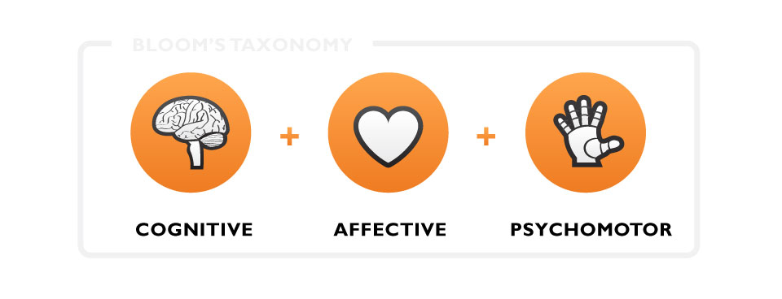
Domains of learning
Image: http://www.icomproductions.ca/what-we-know/

Slide 19
Writing Learning Objectives
Learning Domains
Cognitive – knowledge, intellectual
Affective – attitudes, emotions
Psychomotor – skills, often physical

Slide 20
Different Levels of Learning
Learners must be able to do/know things on lower levels before can do/know things at higher levels
Cumulative, hierarchy
Example verbs for use in DACUM/course profile chart
“Cheat sheet” for writing learning objectives

Slide 21
Activity: Driving a car
In your groups, go back to your DACUM
Choose one course goal and 2-3 of its related learning objectives
Using Bloom’s taxonomy, write out 2 or 3 learning objectives (on post-its)

Slide 22
Learning objectives
Learning objectives articulate the knowledge, skills and/or attitudes you want students to acquire by the end of the class or after completing a specific assignment
“What will the learners be able to do/ know/feel by the end of this session?”

Slide 23
Verbs to Avoid
Understand
Know
Learn
Why do we want to avoid using these?
Because….Objectives should be: specific, measurable, observable, achievable, realistic, clear

Slide 24
Activity: Driving a car
In your groups, go back to your DACUM
Choose one course goal and 2-3 of its related learning objectives
Using Bloom’s taxonomy, write out 2 or 3 learning objectives (on post-its)
Learning centered, specific, measurable, observable, achievable, realistic, clear

Slide 25
Using Course Goals & Learning Objectives
What do we “do” with learning objectives (as instructors)?
Plan
Teach
Evaluate
Once we have course goals & learning objectives, have foundation to write lesson plans, select teaching strategies and learning activities, consider assessment

Slide 26
Process Considerations
Each learning objective = approx. 30-60 mins of instruction
Recommend keeping a course design journal
Log what changes you made and why
Each time use DACUM, add/subtract elements

Slide 27
Choices for Applying Your Learning
If you are building a course from scratch
Start working on your course profile/ DACUM
If you are re-working a course, & you do not have explicit course goals & learning objectives for your course
Start working on your course profile/ DACUM
If you are re-working a course, & you have explicit course goals & learning objectives for your course
Re-visit them – brainstorm, cluster, make changes, reword

Slide 28
Feedback from a Colleague (10 mins total)
In pairs, take turns sharing your DACUM.
Discuss 1-2 challenges (does your colleague have ideas that can assist you with resolving these challenges?)
Individually determine the immediate next steps for progressing with your DACUM: What do you commit to doing before Wednesday, June 3rd at 9 am?!
Share the above with your colleague (colleague, please make note so you can check in next day!)

