Slide 1
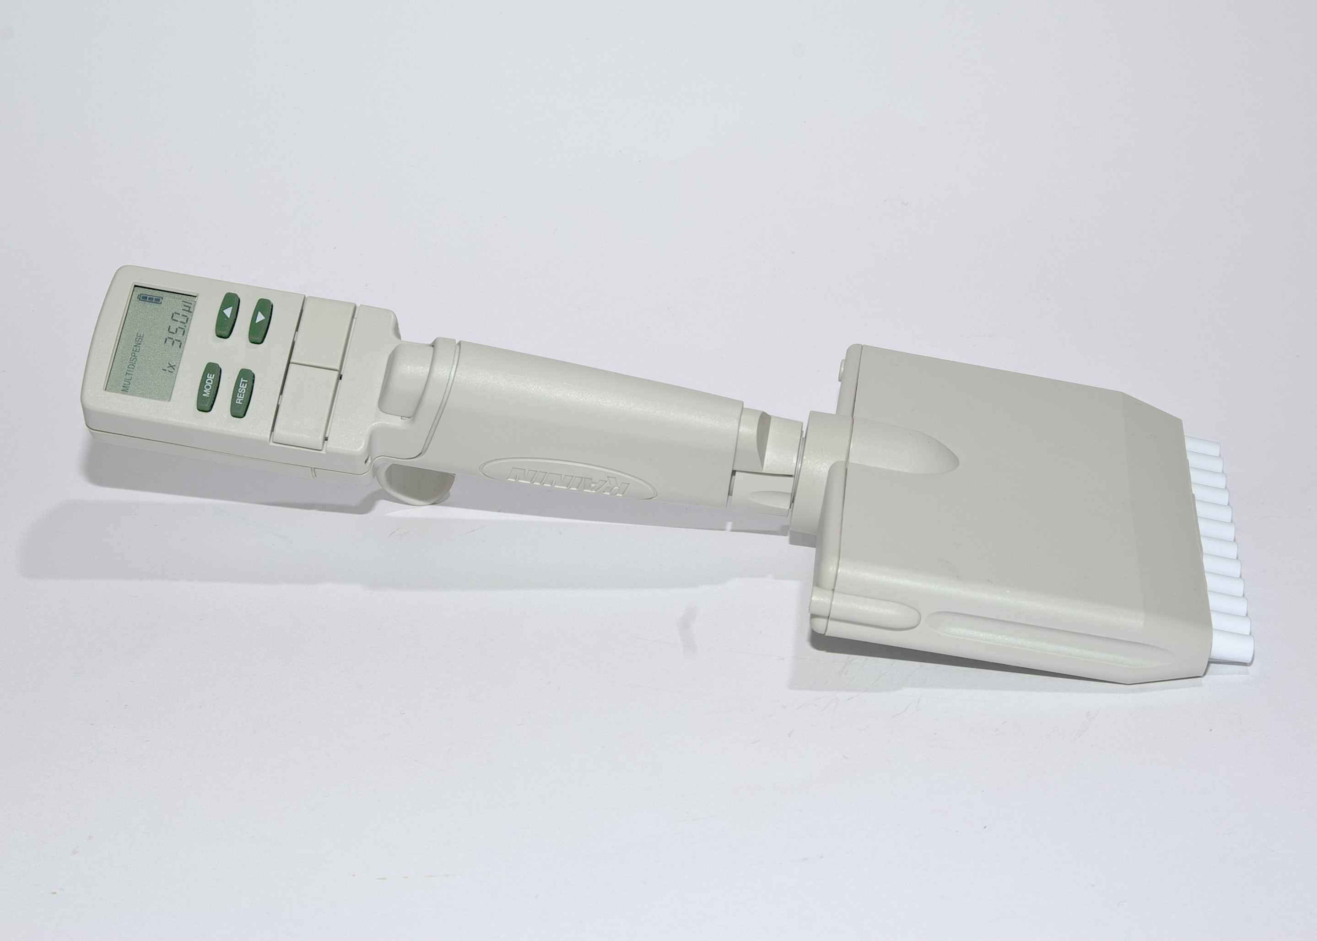
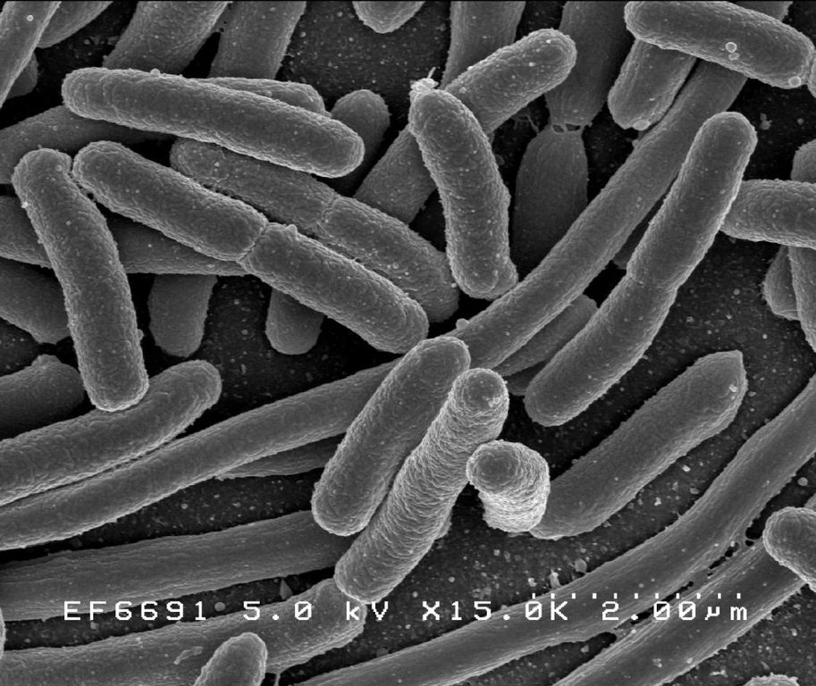
Case 1: Microbiology Laboratory
Antonio Imperial

Slide 2
The Raw Food Diet
25-year-old Johnny has been eating raw eggs as part of his new body building diet. One week into his new diet, he develops a mild fever, severe abdominal cramps and watery diarrhea. After 4 days of diarrhea, he goes to a walk-in clinic where the doctor finds that Johnny is volume depleted and has some abdominal tenderness. She gives him a container to collect a stool sample to send to the Microbiology Laboratory and suggests that he stop eating the raw eggs. Johnny’s stool sample grows Salmonella serotype enteriditis.

Slide 3
Question 1: Other than the stated bacterial cause, what are the most common bacterial pathogens associated with this type of infectious scenario?
Three species of bacteria are likely causes of Jimmy’s symptoms in the absence of Salmonella
Bacillus cereus
Has an incubation period of up to 6 hours, after which infected individuals experience vomiting and abdominal cramps
Bacillus enterotoxins specifically target the intestinal wall after 12 hours. Punctures in cell membranes lead to activation of adenylate cyclase. Downstream effects of this signaling cascade include watery diarrhea (Todar, 2012) and fluid accumulation in the ileum (Hansen, 2001)
Campylobacter jejuni
Responsible for causing food infections (Todar, 2012). It can be found in chicken meat, raw eggs like the ones Jimmy ate, and contaminated water (Yang et al., 2003)
Symptoms include diarrhea, cramping, abdominal pain, and fever, lasting for a week

Slide 4
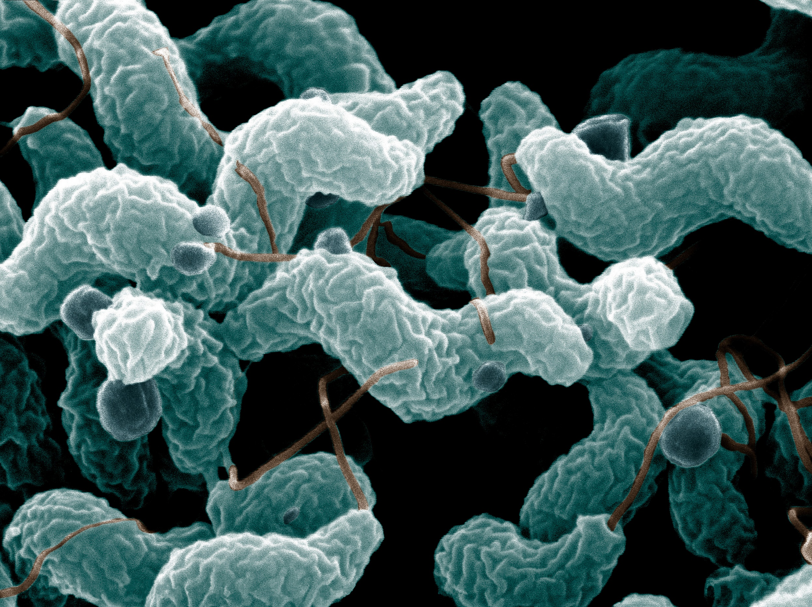
Staphylococcus aureus
Causes food poisoning through a toxin dependent mechanism
Symptoms include vomiting, nausea, stomach cramps, and diarrhea.
Infection is usually cleared within a day or two
Of the three bacteria, Campylobacter jejuni exhibits the most similar disease phenotype to Jimmy’s illness. B. cereus and S. aureus are usually cleared by the immune system within a couple days. Jimmy’s illness has lasted almost a week by the time he goes to see a doctor.
Fig 1. Campylobactor jejuni under microscope

Slide 5
Question 2: What samples are taken for laboratory testing and how important is the Microbiology Laboratory in the diagnosis of this particular infectious disease?
A stool sample is collected and sent to the laboratory for testing
Collection of a stool sample is especially important in the diagnosis of a gastroenteric illness. Collection and subsequent culturing of the stool sample can distinguish between Jimmy’s normal gut microbiota and the pathogen causing his illness.
Biochemical, genotyping, and antibody tests are the most common methods of pathogen identification
Collection, storage, and transport
Methods of collection include a stool collection kit or a rectal swab
Samples must be stored and handled so as to prevent contamination. Additionally, stool samples should be analyzed within 2 hours after collection or otherwise preserved in special media so samples are as true to life as possible
Before culture, samples must be incubated at 37 degrees Celsius for 18-24 hours to mimic body temperature

Slide 6
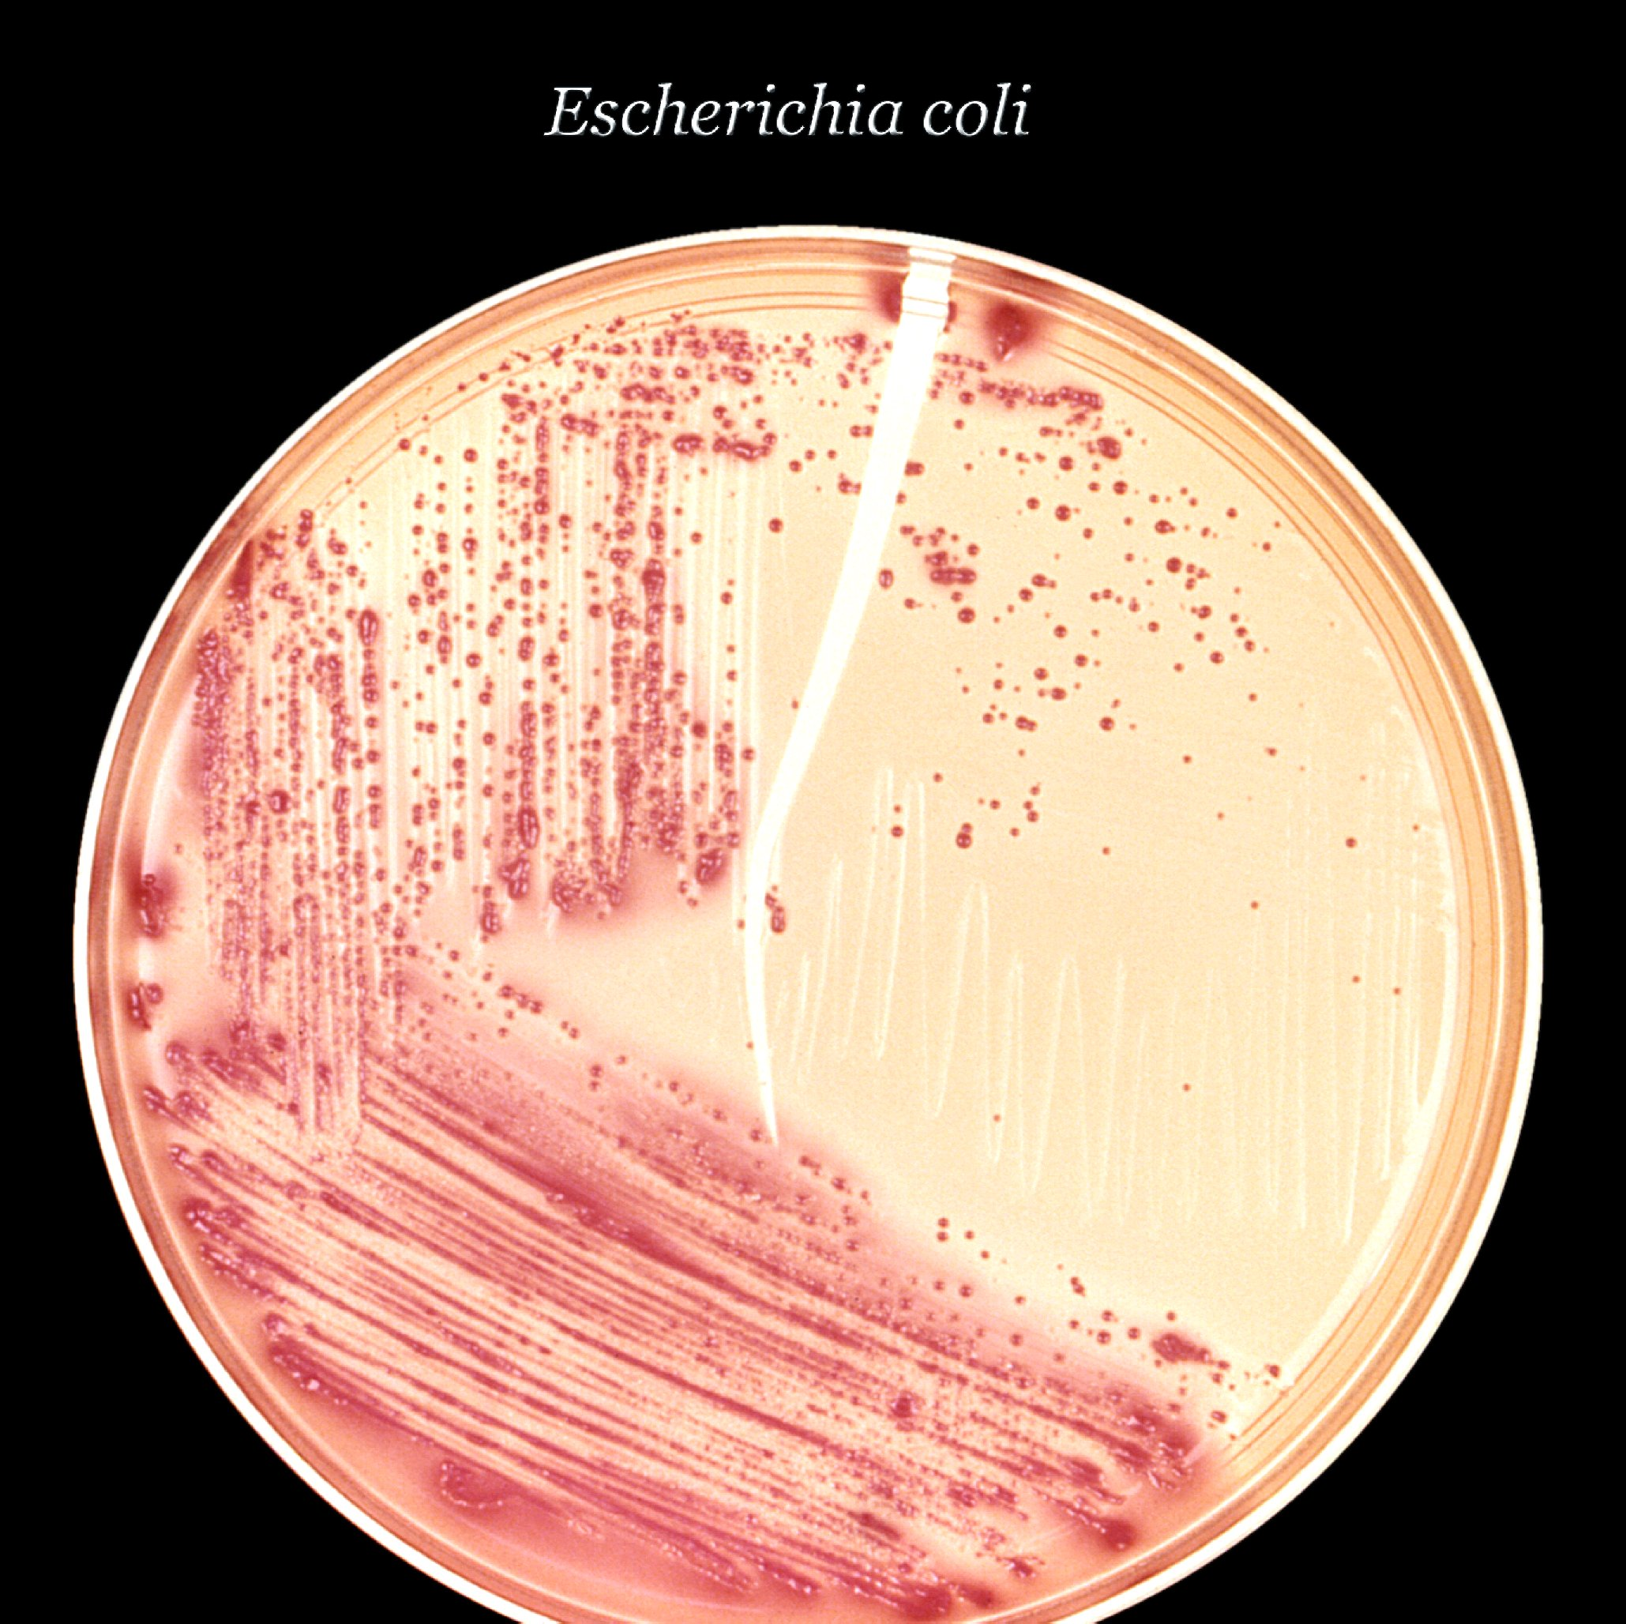
Pathogen identification & surveillance
Stool sample collection allows for diagnosis of the disease-causing pathogen
Compiling data of many stool analyses can determine how common a pathogen is within a region. Surveillance is critical in analysing prevalence of a gastroenteric disease and developing methods of reducing its incidence
Fig 2. E. coli plated out on agar.

Slide 7
Question 3: Explain the tests that will be performed on the samples in order to detect any of the potential bacterial pathogens causing this disease.
Typically, a stool and blood sample are collected and sent to the laboratory for diagnostic testing. Upon evaluation of the samples, doctors can determine what treatment is best suited. In the case of Salmonella enteriditis, possible treatments can include fluid and electrolyte replacement and antibiotics.
Tests
ELISAs can elucidate which bacteria is present. Fluorescently-labelled antibodies will bind and fluoresce in the presence of a bacterial toxin or surface protein. According to Wikipedia, ELISAs are effective in evaluating stool samples for E. coli enterotoxin, for example
PCR is another similar diagnostic method. Bands of cultured stool bacteria DNA are compared to known DNA of specific bacterial strains, confirming a match

Slide 8
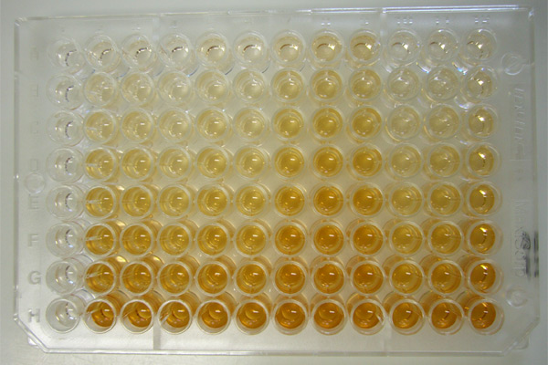
Although less specific, gram staining is effective. Gram positive and negative bacteria stain purple or red, respectively. Additionally, gram staining can elucidate bacterial morphology.
Different bacterial strains are more susceptible to particular antibiotics than others. Thus, antibiotic sensitivity testing can narrow the scope of potential pathogens. It can also determine if the strain is resistant
Plating samples on different agars can also determine what pathogen is present
Fig 3. Standard ELISA on 96-well plate.

Slide 9
Question 4: What are the results expected from these tests allowing for the identification of the bacteria named in this case?
ELISA
Binding and fluorescing of antibody to Salmonella enterotoxin confirms presence of Salmonella
PCR
Comparison of stool bacteria to a number of bacteria species. If the stool sample profile matches that of a standard bacteria, the presence of the bacteria is determined
Antibiotic sensitivity
Salmonella is gram negative. Thus, it will display the highest susceptibility to antibiotics specific for gram negative bacteria. These include cephalosporins and aminoglycosides
Gram staining
Salmonella will stain red since they are gram negative

Slide 10
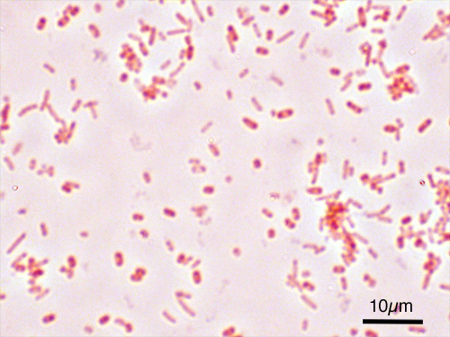
All purpose agar
Hektoen Enteric (HE): Salmonella is a non-fermenter. Thus, blue or green colonies should appear and black precipitate may also be seen due to H2S production
MAC: Colourless
SS: Colourless with black precipitate
XLD: Red colonies and black precipitate
Selective and Differential Agar:
Bismuth Sulfite: Black should appear
Brilliant Green: Red, pink or white should appear with a halo. Other serotypes of Salmonella are inhibited as well, further isolating for serovar enteriditis
Fig 4. Salmonella typhimerium stains red

