Slide 1
Creating Inclusive Interactive H5P Content
Parm Gill, Learning Designer
Notes:
This PowerPoint was presented on November 15th, 2022 for the UBC, Faculty of Education, Tech Expo event.
(See: https://ets.educ.ubc.ca/tec-expo-2022/)

Slide 2
Session Description
H5P is a technology that enables users to create interactive and engaging online content. H5P interactive content types can help facilitate multimodal strategies that enhance student experiences in online or blended courses and can make learning more inclusive for diverse learners. However, not all H5P interactive content types are accessible, and not all interactions are created with accessibility and inclusion in mind. In this session, I will introduce you to the H5P Evaluation Checklist. I designed this checklist to help guide H5P interactive content creators to consider pedagogical functionality, technical and cognitive accessibility, visual/multimedia communication principles, learner experience as well as inclusive design. This session is designed for participants who have knowledge about H5P and would like to learn how to use H5P interactive contents for inclusive course design.
Notes:
Please note for this session I’m going to deviate from the planned present for 10 mins and 20 mins discussion. I will take a bit longer to introduce the H5P Evaluation Checklist and then at the end we can try it out and evaluate a few H5P interactions. If I go to fast on the checklist don’t worry I will share the link with you.

Slide 3
As H5P becomes an increasingly popular tool for educators, accessibility and inclusion considerations become more and more relevant.
Notes:
H5P was created in 2013, shortly after HTML 5 was released and started gaining use as a more efficient, and accessible replacement for Adobe Flash and other scripting programs, like Director, for example. H5P is an abbreviation for HTML5 Package. The main purpose and the vision of the H5P creators was to empower everyone to create, share and reuse interactive HTML5 content. Ensuring interactive content is accessible and inclusive is in line with that original vision to make “interactive content flow freely” and “democratizing” it. I’ll go over the process for how the checklist came to be. And how it can be used.
H5P Conference 2017: Keynote Part 1/7: Our Vision
https://youtu.be/SdHYYn-OjA0
https://youtu.be/bDStqbYzq7k

Slide 4
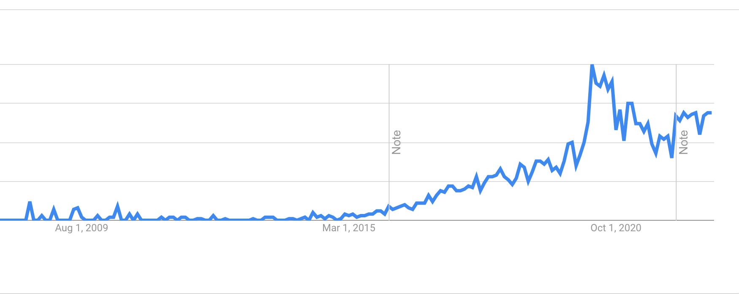
Source: https://trends.google.com/trends/explore?date=2009-01-27%202022-11-02&q=H5P
Notes:
Google Trend chart shows an increase in the H5P term searches between Jan and April 2020. As you can see there is still a sustained interest in H5P. While I don’t have data, but based on what I’ve seen it’s being used more and more here at UBC as well as other educational institutions.
It’s important to not assume the the overall interest as decreased, as the trend can be impacted as more people are aware of H5P and don’t need to search it.
The key point of this graphic is how moving online increased interest in H5P, and that its an easy to adopt tech. It’s notable that this pattern isn’t seen with other (more complex and expensive) educational technologies for creating interactive content.

Slide 5
Observations
What Works
Substitutes more expensive/complex tools for using/creating interactive content
Most content types are fairly easy to reuse or create
Increases student engagement with active learning (esp. self-paced and self-directed)
What Needs Attention
Aligning interactive content types with learning outcomes
Using H5P intentionally to facilitate learning processes.
Accessibility and Inclusion
Reusability considerations (copyright, licensing)
Notes:
As a Learning Designer, I’ve been using interactive content and H5P interactive contents for a number of years. I’ve been exposed to H5P in courses, which I’ve taken, worked on, or just have had access to during the course of my work. I’ve scoured the web to find good examples for resources I’ve compiled. In addition, I participated in research to develop an algorithm for a potential automatic assessment research tool for H5P for the global hub, as an H5P quality tester. Numerous conversations and feedback with faculty and ed tech folks have also informed these observations. A special thanks to Ian Linkletter and Hanna Solstad.
WORKS
A range of content types, ranging from simple to create to more complex types
Reseach findings indicate that H5P does works well to increase student engagement. This is a benefit for online/blended/hybrid approaches.
NOT WORKING
Like most new ed tech it should be used deliberately - ex not using interactives just for the sake of making things interactive
making sure content presented is important for learning, not just the most easy to H5P-ify content
(Examples: I’ve seen interactions used for course admin info like syllabuses or simply to condense a page in Canvas. Timeline, course presentations used for a syllabus will impact the learner experience by making students click and wait or go through a lot content before finding what they want
uses of accordion tabs not consistent with other web approaches – for example non-related information grouped together just to make the page look smaller.
Research referenced:
P. Sinnayah A. Salcedo, and S. Rekhari. (2021) Reimagining physiology education with interactive content developed in H5P.

Slide 6
Assessing H5P Interactions
For assessing the H5P interactive contents I questioned:
Is it needed for learning?
Does the design help aid learning?
Is it designed for all learners?

Slide 7
Themes Emerged
Usability and Functionality
Design
Accessibility and Inclusion
I approached this with the lens of instructional design, knowledge of graphic and web design, multimedia production, Ed Tech, LX/UX, UDL, and diversity and inclusion.
Notes:
These three main themes can be considered for both:
Selecting H5P interactive contents for reuse
Or as a guideline when creating your own H5Ps

Slide 8
Usability and Functionality
Pedagogical Functionality
Ease of Use
Sharable
Overall Quality
Notes:
Like any other educational technologies, the key function of H5P is to support the pedagogical intentions of teaching and learning. When this is considered, combined with use of ease, and good design, H5P is truly a beneficial tool for education.

Slide 9
Look at Checklist
https://docs.google.com/document/d/1xO2qP9cjCaEwXHWNIa81Rhfqm9Nfusvz/edit#
Notes:
Mention that Pedagogical Functionality is listed first, as that should be the main reason to use H5P for teaching and learning

Slide 10
Design
Visual
Multimedia
Lindgaard, G., Fernandes, G., Dudek, C., & Brown, J. (2006). Attention web designers: You have 50 milliseconds to make a good first impression. Behaviour & Information Technology, 25(2), 115-126. https://doi.org/10.1080/01449290500330448
Image source: https://www.structural-learning.com/post/cognitive-load-theory-a-teachers-guide
Notes:
The design is often overlooked as being trivial or purely aesthetics. But visual design principles and multimedia learning principles can impact both affective and cognitive domains For example: There could be a negative impacts if H5P interactives are not working well, or information is too hard to decipher or process resulting in frustrated, disengaged or unmotivated learners.
The design part of the checklist is informed by Visual Design Principles, Richard Mayer’s Principles of Multimedia Learning and Cognitive load theory.
Intrinsic – the load involved in learning – the difficulty of the materials -
Germane – manage this for learning – (use H5pP for pre-training for example, and chunking and segmenting to making sure there is not too much information presented at once…or present via multiple channels… )
Extraneous – eliminate or reduce this to free up working memory
Maybe mention:
Along with student engagement its important to consider students time for learning.
We know that visuals communicate faster than text or word.
For example, Web design usability tests show that users formed an opinion on the visual appeal of home pages after a very short exposure of only 50 milliseconds.

Slide 11
Look at Checklist
https://docs.google.com/document/d/1xO2qP9cjCaEwXHWNIa81Rhfqm9Nfusvz/edit#

Slide 12
W3C Cognitive Accessibility Guidelines
https://www.w3.org/WAI/WCAG2/supplemental/#cognitiveaccessibilityguidance
Notes:
The guidelines created by the world wide web consortium overlap in the Design and the Accessibility & Inclusion sections of the checklist.
Visit this link, and show some of the guidelines and how they are intended to help neurodivergent learners.

Slide 13
Accessibility & Inclusion
Accessible (technical and operational)
Inclusive
Notes:
Making the H5P interactives accessible (technically – the content works and can be accessed), offering multiples ways to access – things like alt tags, screen reader considerations, and cognitively, for a diversity of learners improves the learning for all students.

Slide 14
Look at Checklist
https://docs.google.com/document/d/1xO2qP9cjCaEwXHWNIa81Rhfqm9Nfusvz/edit#
Notes:
Audiences Questions
Is the purpose of the checklist for selecting H5P for reuse?
- For both - assessing quality of existing H5P interactive contents for reuse AND to use as a guideline for creating H5Ps
H5P compared to other tools like articulate
Articulate is typically used to create entire learning modules
Expensive and limited licenses
Requires more time and knowledge to create
Allows for collaboration
Software updates create issues with SCORMS
Is suitable for some types of courses – for example, I’ve seen it for workplace or ministry required courses where tracking user progress is important
H5P is more like creating learning objects to add throughout courses in an LMS
My personal preference – based on how people read online is to use interactives in a course. There is more variation in media for students. Students can read more in depth articles on paper, for example. (there is recent data that screen reading large amounts of text isn’t the most effective for learning), and then do formative assessments in the course – they can access video and audio. H5P.com, the paid version does allow for collaboration in creating H5Ps

Slide 15
Resources
BCcampus, Faculty Guide for Evaluating Open Resources
Williams, R., & O'Reilly for Higher Education. (2008). The non-designers design book: Design and typographic principles for the visual novice (3rd ed.). Peachpit Press.
DiPeri, D.,(2022). Graphic Design for Course Creators: Digitally accessible, visually appealing courses. Pressbooks
Gill, P. (2022) H5P Evaluation Checklist
Kawachi, Paul. (2014). Quality Assurance Guidelines for Open Educational Resources: TIPS Framework. Commonwealth Educational Media Centre for Asia (CEMCA).
National Center on Disability and Journalism. (August 2021). Disability Language Style Guide.
RCampus, iRubric: Evaluating OER rubric
UBC Wiki. Design Principles for Multimedia https://wiki.ubc.ca/Documentation:Design_Principles_for_Multimedia
W3C. (n.d.) Cognitive Accessibility Guidance.
W3C. (April 2021) Making Content Usable for People with Cognitive and Learning Disabilities.

