Slide 1
Body system in Paediatric Nonbullous Impetigo
Jen Yong
PATH 417A, 25 January 2017

Slide 2
Paediatric Nonbullous Impetigo
Signs and Symptoms
Normal Physiology of Skin
Skin Disturbance due to Infection
Secondary Sites of Infection

Slide 3
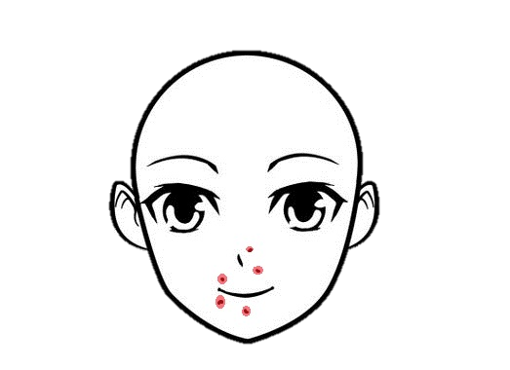
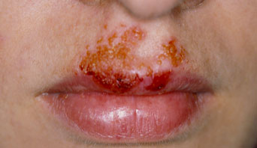
1. Signs and Symptoms
The usual clinical presentation of nonbullous impetigo in children include the following signs and symptoms.
Red sores
Perioral / Perinasal
Other facial surfaces
Ruptured lesions
Honey-coloured
Crusted
Less common symptoms
+/- Fever
+/- Mild lymphadenopathy
Break in the skin
Extremities
Erythematous base

Slide 4
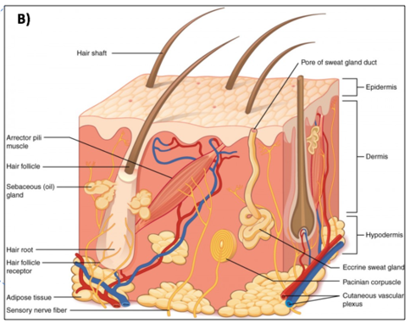
2. Normal Physiology of Skin
The skin forms the protective layer against the external environment, serving as the semipermeable barrier that excludes hydrophilic/hydrophobic substances as well as various pathogens from the internal body system.
Skin is composed of three major layers:
Epidermis
Dermis
Hypodermis

Slide 5
2. Normal Physiology of Skin
Epidermis is avascular and harbours cellular components such as melanocytes and Langerhans cells. 4 layers of the epidermis are:
Stratum corneum
Stratum granulosum
Stratum spinosum
Stratum basale
Dermis is vascular and plays a critical role in supplying the nutrients to epidermis. It harbours structures such as:
Eccrine sweat glands
Hair follicles
Pacinian corpuscle
Sebaceous glands

Slide 6
3. Skin Disturbance in Impetigo
Cascade of Immune response
Destruction of epidermis
& destruction of normal flora
Impaired maintenance of pH & breached physical/mechanical barrier
↓ protection against UV, chemicals, oxidative stress & mechanical stress

Slide 7
4. Secondary sites of infection
1’ site of infection:
Skin
Subcutaneous connective tissue
Lymphatic vessel walls
Lymph nodes
(very rarely) Kidney
Other areas of skin

