Slide 1
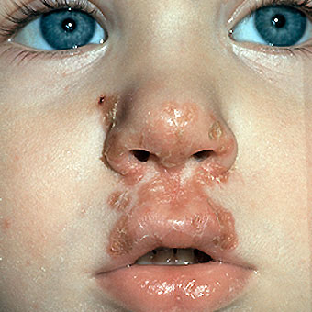
Case 1: Stephanie’s Case
I. Aversa
Notes:
Img.Medicine Net

Slide 2
The Case
6 year old Stephanie O. has developed red sores around her mouth and nose.
At the start of class her teacher noticed the rash and called her parents to take her home.
She is afebrile and does not have any swollen lymph nodes.
There is no rash on her hands or feet or inside her mouth.

Slide 3
Question 1: What are the signs and symptoms?

Slide 4
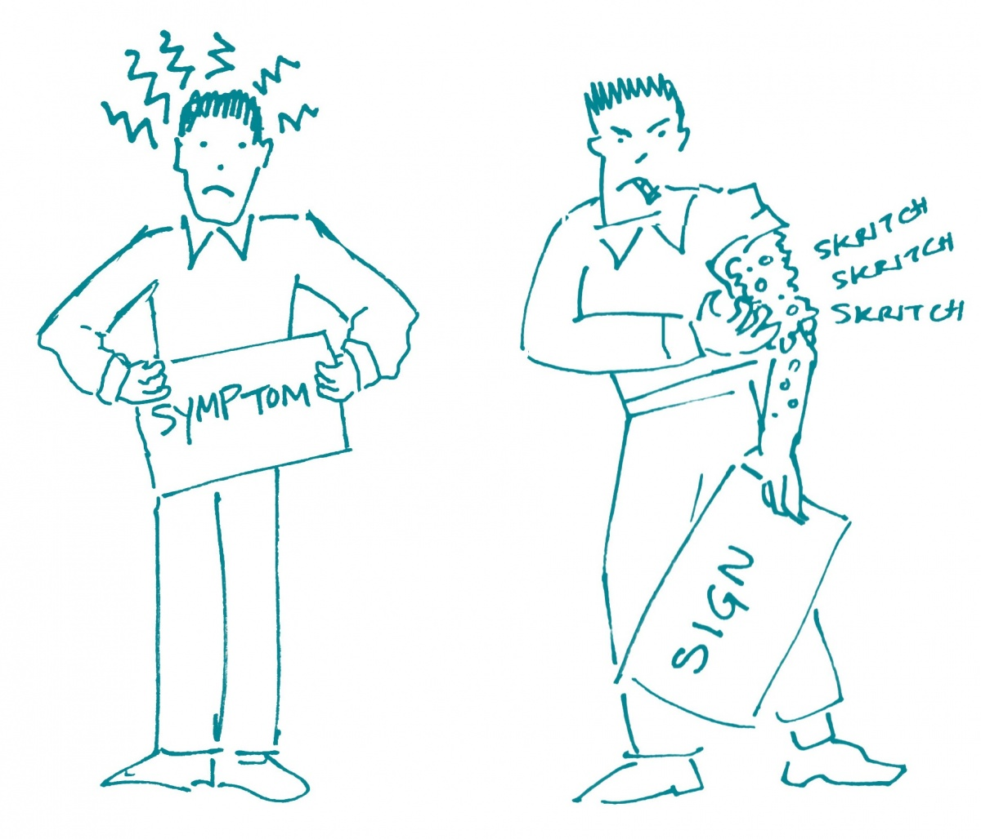
Q1: Signs versus Symptoms
Sign: any indication of a medical condition that can be objectively observed
The patient and others can see it
Symptom: any manifestation of a condition that is apparent to the patient.
- Only the patient feel is there.
Img. Communicate Health
Notes:
http://communicatehealth.com/2014/01/sign-vs-symptom-its-in-the-eye-of-the-beholder/

Slide 5
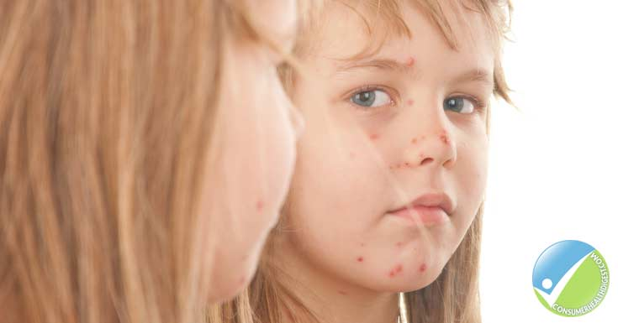
Stephanie’s Signs and Symptoms
Signs:
Lack of rash on her hands, feet or interior of the mouth.
Afebrile (no fever)
No enlarged lymph nodes
Microbiology lab tests once completed
Symptoms:
Rash around her mouth and nose
(Stephanie would have explained rash in her own
words)
Note: The rash around her mouth and nose can be considered both a sign and a symptom since the healthcare worker will have noticed as well as Stephanie.
Img. Consumer Health Digest-Impetigo
Notes:
https://www.consumerhealthdigest.com/health-conditions/impetigo.html

Slide 6
Question 2: Which body system is affected? In what specific area and what is the normal physiological function of this area of the body?

Slide 7
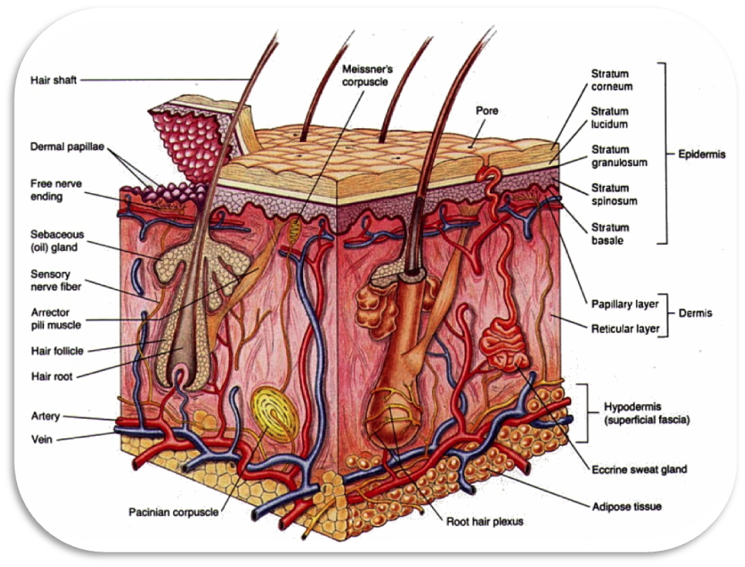
Q2: Body System
In Stephanie’s case, the Integumentary system is affected.
Made up of the skin and its appendages, including hair and nails.
Img. Dr. Od, Integumentary System
Notes:
https://www.ncbi.nlm.nih.gov/pmc/articles/PMC4008061/
http://library.med.utah.edu/kw/derm/pages/ph06_11.htm
Img http://www.drodd.com/html7/integumentary-system.html

Slide 8
Roles of Integumentary System
Provides a barrier of protection for the interior of the body, including nasal and oral cavity from the external environment.
It protects the body from loss of water, act as a barrier against foreign microbes, such as S.Aureus and S.Pyrogenes, protects deeper tissues, regulates temperature, and contains sensory receptors to detect external stimuli.
Acts as the first line of defense against pathogens, through its physical and chemical barriers.

Slide 9
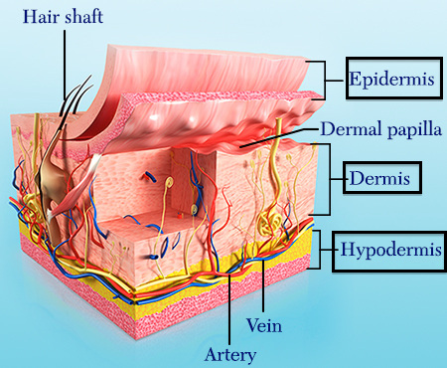
Normal Physiological Function
Stephanie’s infection targets the Integumentary system, especially the skin, which is made up of two main layers:
Epidermis
Dermis
Note: Sores and rashes like Stephanie’s, often affect the epidermis and dermis.
Img. Boundless Physiology

Slide 10
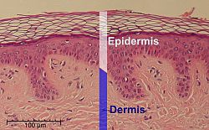
Epidermis Function
The epidermis is the outer layer of the two that make up the skin.
Provides a barrier against pathogens
Regulates amount of water released.
Avascular (no blood supply)
Acidic pH = Hostile to pathogens
Chemical barrier= presence of lipids,
enzymes and antimicrobial peptides.
Made up mostly of keratinocytes which produce a keratin layer in stratum corneum which aids in the integrity of the skin, preventing damage to it and tissues residing underneath.
Img. Kenneth

Slide 11
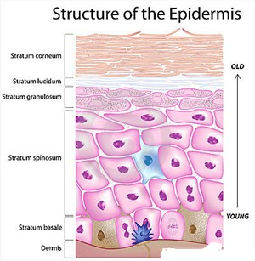
Epidermis Structure
Compromised of 5 layers:
Stratum Corneum
Stratum Lucidum
Stratum Granulosum
Stratum Spongiosum
Stratum Basale
Img. Womens health, Skin structure
Notes:
http://www.womens-health-advice.com/skin-structure-function.html

Slide 12
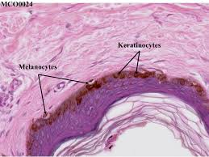
Epidermis Structure Cont.
Keratinocytes:
Epidermal cells that produce keratin
Form protective barrier against environmental
damage by UV, pathogens, water loss
Take part in vitamin D synthesis producing
precursors of vitamin D.
Proliferate and differentiate from the stratum basale towards stratum corneum (outermost).
Use TLRs (toll-like receptors) to detect pathogens via PAMPs (pathogen-associated molecular patterns)
This in turn activates interferons, cytokines and anti-inflammatory mediators (IL-10, TGF-beta) which protect the epidermis.
Img. Kenneth

Slide 13
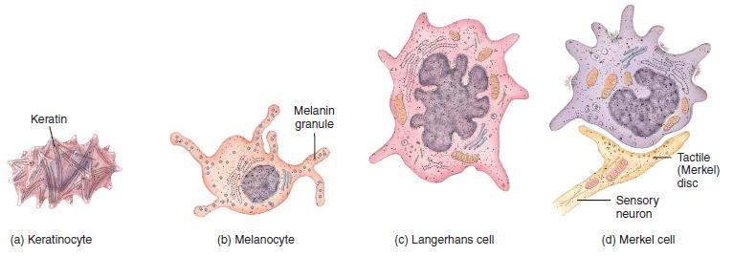
Epidermis Structure Cont.
Epidermis also contains:
Langerhan cells: dendritic cells; phagocytic cells which capture antigens, migrate to lymph nodes where they present the antigens to T cells.
Merkel cells: mechanoreceptors; essential for light touch sensation and are located in stratum basale .
Melanocytes: melanin-producing cells located in stratum basale. Melanin absorbs UV light and protects cells from UV.
Img. Todar

Slide 14
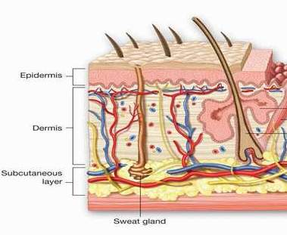
Dermis
Layer underneath the epidermis and above the subcutaneous tissues.
Connected to the epidermis through the basement membrane.
Consists of dense irregular connective tissue, collagen (strength) and elastic fibers (elasticity).
Provides the skin with flexibility
and strength and cushions it from
strains.
Highly vascular
Img.Todar

Slide 15
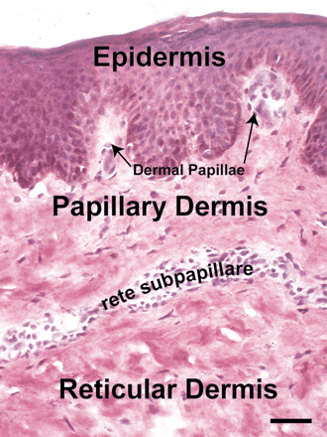
Structure of Dermis
Divided into two layers:
1. Papillary Dermis (uppermost)
Intertwines with epidermis
Composed of loose areolar connective tissue.
Contains dermal papillae which nourish hair follicles and increase oxygen exchange and nutrients with the epidermal layer.
Img. Kanebo
Notes:
http://www.kanebo.com/beautyadvice/basic/ourskin.html

Slide 16
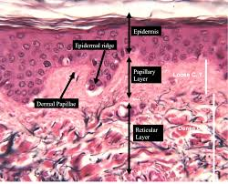
Structure of Dermis
2. Reticular Dermis (underneath)
Mechanoreceptors-provide sense of touch
Thermo-receptors- provide a sense of heat
Sebaceous glands produce fatty acids and sebaceous fluids that inhibit growth of pathogens (such as S.aureus and S.pyogenes)
Hair follicles regulate body temperature and prevent loss of water/dryness of skin.
Blood and lymphatic vessels also carry immune cells to help fight invading pathogens.
Macrophages: engulf invading bacteria, such as S.aureus or S.pyogenes
Fibroblasts: lay down the collagen and other fibers

Slide 17
Dermis Functions Summary
1. Immune Protection + Antimicrobial peptides
Immune cells such as T cells, macrophages, mast cells are present that help fend off invading pathogens.
Sebaceous glands producing peptides
2. Sensory and Thermoregulatory Function
- Mechanoreceptors and thermo-receptors located in reticular dermis
3. Exchange of Nutrients
Collagen fibers keep skin hydrated by retaining water
Highly vascular, provides oxygen and nutrient exchange with epidermis.
4. Strength and Elasticity
Fibers and connective tissue provides elasticity and strength to the skin.
5. UV protection

Slide 18
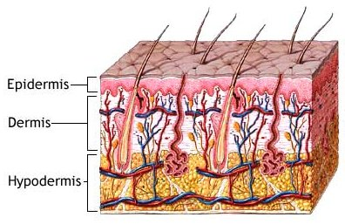
Hypodermis
Consists of loose connective tissue and elastin
Contains: Hair follicles, sweat glands, lymph and blood vessels.
Adipocytes provide insulation for the body and serve as a way to store energy
Located under the dermis
Img. MedicineNet

Slide 19
Question 3: In what way has the normal physiological functioning of this area of the body been disturbed by the infection?

Slide 20
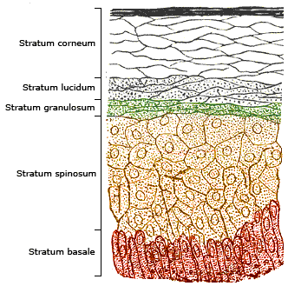
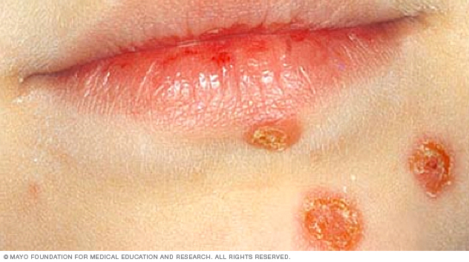
Impetigo Effects
The bacteria that cause impetigo, S.aureus or S.pyogenes, results in an infection of the epidermal layer.
Bacteria penetrate the stratum corneum and may reach all the way down to the stratum basale, infecting the epidermis.
The stratum corneum is destroyed. Generally the ooze from the dermal blood vessels dries on the skin and forms a honey-colored crust.
Img. Structure of Epidermis, Boundless Physiology
Notes:
https://www.boundless.com/physiology/textbooks/boundless-anatomy-and-physiology-textbook/integumentary-system-5/the-skin-64/structure-of-the-skin-epidermis-394-7794/
http://www.mayoclinic.org/diseases-conditions/impetigo/home/ovc-20202557

Slide 21
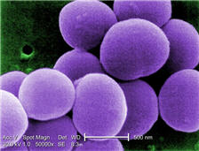
Impetigo Effects Cont.
Sores:
The sores on the face and/or body are due to the build up of neutrophils, other immune cells, and bacterial products underneath the stratum corneum, forming a pustule.
The pustule is made up of serum proteins, inflammatory cells and bacterial products.
Local Flora:
The local flora is disturbed by the breach and pathogens such as S.aureus and S.pyogenes are able to invade more readily without as much competition from the hosts microflora.
Img. S.Aureus Nature Reviews
Notes:
5;30

Slide 22
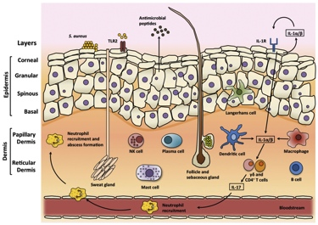
Impetigo compromises Skin Physiology
As the skin is breached by impetigo
it becomes more vulnerable to other
external factors:
More vulnerable to chemical and mechanical stresses
Impairment of absorption and protection against UV light, as the melanocytes reside in the epidermal layer.
Secretions disrupted as the sebaceous glands residing in the epidermal layer would not be able to produce anti-microbial peptides and an acidic environment as readily
Img. Darmstradt

Slide 23
Question 4: Are there any secondary sites of infection? What enables bacteria to a) travel to b) affect these areas of the body

Slide 24
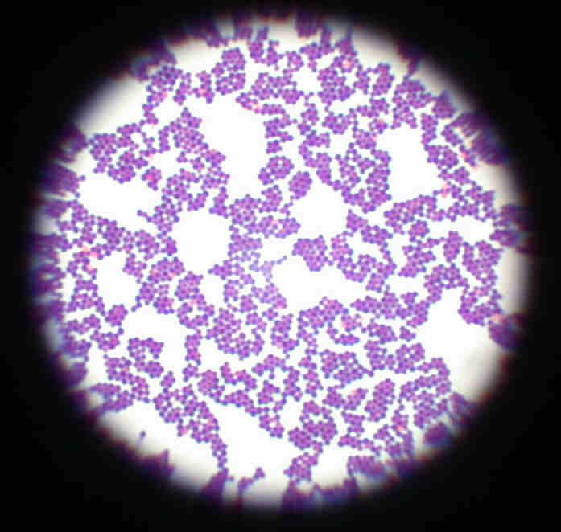
Primary and Secondary Sites of Infection
Primary Site: Location where infection first established (ie. on intact skin).
In Stephanie’s case her primary site of infection is around the nose and mouth.
Secondary Site: Infection can spread to other sites (ie. skin sites where there are other unrelated lesion, such as eczema, trauma)
Can spread via:
Direct contact
(ie. Impetigo: via virulence factors of bacteria)
ii. Blood or lymph systems
Img. S.Aureus. MedicineNet

Slide 25
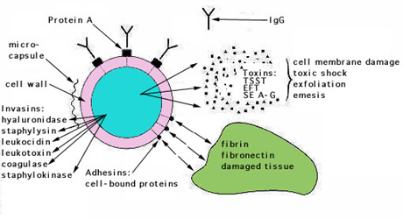
Secondary Sites of Infection
What enables bacteria to affect the secondary sites of infection:
- Lesions such as eczema or trauma (un-related to impetigo) will facilitate bacterial invasion by contact.
Virulence factors, such as M protein, exotoxins and invasins that compromise the immune system and readily promote bacterial invasion by S.aureus or S.pyogenes.
Img. Darmstradt

Slide 26
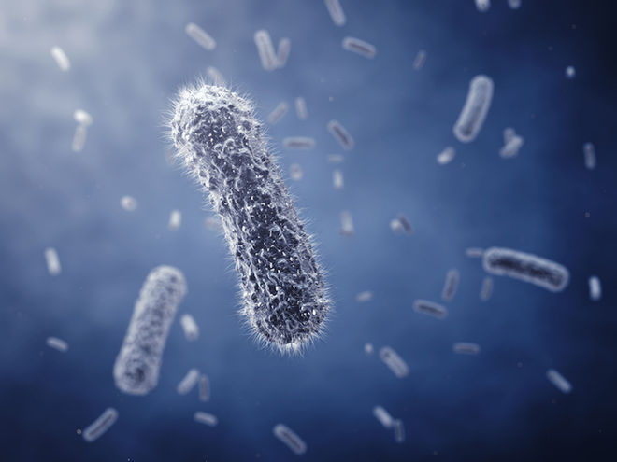
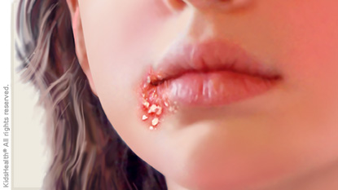
Diagnosis
In Stephanie’s case, the healthcare worker did not see any rash on “her hands or feet or inside her mouth” and “no swollen lymph nodes” or fever.
Therefore, it was a simpler diagnosis with no other confounding observations or findings.
Which pointed out the bacterial infection rather than viral infections which would cause fever, swollen lymph nodes and multiple sites of infection with sores.
Imgs. Medicine Net

Slide 27
References:
Luciana Baptista Pereira. Impetigo – review. https://www.ncbi.nlm.nih.gov/pmc/articles/PMC4008061/
Macrophage Cytokines: Involvement in Immunity and Infectious Diseases Guillermo Arango Duque1,2,* and Albert Descoteaux1,2,*
Author information ► Article notes ► Copyright and License information ►
Foster, Timothy. Immune evasion by straphylococci Review. Nature Reviews.
http://www.nature.com/nrmicro/journal/v3/n12/full/nrmicro1289.html
(immune evasion)
Healthline. “Impetigo”.
http://www.healthline.com/health/impetigo#Overview1
Intracellular Survival of Streptococcus pyogenes in Polymorphonuclear Cells Results in Increased Bacterial Virulence
Eva Medina,* Manfred Rohde, and Gursharan S. Chhatwal Author information ► Article notes ► Copyright and License information ►
Mayoclinic. Impetigo. Mersch, John. Impetigo. Medicine Net
http://www.medicinenet.com/impetigo/page6.htm
MicrobeOnline. “Extracellular and Intracellular bacteria”
https://microbeonline.com/extracellular-and-intracellular-bacteria-and-their- preferred-growth-phase-within-the-host/
MicrobiologyOnline. “Immune System.” Microbiology Society.
http://microbiologyonline.org/about-microbiology/microbes-and-the-human- body/immune-system
Role of Group A Streptococcal Virulence Factors in Adherence to Keratinocytes
Gary L. Darmstadt,1,2 Laurel Mentele,1 Andreas Podbielski,3 and Craig E. Rubens1,* Editor: E. I. Tuomanen
Todar, Kenneth. Online Textbook of Bacteriology.
http://textbookofbacteriology.net/streptococcus.html
Travers, P. Immunobiology: The Immune System in Health and Disease. 5th edition.
https://www.ncbi.nlm.nih.gov/books/NBK27090/
WebMD. Impetigo-Topic Overview.
http://www.webmd.com/skin-problems-and-treatments/tc/impetigo-overview#1

