Slide 1
Pathology 417 – Case 3: The Immune Response
By: Hassan F. Sheriff

Slide 2
The Case
Robert is a 41-year-old man who came down with a high fever, headache, abdominal pain, and muscle aches. He decide to tough it out at home, but after 2 days he also develops a red rash on his arms and legs. His wife drives him to the hospital where he is assessed by the emergency physician. The doctor asks about any insect bites and Robert tells him about getting tick bites during a camping trip one week prior to developing the first symptoms. Upon examining Robert, he notes the macular rash on his arms and legs. Initial bloodwork shows that Robert has a low platelet count, low sodium levels, and abnormal liver function tests. The doctor orders a microbiological serology test, and starts him on intravenous antibiotics. The acute serologic test for Rickettsia rickettsii shows a low level of IgM antibodies, and Robert is diagnosed with Rocky Mountain Spotted Fever. The diagnosis is subsequently confirmed when convalescent serology show a 16-fold rise in antibody titres to R. rickettsii.

Slide 3
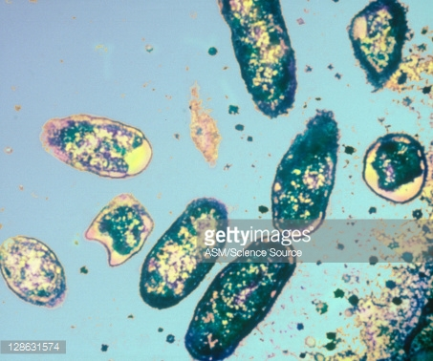
Rickettsia rickettsii
Rickettsia rickettsii is a species of gram-negative, coccobacillus bacteria. Its most common hosts are hard-bodied ticks (of the family Ixodidae).
Rickettsia rickettsii infections usually present with fever, headache, myalgia (muscle pain), and the formation of pink to reddish rashes, with thrombocytopenia (low platelet count) and hyponatremia (low blood sodium levels) appearing in severe infections.

Slide 4
Elements of the Immune response Involved in a Rickettsia rickettsii infection

Slide 5
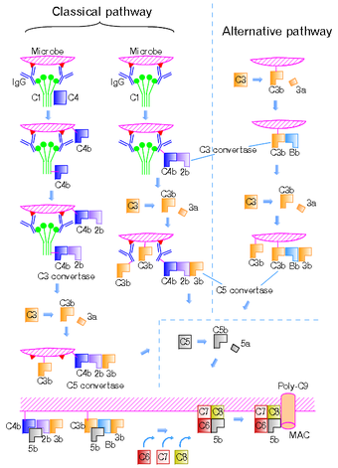
Innate Immune Response
The innate immune response to R. rickettsii begins with the initial inflammatory response. This involves the activation and recruitment of immune cells (mainly eosinophils) to the site of the tick bite via cytokines.
During the innate immune response to R. rickettsii, the complement system is also activated. Activation of the complement system results in formation of the Membrane Attack Complex, which leads to the lysing of the invading bacteria.

Slide 6
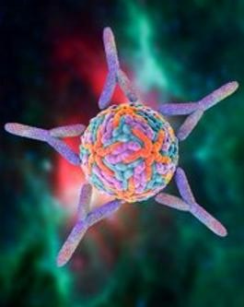
Adaptive Immune Response
The adaptive immune response to R. rickettsii consists of an antibody-mediated (humoral) response. In this type of response, T helper cells activate B cells, which then produce antibodies.
The humoral response to R. rickettsii results in the production of IgM, IgG, IgA, and IgG antibodies. These antibodies bind to various structures on the surface of R. rickettsii (e.g. OmpA and OmpB proteins).
T helper cells also activate macrophages to initiate the cytotoxic destruction of invaded host cells.

Slide 7
What damage ensues from the host immune response?

Slide 8
Damage Due to Immune Response
R. rickettsii infections trigger the release of numerous cytokines. Certain cytokines such as Tumour Necrosis Factor-α (TNF-α) and Interfuron-γ (INF-γ) trigger the recruitment and activation of various cells involved in the inflammatory response.
TNF-α and INF-γ cause certain immune cells to produce and release reactive oxygen species (ROS). ROS (e.g. superoxide anions, hydrogen peroxide, and hydroxyl radical products) not only damage bacterial cells, but can also cause damage to the hosts cells. This can result in the leakage of blood vessels, leading to hypovolemia (decreased blood volume) and edema (fluid buildup in the tissues).
TNF-α, as well as histamines produce by Mast cells also increases vascular permeability, contributing to hypovolemia and edema.

Slide 9
Damage Due to Immune Response (continued)
The inflammatory response to damage caused by R. rickettsii also triggers coagulation. Since R. rickettsii infections are systemic, thrombi (clots) form throughout the body. This can lead to obstruction of blood vessels, which in addition to hypovolemia, can cause a severe decrease in organ perfusion.
Systemic clotting also lead to a depletion of clotting factors, which may result in hemorrhaging. This condition is known as Disseminating Intravascular Coagulation (DIC).

Slide 10
Evasion of the Immune Response by Rickettsia rickettsii

Slide 11
Evasion of the Immune Response
R. rickettsii has multiple ways of evading the host immune system:
R. rickettsii is able to inhibit apoptosis by activating the Nuclear Factor NF-κB of the host cell. This allows R. rickettsii to survive within host cells, and avoid immune cells.
R. rickettsii is able to escape phagosomes after being taken up by phagocytosis. It does this by using phospholipase D and hemolysin C to disrupt the membrane of the phagosome.
R. rickettsii is able to enter non-phagocytic cells via the use of OmpB. This allows it to avoid the immune cells and molecules found in the extracellular environment.

Slide 12
Evasion of the Immune Respones (Continued)
R. rickettsii is able to use the actin system of the host to rapidly travel from one host cell to another.
R. rickettsii is a tick-borne illness, and as such, uses various factors of its vector to evade the immune response. Tick saliva contains molecules that inhibit the complement pathway, as well as decrease Natural Killer Cell activity.
R. rickettsii is able to use the Type IV Secretion System (T4SS) to promote survival. This is done by the transport of virulence factors and effector proteins as well as the synthesis of nutrients from the host.

Slide 13
The Outcome of Rickettsia rickettsii Infections

Slide 14
Outcome
If untreated, Rocky Mountain Spotted Fever has a mortality rate of 20 to 25%.
If treated promptly (within 4 to 5 day of the onset of disease), Rocky Mountain Spotted Fever has a mortality rate of only 3 to 5%. Most patients eliminate the bacteria completely and make a full recovery.
In some cases of severe illness, some long term health problems may occur such as partial paralysis of the lower extremities, movement disorders, loss of bowel or bladder control, hearing loss, and/or language disorders. R. rickettsii infections may also cause gangrene, and may require amputation of the affected areas.

Slide 15
Treatment
Rocky Mountain Spotted Fever is treated with antibiotic therapy. The antibiotic of choice usually used to treat R. rickettsii infections is Doxycycline.
Doxycycline is a broad-spectrum antibiotic derived from tetracycline. Its mode of action is the inhibition of protein synthesis, resulting in the death of the pathogen.
In some cases, tetracycline or chloramphenicol may be used as alternatives to doxycycline.

Slide 16
Immunity
Protective immunity can be developed after the primary infection of R. rickettsii to subsequent infections. The two main effectors of this immunity are:
Circulating antibodies (namely IgG2a) which recognize and bind to the Adr2 surface protein on R. rickettsii.
Memory T cell which can rapidly activate adequate and appropriate immune response to R. rickettsii.

Slide 17
Acknowledgement
Special thanks to Michaela Darjuan, Alex Hernandez, Jason Roth, and Sophia Sidi for their exceptional job on the Immune Response section of the wiki.

