Slide 1
PHysics of music
1: The Nature of Sound

Slide 2

Hearing and Making sounds
Nature full of sound, which contains valuable information for survival
Feeling vibrations and hearing sound became distinct abilities about half a billion years ago: hair cells
Hearing airborne sound became important when we crawled out of the ocean 400M years ago: eardrums and cochleae
Ability to make sounds important for signalling; sound is much easier to make than light.
Fossil sheds light on evolution of birdsong
BBC News 2016.10.12
http://www.bbc.com/news/science-environment-37618314

Slide 3
Sonic Environment
Our ears have evolved to analyze our sonic environment, which is now obviously very different from that experienced by our forebears prior to the industrial revolution.
What can we glean from analyzing a sound?
Nature of source (Human, animal, atmosphere, terrain): temporal form, frequency spectrum
Source position: frequency spectrum, loudness
Deeper meaning (friend or foe? threat or benign?): temporal form, frequency spectrum, loudness

Slide 4

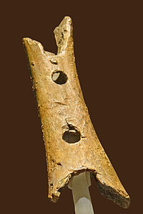
Speech and music
Our Neanderthal forebears made music at least 50,000 years ago
Stephen Mithen in “The Singing Neanderthals” speculates that separation of speech and music marked the birth of fully modern humans
Bone flute, Divje Bave, Slovenia
https://en.wikipedia.org/wiki/Divje_Babe_Flute

Slide 5

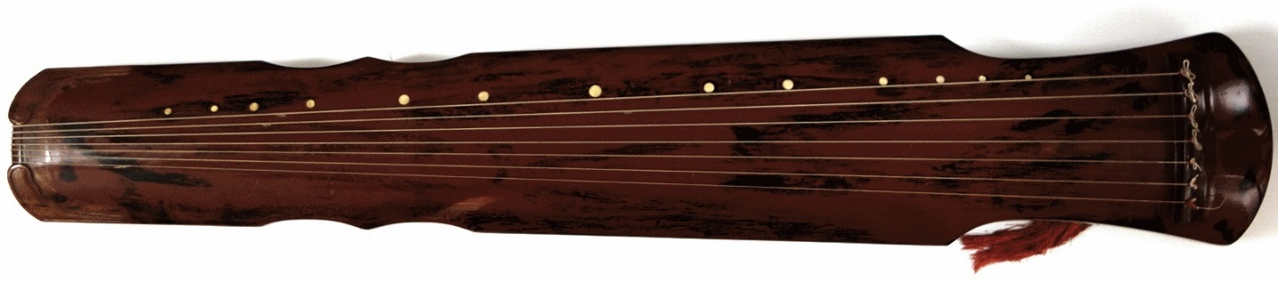
Music and mathematics
2,500 years ago, it was apparent that harmony – the pleasant sounding together of two musical notes – had something to do with mathematics.
Pythagoras (et al.) noted harmony between strings with lengths in simple integer ratios
Qin string lengths are divided into simple fractions to play harmonics. Qins (a.k.a. guqins – “gu” means “ancient”) go back a few thousand years.
Raphael: School of Athens
(Pythagoras teaching music)
https://en.wikipedia.org/wiki/Pythagoras
A qin (Chinese zither): harmonic positions are marked by white dots called hui
Waltham et al., J. Acoust. Soc. Am. 139, 1592 (2016)

Slide 6

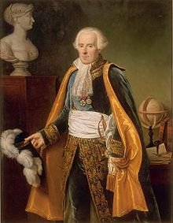
Music and physics
Physics took a lot longer to get going compared to mathematics (mid-C17).
Robert Hooke (1635-1703): pitch (subjective) relates to frequency (objective).
Pierre Simon Laplace (1749-1827): speed correctly understood (Newton got it wrong).
https://en.wikipedia.org/wiki/Robert_Hooke
https://en.wikipedia.org/wiki/Pierre-Simon_Laplace

Slide 7
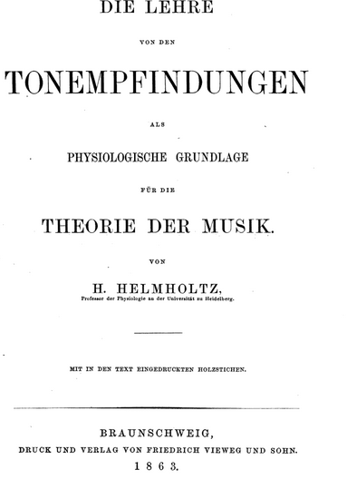
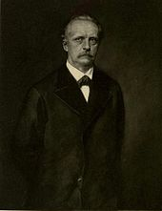
Acoustics in the nineteenth century
Hermann von Helmholtz 1821-94
Great C19 polymath
Helmholtz resonators
Psychoacoustics
Helmholtz by Franz von Lenbach
https://en.wikipedia.org/wiki/Hermann_von_Helmholtz
“On the Sensation of Tone,
or the Physiological Basis for a Theory of Music”

Slide 8
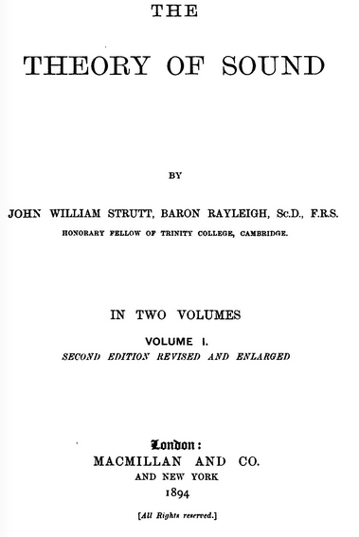
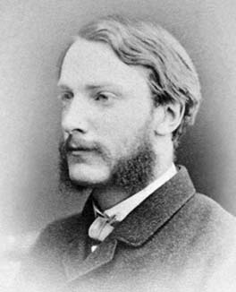
Acoustics in the nineteenth century
John William Strutt, 3rd Baron Rayleigh 1842-1919
A great Victorian polymath
“Theory of Sound” still in print and widely read
http://www-history.mcs.st-andrews.ac.uk/PictDisplay/Rayleigh.html

Slide 9
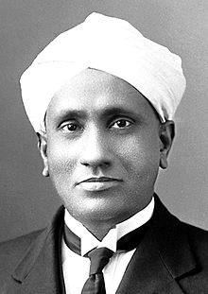
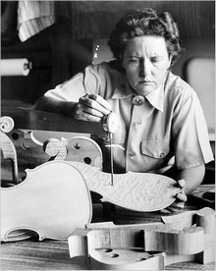
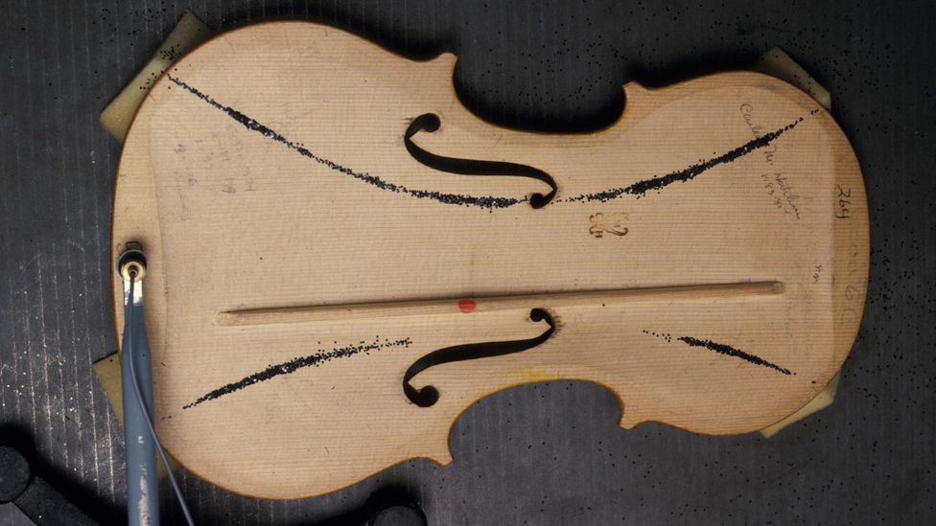
Musical Acoustics in the 20th century two pioneers
Deepanwita Dasgupta. "Scientific Practice in the Contexts of Peripheral Science: C. V. Raman and His Construction of a Mechanical Violin-Player." Perspectives on Science 24, no. 4 (2016): 381-395.
http://www.bbc.co.uk/news/
science-environment-13573631
Bernard Richarson, Cardiff University
C.V. Raman (1888-1970): mechanism of bowed strings
Carleen Hutchins (1911-2009): perfecting string instrument soundboxes
https://en.wikipedia.org/wiki/C._V._Raman
https://en.wikipedia.org/wiki/Carleen_Hutchins

Slide 10
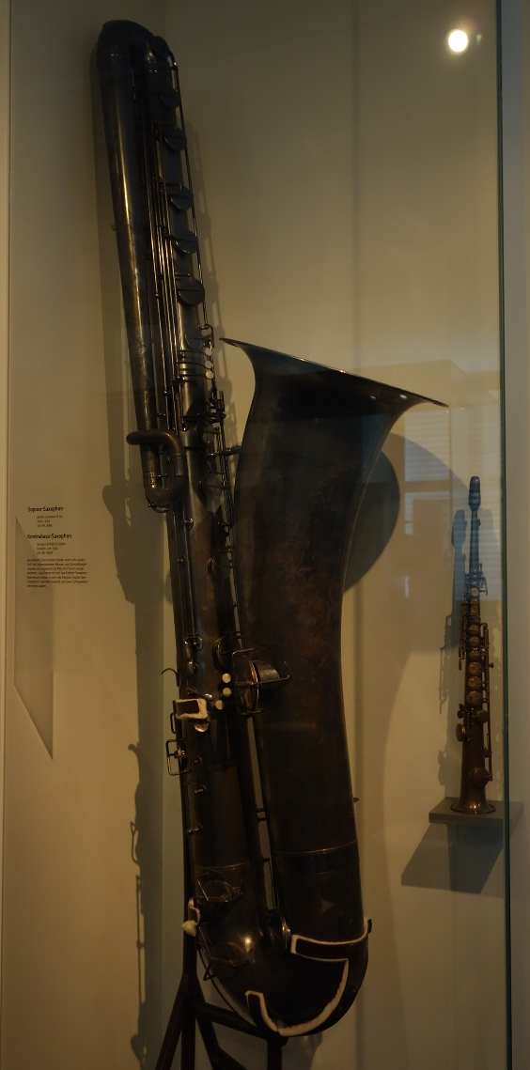
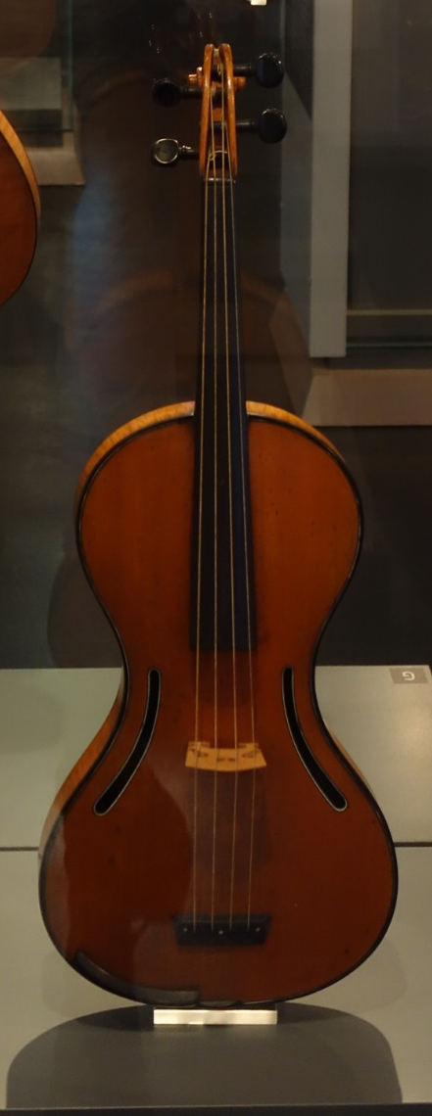
Scientific experiments in instrument making the nineteenth century
Wind instruments
  Antoine-Joseph "Adolphe" Sax (1814-1894)
Experimental lutherie
  François Chanot http://www.corilon.com/shop/en/info/chanot-paris-london.html
Some successful (e.g. saxophone family);
some not (e.g. Chanot’s guitar-violin)
Gini Museum, Leipzig, CEW photos

Slide 11
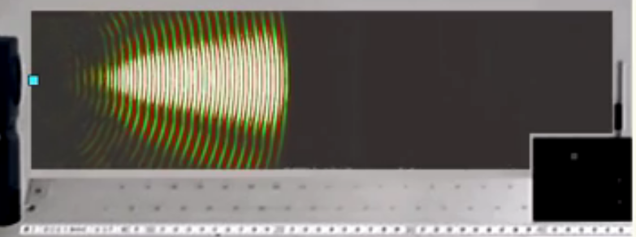
Visualizing sound
Thomas Huber’s visualization of (ultra-)sound

Slide 12
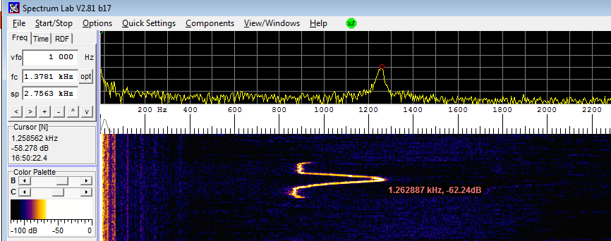
Analyzing sound
Spectrograms
Frequency (Hz)
Time
Download Spectrum Lab from http://www.qsl.net/dl4yhf/spectra1.html

Slide 13
Describing sounds
Les deux solitudes: physicists and musicians don’t talk the same language(!)
Subjective vs. objective
But: sensory experience is what music is all about, so physicists cannot ignore it
Subjective | Objective
Pitch | Frequency (Hz)
Loudness | Intensity (W/m²)
Timbre | Waveform (spectral shape)

Slide 14
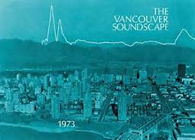
Soundscape
Consider the types of sound pre-mechanization:
Continuous “noise” (word used in the physics sense or broad frequency spectrum): wind, water.
Impulsive sounds (short duration, broad frequency spectrum): snapping twig denoting a stalking predator (or a guy with a nail gun).
Sounds with well-defined frequencies: animal calls, human voices.
https://en.wikipedia.org/wiki/Soundscape
Check out links to R. Murray Shafer and the SFU soundscape folk - Barry Truax and Hildegard Westerkamp.

Slide 16


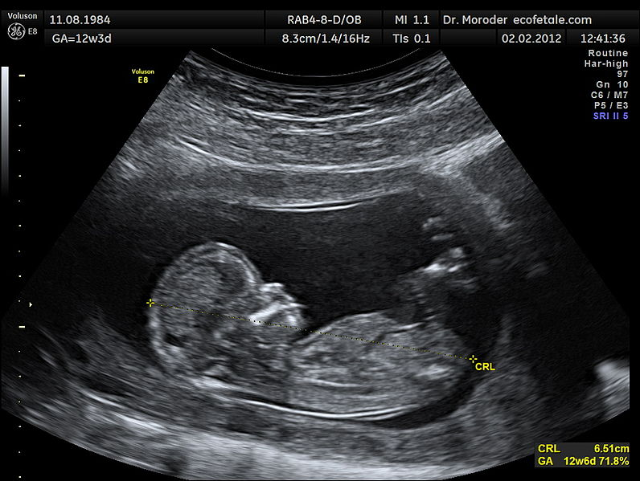
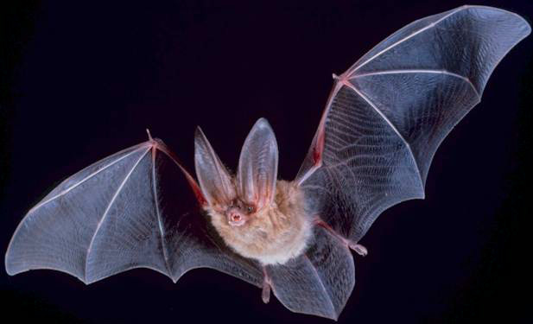
Human Inaudible sound
Sound with frequencies less than 20 Hz (wavelengths in air more than 17 m) is called infrasound
Sound with frequencies greater than 20 kHz (wavelengths in air less than 17 mm) is called ultrasound

