Slide 1
Rocky mountain spotted fever
Immune Response by paula tao

Slide 2
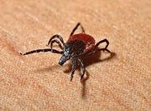
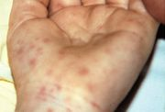
A red rash
Robert is a 41-year-old man who came down with a high fever, headache, abdominal pain and muscle aches. He decides to tough it out at home but after 2 days, he also develops a red rash on his arms and legs. His wife drives him to the hospital where he is assessed by the emergency physician. The doctor asks about any insect bites and Robert tells him about getting tick bites during a camping trip one week prior to developing the first symptoms. Upon examining Robert he notes the macular rash on the arms and legs. Initial bloodwork shows that Robert has a low platelet count, low sodium levels and abnormal liver function tests.
The doctor orders a microbiological serology test and starts him on intravenous antibiotics. The acute serologic test for Rickettsia rickettsii shows a low level of IgM antibodies and Rick is diagnosed with Rocky Mountain Spotted Fever. The diagnosis is subsequently confirmed when convalescent serology shows a 16-fold rise in antibody titers to R. rickettsia.

Slide 3
Rickettsia rickettsii
Spread to human hosts by ixodid (hard) ticks
Onset of diseases begins with:
Fever
Severe headache
Muscle pain
Followed by a development of rash
The skin is considered the pathogen carrying tick-host interface
Tick bites elicit an inflammatory immune response in the skin
Eosinophils accumulate at the tick-bite site

Slide 4
Responses to tick laceration
Tick laceration and the creation of a pool-like feeding site in the skin initiates 5 key responses:
Immediate Response
Inflammatory Response
Proliferation
Migration
Contraction

Slide 5
Host response
Innate Immune Response
Complement Activation
Ixodid tick saliva contains a complex mixture of active molecules that potentiate transmission of R. rickettsia by modulating host immune defenses
Adaptive Immune Response
Antigen specific responses of the T lymphocytes
Antigen specific responses of the B lymphocytes

Slide 6
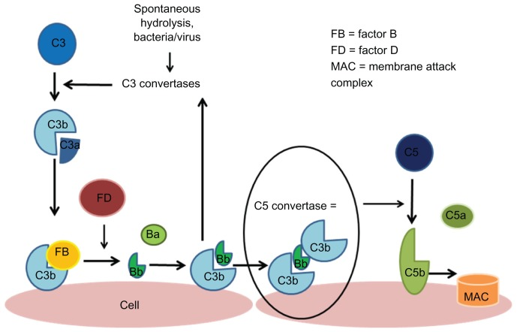
Innate immune response Complement activation
The alternative, lectin, and classical pathways of complement activation are the primary lines of defense against infectious agents
The alternative pathway is the most common target for tick modulation
C3 protein is made in the liver and present at large concentrations in the blood and tissue
C3 gets spontaneously cleaved into C3b and reacts strongly to bind to amino or hydroxyl groups on the surface of bacteria
C3bBb molecule (a convertase) cleaves other C3 molecules to make more C3b as well as cleaving C5 to make C5b

Slide 7
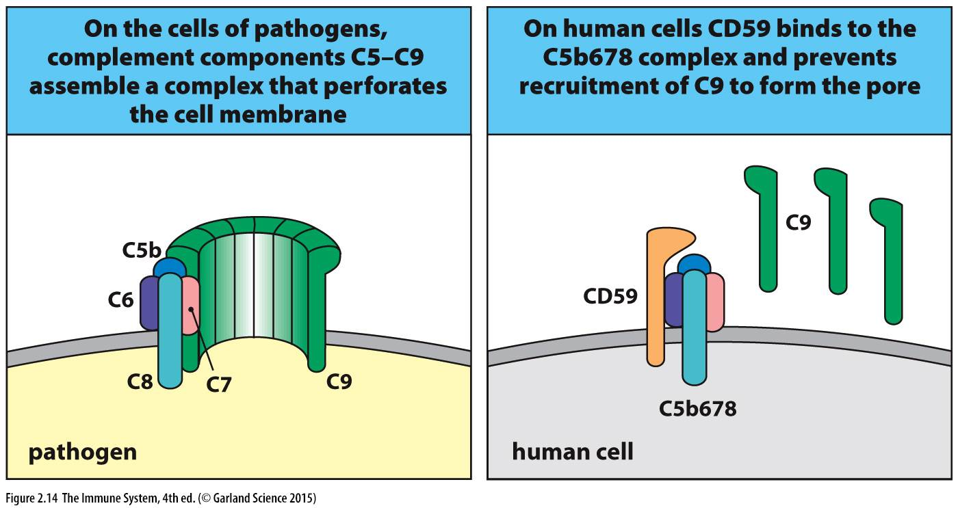
Innate immune response Membrane attack complex (Mac) formation
C5b binds to C6 to form the C5b-6 complex
This complex then binds to C7 forming the C5b-6-7 complex
The C5b-6-7 complex binds to C8 to form the C5b-6-7-8 complex
C5b-6-7-8 subsequently binds to C9 (alpha, beta and gamma chains) and acts as a catalyst in the polymerization of C9
The MAC as well as other complement proteins (C5b, C6, C7 and C8) anchor themselves to the cell wall and work together to opsonize bacteria

Slide 8
Innate immune response the inflammatory response
Begins with the passive leakage of circulating leukocytes (mostly neutrophils) from damaged blood vessels into the wound
Immune cells that are already resident within the tissue (mast cells) release chemokines and cytokines (TNF-a and IFNy)
Inflammatory chemokines and cytokines recruit neutrophils and macrophages from nearby blood vessels
Cytokines also trigger the expression of selectins, which control the rolling and then tethering of leukocytes to the vessel wall and facilitate crossing of the endothelial barrier, enhanced by the vessel dilation from histamine released by mast cells
Neutrophils play an important role in killing the invading microorganisms by using bursts of reactive oxygen species (ROS)

Slide 9
Innate immune response Innate immune cells

Slide 10
Adaptive immune response
B cells are uniquely adapted to bind specific soluble molecules through their cell-surface immunoglobulins (Ig)
B cells internalize the antigens bound by their Ig receptors and display peptide fragments on their MHC II complexes which induces CD4 T cell differentiation into T helper cells (Th)
Cell mediated immune responses involve the destruction of infected cells by cytotoxic T cells
R. rickettsii mounts an intracellular invasion and destruction of intracellular pathogens is done by macrophages, which are activated by Th1 cells
Th1 cells are involved in humoral immunity by inducing the production of opsonizing antibodies and Th2 cells are involved in activating naïve B cells to secrete IgM, IgG, IgA, and IgE
Helper T-cell memory against an antigen appears abruptly and is at its maximal level after 5 days
Then Memory B cells appear some days later and enter a phase of proliferation and selection in the lymphoid tissue

Slide 11
Adaptive immune response Adaptive immune cells

Slide 12
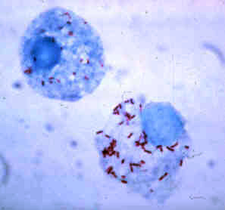
Case study relevance
R. rickettsii expresses OmpA and OmpB surface proteins
OmpA and OmpB proteins on the bacteria’s outer membrane are recognized by the OMP antibodies (IgG2a)
The antibodies have the ability to eliminate the bacteria from tissues within 24 hours after the infection
Robert’s high antibody titers from analyzed by the microbiology lab can be explained by this response
After the activation of naïve T cells in in response to an antigen (primary immune response), armed effector T cells generates immunological memory, which in the future will provide a quicker and more robust response to a pathogenic invasion

Slide 13
Host damage
Medical Microbiology suggests that symptoms are induced by the pathogen itself as the pathogenic infection is responsible for activating host immune components which cause damage to host
Host immune, inflammatory, and coagulation systems are activated and appear to benefit the patient however cytokine and inflammatory mediator account of host damage

Slide 14
Host damage Inflammatory cytokines and reactive species
TNF alpha and IFN gamma induce the production of chemically reactive oxygen species (ROS) in neutrophils that result in host damage:
Superoxide anion
Hydrogen peroxide
Hydroxyl radical products
In response to bacterial invasion, epithelial cells produce these reactive species:
Yields lipid peroxidation of the host cell membrane causing damage and death to endothelial cell
Leaking of plasma into peripheral tissues
Decrease in blood volume
Shock
Damage to the cell membrane causes an influx of water

Slide 15
Host damage Immune Response
Damage results from the accumulation of inflammatory cells along the sites of blood vessel infection
The functions of several cells and components of the immune response in reaction to the presence of the pathogen all contribute to the host damage
Neutrophil phagocytosis and entry into blood vessels
Mast cells secrete factors and mediators such as histamine which dilate blood vessels
Macrophage phagocytosis and cytokine/chemokine secretion
These prolong the inflammatory response, yielding damage to self tissues as well as sustained attraction of phagocytes to the site of infection and continuous production of destructive ROS until clearance

Slide 16
HOST Damage R. rickettsii
R. rickettsii grow in small or medium sized blood vessels throughout the human body including:
Brain
Skin
Heart
Cause “severe” damage and death to the cells which R. rickettsia multiply and replicate in
Causes hyperplasia (blood leakage into peripheral tissues via holes)
Causes blood flow obstructing thrombus to form
Thrombosis (blood clot formation) can ultimately result in deficiencies to circulation

Slide 17
Bacterial evasion
Bacterial evasion occurs in six different ways:
Evade the Host Apoptotic Defence
Phagosome Escape
Invasion of Non-Phagocytic Cells
Use of Actin Systems
Arthropod Vector Support in Evasion
Use of Type IV Secretion System (T4SS)

Slide 18
Evade the Host Apoptotic Defence
R. rickettsii is able to directly interact with NF-kB in its inactive form, causing activation and inducing the transcription of its regulated genes
This activation is actually key to R. rickettsii survival as the bacteria utilizes NF- κB as an inhibitor of the apoptotic defense activated in host cells
In a normal case, when cells become infected, apoptosis (programmed cell death) is induced by the host to limit the spread of infection, since this intracellular environment is often key to pathogen survival and infection
R. rickettsii has evolved the ability to evade this host defense using NF-kB, which allows R. rickettsii to maintain an intracellular environment essential for its replication and spread
NF- κB allows the maintenance of mitochondrial integrity inside the host cell, which during infection would usually not be maintained inducing apoptosis by the activation of caspase-9

Slide 19
Phagosome escape
R. rickettsii are able to escape the phagosome, once ingested by lysing the phagosomal membrane in order to avoid lysozymes that would usually degrade it
R. rickettsii secretes phospholipase D and hemolysin C, encoded in genes the genes tlyC and pld
Phospholipase D and hemolysin C disrupt the phagosomal membrane, allowing escape
This process allows evasion of the negative environment inside the phagosome, degradation by lysozymes, and allows access to nutrient rich cytosols

Slide 20
Invasion of Non-Phagocytic Cells
R. rickettsii are able to invade non-phagocytic host cells with the use of its surface protein, OmpB
OmpB protein was found to act as a ligand for Ku70, a subunit of a DNA-dependant protein kinase
The interaction that occurs between Ku70 and OmpB, is then sufficient enough to mediate invasion of nonphagocytic cells

Slide 21
Use of Actin Systems
R. rickettsii utilize host actin systems to gain mobility and facilitate rapid escape from host cells
In the cytosol, R. rickettsii expresses a surface protein, Sca2
Sca2 recruit an Arp2/3 complex, allowing induction of host actin polymerization
This actin tail formation helps the bacterium through the cell and across cell membranes into adjacent endothelial cells or extracellular space

Slide 22
Arthropod Vector Support in Evasion
Bacteria are able to evade the host immune system by being transferred through an arthropod vector’s saliva
Tick saliva contains molecules that help block components of the alternative complement pathway such as displacing C3b from factor Bb and cleaving C3b
C5a production by the cleavage of C5 is also used to inhibit the creation of the membrane attack complex
C5a production by the cleavage of C5 is also used to inhibit the creation of the membrane attack complex
Multiple tick species synthesize salivary gland inhibitors for the neutrophil chemoattractant IL-8 and other chemokines
Overall, we can see that many aspects of their evolved transfer vector can help the bacteria evade the host immune response

Slide 23
Use of Type IV Secretion System (T4SS)
R. rickettsii utilize the type IV secretion system, to promote survival by transport of virulence factors/effector proteins, as well as synthesize nutrients from the host cell
Type IV secretion systems (T4SSs) are macromolecular complexes that transport protein, DNA, and nucleoprotein across the bacterial cell envelope in both Gram-negative and Gram-positive species, as well as some wall-less bacteria and archaea
Highly specialized P-T4SS, Rickettsiales vir homolog (rvh) is encoded by all species of Rickettsia
However, the Rickettsia T4SS has not been functionally characterized for its role in symbiosis/virulence, and none of its substrates are known.

Slide 24
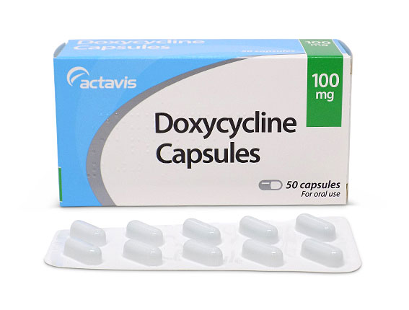
outcome
As long as prompt and appropriate antibiotic treatment is ensued, full recovery and elimination of bacteria is quite common, with only a 3-5% mortality rate
However, if the R. rickettsii infection remains untreated, there is a mortality rate of 20-25%
If the patient receives treatment within the first 4-5 days of disease, the fever can generally subside within 1-3 days
Doxycyclin is generally the antibiotic drug of choice for Rocky Mountain Spotted Fever, however in some cases Tetracyclin or Chloramphenicol are also options for use

Slide 25
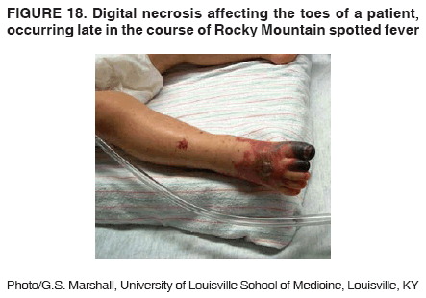
Outcome Severe cases
Severely ill patients may require longer antibiotic treatments
Some long-term health problems may surface such as:
Partial paralysis of the lower extremities
Gangrene requiring amputation of fingers, toes, or arms or legs
Hearing loss
Loss of bowel or bladder control
Movement disorders
Language disorders
These don’t often occur, however if the disease remains untreated for a long period of time it is possible

Slide 26
Outcome future
Protective immunity can be conferred after primary infection with R. rickettsia
Specifically noted, IgG2a provides protective immunity with recognition of Adr2, a surface antigen on the bacteria
This antibody supports a strong immune response, with rapid activation of T-cells and innate immune cells

