Slide 1
Invasion of V cholerae
The Immune Response

Slide 2
Case
Travelling in India
Fulfilling a long held travel dream, Robert has taken six months off work and is making his way through India taking in the sights, experiencing local festivals and making time to get to know the people. He is cautious in his hygiene, eating and drinking habits but despite this he contracts a diarrhea with voluminous outpouring of fluid accompanied by vomiting. He suspects cholera and with the help of a fellow traveler gets himself to a local hospital where a stool sample is examined and his presumptive diagnosis is confirmed. He stocks up on appropriate fluids and stays put at the hostel he has booked into for a few days, experiencing some minor leg cramping along with the diarrhea. His curiosity about his illness has him reading up on the organisms when he returns to North America and he is left wondering what serotype of Vibrio cholerae he might have contracted, should he have been prescribed antibiotics, was there anything more he could have done to prevent contracting the organism and might he now be a carrier?

Slide 3
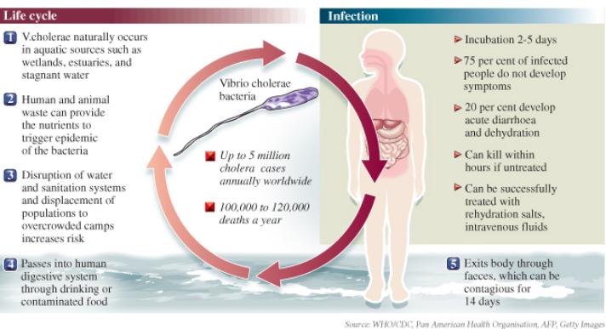

Slide 4
Innate Response Mechanisms In place against V cholerae

Slide 5
What is the role of the Innate Host Response?
Recruitment
Other immune cells are recruited to the site of infection
Activation
Complement cascade is activated
Removal
Rids foreign substances

Slide 6
Mucus
Mucus contains high concentrations of defensive chemicals
TNF-alpha
Neutrophils
Mast cells
Eosinophils
Mucus also contains bactericidal proteins that lyse susceptible pathogens
Lactoferrin
Myeloperoxidase
Defensins

Slide 7
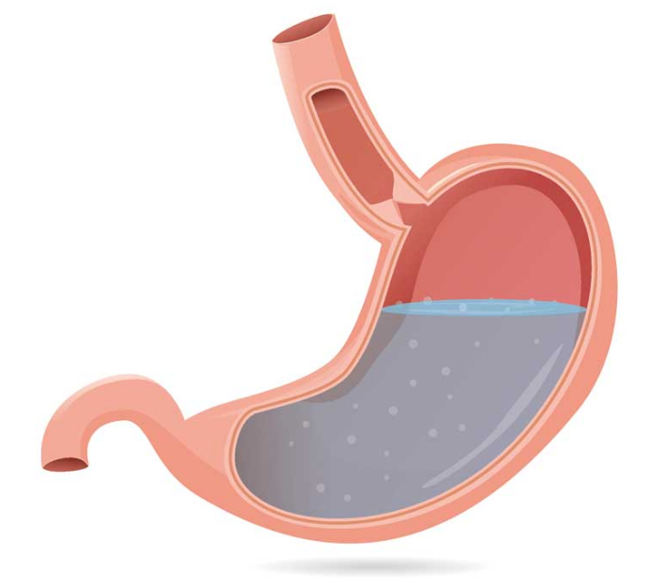
Gastric Acid
After V. cholerae is ingested, it faces gastric acid within the stomach
Low pH is an effective defence mechanism against pH sensitive V cholerae
Surviving V cholerae continue to travel down the GI tract and reside in the small intestines

Slide 8
Adaptive Immune Response

Slide 9
Features of the Adaptive Immune Response
SPECIFIC:
Immunological memory to a specific antigen from offending pathogens
SLOW(er):
Takes a longer period of time than innate response
Days - weeks
COMPLEX:
Consists of humoral & cell mediated immunity

Slide 10
Features of the Adaptive Immune Response
Humoral Immunity:
Antibody production by B-lymphocytes
Dominates adaptive response against V cholerae
Cell-mediated Immunity:
Cytotoxic T-lymphocytes, activated macrophages, cytokines directly attack pathogens
Plays a lesser role against V cholerae

Slide 11
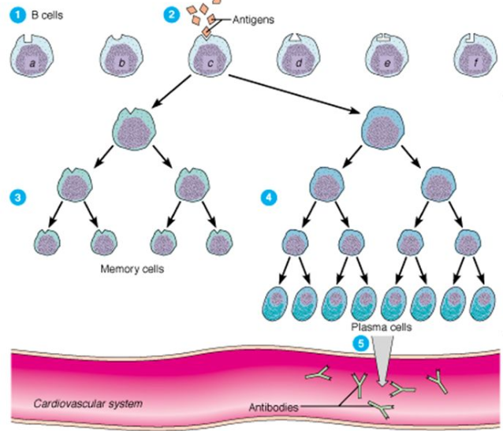
Humoral Immunity against V cholerae
A component of the V cholerae is recognized by APC (antigen presenting cells)
Usually flagellar protein, enterotoxin or outer membrane protein
APCs present antigen to lymphocytes to initiate response
Begin in Peyer’s patch in intestinal mucosa
Then migrated to lymph nodes
B-lymphocytes differentiate into antibody-secreting cells

Slide 12
Antibodies against V cholerae
IgM is first produced after exposure to antigen
Isotype switching of IgM leads to IgG and IgA
IgA:
Prevents attachment of V cholerae onto mucosal surface
Neutralized enterotoxins
Memory B cells:
Vital in long term immunity
Circulates in body after natural infections
Upon re-exposure to antigens(and pathogens), B-cells rapidly activate the adaptive immune response

Slide 13
Host damage: what damage ensues to the host from the immune response?

Slide 14
Damage to the host
Pathogenic factors inducing damage
Cholera Toxin
Nephropathy

Slide 15
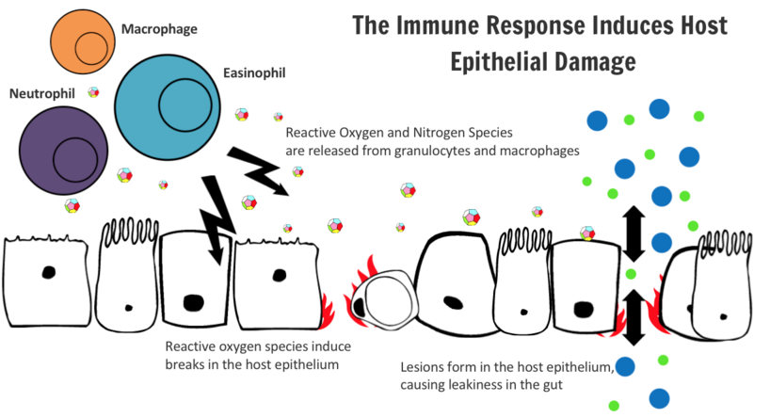
Pathogenic Factors Inducing Damage
Exaggerated Inflammation
At the site of infection, neutrophils and macrophages release cytotoxic granules in response to invading pathogens
Reactive nitrogen and oxygen molecules
These granules are non-specific to the invaders and induces damage on host tissue as well

Slide 16
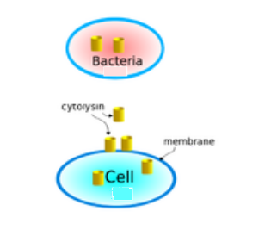
Pathogenic Factors Inducing Damage
Toxins
V cholerae releases accessory toxins (not cholera toxin) that triggers the inflammatory process
Cytolysin:Promotes inflammation and increases permeability of epithelial layers to cytokines and proinflammatory molecules
These toxins lead to further inflammatory damage to the host
Cytolysin: induces pore formation within intestinal epithelial cells → cell lysis & intestinal malfunction

Slide 17
Pathogenic Factors Inducing Damage
Up-regulation of TNF-a and interleukin-1
Lipopolysaccharide (LPS) of gram-negative bacteria interact with cells that have TLR-4 receptors on their surface
MyD88 and TRIF pathways are activated
NFkB transcription factors are activated
Transcription of proinflammatory cytokines are activated
Neutrophils and macrophages are recruited to the site, as described previously
Septic shocks
Both TNF-a and IL-1 are important mediators in the inflammatory response of septic shock
Underlying mechanism unclear
Patients in septic shock have been managed with anti-TNF-a-antibodies in immunotherapy
IL-1-antagonists have been utilized to provide protection against toxin-lethality

Slide 18
Cholera Toxin's Role in Host Damage
Cholera toxin is the primary virulence factor of V cholerae
Consists of two main subtypes:
B-subunit:
Binds with high affinity to GM1 ganglioside receptors on intestinal cell membranes
Binding allows entry of A-subunit
A-subunit:
Enters cells and disrupts intracellular adenylate cyclase pathways

Slide 19
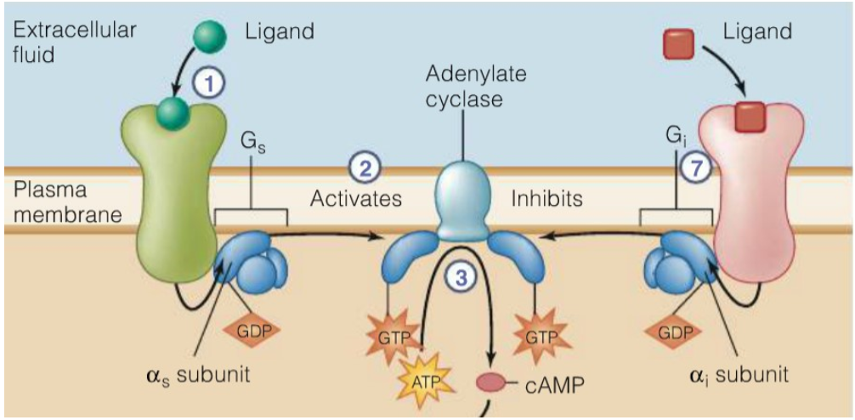
Cholera Toxin's Role in Host Damage
Adenylate Cyclase Pathway:
Normally, stimulated by Gs regulatory protein & GTP
Converts ATP → cAMP
Rapidly inactivated by inhibitory protein Gi through hydrolysis of GTP

Slide 20
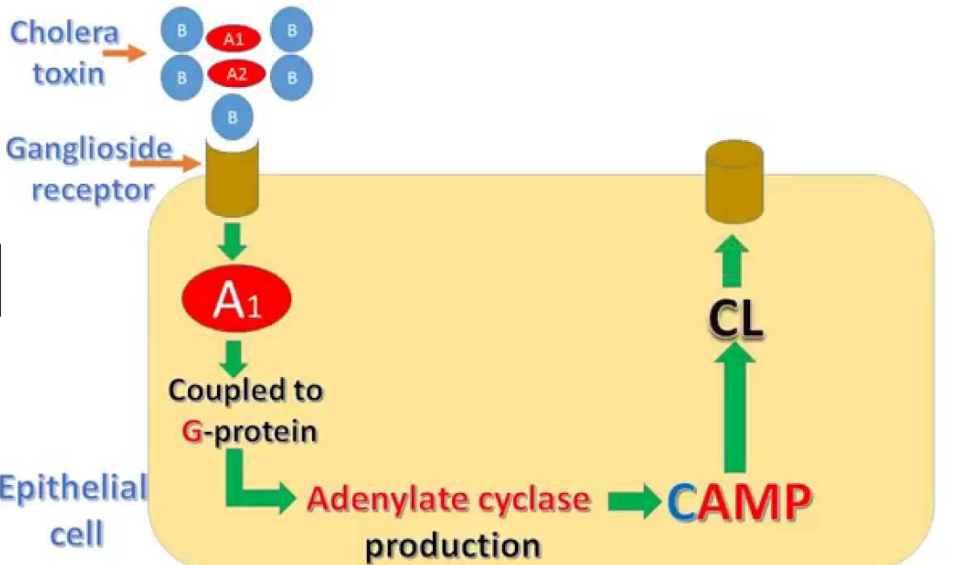
Cholera Toxin's Role in Host Damage
Adenylate Cyclase pathway disruption:
After entering the cell, the a-subunit of cholera toxin dissociates into fragments (A1 & A2)
A1 fragment allows the transfer of an ADP-ribose complex to Gs protein
Consequently, Gs protein activates adenylate cyclase enzyme constitutively
As a result, there is an excessive production of cAMP
Excessive cAMP:
Drives significant efflux of chloride ions from intestinal mucosal cells into the lumen of the small intestines
The unbalanced osmotic and electrical gradient drives water molecules, sodium ions and other electrolytes secretion
Consequently, diarrhea and severe dehydration occurs

Slide 21
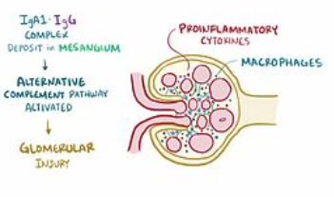
Nephropathy due to V cholerae
Buildup of IgA
At times of abnormal infections, such as a V cholerae infection, IgA builds up as a result of immune response against the pathogen
IgA accumulates in glomerular mesangium and glomerular lesions
May lead to kidney failure after infection

Slide 22
Bacterial evasion: how does the bacteria attempt to evade these host response elements?

Slide 23
Accessory Toxins
V cholerae secretes a number of toxins beside cholera enterotoxin (CT), the main culprit of the characteristic diarrhea and dehydration seen
Other accessory toxins include:
Hemolysin
Hemagglutinin(HA)/protease
Multifunctional autoprocessing repeats-in-toxin (MARTX)
Cytolysin

Slide 24
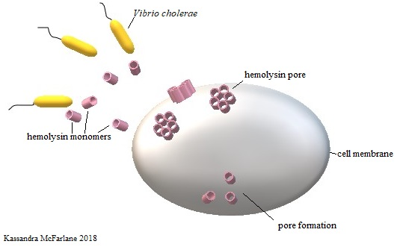
Accessory Toxins
Hemolysin:
Encoded by gene hylA
A cytotoxin that creates oligomeric pores in cell membranes
Pores selectively allow certain ions to cross, e.g. calcium ions
Subsequently , this leads to cell lysis
Disrupts integrity of epithelial lining of small intestines
Increases vulnerability to infection

Slide 25
Accessory Toxins
Hemagglutinin(HA)/protease
Zinc metalloprotease
HapR is an enzyme that mediates the transcription of HA/protease from its gene
Degrades host proteins such as:
Mucin
Lactoferrin
Fibronectin
Mediates the detachment of the bacteria from intestinal lining
Allows dispersal to a new infection site within the gastrointestinal tract or released into the environment

Slide 26
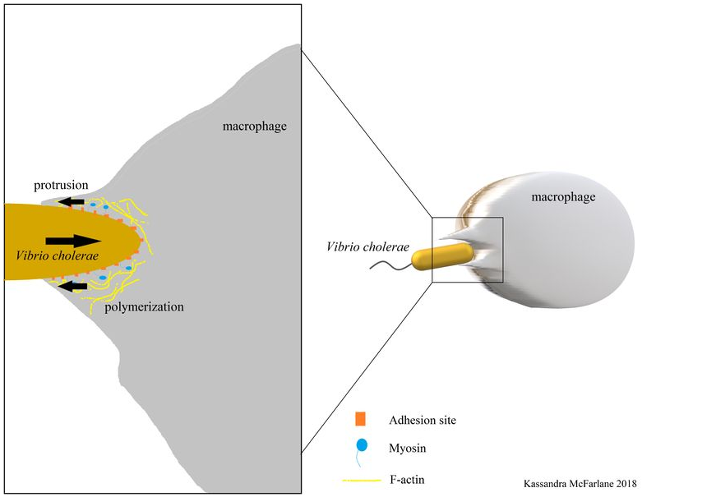
Accessory Toxins
Multifunctional autoprocessing repeats-in-toxin (MARTX)
Targets macrophages and disables phagocytosis via depolymerizing and disrupting the intracellular actin cytoskeleton
Crosslinks G-actin filaments and effectively removes them from actin pool
Disrupts equilibrium between G-actin and F-actin
F-actin disassembles and cytoskeleton integrity is compromised

Slide 27
Accessory Toxins
Cytolysin
Released in its inactivated form
Proteolytic cleavage from host-cell bound proteases activate cytolysin into pore-forming toxins
Positive feedback:
As cytolysin lyses more host cells (such as neutrophils), more proteolytic compounds are released and more cytolysins are activated

Slide 28
Secondary enterotoxin (to evade innate immune responses)
Zona Occludens Toxin (ZOT)
Damages tight junctions within the small intestine via modulating intracellular signaling pathways
These pathways control tight junction regulation via the signaling molecule protein kinase C alpha (PKCa)
Selectivity:
Tissue-specific and only induces effects on cells of the small intestine, but not in the large intestine
Disrupts dynamic equilibrium between G-actin and F-actin, which disrupts cellular cytoskeleton and overall tight junction integrity

Slide 29
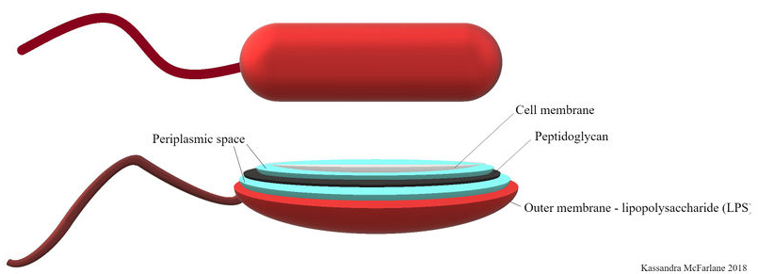
LPS (to evade innate and adaptive immune responses)
Lipopolysaccharide (LPS):
Major component of gram-negative bacteria outer membrane
Allows avoidance of phagocytosis and antibody/complement binding on membrane surface
Alters the distribution of cytoskeletal elements, including microfilaments and microtubules
Reduces phagocytic efficiency by host cells

Slide 30
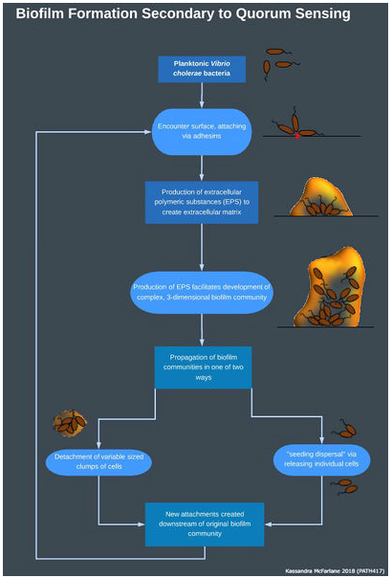
Quorum sensing and film production (to evade innate and adaptive immune responses)
Used by pathogenic bacteria
Regulate virulence gene expression in relation to total bacterial cell density
Often results in the formation of a biofilm
Microbial community bound embedded into a surface
Bound to an extracellular polymeric matrix created by all components of the environment
Community formation is induced when bacterial density is low
Adhesins are released to attach to a suitable surface
Release extracellular polymeric substances (EPS) to create extracellular matrix
At high densities, biofilm is no longer maintained and individual bacteria is released

Slide 31
Production of an extracellular matrix (ECM) in response to anti-LPS antibodies (Abs) (to evade innate and adaptive immune responses)
In the presence of anti-LPS antibodies, motility and cell-cell cross linking is disrupted, leading to aggregation of cells
V cholerae produces ECM in response
Provides protection against complement-mediated attacks
Theorized to be a self-defence mechanism to survive within the gastrointestinal tract

Slide 32
MHSA (to evade the adaptive response)
IgA is able to bind to Type IV Mannose Sensitive Hemagglutinin (MHSA)
Subsequently this prevents the penetration of V cholerae into the mucus membrane
V cholerae is able to downregulate MHSA via ToxT, a transcription factor that mediates the level of pilus expression
Repression and expression of MHSA at appropriate times ensures maximum host colonization and minimizes risk of elimination by host defense

Slide 33
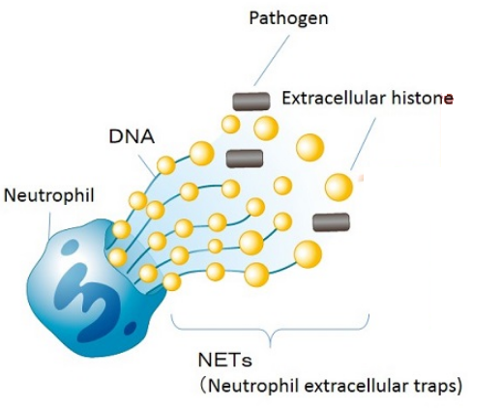
Nucleases to escape NETs (to evade innate response)
Dns and Xds:
Nucleases released in response to neutrophil extracellular traps or NETs
They breakdown DNA within NETs
Prevents neutrophils from eliminating bacterial cells

Slide 34
Is the bacteria completely removed from the host?

Slide 35
How is V cholerae eliminated from the body?
Antibiotics:
Indicated for severe cases of cholera
Doxycycline, ciprofloxacin, and azithromycin
Dead vibrios are excreted with stools and passed out of the human body
Gut motility:
Important role in removing bacterial cells in rhythmic and peristaltic movements of the gut

Slide 36
Does the patient fully recover?
Bottom Line:
… Yes!
Once the infection is managed and treated (with or without antibiotics), all remnants of the bacterial cells are usually eliminated
In very rare cases, some patients become a carrier of the bacteria for decades post-infection

Slide 37
Secondary Infections of V cholerae
Primary infection of V cholerae generates protective immunity against future infections
Host immune cells that were primed during the first infection can rapidly engage immune response
Antigen recognition is much more rapid due to prior exposure
Memory B-cells produce antibodies against pathogenic antigens more efficiently
Generally, 3 years of protection can be assumed for those who have recovered from their first infection
However, memory response to one serotype of V cholerae (Ogawa and Inaba) may be ineffective against the other

Slide 38
Is complete immunity from V cholerae infections possible?
No!
New serotypes of V cholerae may arise in the future, which will not be recognised by the host’s immune system
Although mutation rates of V cholerae is fairly low (less than 10-3/genome/generation), it is still entirely possible
Bottom line:
If new serotypes appear, previous infections from a different serotype will not provide life-long immunity

