Slide 1
History of the Creative Commons
By Rie Namba
This work is licensed under the Creative Commons Attribution 4.0 International License.
Notes:
Today, I would like to tell you about a brief story of the creative commons.

Slide 2
In the era of the Internet..
We have the ability to easily
share, access and collaborate
Notes:
In the era of the Internet, We have the ability to easily share, access and collaborate our works.

Slide 3
However, we have a strict copyright law that restricts that..
Notes:
However, we have a strict copyright rule that restricts us from sharing, accessing and collaborating our works……. which is copyright. Now, let’s take a look at the quick history of why this happened, and how the Creative Commons took a role in this big history.

Slide 4
1998...
Sonny Bono Copyright Term Extension Act (CTEA)
Notes:
In 1998 - Copyright legislation called the Sonny Bono Copyright Term Extension Act was enacted in the United States.

Slide 5
After CTEA
Before CTEA
Copyright term: Life of the creator
+ 50 years
Copyright term: Life of the creator
+ 70 years
Notes:
What the Sonny Bono Copyright Term Extension Act - CTEA did was It extended the term of copyright for every work (even for those it published)in the United States for 20 years!! Now, that is a lot because before the CTEA, copyright term used to be life of the creator + 50 years. However after CTEA, the copyright term is life of the creator +70 years.
This CTEA was also referred to it as Mickey Mouse Protection Act because the extension came just before the original Mickey Mouse cartoon, Steamboat Willie, would have fallen into the public domain..After the CTEA law, the Steamboat Willie expires in 2023

Slide 6
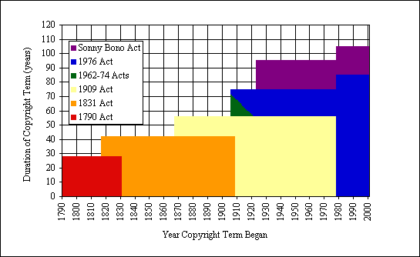
Notes:
Now this is not good- the copyright term kept increasing and increasing. This is a chart created by Thomas Bell, who is a professor of Law from Chapman University. He showed an evidence with a chart that shows how the copyright term in the United States kept increasing and increasing over year. (This chart assumes authors create their works 35 years before their death)

Slide 7
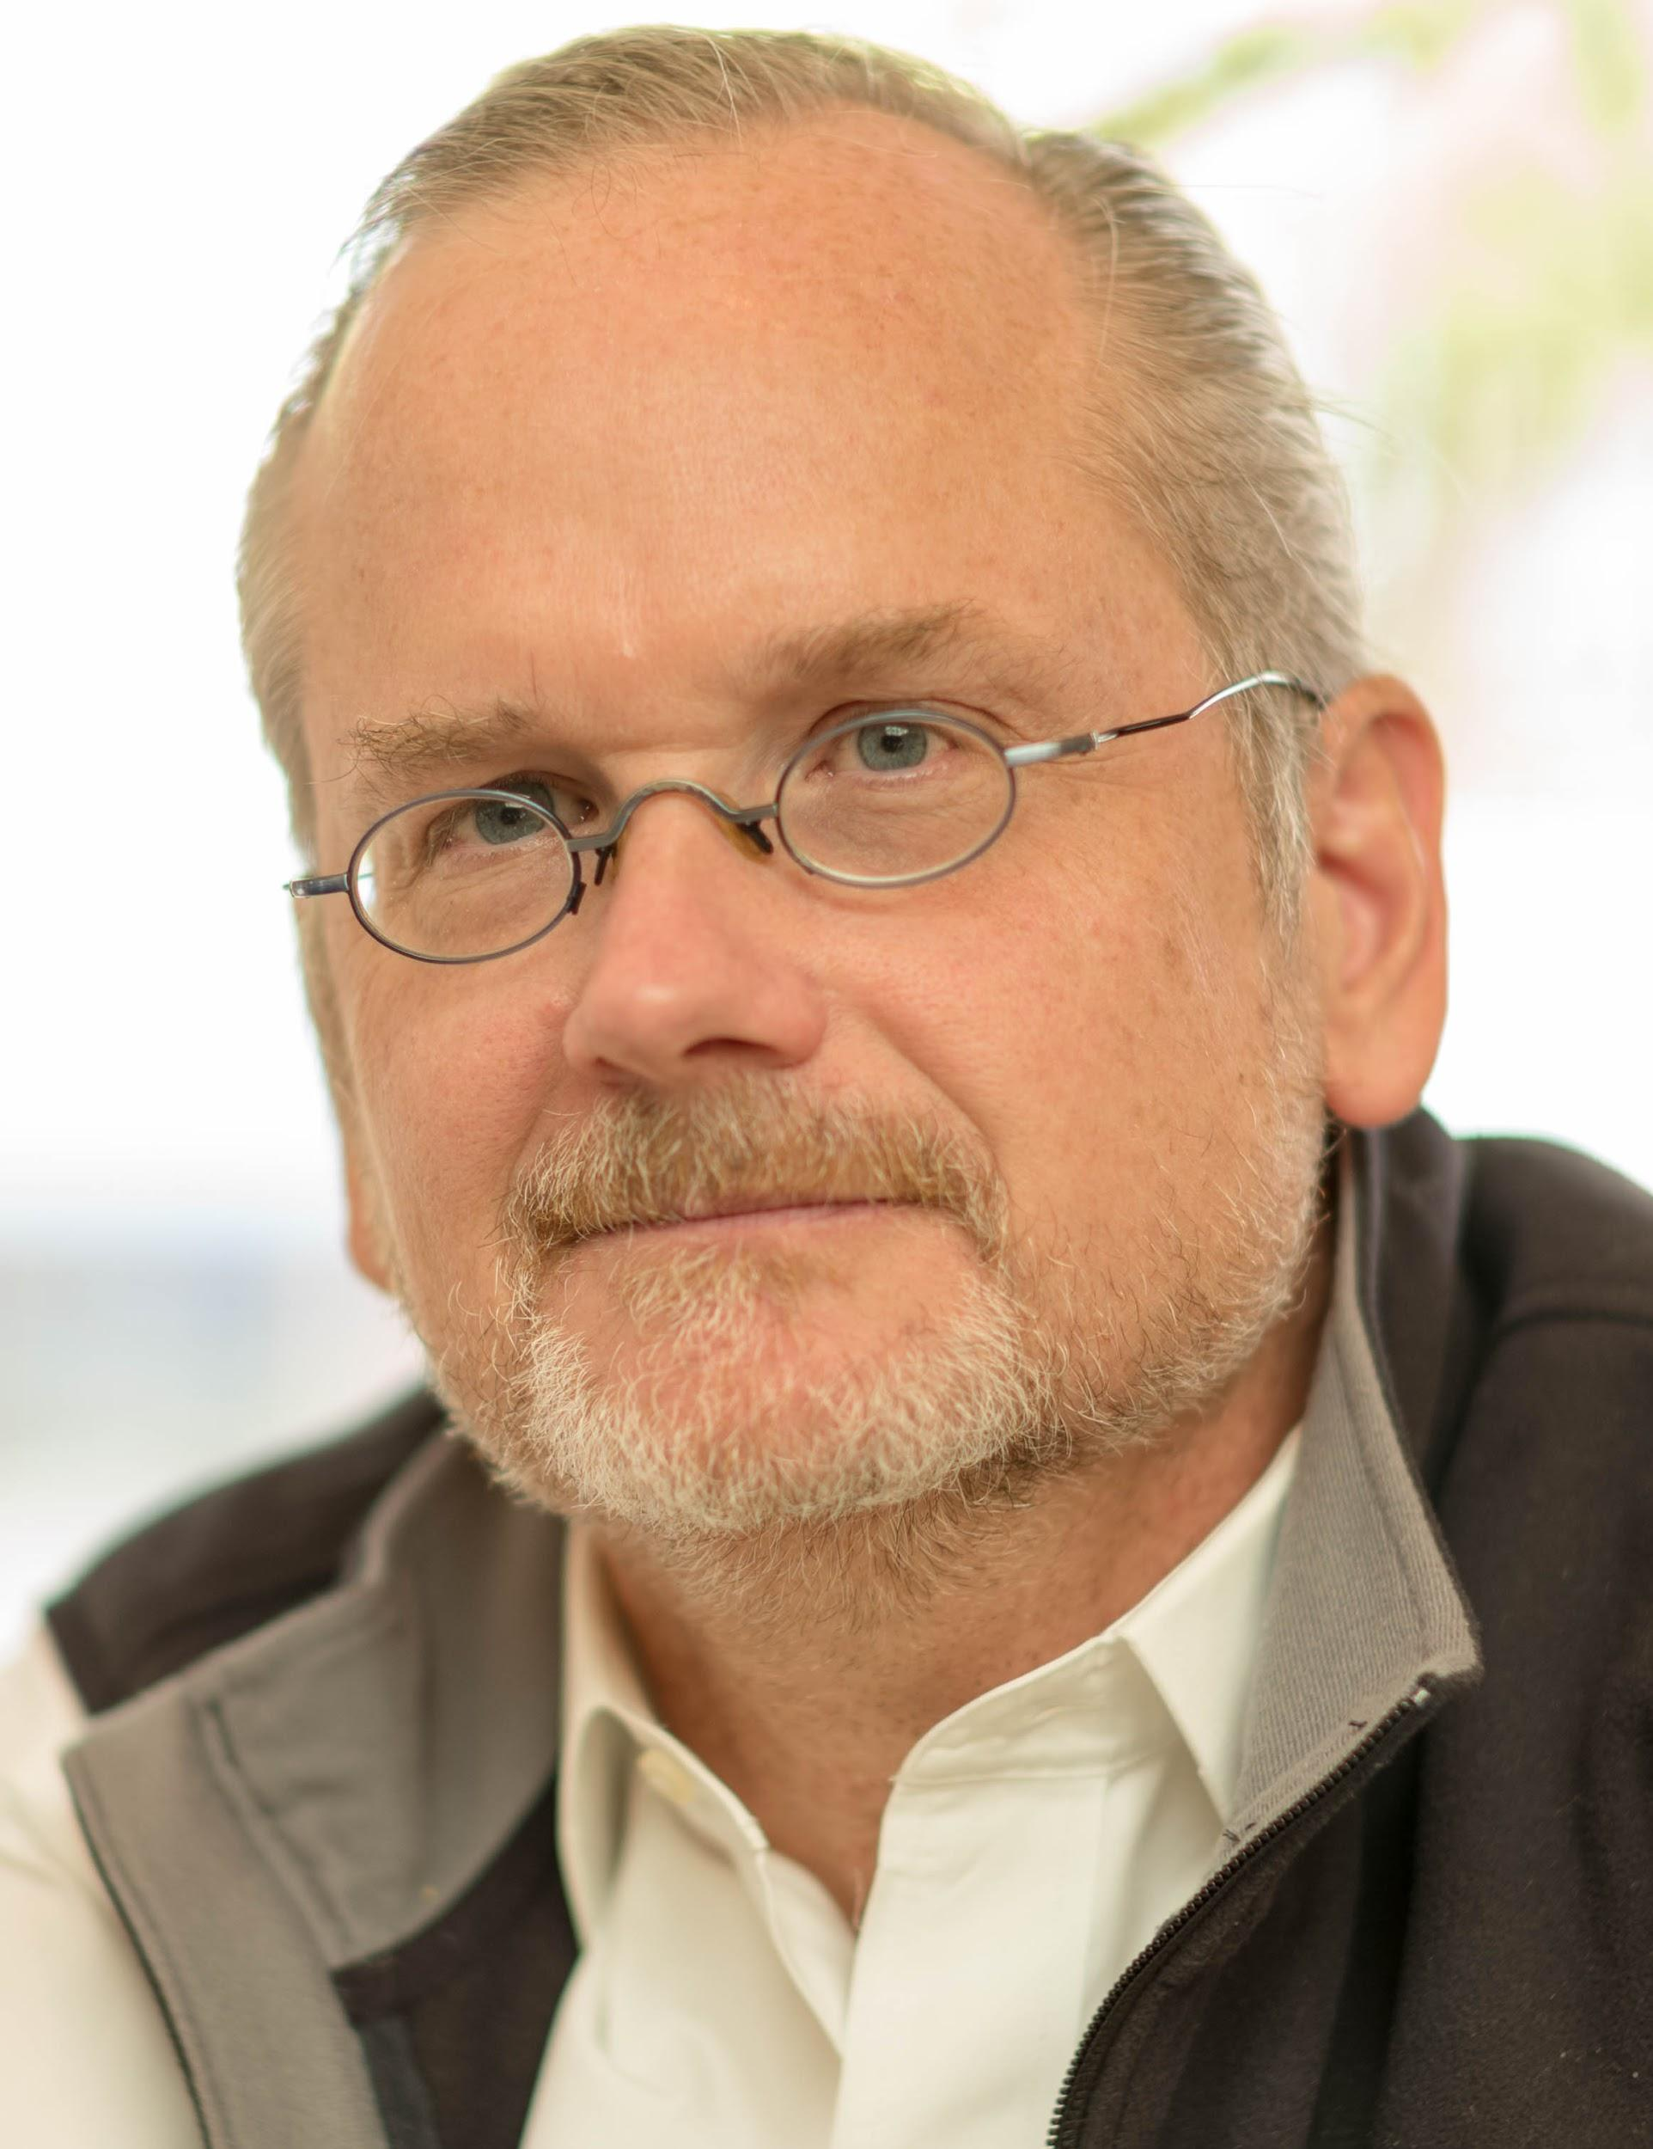
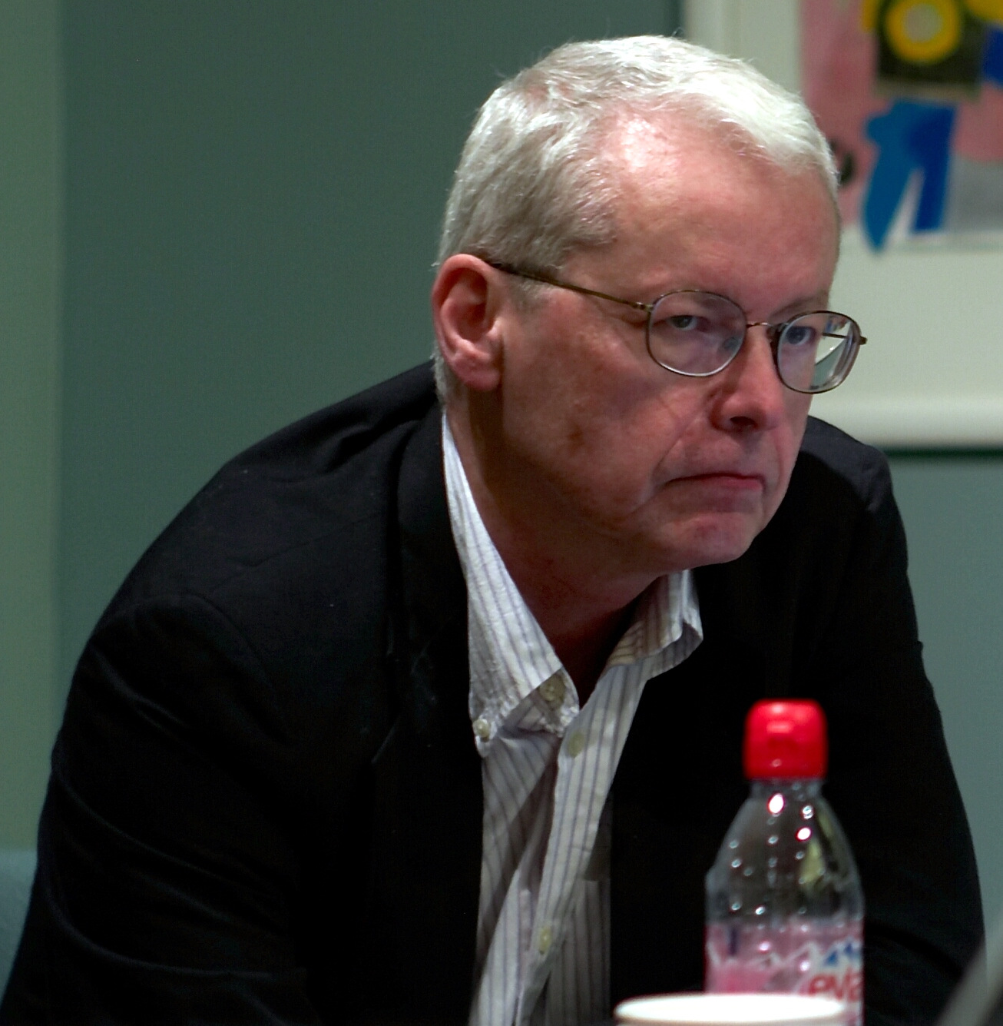
Eldred v. Ashcroft
Eric Eldred
Lawrence Lessig
Notes:
So when the time CTEA was enacted, there were several people who object to the law. Stanford Law Professor, Lawrence Lessig (His photo is on the left) believed this new law was unconstitutional. As you have seen the chart on the previous slide, the copyright term has been extended for years and years. The end of copyright term is very important. When the work is in public domain, it allows everyone to use the work without permission. This is important because creativity and knowledge is built upon what’s created before. If the work never goes on public domain, creativity and knowledge will be restricted. So Lawrence Lessig, represented Eric Eldred (the photo on the right), who created a website which republished the works of others in the public domain, fought together to challenge challenged the constitutionality of the Act. this case was known as Eldred v Ashcroft Unfortunately Eldred has lost the case.

Slide 8
The world was in the conflict..
SHARING
COPYRIGHT
Notes:
At this point, we were lacking an option to allow creators to share and remix their work. There was a tension between creator’s ability to share digital works globally and the strict copyright regulation To resolve this tension, there was a solution ---- Creative Commons.

Slide 9
2001- Creative Commons Created 2002- Creative Commons License Published
Notes:
Inspired by the value of Eldred’s goal to make more creative works freely available on the internet, Larry Lessig and others came up with an idea to create a non-profit organization called Creative Commons. It is designed to promote a “shared culture” and to be used around the whole world. As a result, In 2002, Creative Commons published Creative Commons License. What creative commons license does is, it is a set of free public licenses that would allow creators to keep their copyrights while sharing their works on more flexible terms than the default “all rights reserved. So for example, in the case of CC by, which is the same license that I am using for my slideshow - It allows you to remix or reuse my work as long as you attribute my work. I can choose other license type so that I can restrict the license so it doesn’t allow commercial use, or etc. the license gives more choices to creators. The license also serve important policy goals in fields like scholarly publishing and education. The license democratized the access to education.

Slide 10
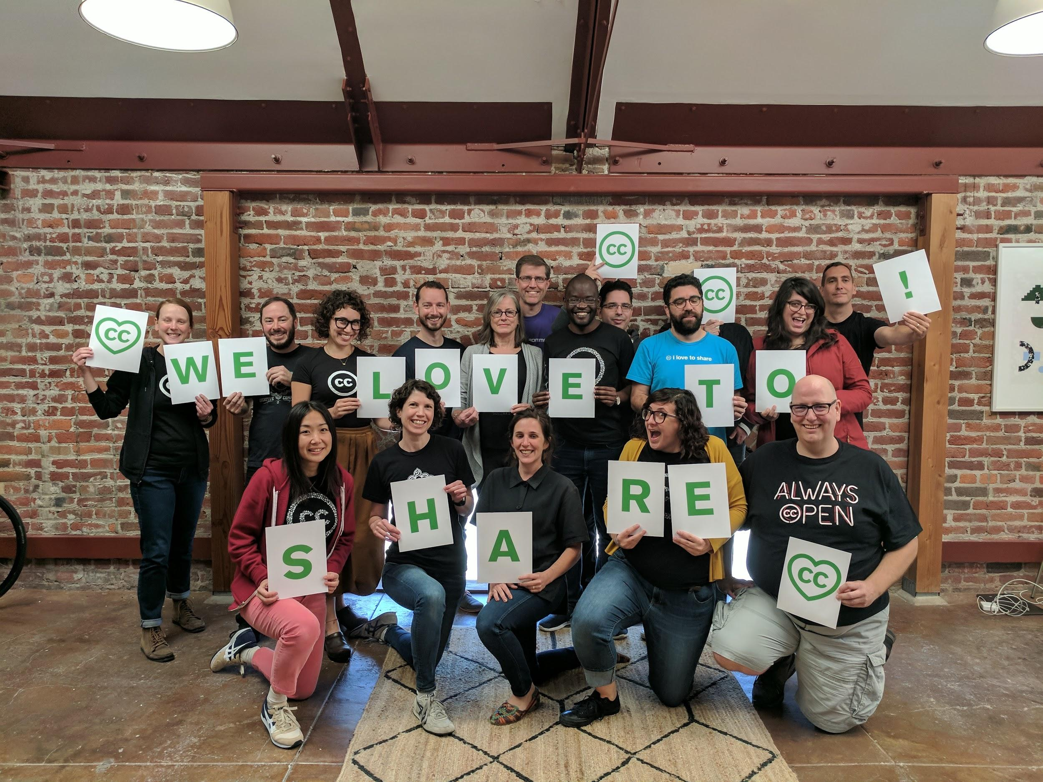
Creative Commons today
Notes:
So Creative Commons today is a small nonprofit organization. CC is a distributed organization, with CC staff and contractors working from various locations around the world. The creative commons stewards the Creative Commons Legal Tool - and as well as to power the “open movement” .

Slide 11
The CC Global Network
Open Data
CC Global Network
Open Access
Open Education
Open Source
Notes:
Now, you started to see that the world has started to change. For example, the CC Global Network. CC Global Network is a movement where, people and institutions are working together to strengthen the commons worldwide. This includes activists working on copyright reform around the globe, policymakers advancing policies mandating open access to research and data, and creators who share a core set of values. THe CC Global Network is just one player in the larger open movement. There are other movement such as open access movement, open data movement, open innovation movement… Many advocates around the world are working together to cooperate and make the work more open.

Slide 12
and today...
1.4 billion creative licensed work (2017)
Notes:
And today (2017), 1.4 billion creative commons licensed work are available today . This is an incredible no. It shows how much Creative Commons has impacted the world - and by licensing your work as a creative commons license- you become part of this history of Creative Commons.

Slide 13
Credit
Content:
Most of the content were adapted from Creative Commons’ Certificate Resources. (CC BY)
Image:
Slide 2 - Handshake by royyanandrian from the Noun Project (CC BY)
Slide 3- Copyright Symbol by Pixabay (CC 0)
Slide 6- Chart that explains the Expansion of U.S. copyright law (assuming authors create their works 35 years before their death) by Tom W. Bell
Slide 7- Photo of Lawrence Lessig by Joi Ito on Flickr (CC BY), Photo of Eric Eldred by Joi Ito/cropped by Padraic on Wikipedia (CC By)
Slide 9 - Copyright Symbol by Pixabay (CC 0) ,
Slide 10 - Creative Commons staff in February 2018 by Creative Commons (CC By)
Slide 11 - Globe by Chris Tucker from the Noun Project

Slide 14
Note to people who are interested in using the slide. This work is licensed under the Creative Commons Attribution 4.0 International License.Please feel free to re-use, remix the google slide. You can just attribute the work under my name - Rie Namba. To reuse the slide on Google Slides, Just go to File> Make a Copy, and make a copy of this presentation. Alternative, you can download this as a powerpoint slide by going to File> Download as pptx.

