Slide 1
The Professional Juggle: How to Manage Time, Work and Life
Tiffany Potter, Professor of Teaching, English Language and Literacy
Judy Chan, Education Consultant, CTLT
Summer Institute 2019

Slide 2
Introduction:
Name
Roles at UBC
What does ‘Having a Life’ mean to you?
Notes:
Tiffany: Ask around the room
Judy: Add to the whiteboard

Slide 3
Learning Objectives and Our Activities:
Examine and reflect on your time management strengths and weaknesses
Identify a number of tried-and-true methods to feel more confidently in control of your day to day life
Begin to commit to a (or more) personal best practices to manage your life at UBC and beyond

Slide 4
Everyone Needs a System!
What’s your system?
Notes:
Tiffany:
Paper - list of to do monthly, weekly, daily… always on my desk
-deadlines? Consider old-school wall calendar. Ken To-do-ist
Judy:
Electronic calendar for everything: work, family and SMALL PLEASURE
Judy records on flipchart

Slide 5
Balancing Your Life: Real vs Actual
On your own, quiet reflection, jot notes if needed:
(2 minutes)
What’s most important goal in your work life?
What’s most important goal in the rest of your life?
What makes you happy?
Notes:
2:15 to 2:30
Okay--so you have an ideal--now do baby steps (you got this far because something is working well. No need to completely reboot yourself, but rather make incremental change based on your ideal). BUT recognize that the goal in your non-work life as just as important as the goals in your work life if you are going to have balance
Suggestions and strategies
Three things that we do in our time management
J: * Get it done; get it out of the way
* Schedule and record ‘down’ time; ‘walk’, ‘read’,
T: desk page already discussed;
*decide how your time is going to work (ie. work every day 9-5, then do not work at
home? (permission to stop). Book one half day per week for personal time and stick to it? Book until 11am two days per week for personal time, and book one evening per week to work? DECIDE consciously how your work/life time is going to work and stick to it for a month, then revisit. For most academics, blocks of time are important.
*plan the term (for me, 2 courses means one article draft or one article revision or one book chapter--set reasonable goals and try to have one major project on your desk at a time--too many makes you feel overwhelmed);
*actually write out the micro-steps of a larger project, divide them over term, then when you finish one cross it off the list. Having specific steps, completable, lets you give yourself permission to do other things (PhD story).

Slide 6
Balancing Your Life: Real vs Actual
3 minutes:
What is the current actual state of your work/life balance? Why is it that way?

Slide 7
Balancing Your Life: Real vs Actual
3 minutes:
What is the ideal state of work/life balance; why would you like it to be that way?

Slide 8
It’s Your Turn!
(1 min) On your own, write down TWO concrete steps to help you move from actual to ideal
(6 min) Share one of your steps with your group
Offer comments/suggestions for each other
(1 min) Write down one more suggestion that
might be useful for you

Slide 9
How to prioritize: Urgent vs Important
Notes:
Ie. it’s okay to put an article on hold (important but not urgent) while you write a grant proposal (important and urgent)
Email (feels urgent, only occasionally important)
Check email three times a day…
Morning, mid-day, end of the day (OHIO what you can, then group the rest for end of day (almost nothing in email actually needs a time-consuming reply immediately))
“Email is a wonderful thing for people whose role in life is to be on top of things. But not for me; my role is to be on the bottom of things. What I do takes long hours of studying and uninterruptible concentration." (Donald Knuth, Stanford Professor Emeritus and one of the godfathers of computer programming--quoted in from "Deep Work: Rules for Focused Success in a Distracted World" by Cal Newport, which is a great resource)

Slide 10
“Email is a wonderful thing for people whose role in life is to be on top of things. But not for me; my role is to be on the bottom of things. What I do takes long hours of studying and uninterruptible concentration."
Donald Knuth, Stanford Professor Emeritus and one of the godfathers of computer programming
Notes:
--quoted in from "Deep Work: Rules for Focused Success in a Distracted World" by Cal Newport, which is a great resource)

Slide 11
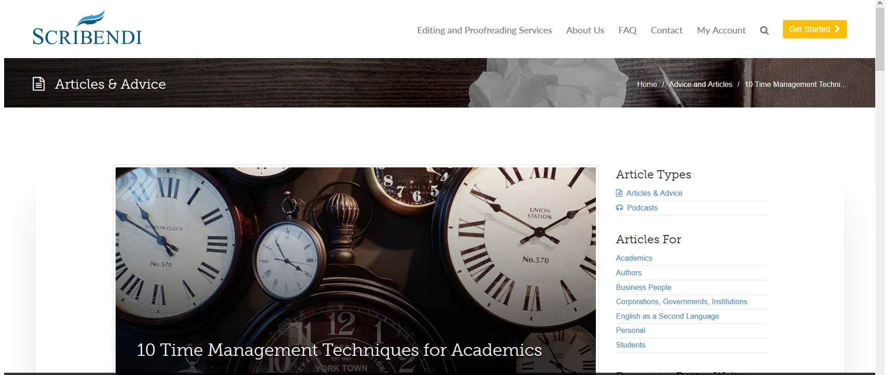
Learn to Say ‘No’
https://www.scribendi.com/advice/10_time_management_techniques_for_academics.en.html
Notes:
The last two techniques suggested here are ‘say no’ We like to give the rest of the time to help you find the ‘no’.

Slide 12
When it’s not balanced… what can you do? (breathe)
Notes:
When it is not balanced, what else can I do or not do?
Reassure ourselves (when feeling overwhelmed with trying to keep too many balls in the air, remember that most of them bounce right back up again if you drop them).
*there are 5-7 years to tenure, or 4-6 in a graduate degree. Take a breath and realize that you can control this, and there is time to make a plan
*in most disciplines, it’s okay to tell a press that you’ve had to adjust the deadline for your article revision, but they will have it by x date (they won’t hold a month against you). Definitely in English, and husband edits a medical journal (practically throws a party when things come in on time).

Slide 13
Finding the ‘No’
What is one thing you did last year that you could have said ‘no’ to?
*at work
*in the rest of your life
What could you have done with that additional time?
Reflect and jot down your thoughts; share with table group

Slide 14
Finding the ‘YES’
What is that one thing you can change from
Guilty Pleasure to Pleasure

Slide 15
Now what? Questions? Thank You!
We advertise this for an hour to respect your time
We will stay to help you make concrete steps to your ‘ideal’ and finding the ‘no’

Slide 16
Tips and Tools Shared at the Workshops by participants
Google Calendar; Google Task
Buffer Time
Establish long term, big picture goals
Permission to be ‘Done’
https://todoist.com/
https://www.wunderlist.com/
https://kanbanflow.com/

