Slide 1
Finding & Assessing Open Education Resource Repositories (OERR)

Slide 2
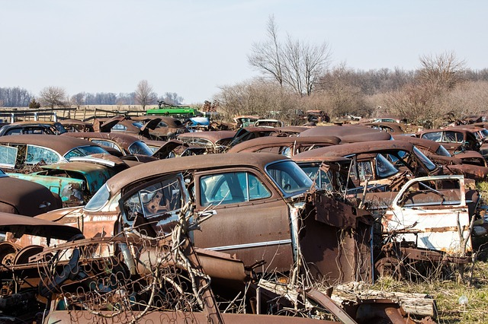
Finding….
Internet is littered with “dead” repositories: outdated & forgotten material, poor description, no assessment.
The Library guide to (current, high quality) Open Education Resource Repositories (OERR) has a curated list of current, high-quality repositories.
http://guides.library.ubc.ca/Level3_OERR
Notes:
We have some already assessed and linked for you to check out.

Slide 3
Assessing
Library: see the guide to Assessing OERRs
Rubric includes criteria such as Authority, Audience, Subject Coverage, Search Functionality & Browsing, and Licensing & Permissions
Also consider: currency of content? Lifecycle policy? Version control?
Top rated OERR include MIT Open Courseware, OER Commons & Merlot. See guide for more detail.
Notes:
New repository projects are developed all the time. Here are some things to consider when vetting a repository that isn’t in the guide.

Slide 4
Assess Content
Your Subject knowledge:
Level correct?
Description correct?
Accurate content?
Complete?
Does content deliver pedagogical promises?
See: http://guides.library.ubc.ca/content.php?pid=659422&sid=5526466 for more
All graphics/images in this presentation are CC0 from pixabay.com
Notes:
Don’t just take their word for it. Subject experts are invaluable when choosing OERs for use in the classroom.

