Slide 1
CSS Basics 101
Rie Namba

Slide 2
Opening
Goals of this session:
To understand the basic language of CSS
Utilize online references, tools and tutorials to create a CSS.
Reference:
http://wiki.ubc.ca/Sandbox:CSS_Basics
Notes:
Welcome to CSS 101 tech express. My name is Rie Namba, In this session, I will facilitate on the basics of CSS. There are 2 main goals of this session. First is to understand the basic language of CSS, which means you don’t have to necessary know EVERYTHING about CSS to make a very nice website. It is because, there are lots of useful online references, tools and tutorials that you can use in order to make a very fancy website. The second goal of this session is to develop the ability to be able to use all those online reference, tools and tutorials.
So the workshop today will be more casual and interactive, instead of me going through all of the information. I also created a reference on wiki, so feel free to access to this wiki anytime. You can even look at it during the session.

Slide 3
Icebreaker
Introduction:
Name
What do you do
What you are going to use CSS for.
Notes:
Before we start the session, let’s start with an icebreaker.
I would like you to introduce your name, department and what you are going to use CSS for.
I will start with my self. My name is Rie, I work as a Connect Resource Developer for Center for Teaching Learning and Technology and I use CSS to style a wordpress website.
…
Thank you. So lots of people use CSS in..

Slide 4
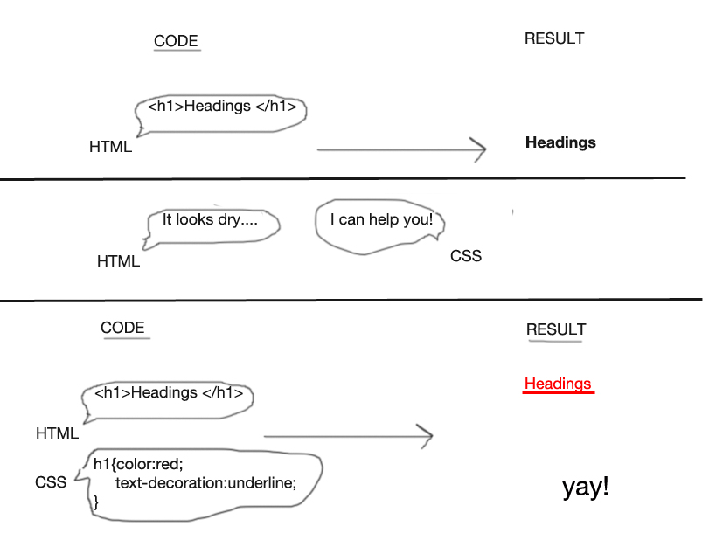
What is a CSS?
Notes:
CSS is a file that can control how HTML can look. While HTML is a file that can tell information to users: Like Text, tables, headings and lists. CSS controls the HTML in order for to make HTML look better. Just like in this diagram… In this diagram, I used Headings as an example. So on HTML, it only tells the information to viewers that there is a heading. It doesn’t look so nice.
So CSS helps HTML to make the heading look nicer, by giving a direction. In this case, the direction is: Make the color red, make the font-size to 50px, and put the underline under the headings. After you applied those CSS, the heading looks nicer.

Slide 5
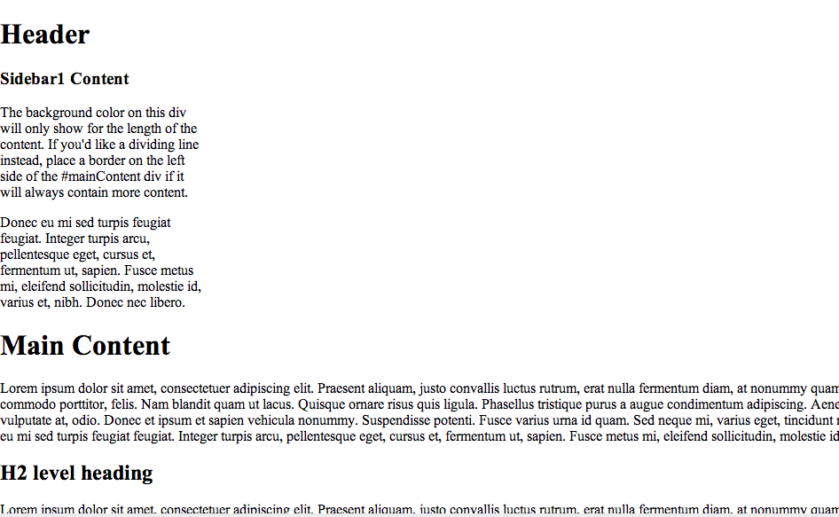
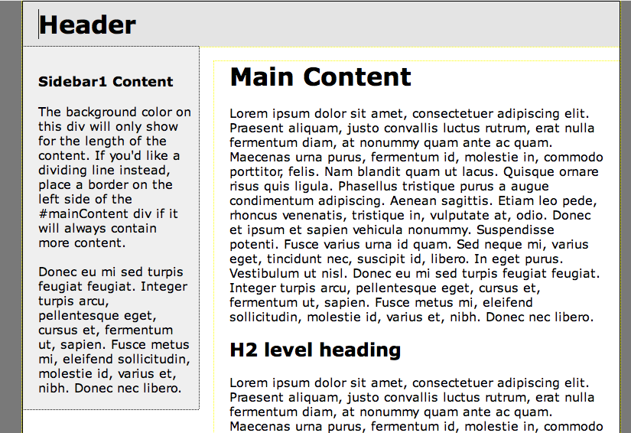
A World without CSS: Compare
Without CSS
With CSS:
Notes:
In this diagram, same HTML is used. One without CSS, and the other with CSS. The one with CSS looks nicer than the one without CSS.

Slide 6
How to read CSS:
h1 {
Color: red;
Font-size:20px;
}
1.CSS Selector
Tells this HTML (In this case: h1 ( <h1> </h1>) ….
2. CSS Properties
…To follow the instructions. (In this case: turn h1 into red, and change the font size to 20px)
Notes:
So now, how to read CSS. So basically, it’s simple. This thing called CSS Selector (which Selects the HTML elements) , is basically telling you which HTML to give the instruction. For example, in this case it’s h1. Then, this thing with CSS Properties is a set of instructions that you want to ask the HTML to do. In this case, the instruction is to turn the h1 into red, and change the font size to 20px. And there are a lot of CSS selectors and CSS properties that you can use. Do you need to remember all of them ?

Slide 7
…You can use online references/tools!
W3schools.com CSS tutorial: http://goo.gl/56WoBY or google “w3schools CSS tutorial ”
“Inspect Elements” feature in Google Chrome/Firefox: Right click > click on Inspect Elements.
Google, “CSS tutorial how to ______”
Notes:
The Answer is no. You don’t have to remember all of them. Even though I have been making websites for more than 5 years, I don’t necessary remember all the CSS or HTML tags.
W3Schools.com provides information on CSS selectors and properties. As well as the basic tutorial on how to change color, how to make menus, etc.
The second thing to take note of is Inspect Elements feature. I will come back on this later. But basically it’s a feature that allows you to find out the CSS and HTML used on the website.
Third way, is to use Google. There are millions of updated free resources you can use online. So if you just search, usually it will come up.

Slide 8
Activity 1: Understand the grammar
In groups, answer the questions provided in the exercise sheet. ( 10-15 min)
You are allowed to chat and discuss the answers with your and/or another group.
You may use any resources provided on the internet. You are allowed to Google the answer.
You may also use resources from: Sandbox:CSS_Basics
Feel free to ask me if you have any questions.
Notes:
So in groups, I want you to answer the questions in the exercise sheet.
You are allowed to chat and discuss, and search for any resources on the internet. Especially for question 3, 4, you might need to look for online resources to find out the answers. If you have trouble looking for resources or understanding the questions. Please don’t hesitate to ask me questions.

Slide 9
Answers
Question | Key HTML | CSS (answer)
2 | <a href=“http://www.ubc.ca”>Welcome to UBC </a> | a{ font-size:30px; }
3 | <div id=“NavMenu”><a href=“/about.html”>about</a></div> | #NavMenu { background-color:red; }
4 | <div id=“NavMenu”><a href=“/about.html”>about</a></div> | #NavMenu a{ Color:blue; }
Notes:
Below are the answers for the questions. How did it feel? What did you think it was a biggest challenge? Any resources do you find it useful? Did you find any patterns to it?
If you can see, there’s a strong link between HTML and CSS, and it shares similar languages. For question 2, the answer is a { font-size: 30px; } which is asking HTML tag a= which is link, to change the font size to 30px.
For question 3, the ansewr is #NavMenu { background-color:red}. This # stands for div ID. All div ID can have names. In this case, it is called NavMenu. This div id= “NavMenu” is translated to #NavMenu in CSS.
For question 4, the answer is #NavMenu space a. This space, is one of the grammar in CSS. It is used to select elements inside elements. In this case, only a link (a) within div id = navMenu will turn to blue.

Slide 10
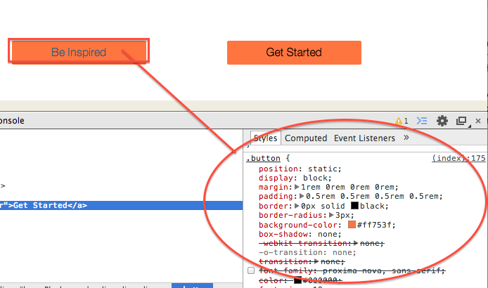
Useful tools : Inspect Elements
Notes:
There are many useful tools that you can learn how to use CSS.
For example: Inspect Elements. Is a useful tool that you can use to find out what CSS is used in the website.
So to do Inspect Elements, Right Click, and click on Inspect Elements. It is ideal to use Google Chrome, but you can also use it for Firefox or Safari.
In Firefox, you can install a add-on called Firebug.
So if you right click, and click on Inspect Elements, it gives me an information on what CSS is composed in this object.
This is the information of the CSS used , and this (index:175) is where the CSS is coming from. In this case, The CSS is coming from the UBC template. So if I want to make changes to the website, I will have to make changes to the CSS in the UBC template. In the case of UBC CLF theme, I can do so by using edit Custom CSS feature.
I will give you 5-10 minutes, try using Inspect Elements on any of the websites you are working on. Play around with it. Ofcourse, you can talk to the person next to you or ask any questions. I will walk around.
How did it go? There are a lot of tools you can use online to help you with CSS. It takes time to learn CSS, but as you use CSS, you will learn more.

Slide 11
Resources
Open http://www.wiki.ubc.ca/Sandbox:CSS_Basics
Notes:
For the rest of the session, I will just go over the online tutorials and resources you can use to play around with it. So open the Sandbox: CSS Basics. And go to Application 2 and 3.
And then we can have a open discussion/ question session if you have any specific questions.

