Slide 1
Open For Learning
Teaching in the Open
Erin Fields, Liaison Librarian and Flexible Learning Coordinator
Christina Hendricks, Sr. Instructor, Philosophy, and Chair of Arts One
Lucas Wright, Open Education Strategist
Cindy Underhill, Learning Design Strategist
Notes:
Quicly introduce ourselves

Slide 2
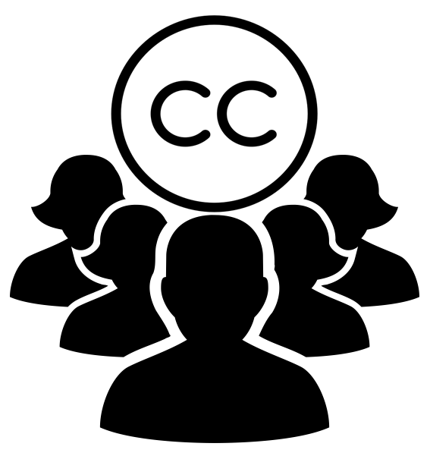
Objectives
By engaging with us and each other, we invite you to:
consider a definition of open pedagogy and discuss possibilities for open practice in your context.
reflect on examples of open practice at UBC.
experiment with open teaching challenges.
context discussion examples Q&D
Notes:
This workshop will cover: Cindy--Lucas will add new icons
Finding & Using Open Resources
Content Strategies
Creative Commons Licenses
Searching for Open Resources
Teaching in the Open
We will also engage in some quick Open Learning Challenges.
And we will conclude with a schedule of upcomming workshops in the Open for Learning series.

Slide 3
“OER by themselves don’t do anything – they don’t have an impact just sitting in the cloud ... It is only when they are used in particular ways that change can happen …”
Dr. Matthew Smith - Program Manager ROERD
ROERD Newsletter - Feb-March 2016
image credit:Art Gallery of Knoxville on Flickr. CC:SA
Notes:
Cindy - Hook - this is the transition from previous discussions and examples of OER to open practice - teaching.
ROED Research on Open Educational Resources for Development/

Slide 4
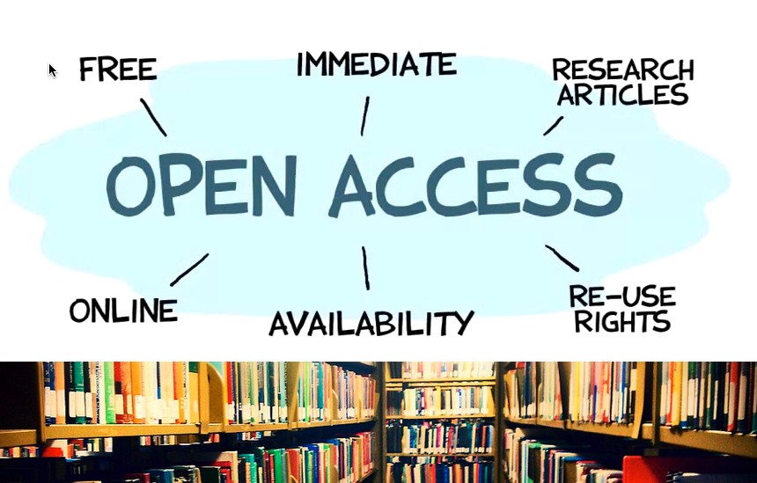
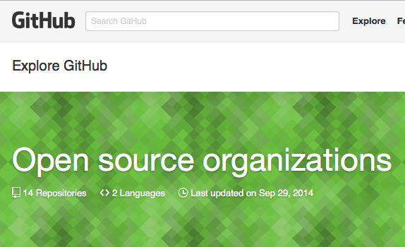
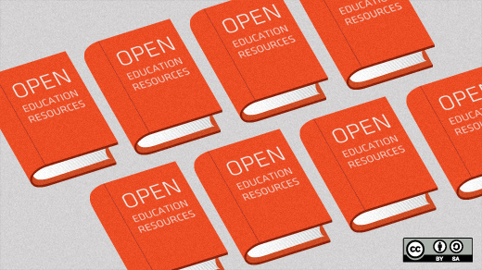
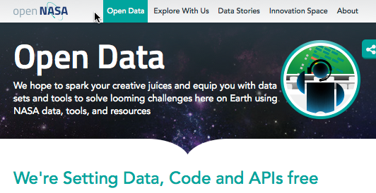
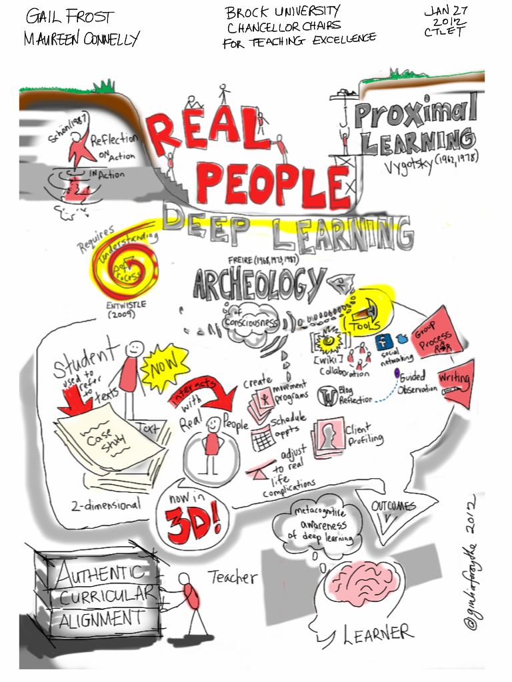
Meaning of Open
open teaching /open educational practices require definition in context - open takes many forms.
OERs = free plus permissions to Re-use, Revise, Remix, Redistribute, Retain -5R
Reference: David Wiley: “Open” Educational Resources vs “Open” Pedagogy: Why Meanings Matter
Image: Giulia Forsythe: on Flickr:CC:BY:NC:CA
Notes:
Cindy - definitions
Note: this is to be a lead up to the opener activity - which needs context. Free plus permissions were meant to deal with copyright - they don’t capture the complexity of the activities involved with teaching and learning. This might include
having students selecting/remixing an open resources to create learning resources for their peers
using open data as a course resource for students to work from
having students start their own blog or contribute to an open course blog
might include opening up your class to other networks through discussions hosted on social media or on open forums.

Slide 5
Open Pedagogy & Practice
“Open pedagogy could be considered as a blend of strategies, technologies, and networked communities that make the process and products of education more transparent, understandable, and available…”
Tom Woodward, Assoc. Director for Online Learning Innovation @ Virginia Commonwealth University - Campus Technology (2014)
image credit: scrappie annie on Flickr. CC:BY:NC
Notes:
Cindy

Slide 6
Open practice - in your context
What would you need to consider if you were to implement these open practices in your teaching? Discuss at your table:
Make all course resources open access.
Have students publish their work.
Provide (and have students provide) open feedback on published work.
And, most importantly, why would you do this? How might these practices support learning?
Notes:
Cindy - 5 minute discussion - debrief highlights.

Slide 7
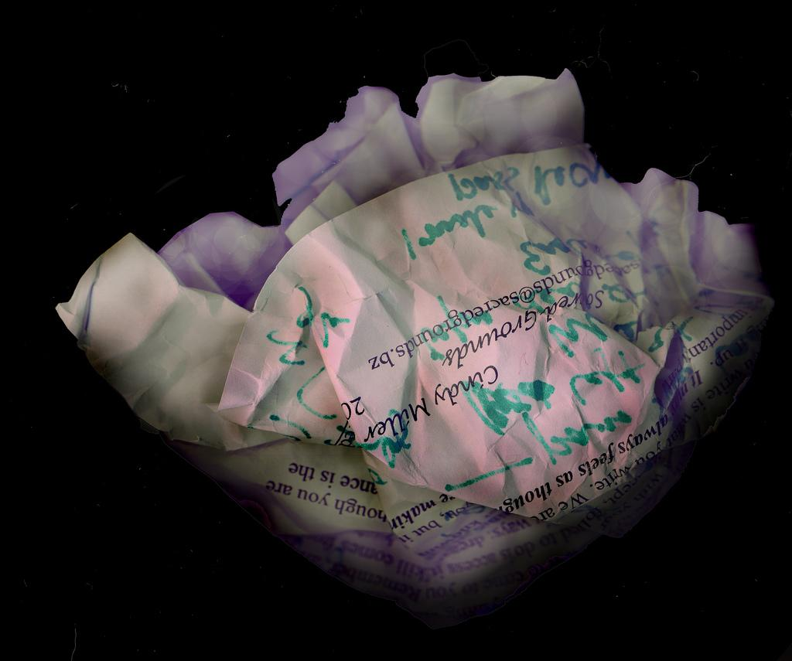
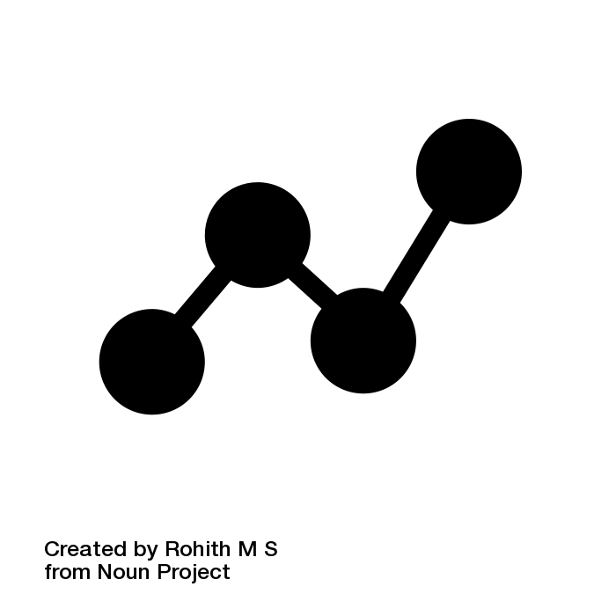
We are often asking students to do work just to show us that they can do it. I wanted them to do something that had genuine value, and not just this makeup exercise they perform just to show [professors] they know how to do things.
Rosie Redfield
Notes:
Disposable assignments: “after a student spends three hours creating it, a teacher spends 30 minutes grading it, and then the student throws it away. Not only do these assignments add no value to the world, they actually suck value out of the world.”
Renewable assignments, on the other hand, do add value to the world beyond earning a mark from an instructor--they provide resources that are useful and usable by others, whether other students in the course or the wider public.
Examples
students creating notes or demonstrations for other students in the same course (and possibly also posted publicly for others)
students editing articles on Wikipedia or an institutional wiki site like the UBC Wiki
students producing research that can be used by a community group.
Even those assignments that might otherwise be "disposable" can be made renewable by sharing them with other students in a course and, if the student agrees, publicly.
In order for such work to be truly "renewable," though, it should be openly licensed to allow others to not only view it but also revise and reuse for their own purposes.

Slide 8
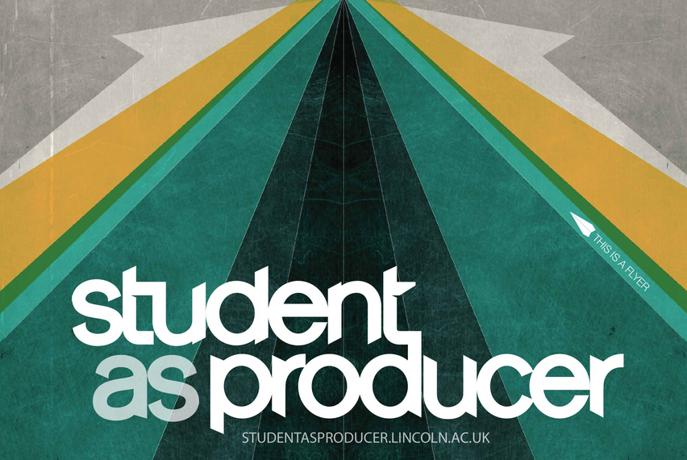
“This approach treats students as co-creators of knowledge, who take an active role in research, the creation of educational resources and curricular content, and teaching itself.”
-- Mintz, “Students as Producers, Students as Partners”
We are often asking students to do work just to show us that they can do it. I wanted them to do something that had genuine value, and not just this makeup exercise they perform just to show [professors] they know how to do things.
Rosie Redfield
materials at website listed at left licensed CC BY-SA
Notes:
Bruff (2013), citing Bass and Elmendorf (n.d.), emphasizes openness in the student as producer model, by arguing for the importance of students sharing their work with “authentic audiences,” people beyond just the instructor who can benefit from what they are producing. In addition, Bruff (2013) lists two other elements of his view of the student as producer model: students work on open-ended questions or problems, ones that don’t yet have a solution (rather than only working to get the “right” solution to a problem), and students have some autonomy in choosing and carrying out projects.

Slide 9
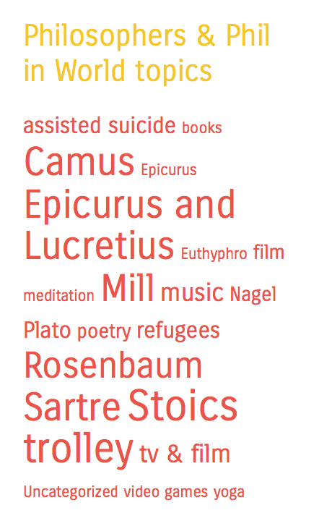
Student work on WordPress course sites
http://artsone-open.arts.ubc.ca
http://a1hendricks.arts.ubc.ca
blogs.ubc.ca/phil102

Slide 10
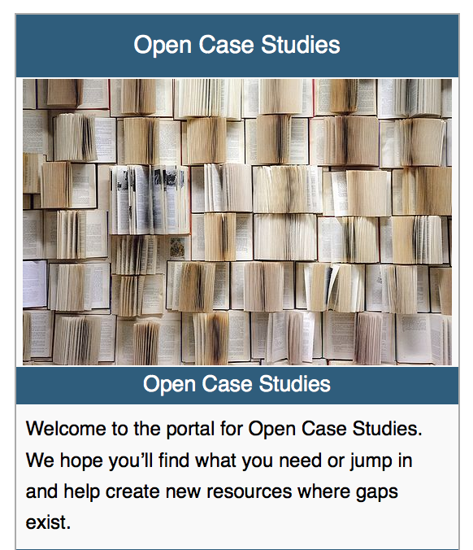
Open Case Studies on
Sustainability & Environmental Ethics
Coming Summer 2016
Economics
Earth, Ocean & Atmospheric Sciences
Engineering (Civil, Mining)
Forestry
Geography
Land and Food Systems
Philosophy
Political Science
We are often asking students to do work just to show us that they can do it. I wanted them to do something that had genuine value, and not just this makeup exercise they perform just to show [professors] they know how to do things.
Rosie Redfield
http://wiki.ubc.ca/Documentation:Open_Case_Studies
Notes:
What Christina

Slide 11
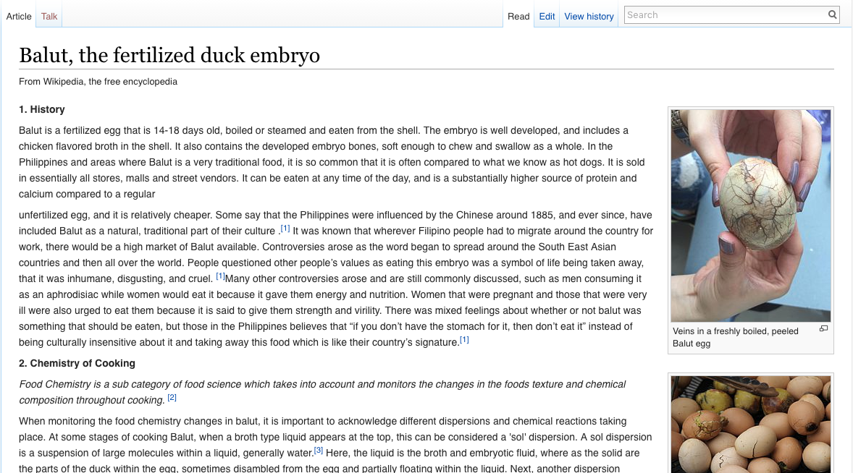
FNH 200 Edits Wikipedia
We are often asking students to do work just to show us that they can do it. I wanted them to do something that had genuine value, and not just this makeup exercise they perform just to show [professors] they know how to do things.
Rosie Redfield
Notes:
What Judy

Slide 12
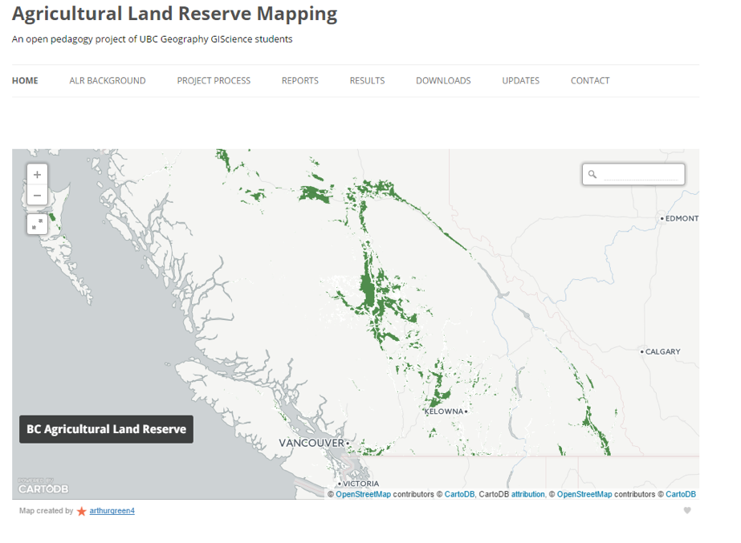
Geography Maps the ALR
http://blogs.ubc.ca/alrmap/
Notes:
What Gil

Slide 13
Open Challenges
http://openlearning.sites.olt.ubc.ca/
Select one of the challenges
Complete a challenge by filling in the form. Include:
A detailed description
A hyperlink to your artifact
If you complete one challenge, try another one or contribute to the challenge bank or resources you used in the challenge.

Slide 14
A purpose for open practice?
“If I have seen a little further it is by standing on the shoulders of Giants.”
Sir Isaac Newton, 1676 - in a letter to his rival Robert Hooke
We are often asking students to do work just to show us that they can do it. I wanted them to do something that had genuine value, and not just this makeup exercise they perform just to show [professors] they know how to do things.
Rosie Redfield
Notes:
CindyClosing bit??

Slide 15
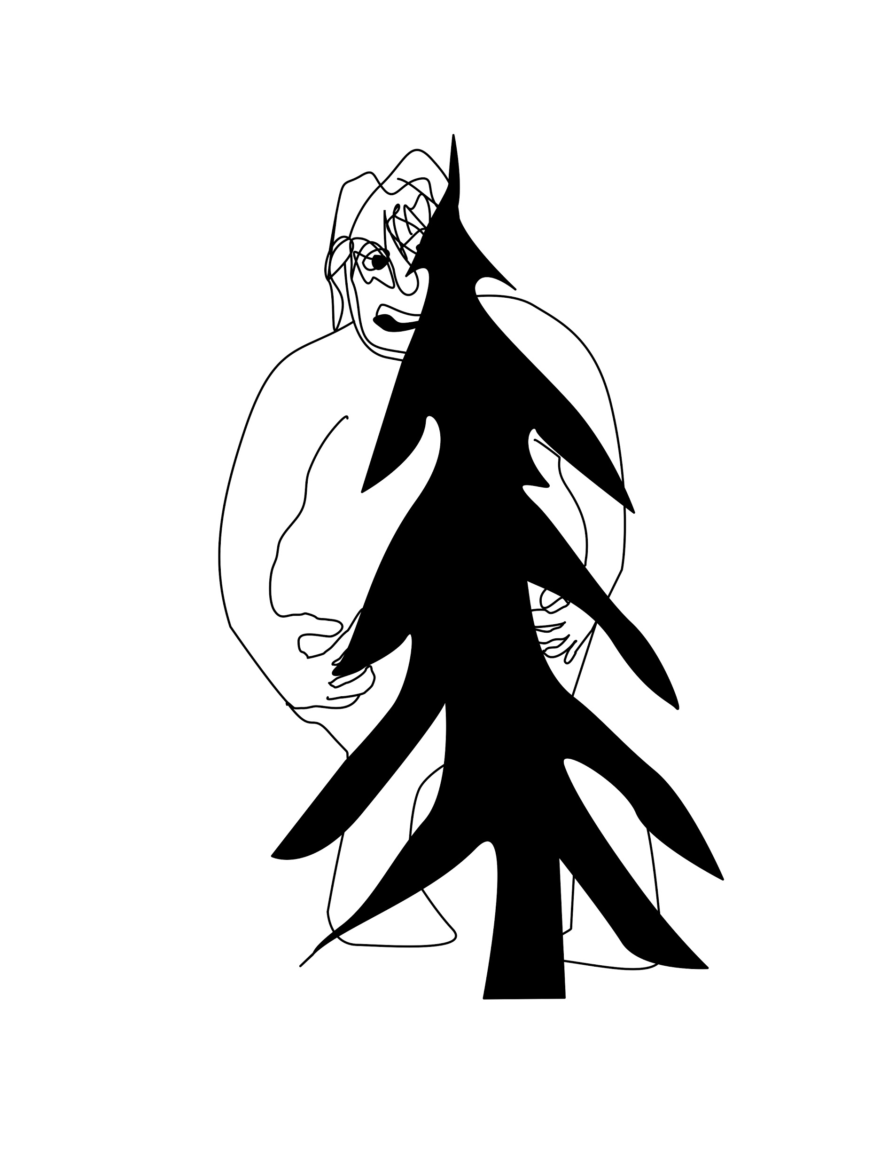
“When work is done privately – when it is carefully hidden from the public – no synergy is possible. When the individual nodes remain disconnected, no network can emerge. When the giant hides, no one can stand on his shoulders.”
David Wiley
We are often asking students to do work just to show us that they can do it. I wanted them to do something that had genuine value, and not just this makeup exercise they perform just to show [professors] they know how to do things.
Rosie Redfield
Notes:
Cindy Closing bit??

Slide 16
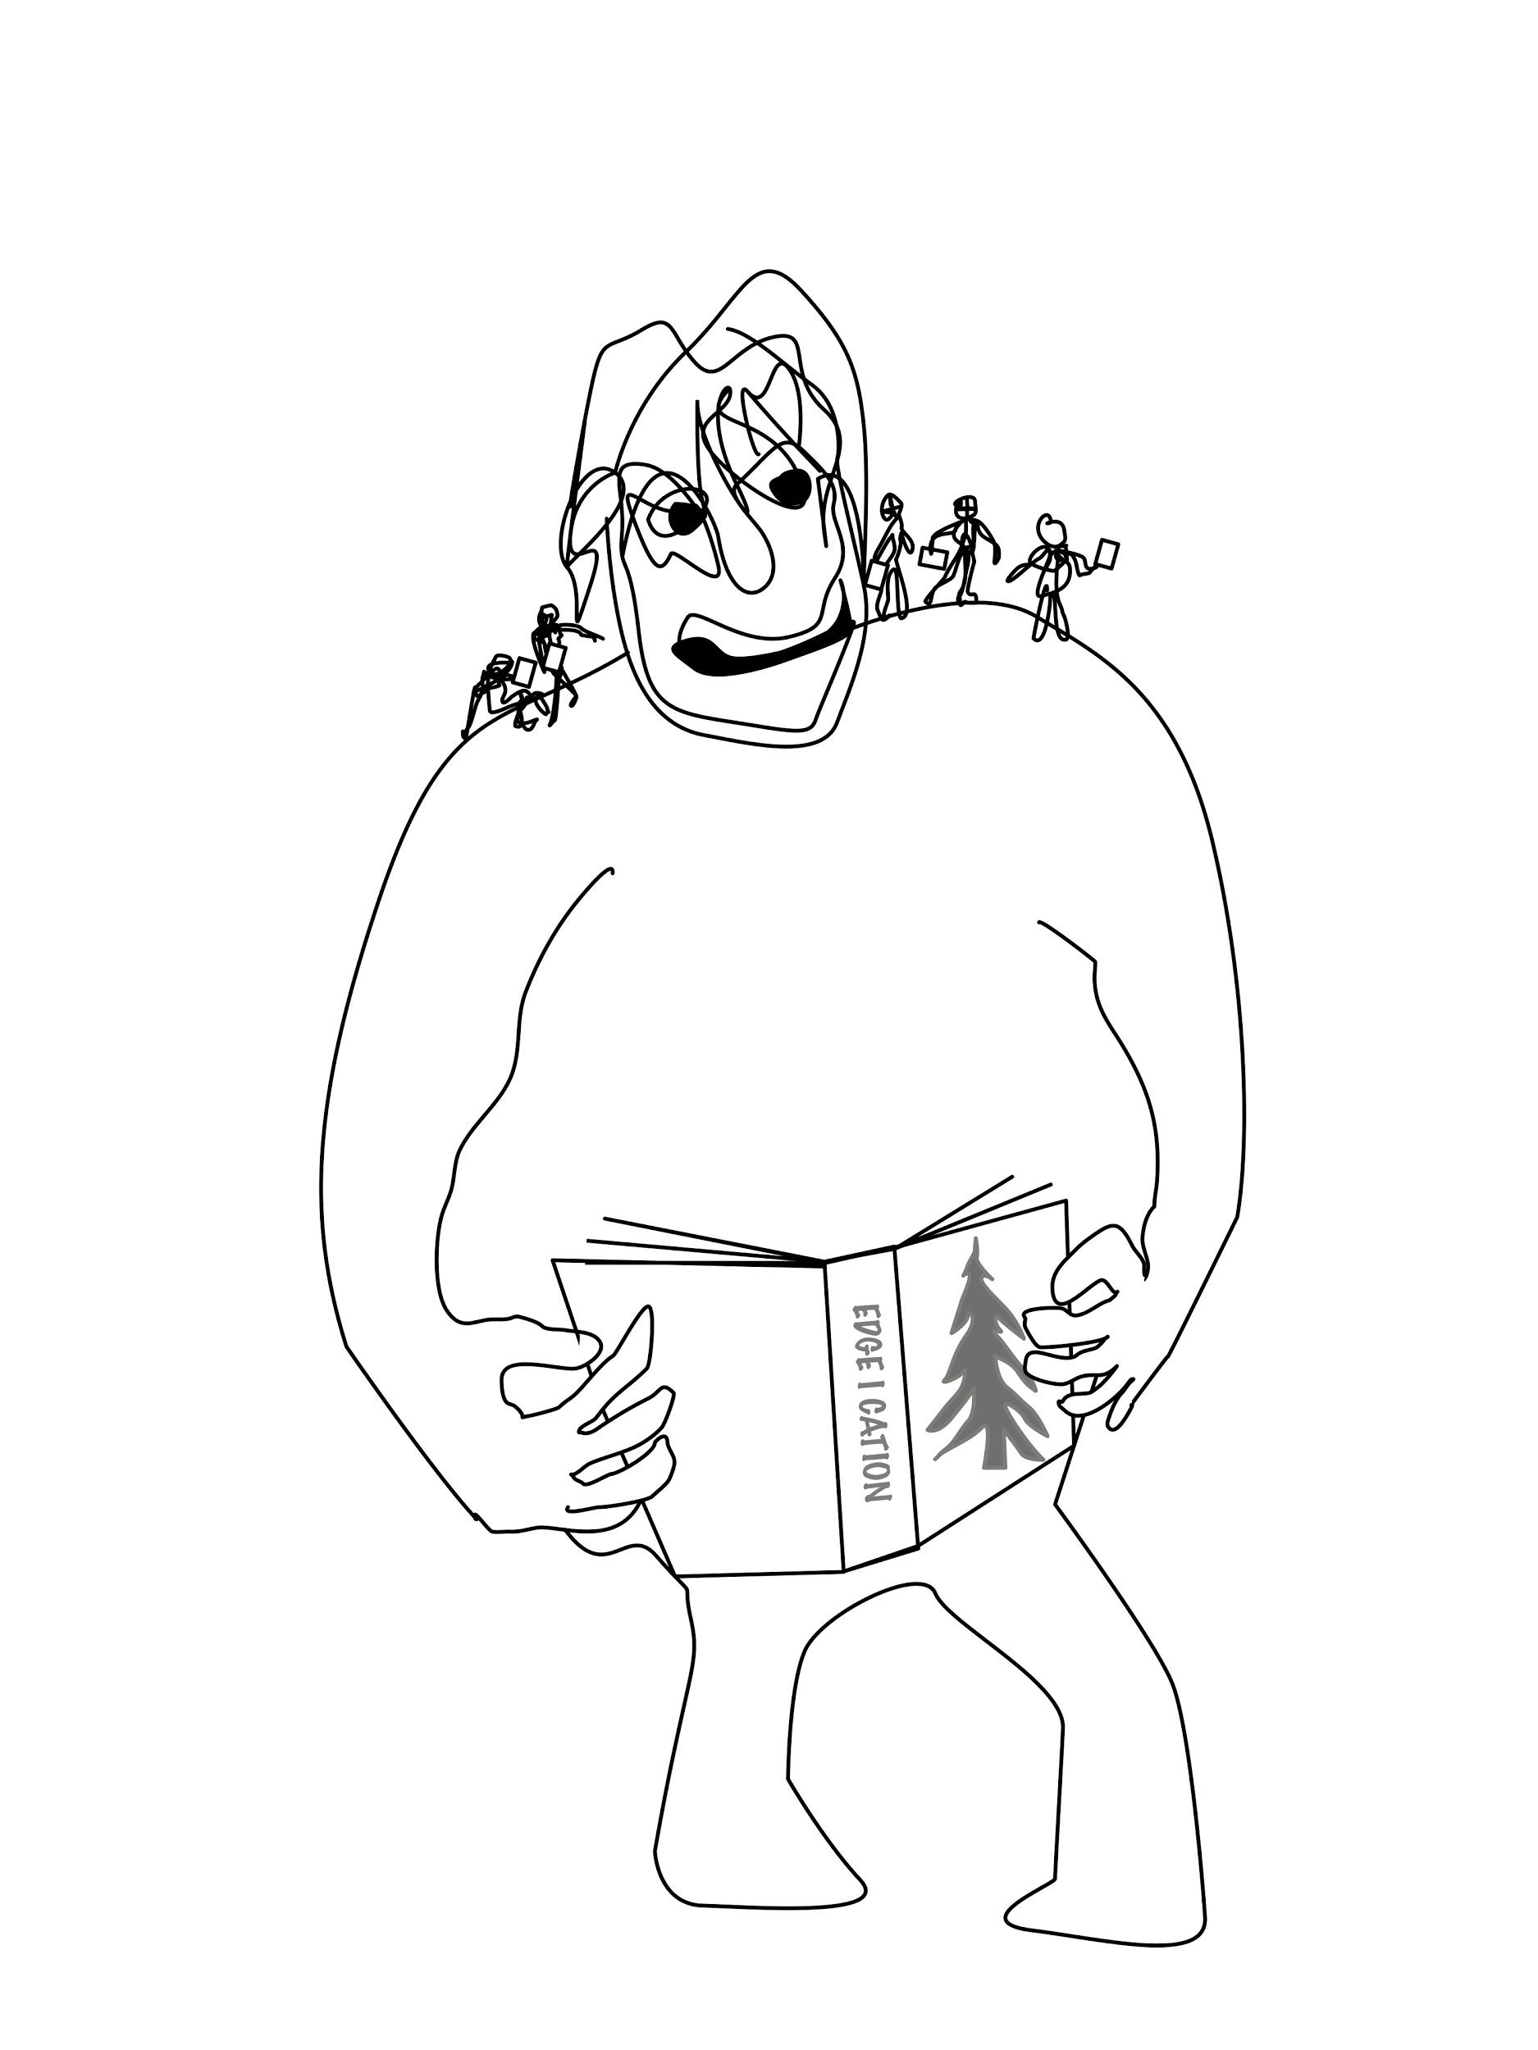
“By contrast, when open pedagogy is practiced publicly its methods, tools, artifacts, and results can be made freely and openly available to the public. They can be disputed, replicated, evaluated, and argued about. There are shoulders to stand on. “
David Wiley
Notes:
Cindy Open questions/comments

Slide 17
Image Attribution
Book Search by Creative Stall, The Noun Project, CC 3.0
Adapted from Group by Gregor Črešnar and Creative Commons by Austin Condiff, The Noun Project, CC 3.0
Classroom by Boudewijn Mijnlieff, The Noun Project, CC 3.0
Molecule by Luca Reghellin, The Noun Project, CC 3.0
Reuse By Johan H. W. Basberg, GB

Slide 18
Thank You
Questions

