Slide 1
case 1 – the body systems
Kirk Chen (1) Pawan Dhaliwal (2) Kyle Gillard (3) Jaspreet Padam (4) Ashley Wang (A) Kevin Chu (B)
PATH 417A JAN. 2016

Slide 2
The Case
6-year-old Stephanie O. has developed red sores around her mouth and nose. At the start of class her teacher noticed the rash and called her parents to take her home. Her parents take her to the family doctor who examines Steph. She is afebrile and does not have any swollen lymph nodes. There is no rash on her hands or feet or inside her mouth. He prescribes an antibiotic and tells her parents that she needs to stay at home for a couple of days. He swabs the rash and sends the swab to the Microbiology Laboratory.

Slide 3
What are the signs and symptoms?
The Body Systems – Q1
Presented By: Pawan Dhaliwal

Slide 4
Defining the Terms
Let’s first look more closely at what is meant by a sign versus a symptom…

Slide 5
Sign vs. Symptom
Table 1: Differences between a sign and a symptom¹
 | Sign | Symptom
Taken note of by… | Healthcare professional | Patient
Characteristics are… | Objective | Subjective
Examples | High blood pressure Abnormal densities in lungs detected on x-ray | Feelings of tiredness or pain Observation of skin rash

Slide 6
Sign vs. Symptom
An illness characteristic can be a sign, symptom (or both) depending on the observer(s):²
Doctor
Patient
Doctor and Patient
Illness characteristic is (a):
Sign
Symptom
Both sign and symptom
Notes:
http://www.clipartpanda.com/categories/doctor-clip-art-pictures
https://www.pinterest.com/scentsy_bex/preschool-3-year-old/

Slide 7
Stephanie’s Signs
Red sores around mouth and nose
Afebrile
No swollen lymph nodes
No rash on hands/feet or inside of mouth
Can you define
this medical
sign?
Click for the
answer!
Afebrile:
absence of
fever³
Notes:
https://commons.wikimedia.org/wiki/File:Clipboard_01.svg
http://www.clker.com/clipart-cartoon-thought-bubble.html

Slide 8
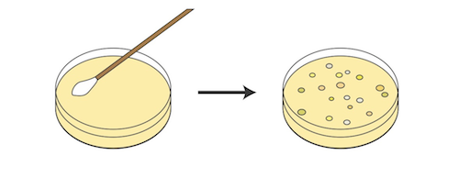
Stephanie’s Signs
The microbiology lab test results, when they are completed, will also be another one of Stephanie’s signs

Slide 9
Stephanie’s Symptoms
As noted before, a symptom is a subjective characteristic experienced (e.g. felt or observed) by the patient.
Although not explicitly stated in the case, in real life Stephanie would have had a chance to describe the rash in her own words (on in her parents’ words).
In this case, the symptom is the rash around Stephanie’s nose and mouth.

Slide 10
Question 1 – References
[1]
Niamh, K., & Lowe, C. (n.d.). Signs and Symptoms. Retrieved January 12, 2016, from https://connect.ubc.ca/webapps/blackboard/execute/content/blankPage?cmd=view
[2]
Niamh, K., & Lowe, C. (n.d.). Signs and Symptoms. Retrieved January 12, 2016, from https://connect.ubc.ca/webapps/blackboard/execute/content/blankPage?cmd=view
[3]
Merriam-Webster Medical Dictionary. (n.d.). Definition of afebrile Retrieved January 12, 2016, from http://www.merriam-webster.com/medical/afebrile

Slide 11
Question 1 - Images
All images used are Public Domain Images:
Doctor:
http://www.clipartpanda.com/categories/doctor-clip-art-pictures
Little girl:
https://www.pinterest.com/scentsy_bex/preschool-3-year-old/
Clipboard:
https://commons.wikimedia.org/wiki/File:Clipboard_01.svg
Thought bubble:
http://www.clker.com/clipart-cartoon-thought-bubble.html
Petri dish:
http://www.clipartsheep.com/petri-dish-with-bacteria-it-on-a-and-let-clipart-1710729.html
Lab results:
http://www.illustrationsource.com/stock/image/752/the-signing-of-a-document/?page=1&square=CHECKED&vcd=CHECKED&vertical=CHECKED&color=CHECKED&photography=CHECKED&grey=CHECKED&illustration=CHECKED&detail=TRUE&filter=CHECKED&panoramic=CHECKED&RF=CHECKED&results_per_page=1&query=Write&RM=CHECKED&horizontal=CHECKED&order=relevance

Slide 12
Which body system is affected, in what specific area and what is the normal physiological function of this area of the body?
The Body Systems – Q2
Presented By: Ashley Wang and Kevin Chu

Slide 13
Which body system is affected?
The Integumentary System is affected. It is comprised of:
Skin
Hair
Nails
Sweat and
sebaceous glands
In this case, red sores are found around patient’s mouth and nose, suggesting that the facial skin is specifically involved.
These are known as “accessory structures.” These structures originate in the epidermis and can extend down through the dermis into the hypodermis.

Slide 14
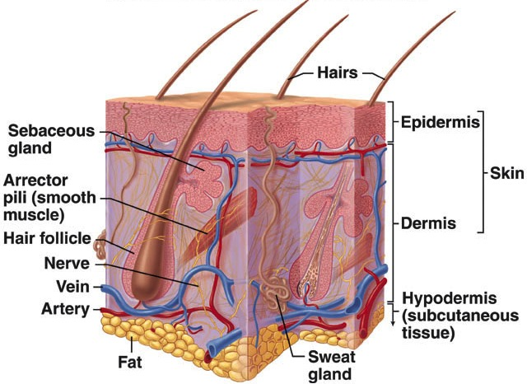
Structure of The Skin
There are two main components of the skin:
Epidermis
Dermis
Below the dermis lies the hypodermis. Although it is not strictly a part of the skin, its structure and function will also be discussed.
McGraw-Hill Companies
Notes:
Image Source:
http://www.rci.rutgers.edu/~uzwiak/AnatPhys/APFallLect7.html

Slide 15
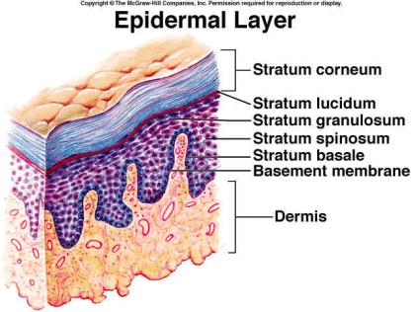
Epidermis
Structure
The epidermis consists of keratinizing stratified squamous epithelium.
It contains 4 strata:
Stratum basale
Stratum spinosum
Stratum granulosum
Stratum corneum
Cosmotruth, 2013
Notes:
Image Source:
https://cosmotruth.wordpress.com/tag/skin-layers/

Slide 16
Epidermis
Functions
Immune Protection
Keratinocytes
Use toll-like receptors (TLRs) to detect pathogens via their pathogen associated molecular patterns (PAMPs)
Activation leads to production of: type 1 interferons, cytokines, T_{H}1 response, and antimicrobial peptides
Langerhans Cells
Antigen-presenting cells that activate Naïve T cells via MHC-II
Secrete cytokines to induce local inflammatory response
Normal Flora
Commensal bacteria normally found on outside surfaces such as the epidermis, and in the gastrointestinal tract
Compete with harmful microbes to inhibit their colonization

Slide 17
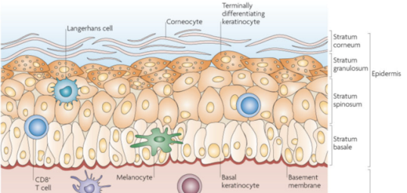
Epidermis
Functions
UV Protection
Melanocytes
Responsible for melanin production
Melanin absorbs UV light, scavenges free radical, and stores ions
Nestle et al. 2009

Slide 18
Epidermis
Functions
Physical Barrier
Waterproof (prevents loss of fluid and nutrients)
Prevent pathogenic invasion (i.e. bacteria, parasites, fungi
Protects against toxins, friction, mechanical trauma
Vitamin D Synthesis
Keratinocytes in epidermal layers synthesize precursor of vitamin D upon sunlight exposure
Chemical Protection
contains enzymes and has a low pH to prevent colonization by pathogens (this property of the epidermis does not affect the normal flora)
Notes:
Image Source
http://www.dreamstime.com/stock-images-cartoon-illustration-boy-red-shield-image18122434

Slide 19
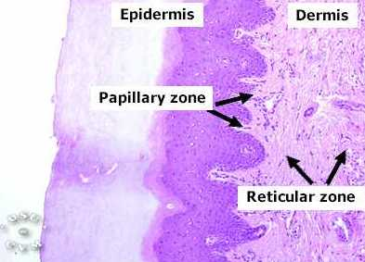
Dermis
Structure
The dermis consists of fibroelastic connective tissue (CT)
It contains 2 layers:
Papillary Layer
loose areolar CT
Reticular Layer
dense irregular CT
Ownby, C., 2002
Notes:
Image Source:
https://instruction.cvhs.okstate.edu/Histology/HistologyReference/hrskin.htm

Slide 20
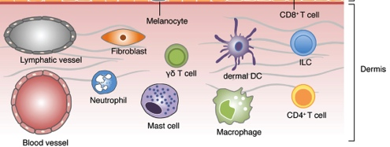
Dermis
Functions
Immune Protection
Immune Cells
Presence of dendritic cells, helper T cells, macrophages, natural killer cells, and mast cells
Chong et al. 2013
Notes:
Image Source (Modified)
http://journal.frontiersin.org/article/10.3389/fimmu.2013.00286/full

Slide 21
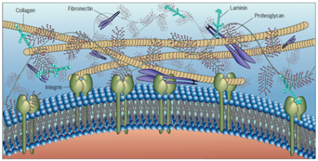
Dermis
Functions
Sensory Function and Thermoregulation
Mechanoreceptors and Thermoreceptors
Nerve endings that respond to the sensation of touch and heat
Tensile Strength
Extracellular Matrix (ECM)
Provide elasticity so that the skin can stretch and resist distortions
ECM
Karp, 2010
Notes:
Image Source
http://nptel.ac.in/courses/102103012/8

Slide 22
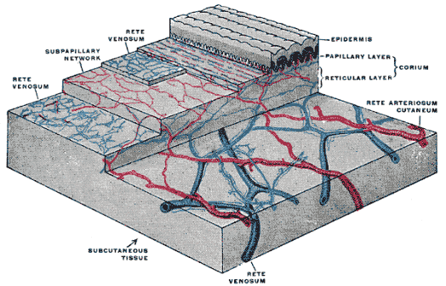
Dermis
Functions
Waste Removal and Nourishment
Blood Vessels
Transport nutrients to, and remove waste products from, the epidermis
Hydration
Collagen fibers bind water to keep
skin hydrated
Antimicrobial properties
Sweat from sweat glands
and sebum from sebaceous
glands prevent bacterial overgrowth
(sweat and sebum do not disturb
normal flora to any great extent)
Boundless, 2015
Notes:
Image Source
https://www.boundless.com/physiology/textbooks/boundless-anatomy-and-physiology-textbook/the-integumentary-system-5/functions-of-the-integumentary-system-66/blood-supply-to-the-epidermis-405-5030/

Slide 23
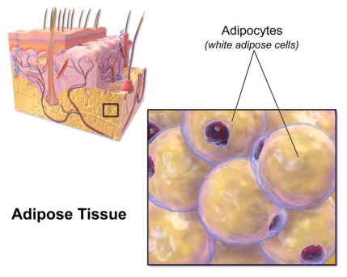
Hypodermis
Structure
Consists of loose connective tissue and elastin
Also contains sweat glands, hair follicles, nerves, lymph and blood vessels
Found beneath the dermis and does not belong to the skin
Functions
Insulation and Energy Storage
Adipocytes
Provides padding and insulation for the body
Serves as energy store
Blausen., 2014
Notes:
Image Source:
https://en.wikipedia.org/wiki/Adipose_tissue#/media/File:Blausen_0012_AdiposeTissue.png

Slide 24
Question 2 - Summary
The skin of the Integumentary System is affected in this case, specifically around the mouth and nose, and its normal physiological functions include…
Immune Protection
Mechanical Protection
Chemical Protection
UV Protection
Elimination of Waste
Providing Nourishment
Providing Elasticity
Thermoregulation
Sensory Function
Insulation, cushioning and
energy storage
McGraw-Hill Companies
Notes:
Image Source:
http://www.rci.rutgers.edu/~uzwiak/AnatPhys/APFallLect7.html

Slide 25
Question 2 - References
Arda, O., Goksugur, N., & Tuzun, Y. (2014). Basic histological structure and functions of facial skin. Clinics in Dermatology, 32(1), 3-13.
Baron, S. (Ed.). (1996). Medical microbiology. 4th edition. [Chapter 12Staphylococcus] (4th ed.). Galveston (TX): University of Texas Medical Branch at Galveston.
Blausen.com staff. "Blausen gallery 2014". Wikiversity Journal of Medicine. DOI:10.15347/wjm/2014.010. ISSN 20018762.
Boundless. “Blood Supply to the Epidermis.” Boundless Anatomy and Physiology. Boundless, 21 Jul. 2015. Retrieved 20 Jan. 2016 from https://www.boundless.com/physiology/textbooks/boundless-anatomy-and-physiology-textbook/the-integumentary-system-5/functions-of-the-integumentary-system-66/blood-supply-to-the-epidermis-405-5030/
Bush WD, Simon JD. (2007) Quantification of Ca(2+) binding to melanin supports the hypothesis that melanosomes serve a functional role in regulating calcium homeostasis.Pigment Cell Res. 20:134–9.
Chong, S. Z., Evrard, M., & Ng, L. G. (2013). Lights, camera, and action: Vertebrate skin sets the stage for immune cell interaction with arthropod-vectored pathogens. Frontiers in Immunology, 4, 286.

Slide 26
Question 2 - References
Cichorek, M., Wachulska, M., Stasiewicz, A., & TymiÅ„ska, A. (2013). Skin melanocytes: Biology and development. Advances in Dermatology and Allergology/PostÈ©py Dermatologii I Alergologii, 30(1), 30-41.
Cosmotruth. (July 8. 2013). Skin anatomy 101. Retrieved Jan. 20, 2016, from https://cosmotruth.wordpress.com/tag/skin-layers/
Costin GE, Hearing VJ. (2007) Human skin pigmentation: melanocytes modulate skin colour in response to stress. FASEB J. 21:976–94.
Costin GE, Hearing VJ. (2007) Human skin pigmentation: melanocytes modulate skin colour in response to stress. FASEB J. 21:976–94.
Elias, P.M. (2007). The skin barrier as an innate immune element. Seminars in Immunopathology 29 (1): 3–14.
Lecture 7: integumentary System., Jan. 20, 2016, from http://www.rci.rutgers.edu/~uzwiak/AnatPhys/APFallLect7.html

Slide 27
Question 2 - References
Nestle, F. O., Di Meglio, P., Qin, J. Z., & Nickoloff, B. J. (2009). Skin immune sentinels in health and disease. Nature Reviews.Immunology, 9(10), 679-691.
OpenStax College, Anatomy & Physiology Chapter 5 The Integumentary System (pages 178 - 186). OpenStax College. 25 April 2013. Retrieved January 12, 2016, from https://openstaxcollege.org/files/textbook_version/low_res_pdf/13/AnatomyAndPhysiology-LR.pdf
Ownby, C. L. (2002). The integument - the skin and all of its derivatives. Retrieved Jan. 20, 2016, from https://instruction.cvhs.okstate.edu/Histology/HistologyReference/hrskin.htm
Riley PA. Melanin. (1997) Int J Biochem Cell Biol. 29:1235–9.
Todar, K. (2012). Todar's online textbook of bacteriology. Retrieved 01/12, 2015, from http://textbookofbacteriology.net/staph_2.html

Slide 28
In what ways has the normal physiological functioning of this area of the body been disturbed by the infection?
The Body Systems – Q3
Presented By: Kyle Gillard

Slide 29
Protective Factors
The epidermis usually has many factors in place to prevent infection:
pH of ~5.6 due to lactic acid in sweat and fatty acids in sebaceous secretions
At this pH, normal flora is not disturbed but growth of transient bacteria is inhibited
Further, fatty acids have antimicrobial properties to inhibit transient microbial growth
Relative dryness
Continuous shedding of the outermost layer
This also sheds off bacteria on the skin

Slide 30
Physiologic Consequences of Infection
The lesions caused by the bacterial infection breach the skin’s defensive mechanisms
This leaves the affected area more prone to damage from environmental sources
UV, mechanical stress, chemical damage
The skin’s ability to retain moisture is lost
The stratum corneum’s lipid layer is breached

Slide 31
Physiologic Consequences of Infection
The affected area is also at risk for further microbial infections because:
Local flora is disturbed and therefore has reduced ability to compete with harmful microbes which can then overpower local flora and establish infection
Destruction of intact skin and of immune cells in area
Skin secretions that allowed for low pH at surface are impaired which further gives way for bacteria to colonize

Slide 32
Question 3 – References
1. DiPiro JT. Pharmacotherapy a pathophysiologic approach [Internet]. New York: McGraw-Hill Medical; 2008 [cited 2016 Jan 14]. Available from: http://site.ebrary.com/id/10251610
2. Goldsmith LA, Fitzpatrick TB. Fitzpatrick’s dermatology in general medicine. New York: McGraw-Hill Medical; 2012.

Slide 33
Are there are any secondary sites of infection and, if so, what enables the bacteria to (a) travel to; and (b) affect these areas of the body?
The Body Systems – Q4
Presented By: Kirk Chen

Slide 34
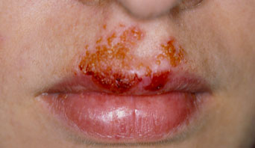
Primary Site of infection
Definition: a site where the infection is first established¹
Stephanie’s primary site of infection is around the mouth and nose.
Common primary site of impetigo is also around the mouth and nose.²
Notes:
Image retrieved from http://www.nhs.uk/Conditions/Impetigo/Pages/Symptoms.aspx

Slide 35
Secondary site of infection
Definition: an infection at a site other than the point of entry³
An infection can spread from a primary site to a secondary site via:
Direct inoculation (e.g. one of the main symptoms of impetigo is itching at the site of infection. This enhances the spread as one continuously touches the site and then other surfaces)
Through the blood or lymph systems
Virulence factors such as surface proteins, invasins, and membrane-damaging toxins enable bacterial invasion of these areas

Slide 36
Secondary site of infection
In Stephanie’s case, the physician did not identify any secondary site of infection
“there is no rash on her hands or feet or inside her mouth”
This helps to diagnose her infection by ruling out other potential causative agents
For example, common symptoms of a viral rash are fever, swollen lymph nodes, and infection of other parts of the body
By determining that there are no vesicles on the patient’s hands, feet and in the mouth we can rule out viral causes of infection

Slide 37
Possible Complications of Infection
In some rare cases, impetigo can lead to acute infectious eczematoid dermatitis, which is a skin infection characterized by an acute eczematous eruption triggered by purulent discharge from a primary site of infection. ⁴
It is usually characterized by spreading vesicles & pustules surrounding an infection site.⁵

Slide 38
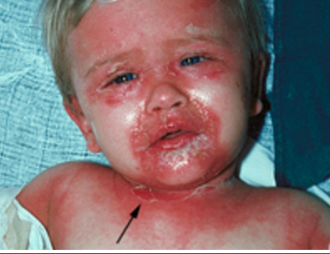
Possible Complications of Infection
Staphylococcal scalded skin syndrome (SSSS)
An exfoliative toxin produced by Staphylococcus acting at secondary sites
The toxin breaks down the desmosomes of the epidermis
Can lead to extensive painful dermatitis, general malaise, fever, and irritability⁶
Retrieved from
http://www.dermnetnz.org/bacterial/scalded-skin-syndrome.html

Slide 39
Possible Complications of Infection
Post-streptococcal glomerulonephritis⁷
Rare complication
Results from the deposition of antibodies, that were produced against virulence factors of infection-causing bacteria, in the glomeruli of kidneys
Deposition of antibodies in glomeruli activates complement system and inflammation ensues
Inflammation hampers the ability of the kidneys to filter urine

Slide 40
Question 4 - References
Marcovitch, H. (2010). Primary site (of infection). In Black's medical dictionary. London: A. & C. Black.
Marcovitch, H. (2010). Secondary site (of infection). In Black's medical dictionary. London: A. & C. Black.
Aly, R. (1996). Microbial Infections of Skin and Nails. In Baron S (Ed.), Medical Microbiology Galveston, TX: University of Texas Medical Branch at Galveston
Lewis, L. S. “Impetigo.”: Practice Essentials, Background, Pathophysiology. Medscape, n.d., Web.
Yamany, T., Schwartz, R. A. (2015) Infectious eczematoid dermatitis: a comprehensive review. J. Eur. Acad. Dermatol. Venereol., 29(2), 203-8.
King, R. W. Staphylococcal Scalded Skin Syndrome. Medscape, n.d., web.
Glomerular Diseases." US Department of Health and Human Services. National Institute of Diabetes and Digestive and Kidney Diseases, n.d. Web.

Slide 41
Why did the doctor suggest that Stephanie stay at home for a few days?
The Body Systems – Q5
Presented By: Jaspreet Padam

Slide 42
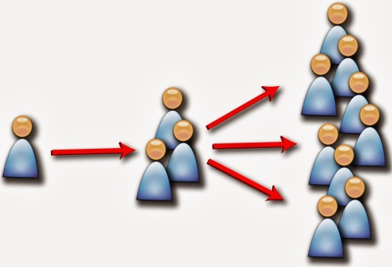
Impetigo Is Highly Contagious
Once infected, a person can quickly and easily pass it on to many others
Another person can become infected either by:
having direct contact with the infected individual
touching things that have been previously touched by the infected person and therefore, may contain infectious residues of the infection
Retrieved from http://www.shinglesexpert.org/is-shingles-contagious

Slide 43
Why Stephanie Should Stay At Home
For Stephanie’s case, the doctor’s suggests for her to stay at home for a few days to prevent the spread of the disease and also so that she can more quickly recover from her infection:
Given Stephanie’s age, she will most likely be interacting with other young children who are especially susceptible to contracting the infection due to the immaturity of their immune systems.
Infections, or any ailments, clear up faster when the body is at rest and not under stress. Therefore, sleep and a well-balanced nutrition at home will make Stephanie feel better sooner.

Slide 44
Why Stephanie Should Stay At Home
Without medication, impetigo is contagious until the sores go
away which can take anywhere from two to four weeks.
If the patient takes oral antibiotics however, the infection is no longer contagious 24-48 hours after beginning treatment.
The amount of time it takes for healing is also accelerated with the sores clearing up in 2-5 days.

Slide 45
Question 5 - References
Hartman-Adams, H., Banvard C., and Juckett G. Ameri. "Impetigo: Diagnosis and Treatment." American Family Physician 90.4 (2014): 229-35. Web.
Nordqvist, Christian. "Impetigo (Infantigo): Causes, Symptoms and Treatments." Medical News Today. MediLexicon International, 30 June 2015. Web.
Opp, M. R. (2009). Sleeping to fuel the immune system: Mammalian sleep and resistance to parasites. BMC Evol Biol BMC Evolutionary Biology, 9(1), 8.
"Impetigo." - Mayo Clinic. Mayo Clinic, n.d. Web.

