Slide 1
Case Study 2 Microbiological Testing for Chlamydia and Gonorrhea
Maria Bleier
PATH 417

Slide 2
Overview
The case
The bacterial causes
Samples for laboratory testing
Types of laboratory tests to conduct
Expected or Positive Results

Slide 3
The Case
21 yr. old male patient Naser G.
Felt burning sensation during urination and discharge after sexual activity
Physician’s examination:
Asked after sexual history (new partner and unprotected sex)
Partner described as asymptomatic for STIs
Recommendation:
Prescription antibiotic
Microbiological testing for both Naser and his partner
NOTE: Based on the symptoms of (1) dysuria (painful urination) and (2) green discharge described by Naser, it is likely that he has urethritis – an inflammatory infection of the urethra.

Slide 4
The Bacterial Causes
The two likeliest bacterial agents to cause Naser’s symptoms of urethritis are…
Neisseria Gonorrhoea
Chlamydia Trachomatis
Characteristics:
Intracellular gram negative cocci bacterium
Incubation period around 2-6 days in males
Areas of infection:
Cervix, urethra, rectum, pharynx, and eyes (conjunctiva)
Appearance:
Seen in pairs with flattened sides and pili for adherence
0.6-1.0 micrometers in diameter
Characteristics:
Non-motile obligate intracellular bacterium
Areas of infection:
Mucous membranes, epithelial cells, lymphatic tissue
Appearance: (2 stage)
Elementary body – non replication particles (0.24-0.3 micrometers), rigid cell wall
Reticulate body – large intracellular cytoplasmic replicating bodies (0.5-0.6 micrometers )

Slide 5
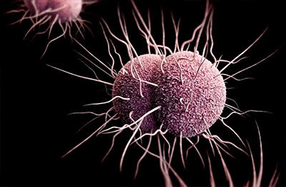
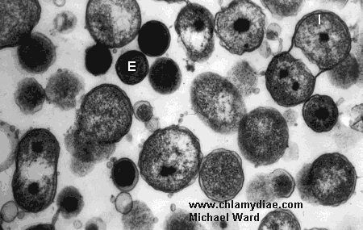
The Bacterial Causes
The two likeliest bacterial agents to cause Naser’s symptoms of urethritis are…
Neisseria Gonorrhoea
Chlamydia Trachomatis
Shown here: E represents the elementary bodies; The larger gray cells are reticulate bodies.

Slide 6
The Bacterial Causes
Other non-gonoccocal urethritis… *Note: They do NOT cause dysuria or discharge
Mycoplasma Genitalium
Ureaplasma
Characteristics:
Gram negative bacteria belonging to Mycoplasma Genus
Able to self-replicate, sexual contact primary mode of transmission
Areas of infection:
Adheres to epithelial lining of respiratory and urogenital tract
Appearance:
Flask shaped and no peptidoglycan cell wall
0.2-0.7 micrometers in diameter
Characteristics:
Urease-producing bacteria
Also belongs to family Mycoplasma
Transmission through sexual contact or during birth (horizontal)
Areas of infection:
Mucous membranes
Appearance:
No cell wall, appears spherical – ovoid coccoid cells
0.2-0.8 micrometers in diameter

Slide 7
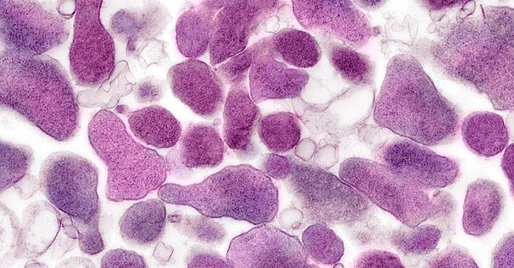
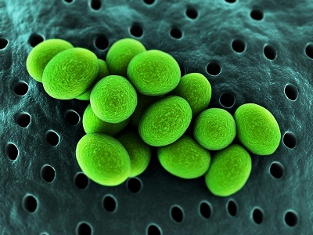
The Bacterial Causes
Other non-gonoccocal urethritis… *Note: They do NOT cause dysuria or discharge
Mycoplasma Genitalium
Ureaplasma

Slide 8
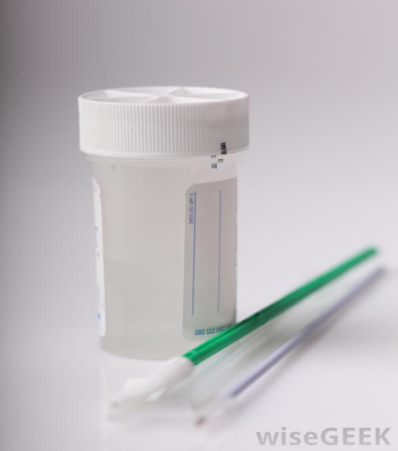
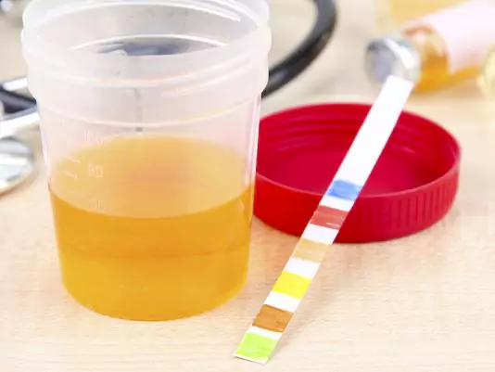
Samples for Laboratory Testing
Two main specimen types for Diagnoses:
Urethral Smear
Prepared with cotton-tipped swab/plastic loop
Performed when discharge is present + urethritis symptoms
Air dried smear of discharge is best, next to swabbed discharge
Perform gram stain and culture for bacterial growth
Urine Samples
Standard of STI testing; particularly useful for culturing pathogens and observing presence of immune or blood cells (best non-invasive method for men)
Sample should contain “first catch” urine and prior to this, no urination for 2 hrs

Slide 9
Types of Conformational Laboratory Tests
Microscopy:
Gram Staining
Shows morphology and determines if bacteria is gram +/-
Gram + stains for blue/violet
Gram – stains for pink (counterstain due to presence of lipid layer)
Also helps to determine colony structure of bacteria
Rapidly identifies cause of infection and robustness/quality of sample
Difficult to identify/stain intracellular bacteria (i.e. c. trachomatis)
Cultures: (plating urine specimen)
Thayer-Martin Agar
Sheep’s blood medium good for colonizing Neisseria bacterium
HeLa Cell Cultures
Another medium for intracellular bacterial obligates to culture in
Mycoplasma Agar
Medium used for colonizing Neisseria gonorrhoea and gram staining

Slide 10
Types of Conformational Laboratory Tests
Cultures cont’d:
Oxidase Test
Determining if bacterium produce cytochrome C oxidases, staining dark blue
Acid detection Test
Degree of acid/metabolic production from carbohydrates with pH indicator
Enzyme Substrate Test
Differentiates between Neisseria pathogens via enzyme staining
Nitrate Reduction Test
Detects nitrite in medium that; distinguish bacterial colonies with red stain
Giemsa stain
Gram stain test specific for chlamydia trachomatis (blood smears; pink-blue)
Other Tests:
Enzyme Immunoassay (EIA)
Antigen detection and staining of LPS structures from chlamydia/pathogens
Nucleic Acid Hybridization (NAH)
Detects sequences of ssDNA/RNA annealing to complementary strands
Direct Fluorescent Antibody Testing

Slide 11
Expected Results
Cultures:
Gram Staining
Gonorrhea - Gram (-) pink diplococci; Chlamydia - gram (–) round pink path.
Thayer-Martin Agar
Formation of N. Gonorrhea colonies
HeLa Cell Cultures
Formation of colonies (i.e. observing reticulate bodies with microscopy)
Mycoplasma Agar
Formation of Colonies
Oxidase Test
Presence of catalyze enzyme of N. Gonorrhea turns reagent dark purple
Acid detection Test
N. gonorrhea produces acid from glucose; indicator turns yellow (acidic)
Enzyme Substrate Test
Chlamydia - Enzyme staining/colored product indicates LPS binding
Nitrate Reduction Test
Red stain present in culture indicates positive result
Giemsa stain
Gram stain pink-blue indicates presence of chlamydia trachomatis

Slide 12
Expected Results
Other Tests:
Enzyme Immunoassay (EIA)
Staining of LPS structures indicates presence of chlamydia
Nucleic Acid Hybridization (NAH)
Detection of hybridized sequences of ssDNA/RNA for pathogens
Direct Fluorescent Antibody Testing
Binding of fluorescent Abs to antigens of Chlamydia observed in assay
Serology Tests
Detection of IgG or IgM abs in patients blood associated with infection (antigen specific Abs produced)
Molecular tests
For positive results these tests detect hybridization of DNA/RNA (like with NAH) or quantifies the amplification of pathogen-specific sequences

Slide 13
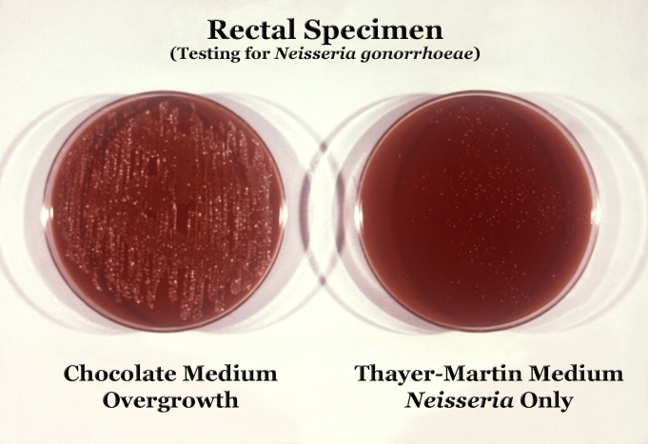
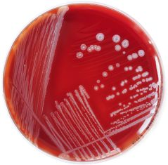
Expected Results
Examples of Positive Cultures for Gonorrhea and Chlamydia:
Chlamydia Trachomatis

Slide 14
END

