Slide 1
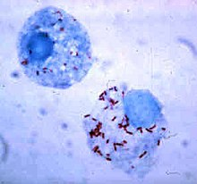
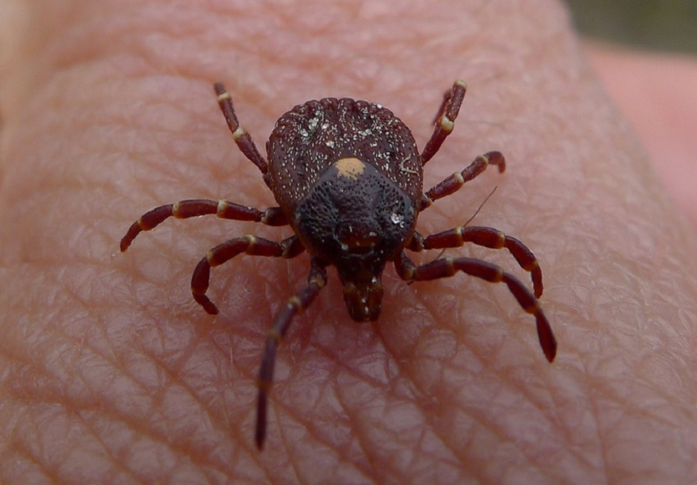
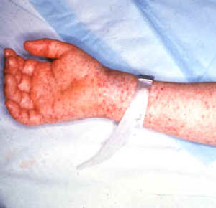
CASE 3: Rickettsia rickettsii and
Rocky Mountain Spotted Fever (RMSF)
By: Riley Ty

Slide 2
Case: A Red Rash
Robert is a 41-year-old man who came down with a high fever, headache, abdominal pain and muscle aches. He decides to tough it out at home but after 2 days, he also develops a red rash on his arms and legs. His wife drives him to the hospital where he is assessed by the emergency physician. The doctor asks about any insect bites and Robert tells him about getting tick bites during a camping trip one week prior to developing the first symptoms. Upon examining Robert he notes the macular rash on the arms and legs. Initial bloodwork shows that Robert has a low platelet count, low sodium levels and abnormal liver function tests.
The doctor orders a microbiological serology test and starts him on intravenous antibiotics. The acute serologic test for Rickettsia rickettsii shows a low level of IgM antibodies and Rick is diagnosed with Rocky Mountain Spotted Fever. The diagnosis is subsequently confirmed when convalescent serology shows a 16-fold rise in antibody titers to R. rickettsia.

Slide 3
Overview of Topics
1. Encounter:
Places of Residence
How Bacteria are suited to survive in areas of Residence.
How Bacteria are suited to survive in the vector.
2. Entry:
Entry Points.
Adherence.
4. Bacterial Damage:
Maintaining Host cell Integrity
Oxidative Stress
Inflammatory mediators.
Vascular Permeability
Further Damage
Robert’s Symptoms
3. Multiplication and Spread:
Zipper Mechanism.
Trigger Mechanism.
Internalization.
Escape Part 1.
Escape Part 2.

Slide 4
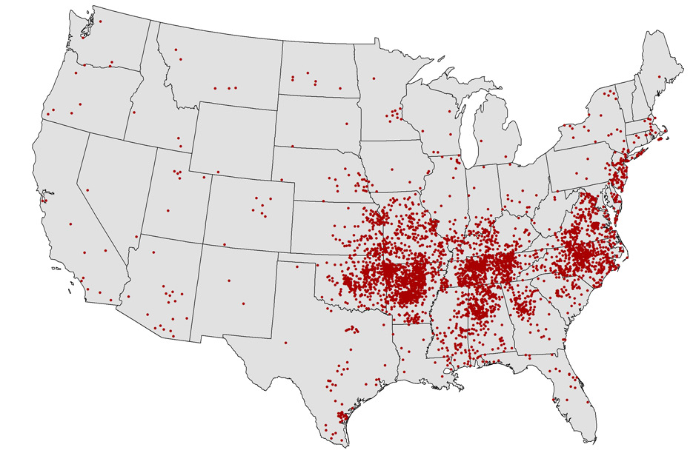
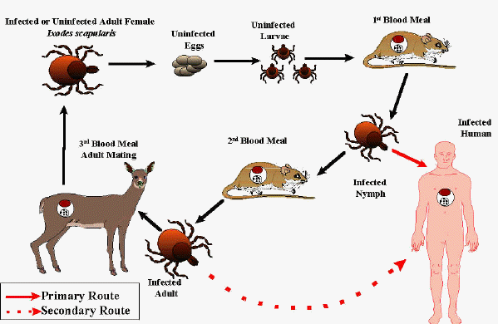
ENCOUNTER (1)
Places of Residence:
R. rickettsii exists worldwide (except Antarctica).
RMSF outbreaks occur mainly in the Americas, in warm damp
environments.
Small rodents can act as reservoirs for the bacteria, but vector transmission is restricted to ticks.
Incidence rates increase when ticks come out (i.e. the rainy and warm seasons of April and October).
Ticks spread R. rickettsii via saliva, blood, feces, or other bodily fluids, into the blood vessels (endothelial cells) and cytoplasm or nuclei of host cells.

Slide 5
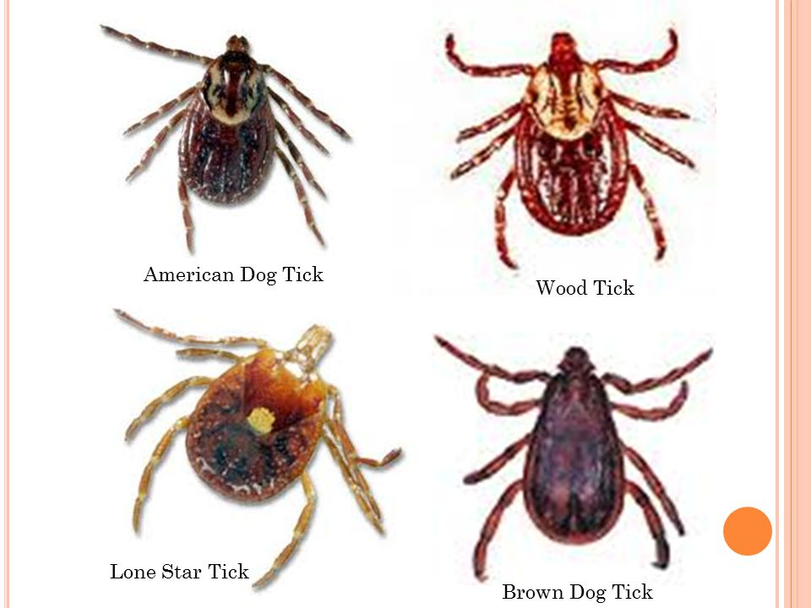
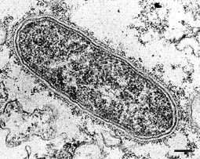
ENCOUNTER (2)
How Bacteria are suited to survive in areas of Residence:
Contains slime layer, which protects against dry environment (desiccation), antibiotics and allows it to adhere to smooth surfaces.
Low Infectious Dose (ID)
Bacteria are small size (0.2 x 0.5 um), allowing them to inhabit cytoplasm and nucleus, also low SA:V ration.
Can metabolize host glutamate via aerobic respiration.
Able to grow in low levels of nutrients.
How Bacteria are suited to survive in the Vector:
Main vector of R. rickettsii is the family of Ixodidae ticks, such as Dermacentor variabilis (American dog tick), Dermacentor andersoni (Rocky Mountain Wood Tick), and Rhipicephalus sanguine (Brown dog tick)
R. rickettsii can colonize the midgut, then bypass it to reach the salivary gland, making vector effective for transmission.
Must also survive host defenses and outcompete other strains of Rickettsia species.
Initial infection is permanent within tick, but bacterium is maintained via the laying of infected larva (transovarial transmission).
Ticks can also become infected by feeding on other reservoirs such as rodents (i.e. transstadial mode of transmission).

Slide 6
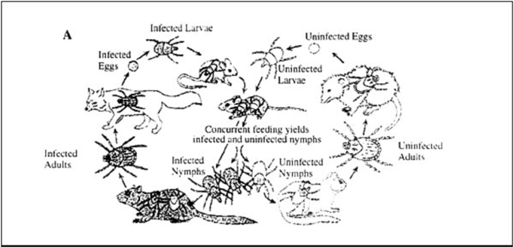
ENCOUNTER (3)
Patient:
Robert most likely go bitten by an infected tick on his camping trip.
The tick must have been attached to Robert for 4-6 hours for successful transmission.
Incubation period is 2-14 days with symptoms manifesting 6-10 days post bite.
Onset of Robert’s symptoms is 7 days post bite, coinciding with expected timeline.
Most likely either American dog tick or Rocky Mountain tick. wood tick.

Slide 7
Entry
R. rickettsii has two potential entry points for a human host.
(1) The less common route, via the mucous membrane (ex. Conjunctiva) and lungs (ex. Aerosol). OR
(2) The primary route via the skin at the bite location.
Afterwards, the bacteria inoculates on the dermis.
From there it adheres and invades vascular endothelial cells.
The bacteria then enter its obligate intracellular environment, necessary for downstream spread and replication.
Adherence is the most important step for pathogenesis and is mediated by adhesion-receptor interaction.
rOmpA and rOmpB are surface-exposed outer membranes/adhesions that attach to host cell’s surface receptors.
rOmpA mediates bacterial adherence to endothelial cells.
rOmpB is involved in adherence and internalization, it is a ligand for ku-70.
Interaction with rOmpB leads to phagocytic internalization of bacteria.

Slide 8
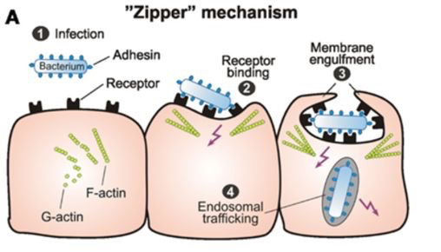
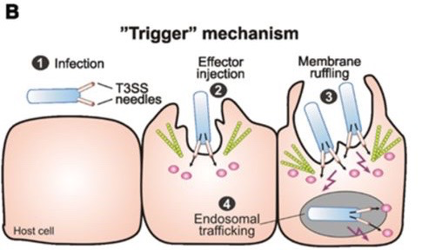
Multiplication and Spread (1)
After adhesion, the R. rickettsii induces actin rearrangement within host cells to cause internalization and further replication of the bacterium. There are two possible mechanisms for internalization:
Zipper Mechanism
Bacterial protein binds to host receptor on cell surface.
This activates cell signaling pathway, which results in rearrangement of the cytoskeleton and for the host membrane to engulf the bacterium.
(2) Trigger Mechanism
Trigger uses a specialized invasion system called Type 3 Secretion System (TTSS), unlike the zipper mechanism which also uses components of adhesion.
TTSS forms a needle like structure on the bacteria’s surface and uses it to penetrate the host cell membrane.
Various effectors proteins will then be released and cause host cell signaling molecules to rearrange the Cytoskeleton.
Genome analysis revealed a lack of TTSS genes in multiple Rickettsia species, therefore it is suggested that the bacteria uses the zipper mechanism for invasion. The process beings when bacterial OmpB binds cellular Ku-70.

Slide 9
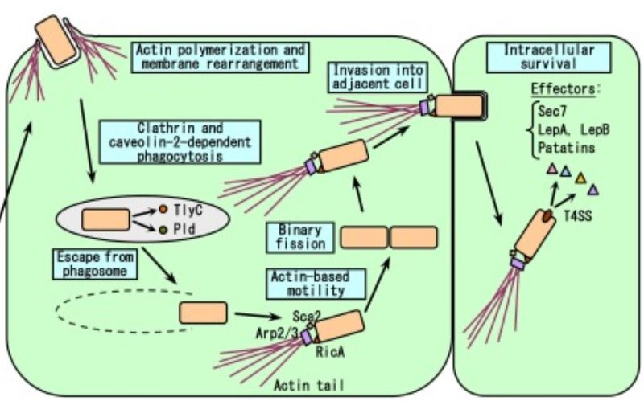
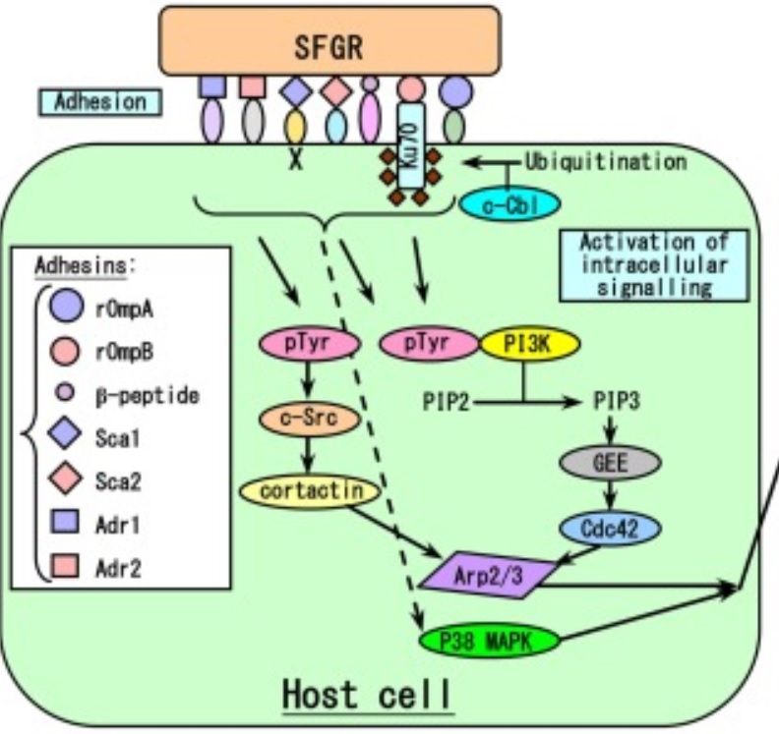
Multiplication and Spread (2)
Internalization (Figure on Left):
Binding of OmpB and Ku-70 recruits c-cbl, which adds ubiquitin to Ku-70.
This activates multiple signaling proteins such as CDC42, Arp 2/3 complex, phosphoinoside 3 kinase and C-src.
Arp 2/3 (an actin nucleating complex) is specially important as it will directly cause localized actin rearrangement around R. rickettsii, causing engulfment via phagosome.
Escape Part 1 (Figure on Right):
To escape prior to lysosome fusion, R. rickettsii utilizes phospholipase D and hemolysin C, which have been shown to have memranolytic abilities.
It is also possible to utilize phospholipase A2, but the exact escape procedure is still unknown.
In the cytosol the bacterium will absorb the host nutrients to survive, grow and multiply.

Slide 10
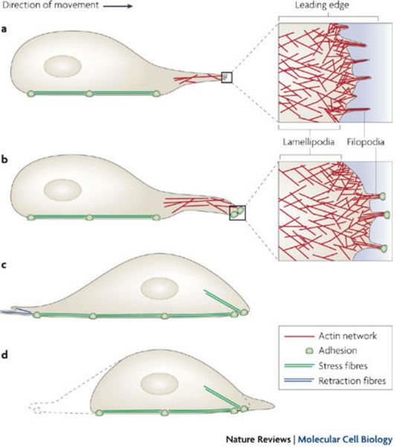
Multiplication and Spread (3)
Escape Part 2:
A few rounds of division is required prior to exiting.
R. rickettsii begins by utilizing Arp 2/3 to activate Rick A, which begins directing actin nucleation at one side of the bacteria, resulting in the formation of little tails.
These tails allow the bacteria to move around the cytosol and begin the formation of filopodia (long thin cell projections) once sufficient speed is achieved.
The filopodia enable the bacteria to pierce and infect adjacent cells.
Filopodia also direct which cells are infected, as filopodia formed on the basal side of vascular endothelial cells are able to infect vascular smooth muscle cells and potentially enter the CNS.
While filopodia on the luminal side can enter the bloodstream and spread further throughout the body.

Slide 11
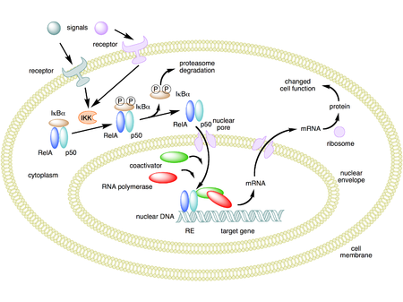
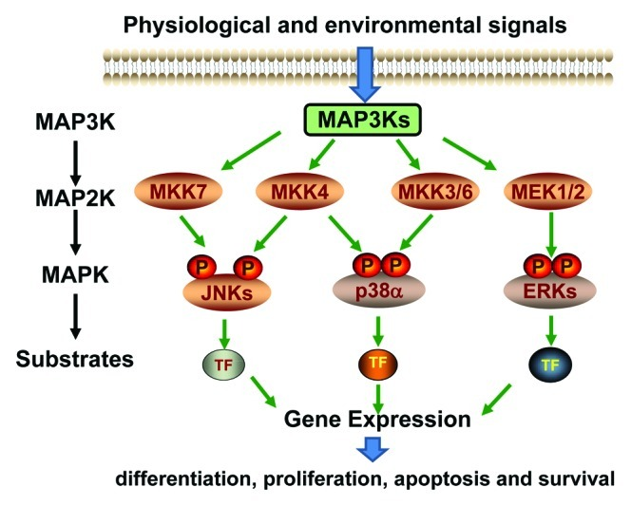
Bacterial Damage (1)
Maintaining host cell integrity:
To ensure its survival prior to inflicting damage upon the host, the bacteria must maintain the host cell’s integrity and intracellular environment by:
Inducing multiple signaling mechanisms, causing endothelial activation, within host endothelial cells.
NF-kB and MAPK are the two primary host factors and signaling pathways involved in this process.
MAPK signaling will have an anti-apoptotic effect on the endothelial host cell.
NF-kB signaling also has anti-apoptotic abilities, but does this by either altering B-cell lymphoma-2 protein expression to maintain integrity of host mitochondria or by inhibiting caspase-8 and caspase-9 apoptosis pathways.
- End result is that the bacteria are allowed to survive, replicate and infect other cells.

Slide 12
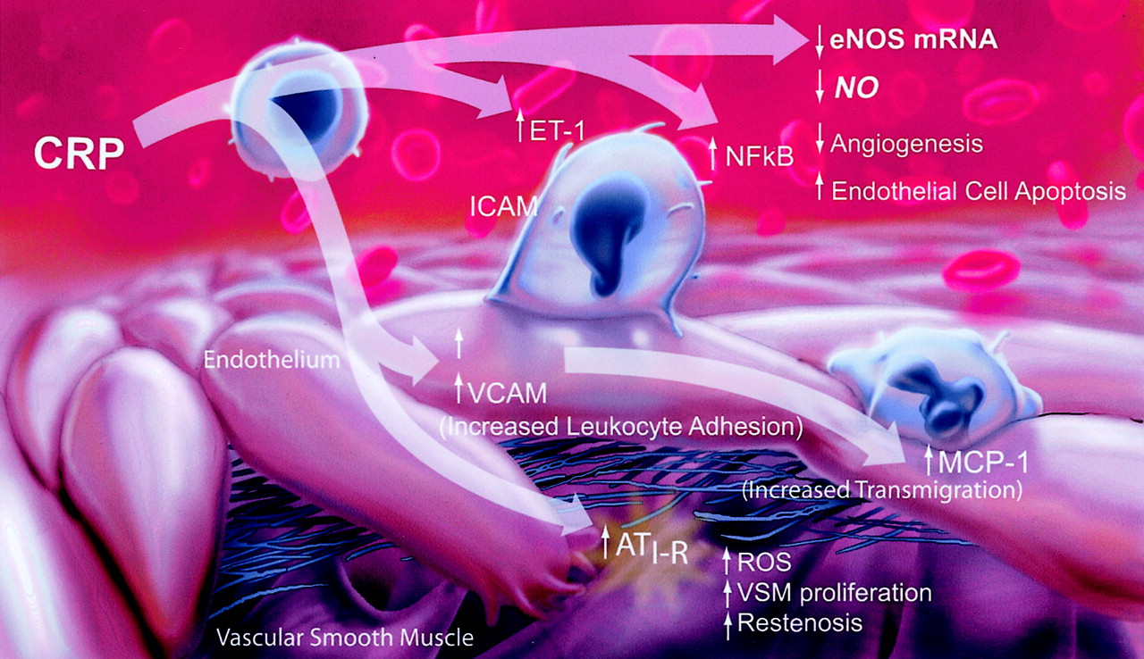
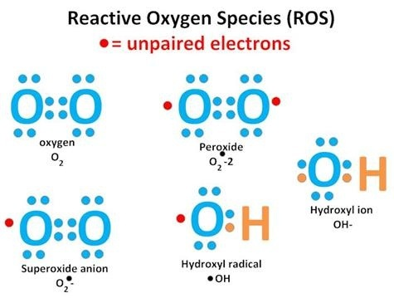
Bacterial Damage (2)
Inflammatory Mediators:
Direct damage begins when NF-kB and MAPK increase the expression of inflammatory proteins (i.e. IL-1α, IL-6, chemokines IL-8, monocyte chemoattractant protein-1, fractalkine)
The influx of these molecules will damage local cells at the site of infection.
Oxidative Stress:
Reactive oxygen species (ROS), such as O²⁻ radical and H₂O_{2,} can be unregulated by MAPK signaling and cause oxidative stress on host cells.
Simultaneously host glutathione can also be reduced by the bacteria, causing a decrease in defenses (i.e. glucose-6-phosphate dehydrogenase, glutathione peroxidase, and catalase) that mitigate ROS damage.
The oxidative stress has the potential to cause intracellular membrane dilation, loss of osmoregulatory control and cell lysis.

Slide 13
Bacterial Damage (3)
Vascular Permeability:
Oxidative stress can also increase expression of heme oxygenase (HO-1), a molecule that cleaves heme to release CO₂ and biliverdin.
This increased expression will also result in increased COX-2 enzyme, prostaglandin and increased vascular permeability.
Biliverdin is converted to bilirubin and will lead to abnormal liver functions, such as in Robert’s case.
The increase in vascular permeability will lead to fluid imbalance along with edema.
Damage will also be inflicted on the vascular endothelial cells, leading to multisystem vasculitis, necrotic lesions and cause fluid/blood to leak into neighboring regions.
The fluid/blood leakage also causes dermal rashes hypovolemia and reduced tissue perfusion, all of which were noted in this case (macular rashes and low platelet count).
Antidiuretic hormone will be released in response and cause hyponatremia.
The bacteria can also cause the depletion of adenosine 5-triphosphate leading to failure of the Na+ pump and improper cellular metabolism,.
Low Na+ levels can also increase vascular permeability along with hyponatremia.
Robert was noted to have low Na+ levels.

Slide 14
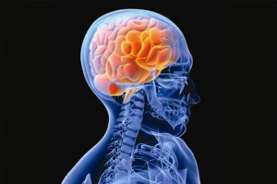
Bacterial Damage (4)
Further Damage:
Bacterial replication occurs within endothelial tissues and hinders the circulatory system.
Lack of platelets (i.e. fluid loss) can lead to decreased volume of blood flow in the organs, causing significant failure along with complications such as encephalitis, non-cardiogenic pulmonary edema, interstitial pneumonia, hypovolemia, hypotensive shock, and acute renal failure.
Bacteria also has the potential to affect CNS causing (meningismus, seizures, altered mental states, temporary deafness, lethargy, and amnesia).
Robert’s Symptoms:
Robert is experiencing the typical RMSF symptoms of high fever, headache, abdominal pain and muscle aches.
The rest of his symptoms and the causes behind them were noted in the previous slide.

