Slide 1
PATH 417 Case 1: School Sores
Bacterial Pathogenesis Summary
By: Sunny Chen

Slide 2
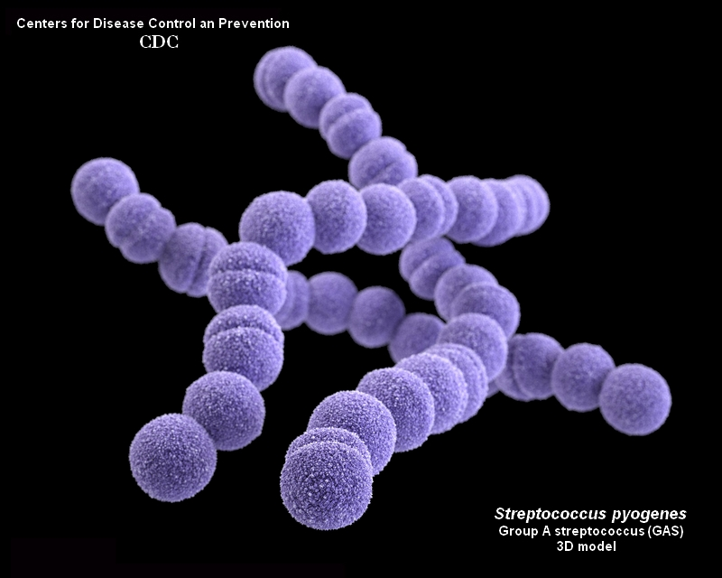
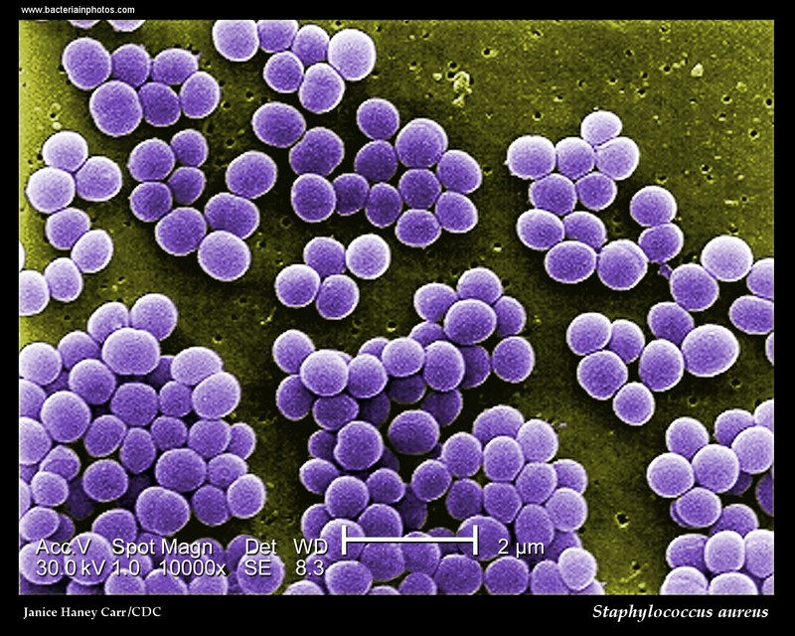
Two bacteria species present in this case
1. Staphylococcus aureus (S. aureus, left figure)
2. Streptococcus pyogenes (S. pyogenes, right figure )

Slide 3
Encounter-Part 1
 | S. aureus | S. pyogenes
Geographical distribution | Largely present everywhere, especially warm weather area; (MRSA commonly reported in temperate and usually affluent regions) | Far more common in tropical regions, warm weather areas
Human body distribution | Part of human body normal flora, usually reside under the skin, anterior nares of the nasopharynx, throat and hair | Part of human body normal flora, present in epithelial surfaces and respiratory tract (e.g. the nasopharyngeal mucosa (throat) and skin)

Slide 4
Encounter-Part 2
 | S. aureus | S. pyogenes
Why suitable in these human body areas? | Environmental conditions (i.e. temperature and pH) in these areas are suitable for the organisms | Environmental conditions (i.e. temperature and CO₂ concentration) are very suitable for the organisms
Transmission Route | Transmitted through aerosol or direct contact with fomites, infected animals, or infected people; normal flora | Transmitted via respiratory droplets, hand contact with nasal discharge, skin contact with impetigo lesions, transmit back to human via contaminated food source

Slide 5
How may Stephanie come in contact with the bacteria?
Two possibilities:
Since both S. aureus and S. pyogenes are parts of the normal flora, they can be introduced to the broken part of the skin (e.g. due to scratch and cut)
Stephanie may pick up the bacteria from elsewhere (e.g. another person, food, other environmental sources) and probably because of her poor hand washing practices (as being a kid), bacteria are left on her hands and can contaminate other parts of the body

Slide 6
Entry-Part 1
 | S. aureus | S. pyogenes
Entry | Enter the host via broken skin | Enter the host via broken skin or via upper respiratory tract
Residence | Reside in the localized tissues of the entry site, later position near throat, ear, mouth and sinus | Reside in both skin and throat after entry

Slide 7
Entry-Part 2: Molecular/cellular/physiological factor at site specificity and initial adherence step
S. aureus
MSCRAMM (Microbial surface components recognizing adhesive matrix molecules): a variety of molecules used for adhering and invading host epithelial cells
Clumping factor B and wall-associated teichoic acid: have proven roles in nasal colonization
Catalase and other antioxidants: neutralize hydrogen peroxide secreted by other bacteria (e.g. S. pneumoniae) to compete for the same niche
S. pyogenes
Different adhesins expressed under the influence of different environmental factors
Important components in bacterial adherence: M protein, fibronectin-binding proteins (protein F), lipoteichoic acid (LTA)
Details next page

Slide 8
Entry-Part 2: Molecular/cellular/physiological factor at site specificity and initial adherence step (Conti)
S. aureus
Fibrinogen/fibrin binding protein (the clumping factor): promote attachment to blood clots and traumatized tissue
Fibronectin and fibrinogen-binding proteins: same purpose as above
Fibronectin: present on epithelial and endothelial surfaces as well as being a component of blood clot
S. pyogenes
M protein: facilitates attachment via host keratinocytes upregulates production of IL-1 and prostaglandin E2
Protein F: promotes streptococcal adherence
By binding to the amino terminus of fibronectin on mucosal surfaces making nasal and oral cavities highly susceptible to infection

Slide 9
Entry-Part 2: Molecular/cellular/physiological factor at site specificity and initial adherence step (Conti)
S. aureus
Receptors(specific in strains cause osteomyelitis and septic arthritis): promote attachment to collagen
might be important in promoting bacterial attachment to damaged tissue where underlying layers have been exposed
agr: quorum sensing locus-responsible for commensalism; only activated if transported to unfamiliar tissues
S. pyogenes
LTA: act as an adhesin
By reacting with bacterial surface molecules (e.g. M protein) through its negatively charged polyglycerol phosphate backbone and positively charged residues of surface proteins

Slide 10
Multiplication and Spread
 | S. aureus | S. pyogenes
Stay localized? | -stay localized most of the time - occasionally spread to bloodstream, causing bacteremia | - stay localized most of the time - can enter bloodstream and causes other nonsuppurative complications; an important cause of toxic shock syndrome
Secondary infections possible? | -secondary infections possible, sites include: skeletal muscles, meninges, kidney, heart, or in the lung | -secondary infections possible, sites include (skin route): the bone, other sites of the skin, muscles, the brain, and the heart –cause joint or bone infections, destructive wound infections, myositis, meningitis, and endocarditis Or (respiratory route) Sites include: sinus, middle ears, and the lungs – cause sinusitis, otitis, and pneumonia

Slide 11
Multiplication and Spread (Conti)— Extracellular vs. Intracellular?
S. aureus
remains extracellular for most of the diseases involved (e.g. furuncles, impetigo, abscesses, necrotizing pneumonia)
can be intracellular sometimes; internalized by the host’s receptor-mediated endocytosis mechanism
express molecules that mimic endogenous ligands to cell receptors on their surface induces specific intracellular signaling cascades by the host cell endocytosis
S. pyogenes
generally an extracellular pathogen
can survive within the host cells via expression of virulence factors to bypass the host immune response

Slide 12
Multiplication and Spread (Conti)
S. aureus
intracellular survival and multiplication of S. aureus*
FnBPs (fibronectin- binding proteins)- a multifunctional adhesin; an efficient mediators of S. aureus internalization
evasion of lysosomal killing by the phagocytosed S. aureus pathogens
disintegrating the organelle membrane in order to translocate into the host cell cytoplasm
*persistence and growth in the host cell depends on the bacteria’s strain, the differences in susceptibility of host cells to particular virulence factors, and gene expression
S. pyogenes
-survive and persist in certain phagocytic cells (e.g. macrophages and polymorphonuclear neutrophils (PMNs)) through breaching phagocytic vacuoles (specific mechanism not clear)

Slide 13
Bacterial Damage
S. aureus & S. pyogenes
both direct damage and indirect damage possible
Direct damages from toxins and enzymes
Indirect damages from host cell immune response

Slide 14
Bacterial Damage (Conti.)
S. aureus—Toxins
Pore-forming exotoxins (i.e. α, β, δ, γ toxins, and leukocidins)
cause pore formation in the membrane of the host cell that damages the cellular membranes of the host cells;
α toxin, in particular, damages membranes of platelets and monocytes
Superantigens
responsible for much more severe systemic consequences.
e.g. enterotoxins and Toxic Shock Syndrome toxins
result in massive uncontrolled cytokine release by immune cells which can systemically circulate, binding to MHC2 of antigen-presenting cells and T-cell receptors of T-cells Septic shock low blood pressure and abnormalities in cellular metabolism can result in death
S. pyogenes—Toxins
superantigens
E.g. Pyrogenic exotoxins, four main types (i.e. 4 Streptococcal Pyrogenic Exotoxins A, B, C, F (SPE A, B, C, F)) result in signs of rashes present during scarlet fever, and can:
cause impetigo to develop
Release of massive uncontrolled cytokine by immune cells can systemically circulate, bind to MHC2 of antigen-presenting cells and T-cell receptors of T-cell febrile, T cell and cytokine responses are generated damage to the host and shock symptoms (e.g.low blood pressure, fever)

Slide 15
Bacterial Damage (Conti.)
S. aureus—Toxins (Conti.)
Enterotoxins
responsible for diarrhea and other gastrointestinal complications (if the infection spreads to the gastrointestinal tract)
Epidermolytic Toxin
causes blistering and loss of skin at the site in infection, contributing to impetigo
S. pyogenes—Toxins (Conti.)
Hemolysins
Streptolysin O and Streptolysin S
leukocidins that causes disruption of cellular membranes by forming unregulated pores disruption of cellular membranes/ interferes with the functions and integrity of the cellular membrane cell death
Streptolysin O—an oxygen labile leukocidin that targets a large range of cells; highly immunogenic
Streptolysin S— targets polymorphonuclear leukocytes and their subcellular organelles; non-immunogenic

Slide 16
Bacterial Damage (Conti.)
S. aureus (Enzymes)
E.g. staphylokinases, collagenases and proteases degrade or interfere with host cellular proteins, inhibiting their functions
Staphylokinases—specific to S.aureus and activates plasminogen to form plasmin, which digest fibrin clots disrupts the fibrin meshwork which often forms to keep an infection localized
Collagenases—a class of enzymes that break down peptide bonds in collagen, a main extracellular matrix protein found in tissues and prominent on epidermal tissues tissue integrity decreases rashes and inflammation of the area occurs during Impetigo
Proteases— proteolytic enzymes, mainly function to digest and breakdown bonds within host proteins, which inhibits the function of the protease-targeted protein
S. pyogenes (Enzymes)
Streptodornases A,B,C,D
deoxyribonuclease activities that degrades DNA, responsible for the breakdown of cellular DNA
Streptokinases
breakdown proteins via proteolysis, interferes with cellular functions
Hyaluronidases
degrade host hyaluronic acid found in host connective tissue

Slide 17
Bacterial Damage—Link to signs and symptoms of impetigo
S. aureus
Red sores due to:
Mixed effects of toxins and enzymes:
a combination of proteolytic modification enzymes that degrade /interfere with cell and tissue populations, superantigens that cause the release of cytokines resulting in inflammation, and cell damage through exotoxins e.g. α-toxin and leukocidins
S. pyogenes
signs of blisters/impetigo due to:
Mixed effects of toxins and enzymes
Results in the proteolysis of the epidermal and sub-epidermal layers of tissues

Slide 18
Bacterial Damage—caused by own immune system
antimicrobial agents released by immune cells would:
kill the bacteria
damage the host tissues and cells at the same time

Slide 19
Additional Sources
http://www.criver.com/files/pdfs/infectious-agents/rm_ld_r_staphylococcus_aureus.aspx
http://www.phac-aspc.gc.ca/lab-bio/res/psds-ftss/strep-pyogenes-eng.php
https://www.ncbi.nlm.nih.gov/pmc/articles/PMC2919328/

Slide 20
Thank you!

