Slide 1

SBME Makerspace
Power Tools and Equipment Training

Slide 2
Equipment in the Makerspace
SBME
UBC
3D Printers (SLA and FDM)
Electronics Equipment
CNC Machine
Laser Cutter
Soldering Station
Drill Press
Sanding Station
Bandsaw
Compound Mitre Saw
Handheld Power Tools
Waterjet Cutter
Benchtop Shears
Finger Brake
Bench Grinder
Spot Welder
Wood Lathe

Slide 3
Equipment Requiring Training or Supervision
SBME
UBC
Resin 3D Printers
Ultimaker Printer
CNC Machine
Laser Cutter
Soldering Station
Drill Press
Sanding Station
Bandsaw
Compound Mitre Saw
Waterjet Cutter
Benchtop Shears
Finger Brake
Bench Grinder
Spot Welder
Wood Lathe

Slide 4
Restrictied Equipment
SBME
UBC
Resin 3D Printers
Ultimaker Printer
CNC Machine
Waterjet Cutter
Bench Grinder
Spot Welder
Wood Lathe

Slide 5
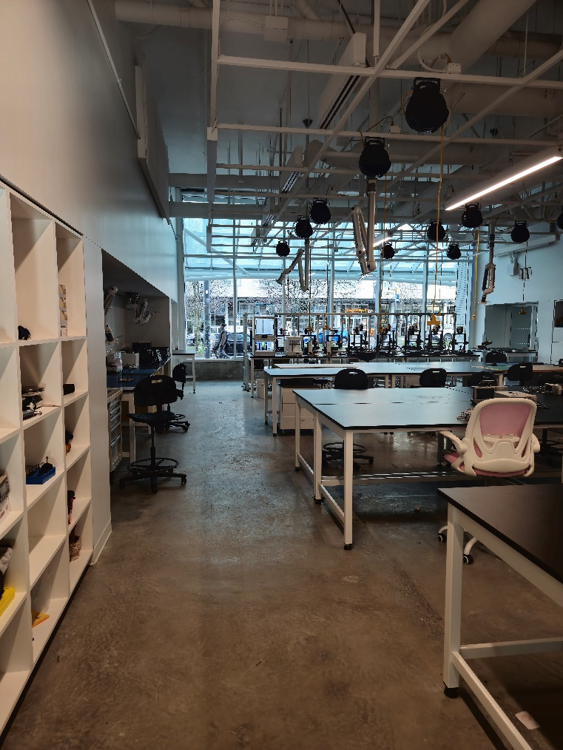
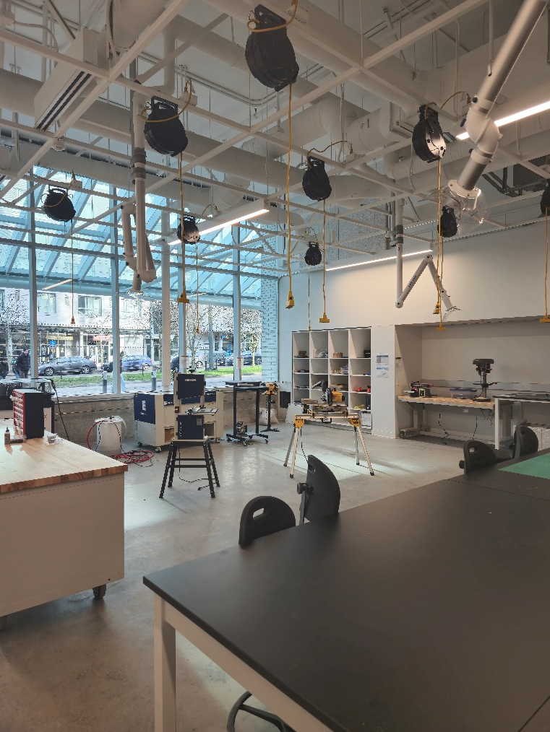
Makerspace Rooms
SBME
UBC
Rm 1009
3D Printing
Electronics
Rm 1011
Machining
Power Tools

Slide 6
General Makerspace Rules
SBME
UBC
Your teams must be supervised by a TA when using the space!
Only sealed water bottles in the makerspace (they must stay near the sink).
We are equipped for working with wood, plastics, and soft metals. No hard metals (i.e. steel)!
If you need to cut a material other than wood, please let a TA know so they can change the machine settings.
Always follow your TA or instructor’s direction.
Report all injuries (even small ones) to your TA or instructor.

Slide 7
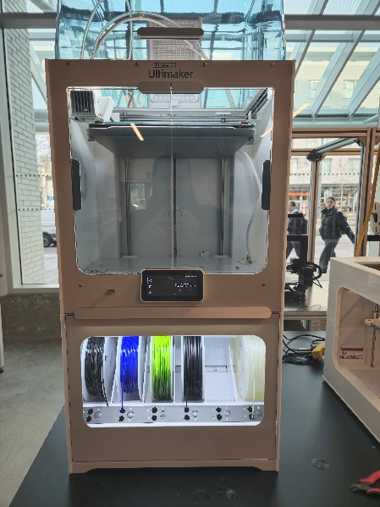
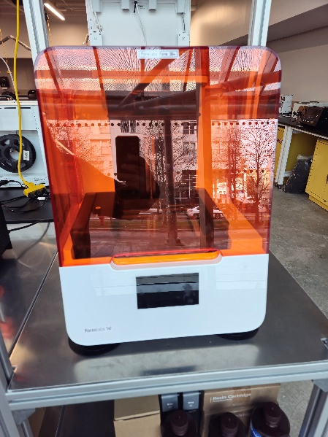
3D Printer Rules
SBME
UBC
Do not change any machine settings or filament yourself, ask a TA / supervisor.
Book all printer usage on the printer booking system (https://bookaspace.sbme.ubc.ca/Web/index.php?redirect=%2FWeb%2Fdashboard.php%3F).
Monitor your prints for at least the first few layers for errors / failures.
The Ultimaker and Resin Printer require pre-authorization to use.
Software: Cura can be used for almost all the printers (through pre-set profiles)

Slide 8
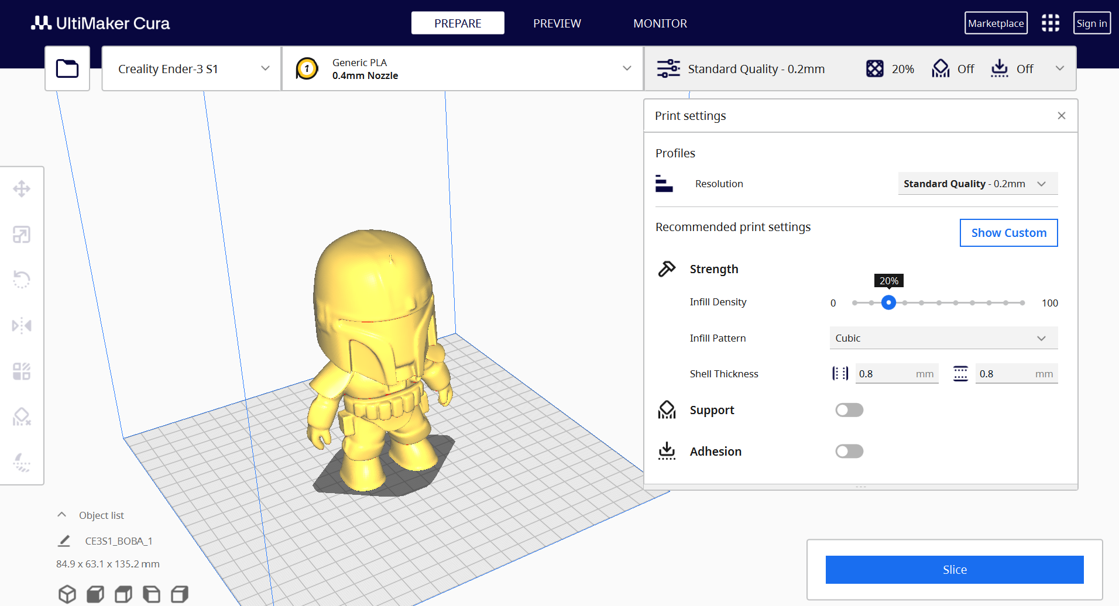
3D Print Setup
SBME
UBC
Existing profiles can be chosen for the specific printer and material.

Slide 9
3D Print Setup
SBME
UBC
Normally, default profiles can be used to determine things like resolution, layer height, speed, wall thickness, etc.

Slide 10
3D Print Setup
SBME
UBC
Model settings (scale, orientation ,etc.) can be edited.

Slide 11
3D Print Setup
SBME
UBC
To finalize print, select “Slice”.

Slide 12
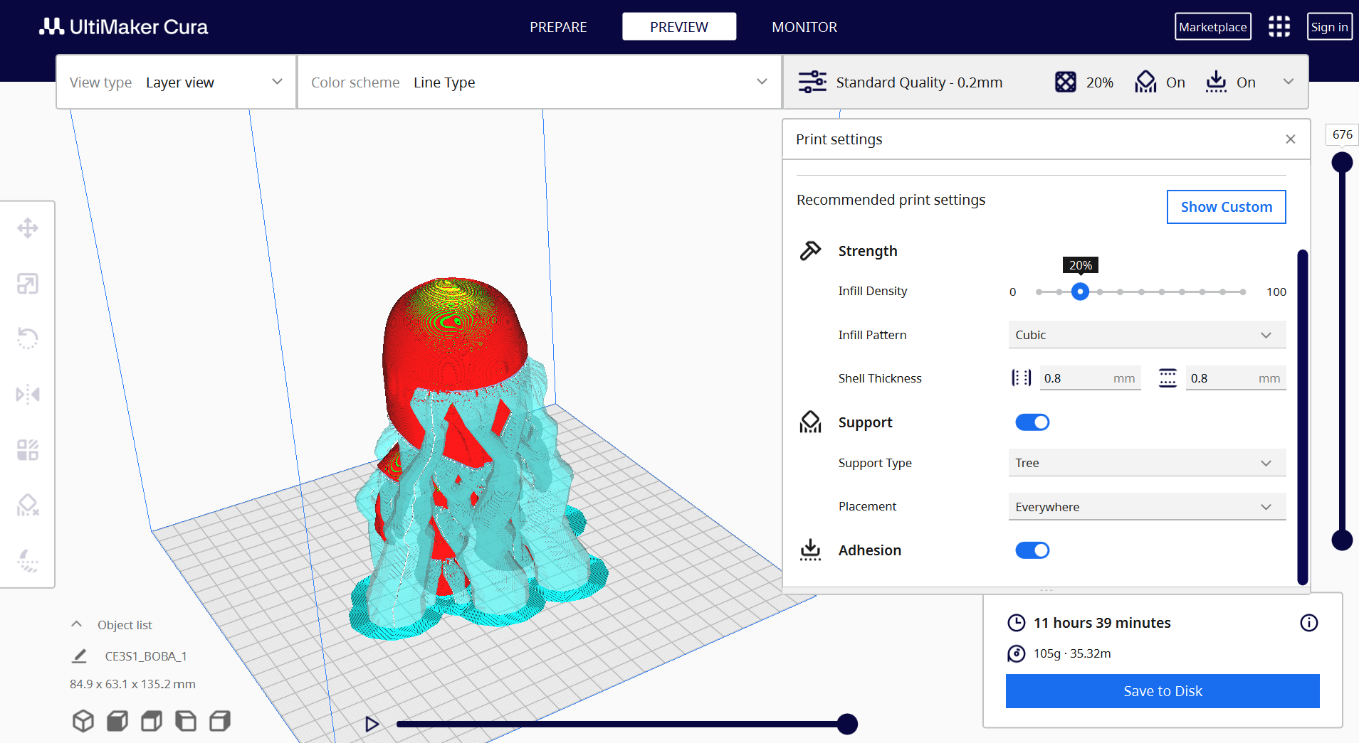
3D Print Setup
SBME
UBC
Check print for an obvious errors and confirm print length and material usage.

Slide 13
Workshop Safety Rules
SBME
UBC
Safety guards must be in place at all times
Never push a blade or sharp tool toward any part of your body.
Do not use gloves with rotatory equipment.
Do not work with small pieces on power machinery. Use hand tools instead.
Always secure the work piece with clamps or a vise.
Always wait for the tool to fully stop before reaching for your stock.
Never remove metal chips, turnings, or shavings with your hands.
No running or horseplay.
If you are unsure of how to operate any equipment or doubts on whether you are using the right tool, ask the your TA or technician!

Slide 14
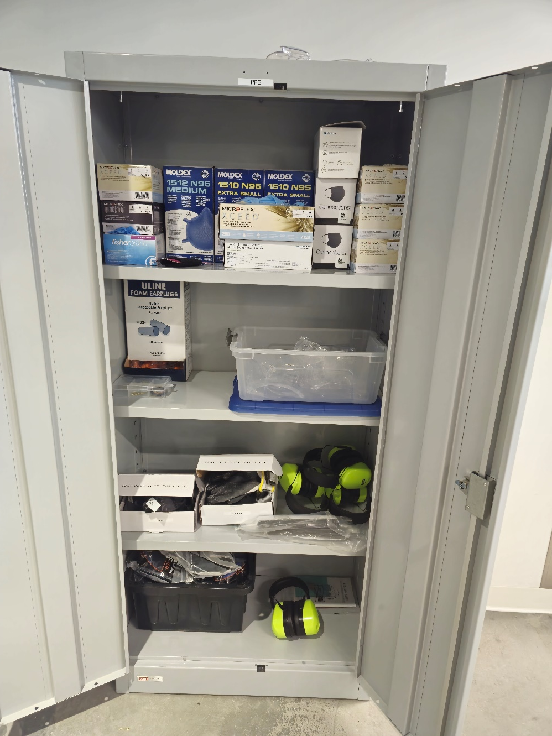
PPE Guidelines
SBME
UBC
Protective eyewear must be worn at all times in SBME 1011.
Long hair must be tied back.
No loose clothing, including scarves, ties, long necklaces, bracelets, rings, long sleeves, etc.
Open-toed footwear is not permitted in the shop.
Ear protection, gloves, masks, etc also provided.
Notes:
EDIT: CHANGE IMAGES

Slide 15
Laser Cutting and Engraving

Slide 16
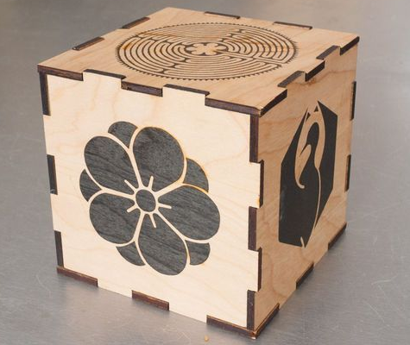
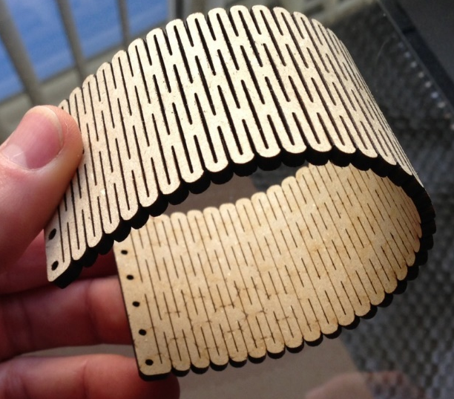
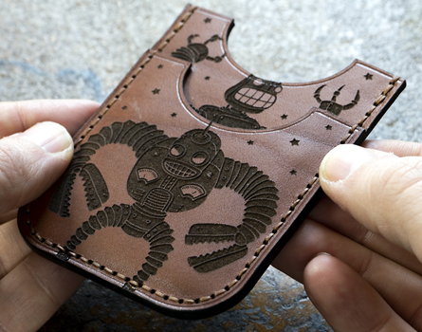
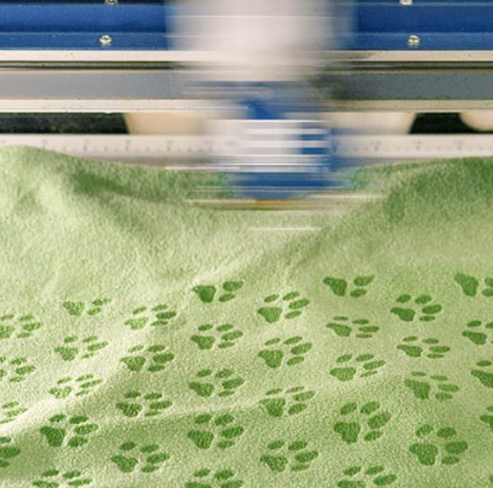

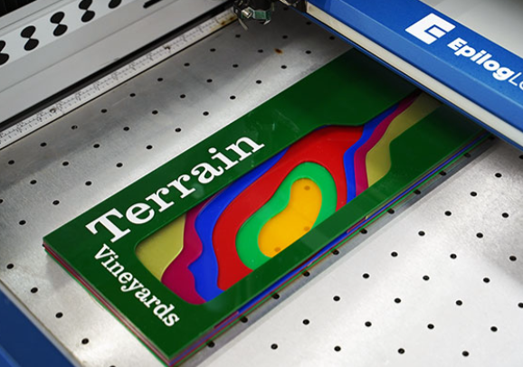
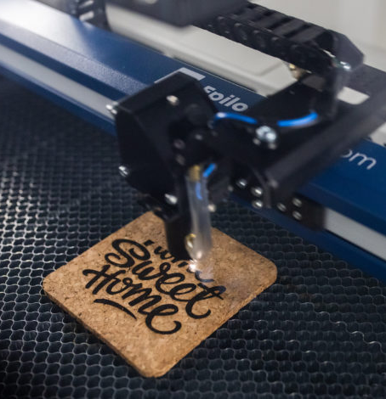
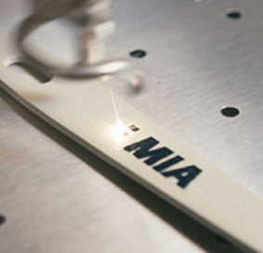
Laser Cutting Examples
SBME
UBC
Wood cutting and engraving for 3D structures
Textile and leather cutting and engraving
Acrylic cutting and engraving
Cork engraving
Aluminium engraving

Slide 17
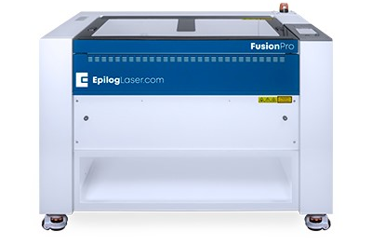
Epilog Fusion Pro 36 Laser Cutter
SBME
UBC
USES: used to cut, score, and engrave a variety of materials
MATERIALS:
Cutting/Scoring: acrylic, delrin, fabric, fiberglass, wood, and more…
Engraving: most plastics, anodized metals, glass, fabric, wood, and more...
REQUIREMENTS: Fume extractor and air pump must be switched on!
Epilog Fusion Pro 36 Laser 36”x24”
SOFTWARE: CorelDraw / InkScape and Epilog Job Suite

Slide 18
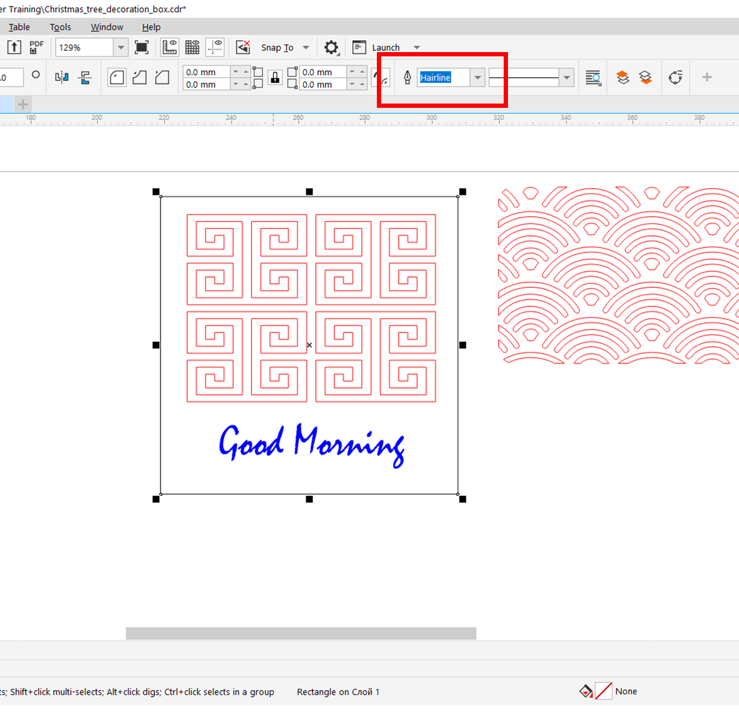
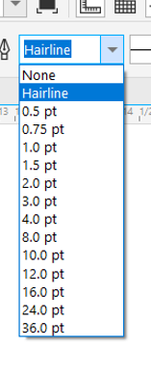
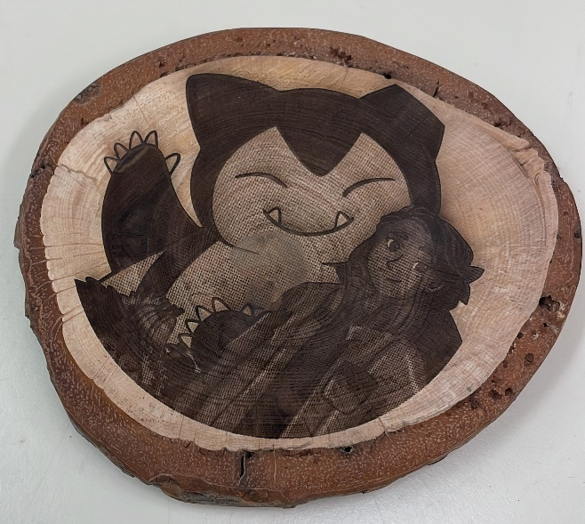
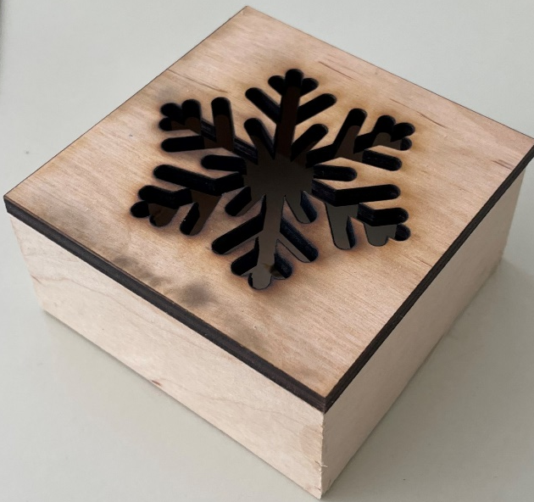
Principles of Laser Cutting
SBME
UBC
Action Defined by Element Line Thickness (L):
Cutting/Vector: L ≤ 0.1 pt (Hairline)
Engraving: L ≥ 0.1 pt
Cutting
Engraving

Slide 19
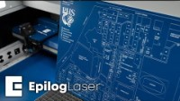
Principles of Laser Cutting
SBME
UBC

Slide 20
Soldering and
Electronic Prototyping

Slide 21
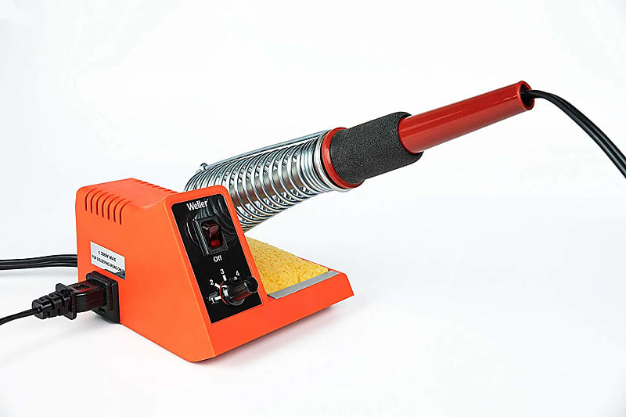
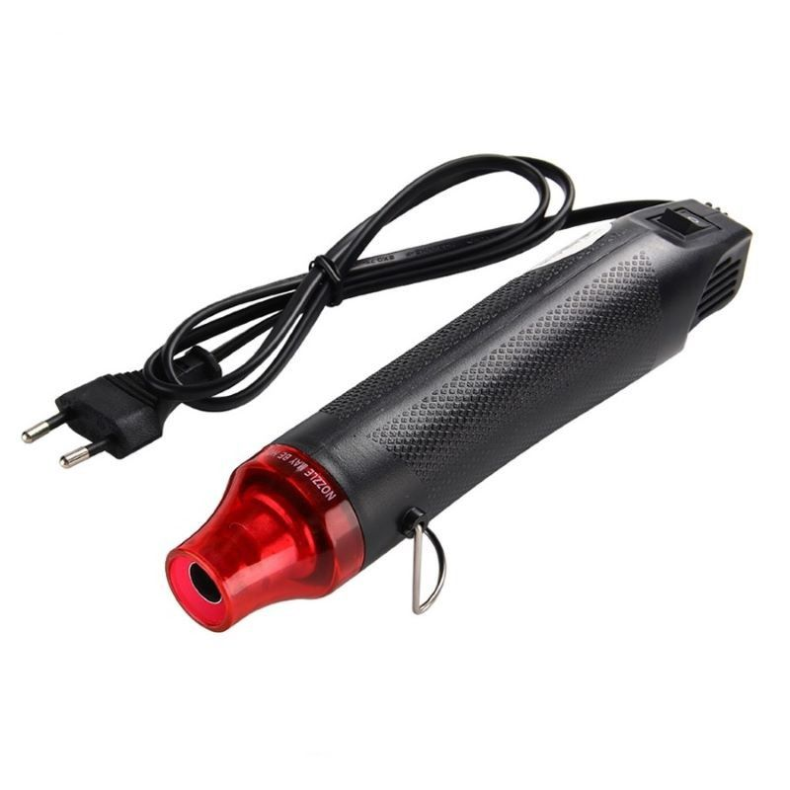
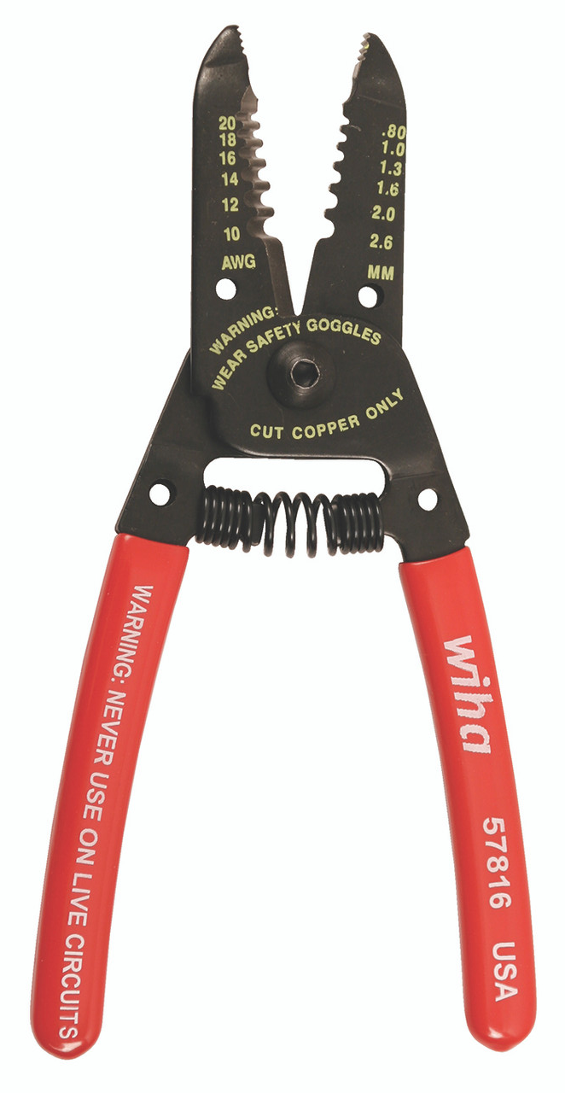
Soldering Station
SBME
UBC
What is soldering?
Soldering is the process of joining metallic surfaces together using a filler metal called solder. The solder acts as a metallic "glue" and allows electrical currents to flow across the joint surfaces.
Wire strippers are used to remove wire insulation before soldering.
Heat guns are used to heat shrink cable tubing which cover exposed soldering surfaces.

Slide 22
Soldering Station
SBME
UBC
Do's
Plug soldering iron to wall timer & set soldering time
Turn on exhaust hood to extract soldering fumes
Hold wires to be heated with tweezers or clamps
Keep cleaning sponge wet during use
Return soldering iron to its stand when not in use
Turn soldering iron off and unplug when finished
Vent soldering fumes.
Don't
Never touch the soldering iron tip... 400°C!
Never put down the soldering iron directly on workbench
Don't melt plastic with the soldering tip
Don't inhale flux fumes
Don't expose heat gun to surrounding electrical components
Don't store heat shrinks near heat gun
Don’t use solder wire that is not from the Makerspace (we do not allow lead solder wire)

Slide 23
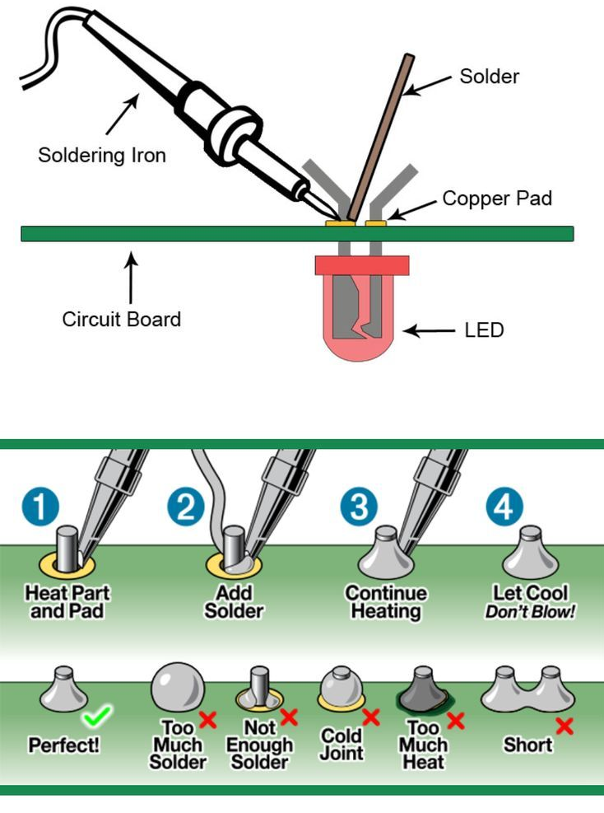
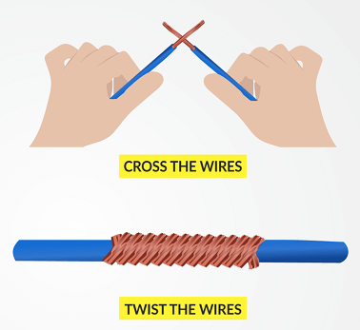
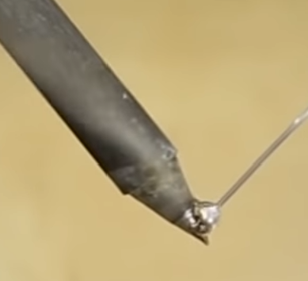
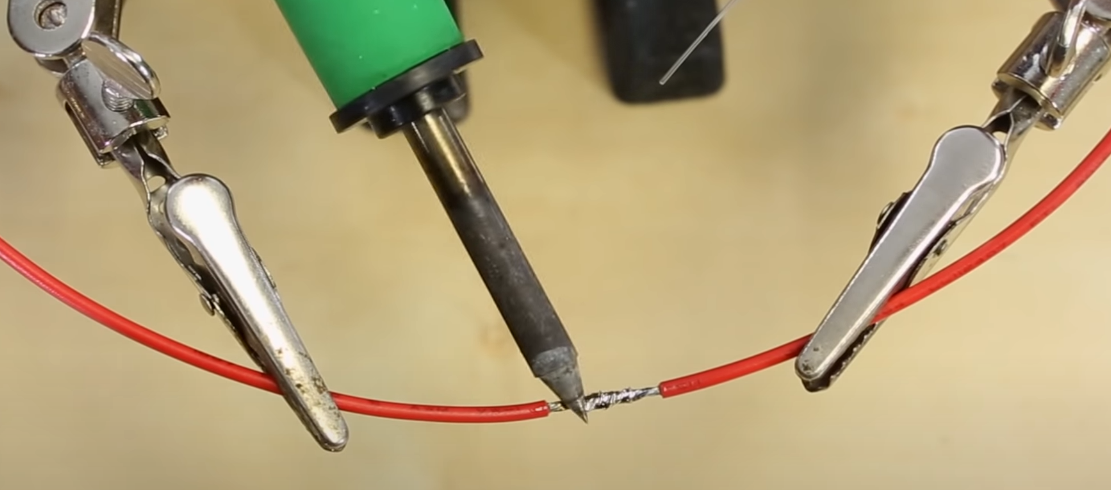
Soldering Station
SBME
UBC
Breadboard Soldering
Component Soldering

Slide 24
Power Tools and
Hand Tools
Anything that creates dust (sawdust, metal shavings, etc.) must be used in the SBME 1011 workshop space!

Slide 25
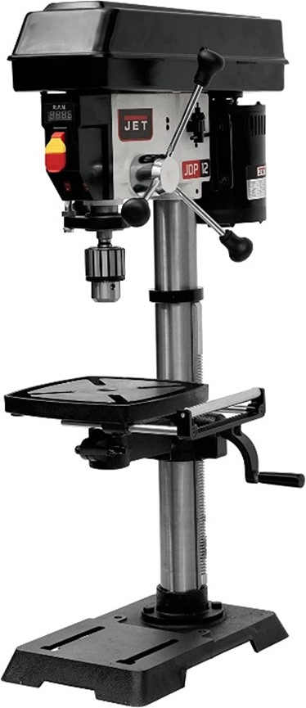
Drill Press
SBME
UBC
USES: To bore controlled and straight holes into pieces at defined depths. Can be straight or at an angle (table tilt: -45° to 45°).
MATERIALS: Aluminum, wood, and plastic
Working area: 9-½" x 9-½" (241 x 241 mm)
Thickness: defined by drill bit specifications
REQUIREMENTS: Safety Glasses, No Gloves / Rings or Loose Jewelry / Clothing

Slide 26
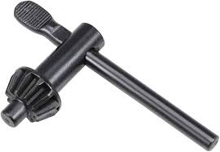
Drill Press
SBME
UBC
When changing the drill bit, tighten the bit evenly into the chuck on all three sides as tight as possible with the chuck key.
Double check that you’ve removed the chuck key. Before turning on, make sure that the workplace is clear and that there is no potential for things to get caught in the rotating parts.
Clamp your workpiece to the table and use a sacrificial piece under it.
Ease into the piece. Cut only as fast as the bit can on its own.
For deep holes or dense materials, back out occasionally to remove waste and cool the bit.
If the piece is seized by the bit or comes loose, press the stop button immediately.

Slide 27
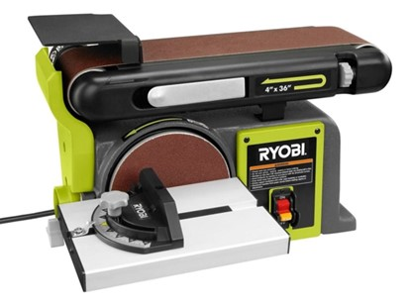
Ryobi Disc and Belt Sanding Station
SBME
UBC
USES: provide a smooth finish to your project
Disc: outside curves
Belt: rough sanding, surface leveling
MATERIALS: Wood and plastic
REQUIREMENTS: Safety Glasses, No Gloves / Rings or Loose Jewelry / Clothing, Dust Mask (dependent on volume / material)

Slide 28

Ryobi Disc and Belt Sanding Station
SBME
UBC
Sand on downward side of a disc sander
Hold piece firmly against the table or edge
Keep fingers away from the sanding belt and avoid awkward hand positions. Secure loose clothing, hair, etc.
Avoid excessive pressure against the sandpaper
Never reach over the disc, under the table, or behind the sander while it is running
Do not sand metal or anything that has loose knots, splits, defects or foreign objects

Slide 29
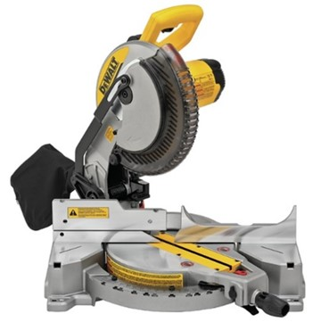
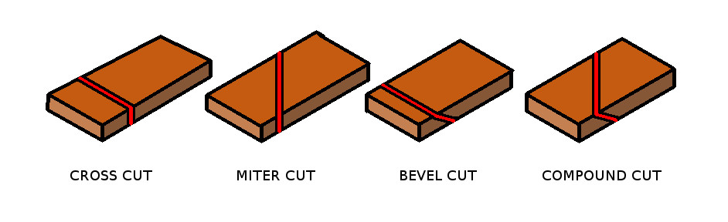
10" Dewalt Mitre Saw
SBME
UBC
USES: to perform cross cuts, bevel cuts, miter cuts, and compound cuts
MATERIALS: Wood, Plastics (special cases only! Please see Technician if you need plastic cut)
REQUIREMENTS: Safety Glasses, No Gloves / Rings or Loose Jewelry / Clothing

Slide 30
10" Dewalt Mitre Saw
SBME
UBC
Keep one hand on the trigger switch and one hand on your piece of stock, outside of the cutting area (whenever possible, the workpiece should be clamped down).
Only cut one work piece at a time.
Do not force the saw. Cuts should be very easy and smooth.
If performing angled cuts, make sure to lock the position before cutting.
After the cut, release the trigger switch and wait for the blade to fully stop before lifting the blade back up.

Slide 31
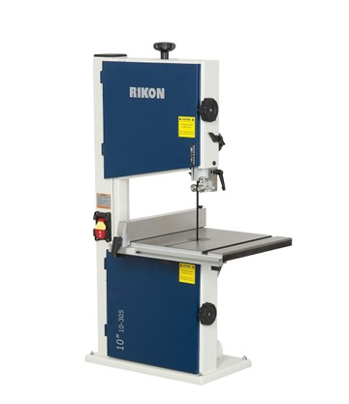
10" Rikon Bandsaw
SBME
UBC
USES: to cut curves, irregular shapes, or long straight cuts (ripping and resawing)
MATERIALS: Wood, plastic, and aluminum (< ¼ in)
Height: 4-5/8" (101 mm)
Width: 9-5/8" (228 mm)
REQUIREMENTS: Safety Glasses, No Gloves / Rings or Loose Jewelry / Clothing

Slide 32
10" Rikon Bandsaw
SBME
UBC
Raise the tension to an appropriate level.
Lower your z-axis guard to be as close to the piece as possible (max. ¼ inch)
When cutting close to the blade, use a push stick instead of your hands.
Slow down when cutting curves on the bandsaw. Screeching sound indicates that the blade is under too much tension.
After you complete your cut, loosen the tension

Slide 33
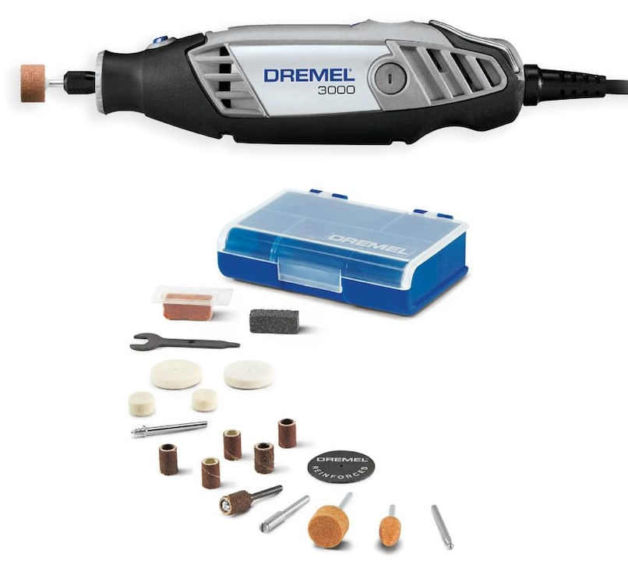
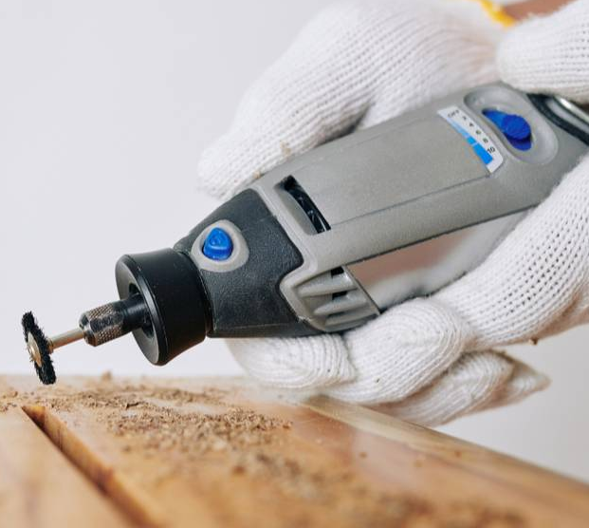
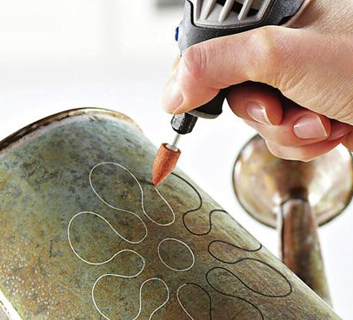
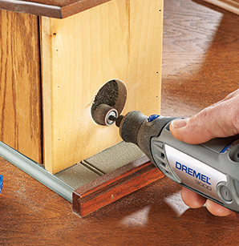
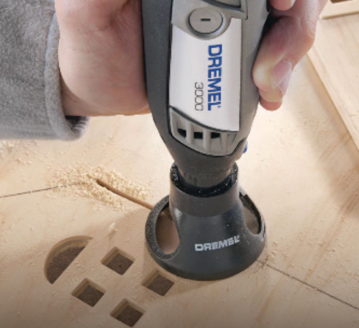
Dremel 3000 Rotary Tool
SBME
UBC
USES: detailing, sculpting, shaping, smoothing, beveling, texturing, carving, and sanding
MATERIALS: metal, wood, marble, concrete, brick, porcelain, ceramics, hard epoxy, drywall, tile, and more.
REQUIREMENTS: Safety Glasses, Gloves (dependent on attached tool and material)

Slide 34
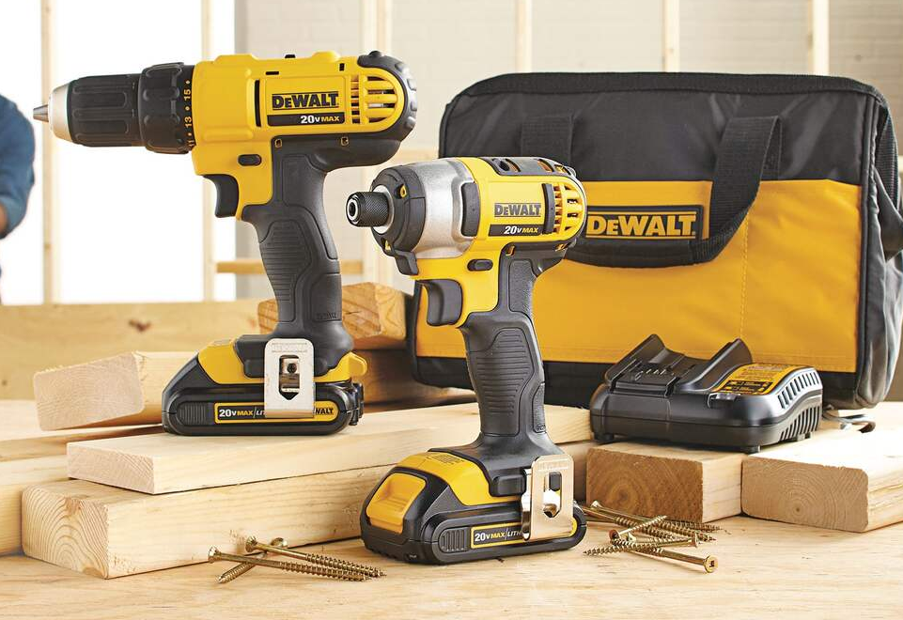
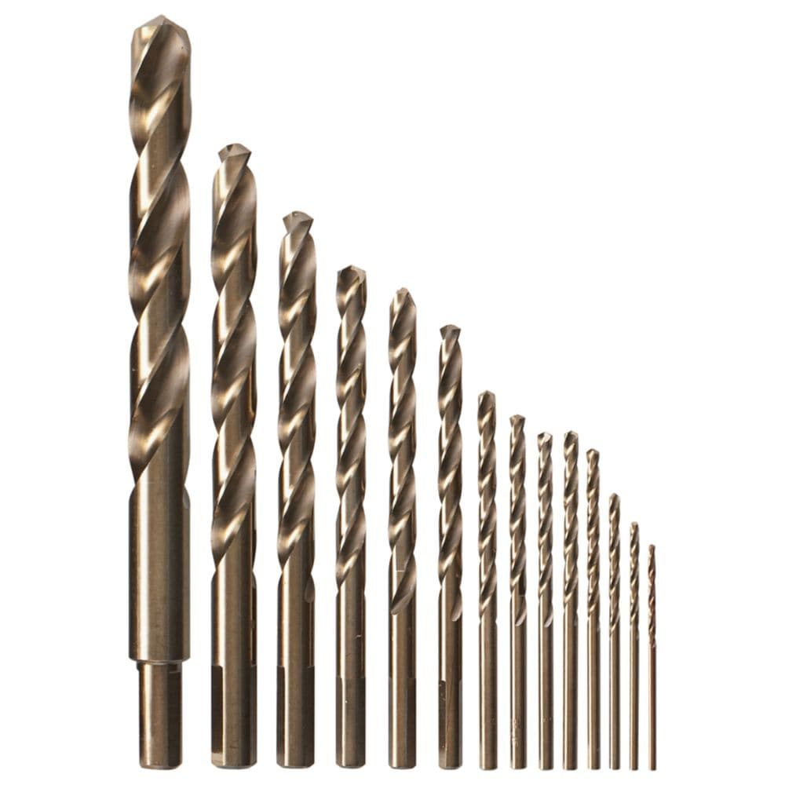
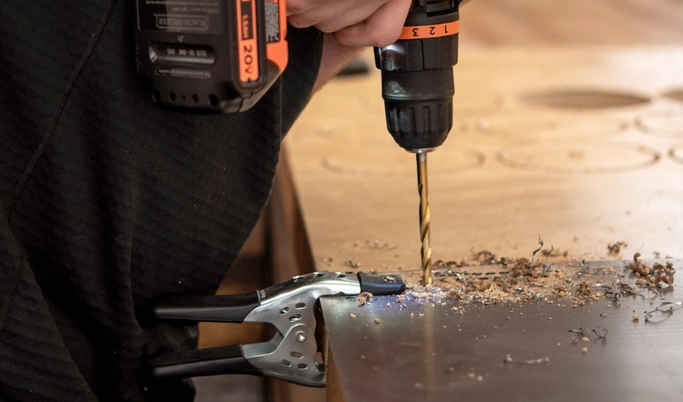
Cordless Drill and Driver
SBME
UBC
USES: drilling and driving tasks.
MATERIALS: depends on the drill bit. Mostly wood, plastic, plaster, soft metals.
REQUIREMENTS: Safety Glasses

Slide 35
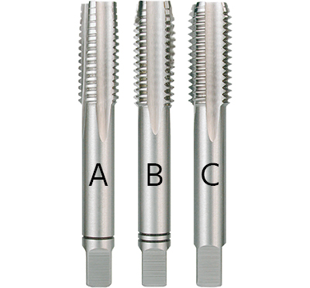
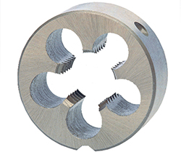
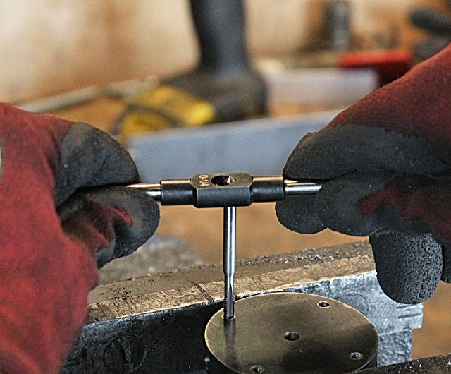
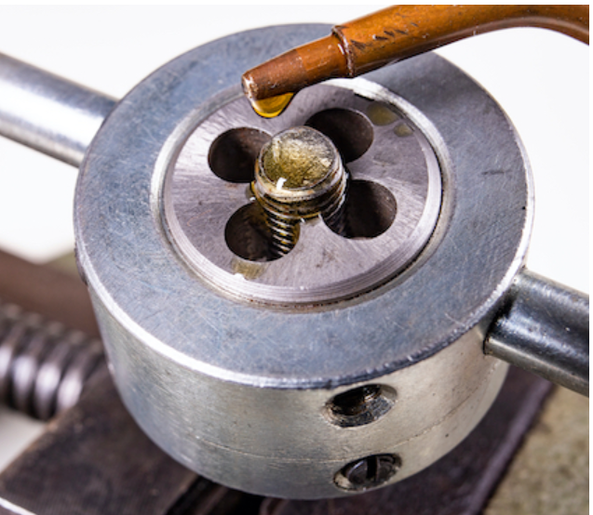
Tap and Die Kit
SBME
UBC
USES: to create threaded holes and threads.
MATERIALS: most metals (aluminium, brass, steel, cast iron, titanium, etc.)
REQUIREMENTS: PPE Guidelines and safety gloves. Use lubricant when necessary.
Taps
Die
Notes:
Taps and dies are cutting tools used to create threads on components such as screws, bolts, nuts and to create a threaded hole to screw components into.
A tap is a threaded tool that cuts or forms threads in the female portion of a mating pair. Therefore, a tap will create threads in the inside of a hole. On the other hand, a die is a threaded tool that cuts or forms threads in the male portion of a mating pair. Therefore, a die will create threads on a cylindrical rods surface to create a screw or bolt. Both a tap and a die create new threads or repair damaged threads.

Slide 36
Working with Sheet Metal
The only time we can use steel in the Makerspace!

Slide 37
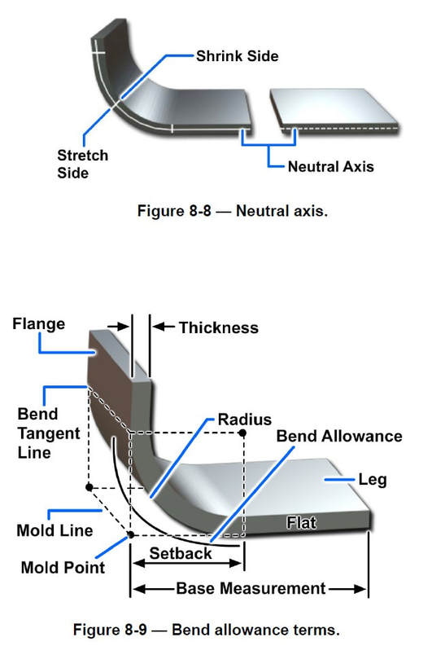
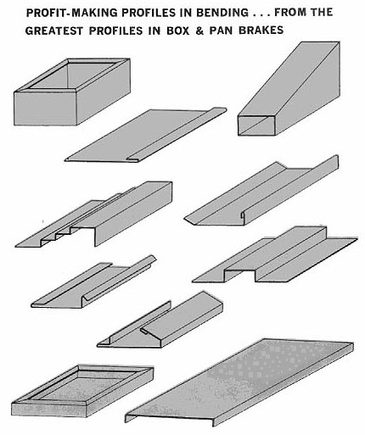
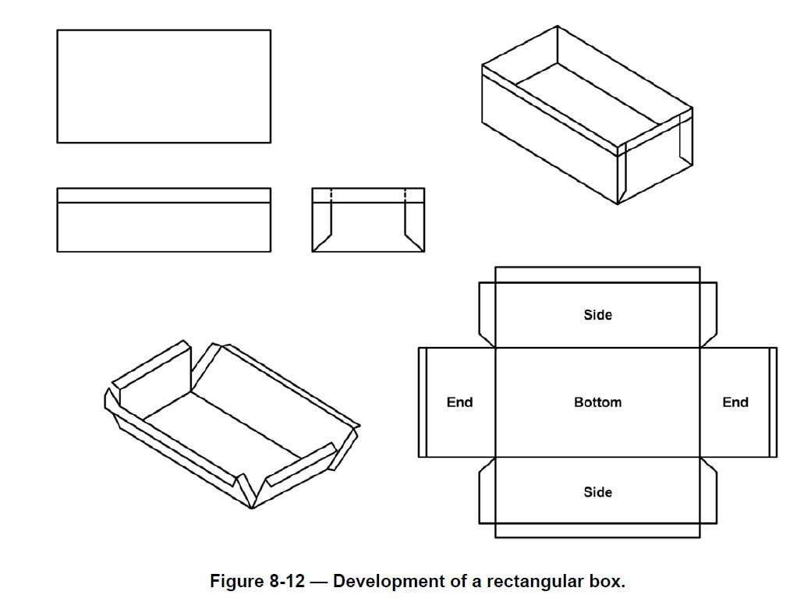
Working with Sheet Metal
SBME
UBC
Tips & Tricks
Design for bending!
  Quicker to waterjet and bend into a box than 3D printing

Slide 38
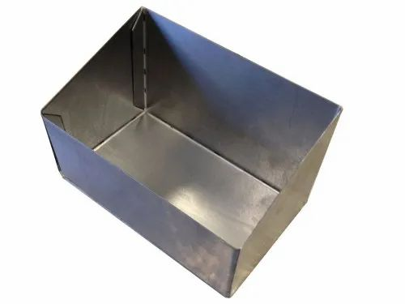
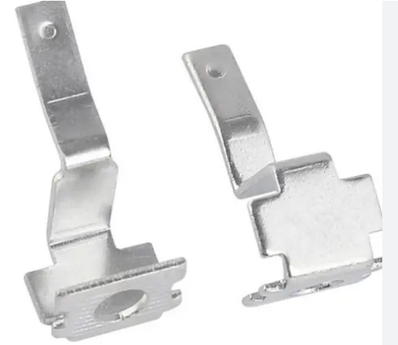





Prototyping with Sheet Metal
SBME
UBC
Cutting and bending to complex shapes
Marble & Granite
Stainless Steel & Glass
Waterjet cutting
Titanium
Stainless Steel

Slide 39

Protomax Waterjet Cutter
SBME
UBC
USES: Low-volume sheet cutting system for prototyping. Cuts up to 1 in thick.
MATERIALS: Aluminum, mild steel, Delrin/Acetal, HDPE/PC, wood, and rubber
Work Area: 12″ x 12″ (304 x 304 mm)
REQUIREMENTS: PPE Guidelines and safety gloves when handling metal

Slide 40

Protomax Waterjet Cutter
SBME
UBC

Slide 41

12" Grizzly Benchtop Shears
SBME
UBC
USES: Cutting large sheets of metals into smaller sizes
MATERIALS: mild sheet metal.
17-gauge mild steel at half width
20-gauge mild steel at full width
Up to 12″ (304 mm) in width
REQUIREMENTS: PPE Guidelines and protective gloves

Slide 42

12" Grizzly Pan and Finger Brake
SBME
UBC
USES: Bends sheets of metals at various angles
MATERIALS: mild sheet metal.
20-gauge mild steel up to 135°
Up to 12″ (304 mm) in width
REQUIREMENTS: PPE Guidelines and protective gloves

Slide 43
Final Reminders
Always clamp your equipment / material.
Always wait for the power tool to completely stop before reaching for your stock.
After use, clean your space:
  Use the shop vac in the Makerspace to vacuum any sawdust
  Place larger pieces of scrap material in the allocated bins
  Place electronics waste in the electronics waste bin
  Place any garbage in the waste bins in the Makerspace
If you ever are unsure about using any equipment in the space, please ask your TAs!
That’s what they are there for! ☺

Slide 44
Makerspace Contacts
Kevin Gilmore, Makerspace Technician
Kevin.gilmore@ubc.ca
Makerspace Wiki: https://wiki.ubc.ca/Documentation:SBME-Teaching-Labs
Please feel free to email me if you have any questions about pretty much anything in the Makerspace, want equipment or material specs and details, or have any concerns with the space!
Other contacts:
Jacqueline Kho, Teaching Labs Manager
Jacqueline.kho@ubc.ca
Rupi Dhesi, Building Manager
Rupinder.Dhesi@ubc.ca
UBC First Aid: 604-822-4444
UBC Security: 604-822-2222

