Slide 1
Case 4 Summary
The Microbiology Lab
By
Derrick Yao

Slide 2
Bacterial Causes
Ronnie’s signs and symptoms points to food poisoning due to a bacterial pathogen
Gastroenteritis
The most common bacterial pathogens present in ground beef include:
Salmonella spp.
Shiga-toxin producing E. coli (STEC)
Campylobacter jejuni
Listeria monocytogenes
Staphylococcus aureus

Slide 3
Bacterial Causes
Of those bacterial pathogens, the ones that are associated with bloody diarrhea are:
Shiga-toxin producing E. coli
Campylobacter jejuni
Salmonella Typhimurium
These 3 bacterial pathogens will be the main focus for this microbiology laboratory case as these 3 are the most likely to have infected Ronnie

Slide 4
Bacterial Causes
C. jejuni
Gram-negative bacterium associated with gastroenteritis
Microaeroplic, non-fermentative, and coccoid or round in shape
Reservoir in gastrointestinal tracts of animals
Transmitted to humans via contaminated food, water or direct contact
Symptoms of infection include bloody stool, abdominal pain, fever, nausea, diarrhea, vomiting and other complications in the digestive system

Slide 5
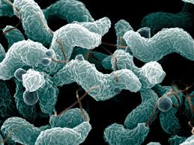
Bacterial Causes
C. jejuni
https://zoonoticecology.files.wordpress.com/2013/05/campylobacter-e1367919882392.jpg

Slide 6
Bacterial Causes
Shiga toxin-producing E. coli (E. coli O157:H7)
Found as part of normal gut microbiota
Produce Shiga toxin that causes extensive damage to intestinal walls, resulting in hemorrhagic colitis (diarrhea and fever followed by bloody diarrhea) and hemolytic uremic syndrome (HUS)
Abnormal destruction of red blood cells that clogs up the filtration system of kidneys and can lead to kidney failure
Transmission through undercooked beef products
Symptoms of infection include abdominal pains, bloody and watery diarrhea, vomiting and mild fevers

Slide 7
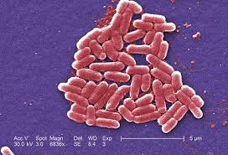
Bacterial Causes
Shiga- toxin producing E. coli
http://articles.extension.org/sites/default/files/w/8/88/Ecoli.jpg

Slide 8
Bacterial Causes
Salmonella typhimurium
Flagellated gram-negative facultative anaerobic bacilli
Found in intestinal tracts of animals
Causes acute gastroenteritis
Foodborne infection of GI tract
Toxicity due to outer membrane containing LPS
Protects bacteria from environment
Transmission through improper preparation of ground meat before consumption
Symptoms of infection include abdominal pain, cramps, vomiting, and diarrhea

Slide 9
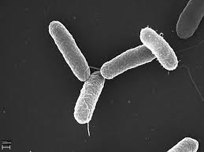
Bacterial Causes
S. typhimurium
https://media1.britannica.com/eb-media/24/123224-004-C1A4B848.jpg

Slide 10
Laboratory Samples
Stool
When to collect
as soon as onset of diarrhea or bloody stool
How much to collect
whole stools or several rectal swabs
Method of collection
Stool collected in sterile plastic container with re-sealable lid
Rectal swabs are inserted 1 to 1.5 inches into the rectum and rotated gently
Storage
Refrigerated at 4C or frozen at -15C
Transportation
Refrigerated for transport using ice
Frozen stool transported using dry ice

Slide 11
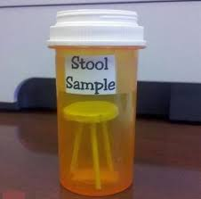
Laboratory Samples
Stool
HAHA ☺
https://jakemcmillan.files.wordpress.com/2009/11/stool-sample1.jpg

Slide 12
Laboratory Samples
Blood
When to collect
Onset of gastroenteritis symptoms
How much to collect
3mL for children; 15mL for adults
Method of collection
Tourniquet is applied and sterile needle is used to puncture
Storage
Collection tubes may contain anti-coagulants, gels or other additives for laboratory preparation
Stores in temp. between 4 to 25C
Transportation
Unspun serum refrigerated for transport using ice
Spun serum can be frozen and shipped using dry ice

Slide 13
Laboratory Samples
Urine
When to collect
First passed urine in the morning or
Midstream catch during day; during onset of symptoms
How much to collect
10 to 50mL
Method of collection
Sterile plastic container with lid
Storage
Refrigerated at 4-6C
Transportation
Centrifuge sample, discard supernatant and re-suspend in transport medium
Refrigerated during transport and processed within 48hrs

Slide 14
Laboratory Tests
Importance of the Microbiology Lab
Able to narrow down and identify the pathogen causing the disease
Results will determine the overall treatment course for the patient
Antibiotic treatment

Slide 15
Laboratory Tests
Stool Culture
Environments of the varying mediums allow selective growth of some bacteria which allows for identification
MacConkey Agar
Selective and differential
Gram-negative vs gram-positive; lactose fermenting vs non-lactose fermenting
Composed of bile salts and crystal violet
Inhibits gram-positive growth
Neutral red as pH indicator
Pink indicates presence of lactose fermentation
Results
S. typhimurium – growth + colorless colonies
C. jejuni – growth + colorless colonies
E. coli – growth + pink colonies

Slide 16
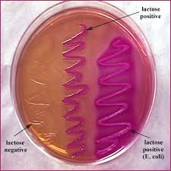
Laboratory Tests
MacConkey Agar
https://s-media-cache-ak0.pinimg.com/564x/70/34/e4/7034e4f6a4d251434fbca3aaa9e603d4.jpg

Slide 17
Laboratory Tests
Stool culture
Bismuth sulfate agar
Highly selective/differential for Salmonella sp.
Bismuth sulfite indicator and brilliant green
Inhibit gram-positive and coliform bacteria
Ferrous sulfate detects H₂S production
Salmonella able to convert Ferrous sulfate into H₂S
Results in black/brown coloured colonies
Results
S. typhimurium – growth + black/brown colonies
E. coli – no growth
C. jejuni – growth + colorless colonies

Slide 18
Laboratory Tests
Stool Cultures
Campy blood agar
Selective and differential for C. jejuni
Compose of :
Casein and meet peptone
Growth of Campylobacter sp
Antimicrobial agents (vancomycin, trimethoprim etc)
Inhibits growth of Enterobacteriaceae, staphyloccocus and yeast
Results
S. typhimurium – no growth
E. coli – no growth
C. jejuni – growth of colonies

Slide 19
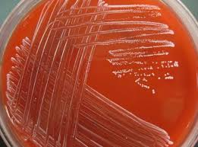
Laboratory Tests
Campy Blood Agar
https://s-media-cache-ak0.pinimg.com/originals/11/fe/9e/11fe9ed1bf5b62b0426f6d288c36652e.jpg

Slide 20
Laboratory Tests
Stool Culture
MacConkey Agar with Sorbitol (SMAC)
Same composition as MAC agar except lactose is replaced with sorbitol
Differentiate pathogenic O157:H7 E. coli from other serotypes
Unable to ferment
Results
E. coli O157:H7 – growth but colorless
Other E. coli serotypes – growth with red colonies

Slide 21
Laboratory Tests
Secondary Biochemical Tests
Triple Sugar Iron (TSI) test
Involves 3 sugars: lactose, sucrose and glucose
Determine fermentation preferences of bacteria
Change of color at the “butt” (bottom of tube) and “slant” (top)
Alkaline slant/no change in butt (K/NC) Red/red = glucose, lactose and sucrose non-fermenters
Alkaline slant/alkaline butt (K/K) Red/red = glucose, lactose and sucrose non-fermenters
Alkaline slant/acidic butt (K/A) Red/yellow= glucose fermentation only, gas (+ or -), H₂S (+ or-)
Acidice slant/acidic butt (A/A) Yellow/yellow= glucose, lactose, and/or sucrose fermenter, gas (+ or -), H₂S (+ or -)
Results
S. typhimurium – K/A, H₂S +/-
E. coli – K/A or A/A, gas

Slide 22
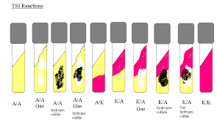
Laboratory Tests
TSI Test
https://germsandworms.files.wordpress.com/2013/03/tsidiagram.gif

Slide 23
Laboratory Tests
Secondary Biochemical Tests
Lysine Iron Agar (LIA) Test
Determine ability of bacteria to deaminate lysine or decarboxylated lysine
K/K = slant purple, butt purple = positive lysine decarboxylation (butt), negative deamination (slant)
A/K = slant yellow, butt purple = negative lysine decarboyxlation (butt), negative deamination (slant)
R/A = slant red, butt yellow = negative lysine decarboyxlation (butt), positive deamination (slant)
A/A = slant yellow, butt yellow = negative lysine decarboyxlation (butt), positive deamination (slant)
H₂S = black precipitate = gas forming
Results
S. Typhimurium – K/K or A/A, H₂S
E. coli – K/A or A/A

Slide 24
Laboratory Tests
Stool Sample Workup
Gram- stain
Staining bacteria using crystal violet dye
Gram- positive retains crystal violet-iodine complex due to thick PG layer = purple
Gram- negative unable to retain dye as decolorizer degrades OM = colorless
counterstain with safranin = red
Results
S. typhimurium – red
E. coli – red
C. jejuni - red

Slide 25
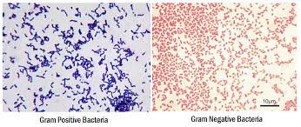
Laboratory Tests
Gram- stain
http://laboratoryinfo.com/wp-content/uploads/2016/01/gram-positive-vs-gram-negative.png

Slide 26
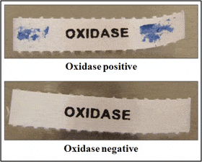
Laboratory Tests
Stool sample workup
Oxidase test
Determine presence of cytochrome C oxidase enzyme
Catalyzes electron transport to electron donors in bacterial electron transport chain
Oxidase reagent, tetramethyl- p-phenylene- diamine dihydrochloride, turns purple upon redox reaction
Results
S. Typhimurium – colorless (negative)
E. coli – colorless
C. jejuni – purple (positive)
http://microbeonline.com/wp-content/uploads/2012/12/Oxidase-test-result.gif

Slide 27
Laboratory Tests
Stool sample workup
Catalase test
Determine presence of catalase
Catalyzes breakdown of H₂O₂ into H₂O and O₂
Catalase positive = bubbling when introduced to H₂O₂
Catalase negative = no bubbling
Results
S. typhimurium – bubbling (positive)
E. coli – bubbling (positive)
C. jejuni – bubbling (positive)
ELISA (Enzyme- linked Immunosorbent Assay)
Detect presence of a specific antigen using antibodies
Antibodies against Shiga toxin
Results
S. typhimurium – negative (does not produce Shiga toxin)
E. coli – positive (produces this toxin)
C. jejuni – negative (does not produce Shiga toxin)

Slide 28
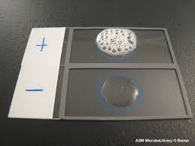
Laboratory Tests
Catalase Test
http://4.bp.blogspot.com/-pGWy_YzoaD4/UZXnPopWsUI/AAAAAAAAAH0/nrnpu-kKutg/s1600/slide+catalase+test+results.jpg

Slide 29
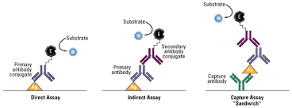
Laboratory Tests
ELISA
https://www.thermofisher.com/content/dam/LifeTech/Images/integration/ELISAFormats575x214.jpg

Slide 30
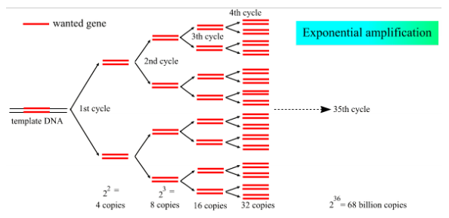
Laboratory Tests
Stool sample workup
PCR (polymerase chain reaction)
Amplification of a specific DNA sequence using specific primers
Use primers for Shiga toxin genes (Stx1 and Stx2 gene)
Results
S. typhimurium – negative (does not possess gene)
E. coli – positive (possess both Stx1 and Stx2 gene)
C. jejuni – negative (does not possess gene)
https://users.ugent.be/~avierstr/principles/pcr.html

Slide 31
Laboratory Tests
Stool sample workup
Antibiotic sensitivity test
Detect presence of antibiotic resistant pathogens
Determine effective antibiotic treatment against pathogen from susceptibility
Results
S. typhimurium
Susceptible to ciproflaxcin
Resistant to ampicillin
E. coli
Susceptible to nitrofurantoin, ciproflaxcin, and norflaxocin
Resistant to tetracycline, erythromycin and amoxicillin
C. jejuni
Susceptible to eythromicin
Resistant to vancomycin, trimethoprim, ciprofloxacin

Slide 32
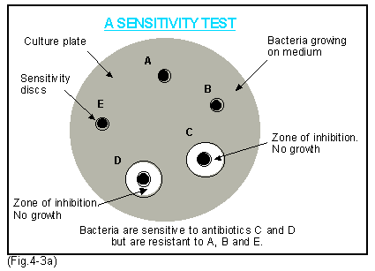
Laboratory Tests
http://www.thepigsite.com/pighealth/contents/Fig4-3a.gif

