Slide 1
PATH 417 Case 2: A New Partner
The Immune System Summary
By: Sunny Chen

Slide 2
Overview of Host Response
Innate Response
  Anatomical Barriers
  Complement System
  Inflammation
  Cellular mediated responses
Transition Phase
  Antigen presentation process
Adaptive Response
  Cellular Response
  Humoral Response

Slide 3
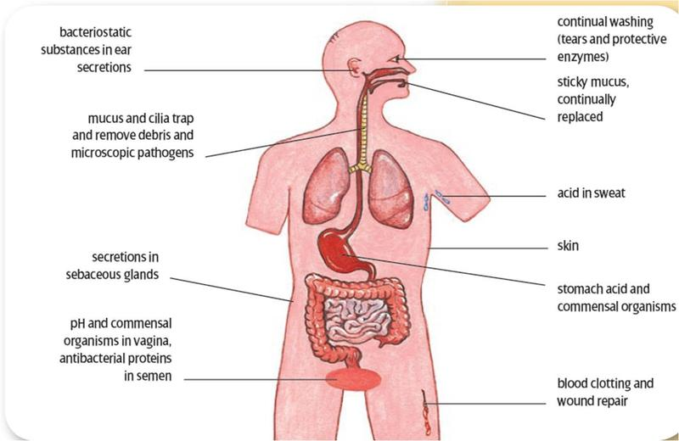
Innate Response-Anatomical Barriers

Slide 4
  Innate Response-Anatomical Barriers
Mucus and secretions of antimicrobial peptides of the mucosal surfaces provide protection against N. gonorrhoeae and C. trachomatis
  Mucus
    slippery secretion produced mucous membranes that is rich in glycoproteins and water which trap bacteria
  Secretions of antimicrobial peptides (mixed into the mucus)
    include defensins, lysozymes, elafin, and other peptides
      inhibit and disrupt the structures and activity of bacteria.
    E.g. Defensins
      most common type of antimicrobial peptide found in mucus secretions
      cationic peptides that disrupt bacterial membranes
    produced by leukocytes that include neutrophils, dendritic cells, natural killer cells, as well as the epithelial cells themselves

Slide 5
Innate Response-Anatomical Barriers
Urinary Tract/Urine Defenses
  variation in urine pH, urea concentration, and osmolarity of the urinary tract can alter the susceptibility of an infection (e.g. when exposed to N.gonorrhea)
  Urine contains many bactericidal and bacteriostatic defenses against the bacteria

Slide 6
Innate Response-Anatomical Barriers
Additional Mechanism Found in Female Reproductive Tract
  commensal bacteria found in the vagina and ectocervix prevent the growth of pathogens via competition

Slide 7
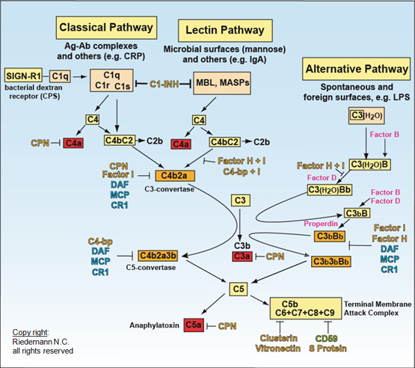
Innate Response-Complement System

Slide 8
Innate Response-Complement System
consists of various plasma proteins found in the blood
3 main pathways: classical, alternative, mannose binding lectin
  Initial enzyme generated-C3 convertase
  Ultimately leads to the formation of C3a, C3b, C5a, C5b, and other associated complement proteins
    They act as opsonins, inflammatory mediators, and make up the membrane attack complex which disrupts bacterial membrane structures causing lysis
  enhance the ability of antibodies produced by plasma cells, phagocyte activity, promotes inflammation and attacks the bacteria’s plasma membrane

Slide 9
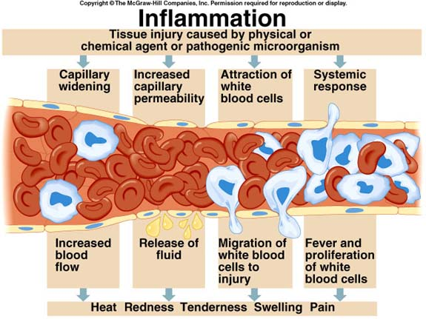
Innate Response-Inflammation

Slide 10
Innate Response-Inflammation
causes increased vascular permeability, fluid leakage, and the recruitment of immune cells
recruitment of immune cells
  expression of adhesion proteins at the endothelial surface of the site of infection that are complementary and bind to adhesion proteins found on immune cells
  allows for recruitment and transit of immune cells into the site of infection
characterized by swollen, red coloration, as well as the feeling of pain and heat

Slide 11
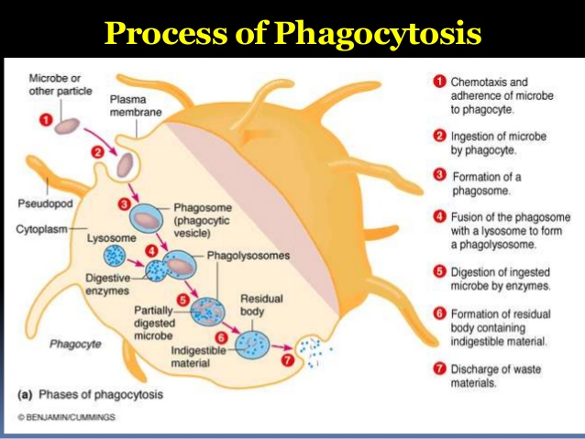
Innate Response-Cellular mediated Response

Slide 12
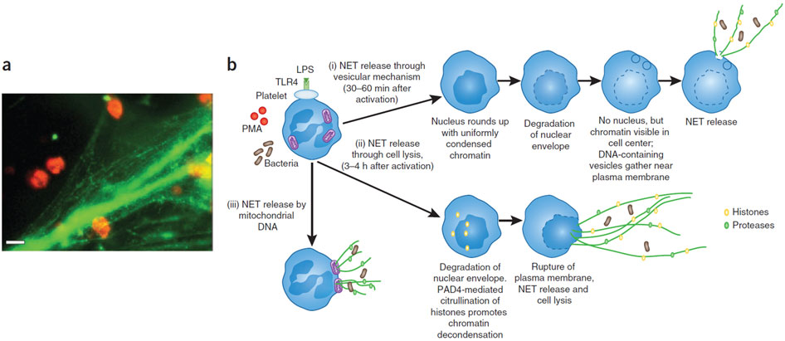
Innate Response-Cellular mediated Response(NETs)

Slide 13
Innate Response-Cellular mediated Response
Main cells involved: macrophages, neutrophils and dendritic cells, responses triggered by release of pro-inflammatory cytokines
phagocytosis
  Main cells involved in cell-mediated killing N. gonorrhoeae or C. trachomatis: Macrophages and neutrophils
    Once in phagosome
      the bacteria exposed to a variety of antimicrobial peptides (e.g. defensins, serine proteases)-disrupts and damages bacterial structures
      Assembly of NADPH oxidase complex- catalyzes the reaction in the generation of Reactive Oxygen Species (ROS).
        characterized by a respiratory burst in which oxygen consumption increases dramatically
        ROS-power oxidant, causes significant damages to bacterial structures
    Fusion of the phagosome and lysosomes
    Afterward, neutrophils typically die, macrophages survive and can repeat phagocytosis process
  Phagocytosis can be enhanced by complement plasma protein, resulting in more effective phagocytosis

Slide 14
Innate Response-Cellular mediated Response
When encountered bacteria of extracellular state (e.g. N. Gonorrhoeae)-Neutrophil/TRAPS
  neutrophil extracellular traps (NETs): comprised of a web of fibers composed of chromatin and serine proteases
    trap and kill bacteria by disrupting protein and DNA structures
    provide a high local concentration of antimicrobial components and bind, disarm, and kill microbes independent of phagocytic uptake

Slide 15
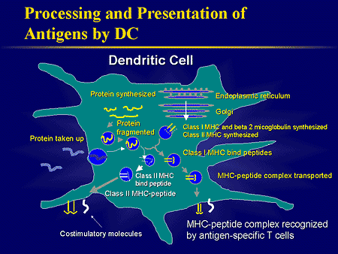
Host Response-Transition Phase

Slide 16
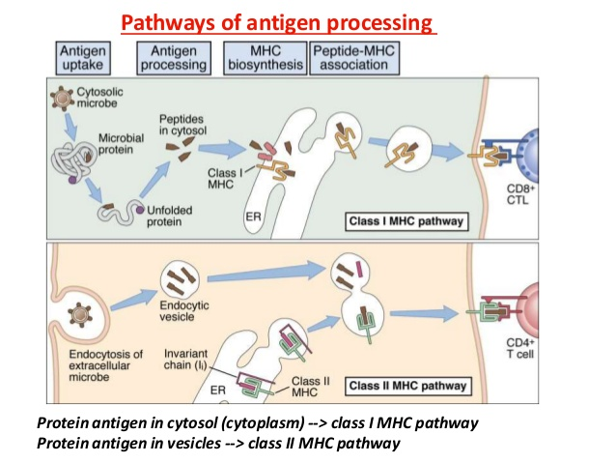
Host Response-Transition Phase

Slide 17
Host Response-Transition Phase
Transition between innate response and adaptive response, antigen presenting cells involved: dendritic cells, macrophages, B cells
Dendritic cell
  main antigen presenting cells (APC), “professional “ as only it can provide cytokines (act as co-stimulatory signals) needed for activation of naïve thymocytes
  Matures and the breakdown of microbial components into antigens occurs; antigen processing occurs (i.e. breakdown of antigens and subsequent presentation onto Major Histocompatibility Complexes (MHC) 1 or 2 )
    endogenous pathway (MHCI) vs. exogenous (MHCII) pathway
  present its antigen to naïve B and T lymphocytes in the lymph node (i.e. Helper T cells, Cytotoxic T cells, and B cells that have the same antigen specificity )

Slide 18
Adaptive Response-Cellular Response
  mediated by the CD8+ cytotoxic T cell and CD4+ T-helper cell (TH cells)
  Antigen specificity required
    provided by dendritic cells when activation occurs
  CD8+ Cytotoxic T cells recognize MHC1-antigen complexes
    once activated, CD8+ will leave the lymph node and home towards the site of infection and conduct its cytotoxic activity towards infected cells via release the cytotoxins perforin, granzymes, and granulysin
    Through the action of perforin, granzymes enter the cytoplasm of the target cell and their serine protease function triggers the caspase cascade, which is a series of cysteine proteases that eventually lead to apoptosis
  CD4+ T-helper cells recognize MHC2-antigen complexes
    once activated differentiate into different phenotypes depending on the cytokine environment created by the activated and matured dendritic cells
    In particular, in this case, the pathogens cause the naïve T-helper cell to polarize towards the Th1 phenotype,
      Once activated, Th1 Helper cells will migrate towards to site of infection and enhance the abilities of macrophages to conduct phagocytosis and antimicrobial compound generation via cytokines

Slide 19
Adaptive Response-Humoral Response
  Activated T-helper cells activates a naïve B cell (same antigen specificity) via MHC2-antigen complex to the TH’s receptor
  Once the B cell is activated becomes an antibody-secreting plasma cell
    secrete antibodies that are specific towards its recognized antigen
  Antibody functions include:
    neutralization (antibodies prevent the binding of bacteria to a target cell surface)
    opsonization (antibodies facilitate phagocytosis)
    complement activation (antibodies activate the complement, resulting in more opsonization and pathogens being lysed)
  Antibody have different isotypes
    E.g. C. trachomatis infection: response polarizes towards IgG and IgA secreting plasma cells aid in opsonization and elimination of the bacteria

Slide 20
Host Damage From the Immune Response (N. Gonorrhoeae)
Tissue damage from inflammatory response
  release of peptidoglycan fragments: toxic to mucosal membrane and can contribute to the intense inflammatory response
  prolonged inflammation can lead to epididymitis, prostatitis and orchitis in men; ectopic pregnancies, scarring in the fallopian tubes, and pelvic inflammatory disease (PID) in women; Infertility in both sexes
The increased number of immune cells and its antimicrobial by-products can cause tissue damage on mucosal membranes

Slide 21
Host Damage From the Immune Response (C. trachomatis)
Damage caused by inflammation
  Prolonged inflammation results in cervicitis in women; urethritis and acute salpingitis in men
  Scarring of tissues
  Prolonged presence of inflammatory cytokines may cause fibrosis and infertility in men and women
  Trigger autoimmune diseases in predisposed individuals
Leydig cells are particularly susceptible to ROS (i.e. affecting the development of sperm cells)

Slide 22
Bacterial Evasion (N. Gonorrhoeae)
Strains have many different outer membrane proteins (Opa)
  might induce IL-10 production by the immune system stimulation of regulatory T cells/dampen the adaptive immune response
  downregulate the Th1 response and promote anti-inflammatory responses that are ineffective at eliminating the pathogen
Different combination of expression of Opa proteins
  escape antibody binding as the adaptive immune system has to adjust to new antigens to target

Slide 23
Bacterial Evasion (N. Gonorrhoeae) Conti.
when phagocytosed, outer membrane porin protein B (PorB) is able to inhibit the oxidative burst in the phagolysosome, preventing the phagocyte from degrading the bacteria
  shown to inhibit apoptosis of cells, possibly assisting in immune evasion(mechanisms still under studying)
Por proteins
  capable of binding to complement regulatory proteins (e.g. Factor H, which can downregulate complement activity and prevent it from working effectively against N. gonorrhoeae)

Slide 24
Bacterial Evasion (N. Gonorrhoeae) Conti.
LOS on the outer membrane
  capable of binding to sialic acid in the serum, forms a microcapsule of sialylated LOS around the bacteria to hinder host immune defenses (e.g. complement and antibodies)
produce IgA1 proteases
  cleave host IgA1 antibodies (normally secreted at the mucosal sites of the host and block adherence of pathogens to host cells)
  enables the bacteria to get past this layer of defense and infect host cells

Slide 25
Bacterial Evasion (C. trachomatis)
Being intracellular, it’s safe from complement, antibodies, phagocytosis and various other innate immune defenses
Remain invisible intracellularly via:
  establishes an isolated zone inside the infected host cell, secluding itself in a cytoplasmic inclusion, preventing bacterial peptides from being loaded onto MHC and identifying the cell as infected
  capable of downregulating MHC I and II expression in infected cells by secreting chlamydial protease-like activity factor (CPAF)
    degrades transcription factors that normally control both constitutive and interferon-gamma induced MHCI and MHCII expression
    inhibit apoptosis using CPAF, which can also target host BH3 proteins, delaying killing of the host cell by both NK cell and CD8+ T cell actions

Slide 26
Bacterial Evasion (C. trachomatis) Conti.
inhibit the release of pro-inflammatory cytokines by the infected cells
  Tsp protease-target and degrade host NF-kB and preventethe transcription of NF-kB genes and the release of inflammatory cytokines
able to acquire cellular resources and prolong cell survival
  E.g. fragmenting the host cell golgi for better access to lipids and preventing stress responses that could lead to apoptosis
  Some are mediated by CPAF, but others are still not well understood
capable of entering a persistent state characterized by the formation of abnormal bodies (ABs) when it is put under stress (e.g. from antibiotics, immune system, or nutrient deprivation)
  remain in the infected host cell
  lay dormant instead of replicating
  avoid immune detection and wait out periods of nutritional scarcity

Slide 27
Outcome (N. Gonorrhoeae)
difficult to completely remove the pathogen from the host relying on the immune system alone
  Due to highly adaptive nature of the pathogen
treatment with antibiotics is required for full recovery
  persistent antibiotic treatment + continued efforts by the immune system=pathogen elimination/recovery from the infection
No induction of development of protective long- term immunity even with repeated previous episodes of infection
  Due to notable antigenic variability of the pathogen (e.g. Op proteins, pili proteins and LOS)
  host generated memory B cells, T cells and antibodies from previous infection becomes no longer effective after the bacteria has undergone antigenic variation

Slide 28
Outcome (C. trachomatis)
This pathogen is difficult to be eliminated with the sole effort of the host response given the pathogen’s methods to evade the immune response
Without treatment, the infection may not be completely removed and could persist for prolonged periods of time
  Complete removal of pathogens can be achieved with the antibiotic treatments and abstention from sexual intercourse for at least seven days.
Long- term immunity can be induced
  complete immunity (no detectable infection after re- exposure) is temporary
    induced by the CD4+ Th1 memory cells and antibodies
    diminished after a short time
  partial (shorter duration of infection and lower organism burden after re-exposure) immunity being more long lasting

Slide 29
Image Source
Slide 3: https://detectingandrespond.wikispaces.com/file/view/body_immune.jpg/264212583/800x520/body_immune.jpg
Slide 7: http://iahealth.net/wp-content/uploads/2009/09/complement-11.jpg
Slide 9: https://montereybayholistic.files.wordpress.com/2012/12/inflammation-diagram.jpg
Slide 11: https://image.slidesharecdn.com/nonspecificdefenses-150831070806-lva1-app6891/95/nonspecific-immune-response-21-638.jpg?cb=1441011153
Slide 12: http://www.nature.com/nm/journal/v17/n11/images/nm.2514-F4.jpg
Slide 15: http://img.medscape.com/slide/migrated/editorial/cmecircle/2002/2012/morse-dendcell/slide03.gif
Slide 16: https://image.slidesharecdn.com/immunologyseminarsreeraj-141113031318-conversion-gate02/95/major-histocompatibility-complex-antigen-presentation-and-processing-33-638.jpg?cb=1416301000

Slide 30
Thank you!

