Slide 1
Summary of
Immune Response Questions
Case 3 week 3
- Brian Black

Slide 2
Objectives:
Host response: what elements of the innate and adaptive (humoral and cellular) immune response are involved in this infection.
Host damage: what damage ensues to the host from the immune response?
Bacterial evasion: how does the bacteria attempt to evade these host response elements.
Outcome: is the bacteria completely removed, does the patient recover fully and is there immunity to future infections from this particular bacteria ?

Slide 3
Case:
A Cruise Holiday
To celebrate Tom’s retirement his wife and two adult children accompany him on a long anticipated cruise. Tom’s asthma flares up a few days before the cruise but with a corticosteroid nebulizer in tow he feels well enough to join the cruise. Even more than the rest of his family, Tom enjoys the various hot tubs aboard the massive ship those first few days, relishing the relaxation after a busy final year at work.
On the fifth day of the cruise, Tom wakes up in a sweat with a cough that continues throughout the day. As the day wears on he feels worse with a headache, muscle aches and nausea accompanying the cough. His wife arranges for the cruise doctor to visit him in his cabin. The doctor examines Tom, notes his high temperature, relatively nonproductive cough and recent history of asthma and corticosteroid therapy. She takes a full history including taking note of his activities during the first days of the cruise and diagnoses Tom with a pneumonia. She explains that her presumptive diagnosis is that of Legionnaires disease and leaves Tom’s wife with a sterile sample container to collect whatever fluid Tom might cough up for delivery to her. She explains that she can do a microscopic examination on the respiratory fluid which will help in the diagnosis.
In the meantime she starts Tom on erythromycin and lets the family know that she will check in on Tom regularly over the next few days to monitor his progress. More people are diagnosed with a similar pneumonia over the next two days, mostly in people who came aboard with a slightly compromised immune system, like in Tom’s case. The cruise ship alerts the hospital at their next port of call in case any of the patients worsen enough to require hospitalization. When they arrive at port blood samples are collected from all of the patients and delivered to the hospital laboratory for serology. The ship also takes extra time in port to allow for a full scale sterilization regime to be performed on all of the hot tubs. At this stage Tom is feeling well enough to continue on the cruise, although at a slower pace than when he first boarded.

Slide 4
Introduction
Legionella pneumophila:
aerobic, gram-negative bacteria found naturally in fresh water(22).
Can contaminate other moist environments such as hot tubs and cooling towers of air conditions.
first identified in 1976 during an outbreak at an American Legion Convention in Philadelphia.
Legionella is a relatively common cause of both community-acquired and hospital-acquired pneumonia.
Legionellosis refers to the two clinical syndromes caused by Legionella spp.:
Legionnaires' disease is a pneumonia caused by Legionella species
Pontiac fever is an acute, febrile illness caused by Legionella species.
Cannot be clinically distinguished from other causes of pneumonia
Requires microbiological lab for definitive diagnosis although empiric therapy can be initiated if diagnosis is suspected.
Usually treated with levofloxacin (750 mg once daily) or azithromycin.
Prognosis is generally good except in severe cases and /or severely immunocompromised patients.

Slide 5
Question 1
Host response: what elements of the innate and adaptive (humoral and cellular) immune response are involved in this infection.

Slide 6
Innate immune response
First- line, rapid, non-targeted response against pathogens.
Many components.

Slide 7
Innate immune response
Components of innate response against legionella include:
Airway epithelium: physical barrier separating our body from the environment.
Pattern recognition receptors (PRRs) such as toll-like receptors on host cells recognize foreign pathogen associated membrane proteins (PAMPs) and initiate the production of antimicrobial compounds and cytokines to fight the pathogen.
TLR2 recognize bacterial peptidoglycans and lipoproteins.
2 NLRs ,NAIP4 and IPAF, recognize the flagellin of L. pneumophila and restrict bacterial replication in macrophages and epithelial cells.
Host cell TLRs activate nf-κB mediated cascade resulting in the production of proinflammatory cytokines and mucin which traps small and large particles in the airway.
Mucus: contains antimicrobial compounds such as IgA, collectins and defensins which defend against pathogens.
Epithelial cell cilia: muco-cilliary escalator allows upward clearance of debris and pathogens.
Phagocytes: Resident macrophages and neutrophils.

Slide 8
Adaptive immune response
The adaptive response is a slower, but specific, directed and more powerful immune mechanism.
Results in longer term immunity.

Slide 9
Adaptive immune response
Antigen presenting cells (APCs) such as resident macrophages induce adaptive immunity by activating T and B cells via major histocompatibility complexes (MHCs) on APCs.
B cells differentiate into:
  anti-body producing plasma cells and
  memory B cells which confer long-term immunity.
T cells differentiate into:
  Th1 cells: produce cytokine interferon-γ which inhibits growth of intracellular pathogens and increase production of reactive oxygen and nitrogen species.
    Reactive Oxygen Species are a group of oxygen radicals such as hydroxyl (OH) and alkoxyl (RO) which have DNA and protein degrading properties to regulate apoptosis.
  Th2 cells: produce IL-5 which is responsible for regulating eosinophils, IL-4 is critical for B cell proliferation and upregulation of MHC class 2 and IL-13.

Slide 10
Question 2
Host damage: what damage ensues to the host from the immune response?

Slide 11
Cell damage
Damage to the host is caused via a number of mechanisms:
  Cytokines
  WBC induced damage
  Macrophage apoptosis
  Epithelial damage

Slide 12
Cytokines
Protect host during early phase of innate response.
Further increases in cytokine concentrations later in immune response can be fatal to the host as it may cause hypotension, coagulation problems , sepsis, acute respiratory distress syndrome, and possibly death.
TNFa and IL-1 responsible are primarily responsible and are produced due to excessive stimulation of host immune cells with lipopolysaccharide (LPS).

Slide 13
WBC induced damaged
Helper T CD4+ and CD8+ T cytotoxic cells cause local tissue damage during the adaptive immune response.
Cytokines such as IFN-gamma produced by Th1 cells causes local tissue damage.

Slide 14
Macrophage apoptosis
Macrophage pyroptosis, a form of apoptosis.
Cell death of macrophages infected with L. pneumophila often occur in order to eliminate the spread of this pathogen
This caspase-1 dependent process is initiated with by the NLRC4 inflammasome.
This complex induces fusion of the infected macrophage with the phagolysosomes causing apoptosis.
During L. pneumophila infection, the alveolar macrophage population decreases as the body attempts to eliminate the pathogen.

Slide 15
Epithelial damage
Inflammatory cells may damage epithelial layer and inflammatory response increases vascular permeability.
This results in interstitial and alveolar fluid accumulation causing pulmonary edema.
Gas exchange is impaired and may cause (shortness of breath).
May cause significant consolidation and necrosis of lung parenchyma which associated with a high mortality rate if not treated appropriately.

Slide 16
Question 3
Bacterial evasion: how does the bacteria attempt to evade these host response elements.

Slide 17
There are a variety of mechanisms that allow Legionella to evade the host immune response.

Slide 18
Type IV pili
Type IV pili on outer membrane contributes in the attachment and entry of the bacteria into target host cells.

Slide 19
Biofilm
Biofilm allows adherence and aggregation.
Remodelling of biofilm structure via twitching motility helps to facilitate the bacteria’s survival in a variety of physiological conditions.

Slide 20
Intracellular survival
Legionella is an intracellular organism and can survive with phagocytes after being phagocytosed.
Vacuolar-ATPases inhibits acidification of phagosome (the Legionella containing vacuole or LCV) thereby enhancing survival after envelopment by phagocyte.
Outer-membrane vesicles (OMVs) inhibit fusion of phagosome with lysosome thereby preventing digestion within phagocyte.
Replication of legionella within host cell is facilitated by Mip protein and also Dot/lcm type IV secretion system which inhibits host cell apoptosis and facilitates the release of the bacteria. .

Slide 21
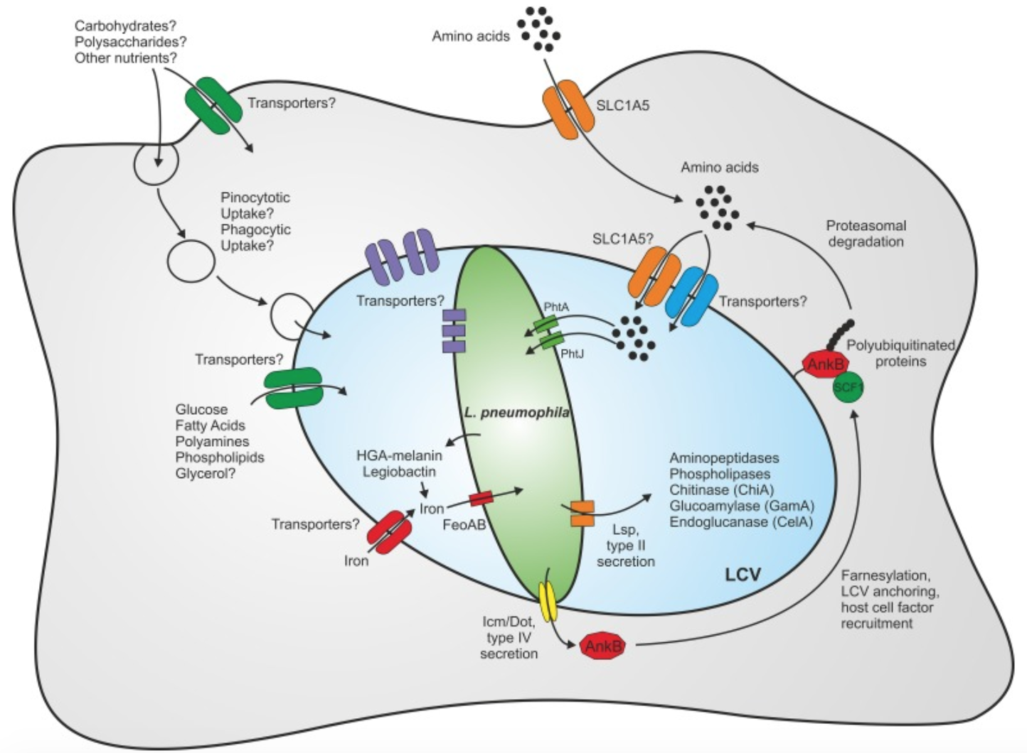
The LCV

Slide 22
Intracellularly mediated macrophage killing
Legionella induces death of macrophages from with the cell.
Causes the host cell to undergo lysis, killing the macrophage while releasing the replicated bacteria.
This reduces the population of macrophages thereby weakening the host immune response.

Slide 23
Question 4
Outcome: is the bacteria completely removed, does the patient recover fully and is there immunity to future infections from this particular bacteria ?

Slide 24
Prognosis
90% of patients fully recover with appropriate and timely treatment.
Mortality is 2-25% among immunocompromised patients.
Scarring of lung tissue due to infection may persist after successful treatment of infection.

Slide 25
Bacterial clearance
After treatment with appropriate antibiotics, the bacteria is completely removed from the host.
Interferon-gamma produced by T cells helps remove the pathogen from the body.

Slide 26
Immunity
Long term immunity primarily determined via cell mediated immunity:
Th 1 helper cells produce type 1 class cytokines, such as interferon gamma and (IL-2) which mediate cellular immunity to Legionella and other intracellular bacteria.
Adaptive immune response directs B cells to differentiate into not only active antibody producing plasma cells, but also memory B cells.
Th 2 helper cells, secrete type 2 class cytokines such as IL-4, IL-5, and IL-6 stimulate B lymphocytes to produce antibodies as part of humoral immune response important resistance to extracellular bacteria
Long term immunity is therefore also conferred via these memory cells.

Slide 27
Question 1 references
(1) Eisele NA, Anderson DM. Host Defense and the Airway Epithelium: Frontline Responses That Protect against Bacterial Invasion and Pneumonia. Journal of Pathogens 2011;2011:e249802.
(2) Yamamoto K, Ahyi AN, Pepper-Cunningham ZA, Ferrari JD, Wilson AA, Jones MR, et al. Roles of lung epithelium in neutrophil recruitment during pneumococcal pneumonia. Am J Respir Cell Mol Biol 2014 Feb;50(2):253-262.
(3) Eddens T, Kolls JK. Host defenses against bacterial lower respiratory tract infection. Current opinion in immunology 2012 Aug;24(4):424-430.
(4) Mall MA. Role of cilia, mucus, and airway surface liquid in mucociliary dysfunction: lessons from mouse models. J Aerosol Med Pulm Drug Deliv 2008 Mar;21(1):13-24.
(5) Alberts B, Johnson A, Lewis J, Raff M, Roberts K, Walter P. The Adaptive Immune System. 2002.
(6) Massiss L, Zamboni D. Innate Immunity to Legionella Pneumophila. Front Microbiol. 2011; 2(109)
(7) Astrat S, Dugan A, Isberg R. The Frustrated Host Response to Legionella pneumophila Is Bypassed by MyD88-Dependent Translation of Pro-inflammatory Cytokines. PLOS pathogens. 2014
(8) Lamberti LM, Zakarija-Grković I, Fischer Walker CL, Theodoratou E, Nair H, Campbell H, et al. Breastfeeding for reducing the risk of pneumonia morbidity and mortality in children under two: a systematic literature review and meta-analysis. BMC public health 2013;13 Suppl 3(Suppl 3):S18.
(9) Medical Microbiology. 4th ed. Galveston (TX): University of Texas Medical Branch at Galveston; 1996.
(10) H.-U Simon, A Haj-Yehia and F Levi-Schaffer. Role of reactive oxygen species (ROS) in apoptosis induction. APOPTOSIS. November 2000; 5[5]: 415-418.

Slide 28
Question 2 references
Brown, A. S., Yang, C., Hartland, E. L., & Driel, I. R. (2017;2016;). The regulation of acute immune responses to the bacterial lung pathogen legionella pneumophila. Journal of Leukocyte Biology, 101(4), 875-886. 10.1189/jlb.4MR0816-340R
Damjanov, I. (1996). Pathology for the health-related professions. Philadelphia: W.B. Saunders Company.
Hoffman, P. S., Friedman, H., Bendinelli, M., & SpringerLink ebooks - Biomedical and Life Sciences. (2007;2008;). Legionella pneumophila: Pathogenesis and immunity. London;New York;: Springer.10.1007/978-0-387-70896-6
Murray, J. F. (2011). Pulmonary edema: Pathophysiology and diagnosis. The International Journal of Tuberculosis and Lung Disease : The Official Journal of the International Union Against Tuberculosis and Lung Disease, 15(2), 155.
Park, B., Park, G., Kim, J., Lim, S. A., & Lee, K. M. (2017). Innate immunity against Legionella pneumophila during pulmonary infections in mice. Archives of pharmacal research, 40(2), 131-145.
Shapira, L., Soskolne, W. A., Houri, Y., Barak, V., Halabi, A., & Stabholz, A. (1996). Protection against endotoxic shock and lipopolysaccharide-induced local inflammation by tetracycline: correlation with inhibition of cytokine secretion. Infection and Immunity, 64(3), 825-828.
Stearns-Kurosawa, D. J., Osuchowski, M. F., Valentine, C., Kurosawa, S., & Remick, D. G. (2011). The Pathogenesis of Sepsis. Annual Review of Pathology, 6, 19–48. http://doi.org/10.1146/annurev-pathol-011110-130327

Slide 29
Question 3 references
1. Shevchuk, O., Jäger, J., & Steinert, M. (2011, April 25). Virulence properties of the legionella pneumophila cell envelope. Retrieved March 03, 2018, from https://www.ncbi.nlm.nih.gov/pubmed/21747794
2. Fernandez-Moreira, E., Helbig, J. H., & Swanson, M. S. (2006, June). Membrane vesicles shed by Legionella pneumophila inhibit fusion of phagosomes with lysosomes. Retrieved March 03, 2018, from https://www.ncbi.nlm.nih.gov/pubmed/16714556
3. Coil, D. A., & Anné, J. (2009, April). Twitching motility in Legionella pneumophila. Retrieved March 03, 2018, from https://www.ncbi.nlm.nih.gov/pubmed/19243440
4. Finlay, B. B., & Mcfadden, G. (2006). Anti-Immunology: Evasion of the Host Immune System by Bacterial and Viral Pathogens. Cell, 124(4), 767-782. doi:10.1016/j.cell.2006.01.034
5. Riboldi-Tunnicliffe, A., König, B., Jessen, S., Weiss, M. S., Rahfeld, J., Hacker, J., . . . Hilgenfeld, R. (2001, September). Crystal structure of Mip, a prolylisomerase from Legionella pneumophila. Retrieved March 03, 2018, from https://www.ncbi.nlm.nih.gov/pubmed/11524681
6. Luo, Z. Q., & Isberg, R. R. (2004, January 20). Multiple substrates of the Legionella pneumophila Dot/Icm system identified by interbacterial protein transfer. Retrieved March 03, 2018, from https://www.ncbi.nlm.nih.gov/pubmed/14715899
7. Losick, V. P., & Isberg, R. R. (2006, September 04). NF-kappaB translocation prevents host cell death after low-dose challenge by Legionella pneumophila. Retrieved March 03, 2018, from https://www.ncbi.nlm.nih.gov/pubmed/16940169
8. Roy CR, Jonathan CK. 1970. Evasion of Phagosome Lysosome Fusion and Establishment of a Replicative Organelle by the Intracellular Pathogen Legionella pneumophila. Madame Curie Bioscience Database [Internet]. U.S. National Library of Medicine.
9. Xu, L., Shen, X., Bryan, A., Banga, S., Swanson, M. S., & Luo, Z. (n.d.). Inhibition of Host Vacuolar H -ATPase Activity by a Legionella pneumophila Effector. Retrieved March 10, 2018, from http://journals.plos.org/plospathogens/article?id=10.1371%2Fjournal.ppat.1000822
10. (n.d.). Retrieved March 3, 2018, from 18. https://www.researchgate.net/figure/Compartmentalization-of-the-metabolism-of-L-pneumophila-Within-eukaryotic-host-cells-L_fig1_266086285

Slide 30
Question 4 references
1. Brieland, J. K., Heath, L. A., Huffnagle, G. B., Remick, D. G., McClain, M. S., Hurley, M. C., Kunkel, R. K. et al. (1996). Humoral immunity and regulation of intrapulmonary growth of Legionella pneumophila in the immunocompetent host. J. Immunol. 157: 5002–5008. 2. Dooling KL, Toews KA, Hicks LA, et al. (2015). Active Bacterial Core Surveillance for Legionellosis–United States, 2011–2013. MMWR Morb Mortal Wkly Rep. 64(42):1190–3 3. Joller, N., Spörri, R., Hilbi, H., & Oxenius, A. (2007). Induction and protective role of antibodies in Legionella pneumophila infection. European journal of immunology, 37(12), 3414-3423. 4. Mykietiuk, A. Carratala, J. Fernandez-Sabe, N. Dorca, J. Verdaguer, R. Manresa, F. Gudiol, F. (2005). Clinical Outcomes for Hospitalized Patients with Legionella Pneumonia in the Antigenuria Era: The Influence of Levofloxacin Therapy. Clinical Infectious Diseases. 40(6): 794-799. https://doi.org/10.1086/428059 5. Salins, S., Newton, C., Widen, R., Klein, T. W., & Friedman, H. (2001). Differential Induction of Gamma Interferon in Legionella pneumophila- Infected Macrophages from BALB/c and A/J Mice. Infection and Immunity, 69(6), 3605–3610. http://doi.org/10.1128/IAI.69.6.3605-3610.2001 6. Susa, M., Ticac, B., Rukavina, T., Doric, M. and Marre, R. (1998). Legionella pneumophila infection in intratracheally inoculated T cell-depleted or -nondepleted A/J mice. J. Immunol. 160: 316–321.

Slide 31
References
UpToDate “Epidemiology, microbiology, and pathogenesis of Pseudomonas aeruginosa infection”, Feb 2017, Wolterz Kluver.
Semin Respir Infect 1998 Jun;13(2):100-8. Immunologic response and pathophysiology of Legionella infection. Friedman

