Slide 1
Case Study 4 Immune Response to Foodborne Diseases: E. Coli and Salmonella
Maria Bleier
PATH 417

Slide 2
Overview
The Case
The Host Response – the Innate and Adaptive Immune Systems
Host Damage due to Immune Response
Bacterial Evasion to Host Response
Outcomes and Recovery

Slide 3
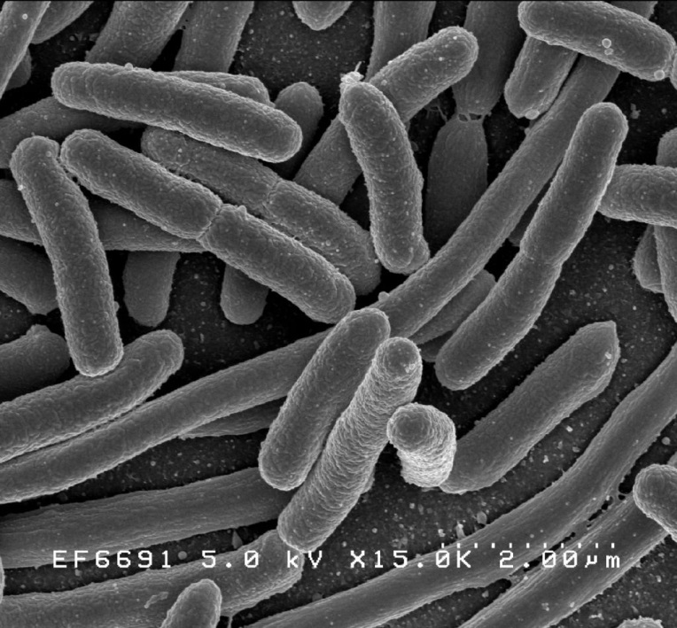
The Case
10 yr. old male patient Ronnie McDonald.
Developed abdominal cramps, bloody diarrhea and low grade fever
Physician’s examination:
Asks about history in terms of food consumed – undercooked hamburgers from previous weekend as prime suspect
No rebound tenderness, with mild periumbilical tenderness
Recommendation:
Stool sampling
Routine blood work
Image of cultured Escherichia coli with scanning electron micrograph
Based on the symptoms and abdominal distress that Ronnie is experiencing, it is likely that he has acquired a foodborne disease.

Slide 4
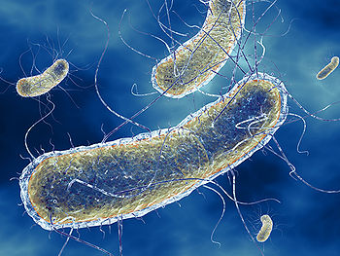
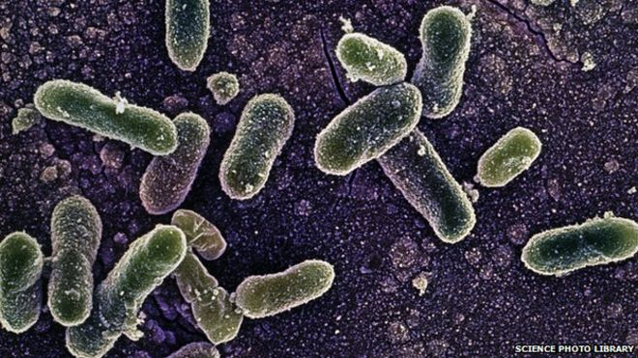
Host Response
Background on the Bacterial Agents
…. The causative agents of this foodborne illness are likely (1) E. Coli and (2) Salmonella
(1) Escherichia Coli
Commonly found as part of gut’s natural flora
Pathogenic E. coli in humans is largely due to enterohemorrhagic (bloody diarrhea causing) serotype O157:H7
(2) Salmonella
Most common pathogenic strain includes Salmonella Enteritidis
Most serotypes known to be pathogenic to humans, and can reside environmentally or in other animal species

Slide 5
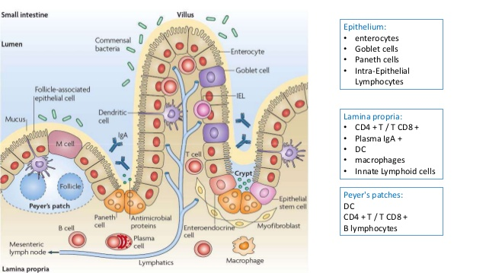
Host Response
The important elements of the host immune defenses and response:
(1) The Mucosal Barrier
Intestinal motility (peristalsis)
Bile acids and stomach acidity
Tight junctions
Intestinal microflora and epithelial cells
Mucus layer, Lamina propria (GALT)
(2) The Innate Immune Response
PAMPs and PRRs (i.e. TLRs, NOD)
Neutrophils and Macrophages and other immune cells (leukocytes)
The complement cascade and antimicrobial peptides
(3) The Adaptive Immune Response
Lymphocytes like memory cells, B cells and antibody production
Activation of T-cells by cytokines
Adaptive
Innate

Slide 6
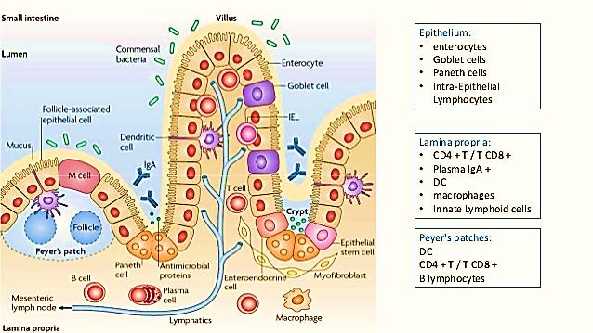
Host Response
(1) The Mucosal Barrier
Fig 1 – The organization of the intestinal layers and the various immune elements that exist within the: (1) Epithelium (2) Lamina propria (3) Payer’s patches

Slide 7
Host Response
(1) The Mucosal Barrier continued
Barriers to infection specific to the intestine: Gastric acidity and bile, peristaltic movements, shedding of the mucosal layer, secreted proteins
Selective barriers such as tight junctions and enterocytes in microvilli
Plasma membrane at base of microvilli forms a selective barrier
Tight junctions have catenins that mediate cell-to-cell adhesion
The Intestinal microflora:
Serves a microbial barrier from birth via competition for resources on outer mucosal sublayer -> limits colonization of pathogenic bacteria
Microflora also produce antibacterial substances like bacteriocins and fatty acids (f.a.) which prevent implantation
Mucosal layer and Paneth Cells:
Mucus: glycoproteins like mucin protects epithelial surface from pathogen/toxin attachment; antibacterial substances like lactoferrin, lysozyme, and peroxidase inhibits bacterial growth
Paneth cells: production of antimicrobial peptides like RegIII/B/y and lysozomes that disrupt bacterial membranes; also produce defensins (pore formation), cathelicidins (neutralize LPS of bacteria), lactoferrin (sequesters essential nutrients like iron)

Slide 8
Host Response
(1) The Mucosal Barrier continued
Lamina Propria: connective tissues layer underneath epithelial cells that contains immune cells from both adaptive and innate immune systems, like B cells, T-cells, Dendritic cells (DCs), Natural Killer (NK) cells, Macrophages, Eosinophils, and Mast cells
Also has gut-associated lymphoid tissue (GALT)
Contains Peyer’s patches and other immune cells that regulate inflammatory response upon GI barrier breach
Function: scavenging dead cells and debris, surveys intestinal environment by sampling luminal antigens (speciality of M cells) and transporting to DCs -> traveling to lymph nodes and subsequent activation of adaptive immune response
Against Salmonella and pathogenic E. coli:
Local anaerobes liberate short chain f.a. which are toxic to salmonella
Sequestering of iron by lactoferrin
Salmonella susceptible to gastric acidity < pH of 3.5
E. coil stopped by lysozymes, antimicrobial peptides in saliva, gastric acid

Slide 9
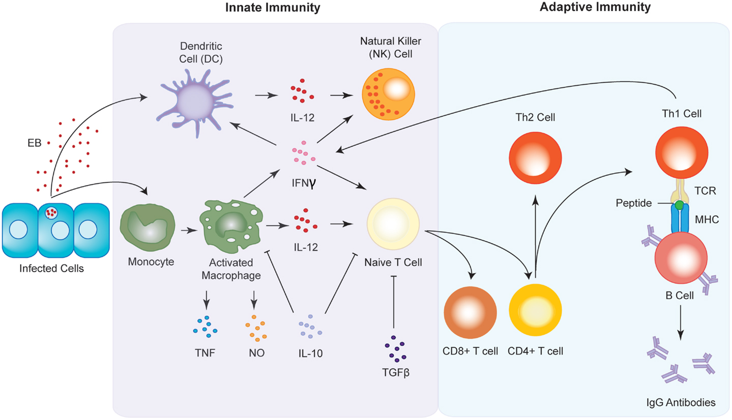
Host Response
(2) The Innate Immune Response
Fig 2 – Depiction of the innate immune cells and their respective cytokine/signal secretions and their interaction with the adaptive immune elements

Slide 10
Host Response
(2) The Innate Immune Response continued
Activation of innate response through the recognition of PAMPs (pathogen associated molecular patterns – flagellin, LPS, peptidoglycan, CpG DNA) by PRRs (pattern recognition receptors) expressed by immune cells
PRRs -> Toll-like receptors (TLRs) on macrophages and other cells [TLR2, TLR4 recog. of LPS, TLR5 recog. of flagellin], NOD receptors that detect cytosolic PAMPs and activates signaling cascades involved in pore formation [NOD1 recog. intracellular peptidoglycan + GALT activation, NOD2 activates secretion of antimicrobial peptides]
The Inflammatory response:
Cytokine activation– Inflammatory cytokines (IL-8, 10, 1B etc.), and IFN-1 signalling
Recruitment of Neutrophils– phagocytosis, degranulation (release of antibacterial proteins)
Compliment Cascade: (aids transition to adaptive response)
Three pathways: (1) Classical (2) Lectin and (3) Alternative
Each activated by different factors, but all leads to opsonization of bacteria by C3, formation of Membrane Attack Complex (MAC) which causes bacterial cell lysis , and activation of inflammatory response

Slide 11
Host Response
(2) The Innate Immune Response continued
Impact on Salmonella and pathogenic E. coli:
Salmonella….
uses M cells in GALT (Peyer’s patches) to access lamina propria and get phagocytized by macrophages -> replication within a specialized vacuole SCV in macrophage which can be halted with lysosomal enzymes, ROIs and RNIs (reactive oxygen/nitrogen intermediates)
Can also be phagocytized by macrophages through C3 opsonization
Neutrophils prevent spread in gut and kill bacteria leaving epithelial cells
E. coli…
Binds to Paneth cells in small intestine which actives secretion of a-defensins, lysozymes, and phospholipase A2 (PLA2) that inhibit its growth
Flagellin binding to TLR5 major factor in inducing cytokine IL-8 response
Neutrophils and macrophages both phagocytize bacteria, with secretion of histamines, IL’s and TNF-a thereafter

Slide 12
Host Response
(3) The Adaptive Immune Response
Fig 2 – Focusing on the adaptive immune cells and their activation and interaction with other lymphocytes

Slide 13
Host Response
(3) The Adaptive Immune Response
Activated via innate immune response
Chemokines from innate response important in activation:
CCL20– role in attracting immature DCs at site of infection -> maturation leads to presentation of antigenic peptides to naive B and T-cells
Il-1, 6, and 23– induce differentiation of native T cells to TH17 cells that recruit and activate neutrophils in the sub epithelium
IL-18, 12 – production of antigen specific TH1 cells
Impact on Salmonella and pathogenic E. coli:
Salmonella…
CD4-T cells activate macrophages, CD8 cytotoxic cells induce apoptosis in infected gut epithelial cells, B cell activation causes secretion of antibodies into gut lumen (primarily IgA, some IgG/IgM)
E. coli….
Helper T cell activation by macrophages with release of IL-2 further activating T cells (TH1 cells), IFN-gamma release causes production of NO, Tir antigen induces strongest Abs response (IgA) + complement activ.

Slide 14
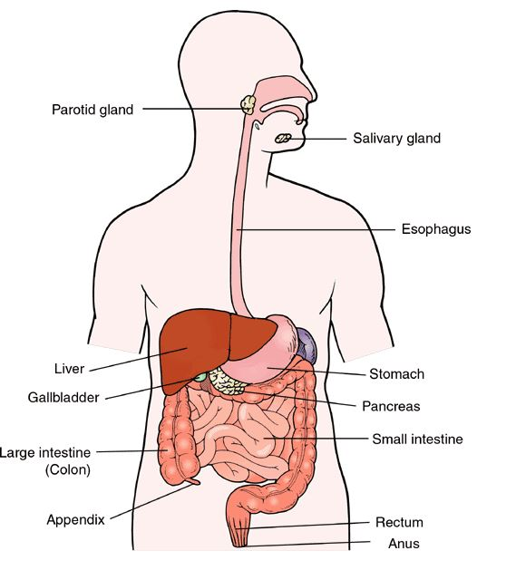
Host Damage
On the basis of Ronnie’s Symptoms ….
Low grade fever
Abdominal cramps
Diarrhea
Blood in stool

Slide 15
Host Damage
Low grade fever
Characteristic of infection that spread to secondary sites (start)
Secretion of pro-inflammatory cytokines (ie. IL-1, 6, TNF-a etc.)
Invasion of epithelial cells stimulates the release of these cytokines
Persistent infection of M cells can compromise barrier and allow pathogen into deeper tissues and blood, with it’s circulation in lymph nodes causing low grade fever
Abdominal cramps
Necrosis of host cells in GI tract + inflammation can cause tenderness (in particular periumbilical region)
Associated with pain, heat, redness, and swelling
Secreted factors like bradykinin and histamine stimulate nerve endings causing pain and inflammation

Slide 16
Host Damage
Diarrhea
Bacteria secreting enterotoxins which impact nutrient absorption mechanisms in cells -> release of water into lumen = watery stool
Neutrophils contribute by stimulating chloride secretion which causes sodium to efflux out of cells creating huge osmotic gradient
Gastroenteritis can largely be attributed to neutrophil action, causing necrosis of ileum and colon -> loss of microvilli -> malabsorption and osmotic diarrhea
Blood in stool
In a potent inflammatory reaction, have increase in host cell death which causes inflammatory lesion
Lymphoid hyperplasia followed by ulceration/cellular death occurring in ileocecal area can cause gastrointestinal bleeding -> ends up being deposited in stool

Slide 17
Bacterial Evasion
Factors contributing to Salmonella evasion:
Tetrathionate (S molec)
ROS (reactive O species)
Ent (iron binding protein)
These molecules/proteins help the pathogen better compete for resources in the lumen (i.e. iron, respiration - ATP)
Removal of Occulidin
SPI2 T3SS (rod protein)
These are involved in invasion of the epithelium and enables pathogens to evade immune cells
The PhoP-PhoQ system
Spo-2 TS33 system
Regulatory Protein SifA
Modification of LPS by TLR2 recognition (halting antigen presentation)
Destruction of P13K or targeting Rab4/7 of cell
Mechanisms of survival in macrophage vacuoles by disrupting host cell’s ability to fuse and secrete cellular toxins like NO and ROS to kill bacteria. Modification of immune response and antigen targeting is also accomplished.

Slide 18
Bacterial Evasion
Factors contributing to E. coli evasion:
NIeH1 -> inhibits NF-kB
Catalase and Perioxidase (protects bacteria cell wall)
Shiga –like toxins [Stx1A and Stx2A] inhibiting cytokine release
Zinc metalloprotease inhibits complement pathway
Factors that disrupts immune response (M cells weakened response, macrophage lysosome fusion restricted, inhibiting complement pathway)

Slide 19
Outcome of Infection
Salmonella
Generally it is a self-limiting disease that can be cleared by the body’s own immune response
Treatment with antibiotics to assist clearance has been found to prolong duration of the illness and fecal excretion/spread and is not necessary in most cases -> however at risk groups can be treated with drugs like amoxicillin, ampicillin, ceftriaxone, and ciprofloxacin [no vaccines available b/c of serovar diversity]
Proliferation and differentiation of B cells into memory and antibody-producing plasma cells are essential to developing immunity (however limited protection against other serovars)
Abs against R core (component of LPS) may provide protection
AT RISK GROUPS FOR INVASIVE DISEASE:
(1) immunocompromised, (2) elderly, (3) pregnant women, (4) infants

Slide 20
Outcome of Infection
E.coli O157:H7
Infectious colonies can be removed completely by immune system
Hydration and rest key to full recovery within 1 week of onset
Proliferation and differentiation of B cells into memory and antibody-producing plasma cells to develop immunity (however limited protection against other serovars)
Abs against R core (component of LPS) may provide protection
Pre-emptive txt: difficulty establishing vaccines and txts. because effectors (i.e. IgA, lymphocytes) difficult to obtain and transfer to uninfected individuals, and there are multiple and changing serotypes
PREVENTATIVE MEASURES:
(1) Control measures for production, processing, and preparation of food, (2) monitoring infected children and pets, (3) hand sanitation, (4) avoiding raw milk and meat products (5) reducing cross contamination

Slide 21
References
Images (in order of appearance):
Escherichia coli scanning electron micrograph image. Retrieved from https://en.wikipedia.org/wiki/Escherichia_coli#/media/File:EscherichiaColi_NIAID.jpg
E. coli O157:H7 GGCWiki. Retrieved from http://wiki.ggc.usg.edu/images/thumb/7/7e/Escherichia-coli.jpg/350px-Escherichia-coli.jpg
Salmonella Enteritditis Electron micrograph image. Retrieved from https://ichef.bbci.co.uk/news/660/media/images/76963000/jpg/_76963531_salmonella_enteritidis_bacteria-spl.jpg
Inflammation of the intestinal mucosa caused by H. pylori. Retrieved from https://image.slidesharecdn.com/projetinflammation-140412130724-phpapp02/95/inflammation-of-the-intestinal-mucosa-caused-by-h-pylori-5-638.jpg?cb=1416406790
Immune system – Innate vs Adaptive. Retrieved from https://s-media-cache-ak0.pinimg.com/736x/8d/59/5f/8d595fdb246c7aae2075c37bf5d6c171.jpg
Innate and Adaptive Immune Responses. Retrieved from http://www.frontiersin.org/files/Articles/107989/fimmu-05-00534-HTML/image_m/fimmu-05-00534-g004.jpg
Anatomy of the Digestive system. Retrieved from http://meatwod.com/wp-content/uploads/2013/01/Digestive-Anatomy-2.jpg

Slide 22
END

