Slide 1
Finding & Assessing Open Education Resource Repositories (OERR)

Slide 2
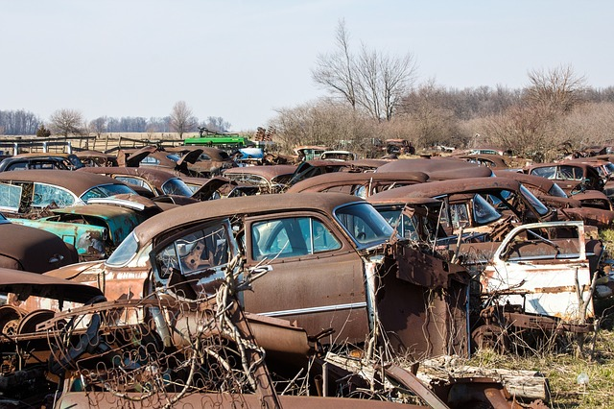
Finding….
Internet is littered with “dead” repositories
Can be a frustrating hunt through outdated and forgotten material.
Check the Library guide to (current, high quality) Open Education Resource Repositories (OERR): http://guides.library.ubc.ca/Level3_OERR

Slide 3
Assessing
Library: great advice in the guide to Assessing OERRs
Rubric includes criteria such as Intended Audience, Subject Coverage, Search & Browsing, and Licensing & Permissions
Also: currency of content? Lifecycle policy? Version control?
Top rated OERR include MIT Open Courseware, OER Commons & Merlot. See guide for more detail.

Slide 4
Assess Content
Your Subject knowledge:
Level correct?
Description correct?
Accurate content?
Complete?
Does content deliver pedagogical promises?
See: http://guides.library.ubc.ca/content.php?pid=659422&sid=5526466 for more
All graphics/images in this presentation are CC0 from pixabay.com

