Slide 1
Case 2 – Meningococcal Meningitis
Bacterial Pathogenesis
By Paula Tao

Slide 2
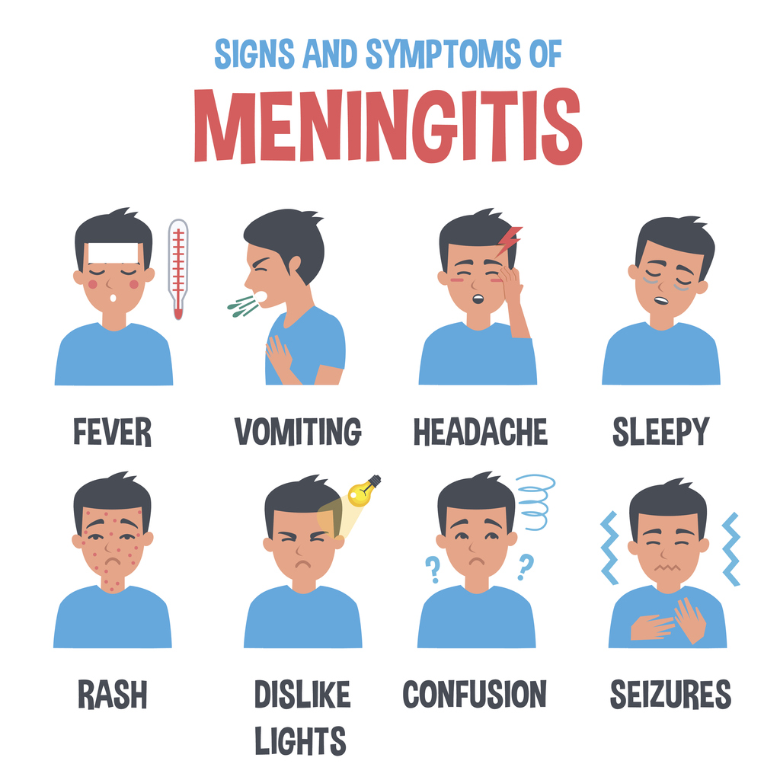
A STIFF NECK
18-year-old Mary has just moved into the dormitory at her university. One day, her roommate finds her lying in bed under her sheets. She is complaining of fever, chills, bad headache and a stiff neck. She is staying under the covers because the light is hurting her eyes. Her roommate calls 911 and an ambulance takes Mary to the local hospital. The emergency room physician asks Mary about her recent vaccinations and she reports that she has not had any since she was in elementary school. The physician documents a fever of 39.2°C and low blood pressure. He sends blood and cerebral spinal fluid to the Microbiology Laboratory. She is started immediately on intravenous antibiotics. Mary’s blood and cerebral spinal fluid grow Neisseria meningitidis and she is diagnosed with meningococcal meningitis.

Slide 3
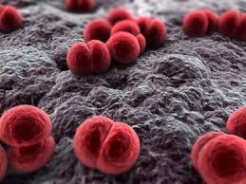
Bacterial pathogenesis
ENCOUNTER
ENTRY
MULTIPLICATION AND SPREAD
BACTERIAL DAMAGE

Slide 4
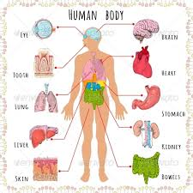
Encounter
Where does the organism normally reside geographically?
Where does the organism reside host wise?
What are the bacterial characteristics that leave it suited to these places of residence?
How would our patient have come in contact with this bacteria?

Slide 5
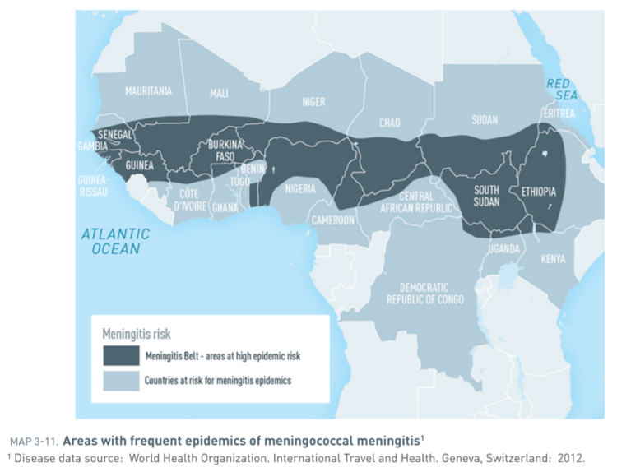
Where does the organism normally reside geographically
The highest outbreaks of Neisseria Meningitidis in the world occur in the “Meningitis Belt” in Africa
In the Sub-Saharan, this extends from Ethiopia to Senegal
N. meningitidis serogroup A strains in particular cause high incidences of due to hot climate and lack of rain
Meningococcal disease is hyperendemic in this region, and periodic epidemics during the dry season (December– June) reach up to 1,000 cases per 100,000 population.

Slide 6
Epidemiology of Meningococcal meningitis
Vieusseux first discovered Meningococcal meningitis in 1805 during an outbreak in Switzerland in which 33 deaths were recorded around Geneva from Cerebral Spinal Fluid samples
Neisseria meningitidis was originally named Neisseria intracellularis due to the nature of the intracellular oval micrococci of the organism
In Developed countries: 1-20 per 100,000 people are affected
There are 5 common serotypes of the N. meningitides disease (A, B, C, Y and W135)
Cause >90% of disease in the world due to presence of polysaccharide capsule
Serogroups A and C are predominant throughout Asia
Serogroups B and C are predominant in Europe and the Americas

Slide 7
Where does the organism reside host wise
Humans are the only reservoir of N. meningitidis
Neisseria meningitidis is a major cause of sepsis and meningitis but is also a common commensal, present in the nasopharynx and upper respiratory tract of between 8 and 20% of healthy individuals.
N. meningitidis resides in the posterior nasopharynx of the host and colonizes the nasopharyngeal mucosal membrane
Found on the surface of the nasopharyngeal epithelium and in deeper tissues during carriage
To cause disease, meningococcus must spread across the respiratory epithelium and enter the systemic circulation
Notes:
http://www.austincc.edu/microbio/2704w/nm.htm

Slide 8
Bacterial Characteristics
The nature of the respiratory system and process of drawing in breath facilitates respiratory droplets containing N. meningitidis entering the nasopharyngeal region specifically
It is the optimal location for the pathogen to accumulate in reservoir within the body as transmission of N. meningitidis is facilitated through respiratory droplets
Adhesion and invasion mechanisms of the bacteria target epithelial cells of the respiratory tract to cause infection

Slide 9
How would our patient have come in contact with this bacteria?
N. meningitidis is transmitted by direct contact through respiratory and throat droplets of infected individuals or asymptomatic carriers
Contact/Interaction with an asymptomatic carrier include:
Kissing
Shaking hands
Hugging
Mary, a non immune individual could have likely come in contact with this bacteria through an asymptomatic carrier
At the peak of adolescence, a person will be more exposed to asymptomatic carriers especially when they interact with a large population of people at the same time, such as college or even joining the military

Slide 10
Entry
What facilitates the entry of the bacteria into the human host?
What are the molecular, cellular and/or physiological factors at play in the initial entry/adherence step from the point of view of the organism
What are the molecular, cellular and/or physiological factors at play in the initial entry/adherence step from the point of view of the host?

Slide 11
Transversal of the Epithelial barrier
STEPS:
Adhesion to the apical surface
Attachment is limited to nonciliated cells of the respiratory epithelium
Mediated by bacterial surface-associated filamentous structures called type 4 pili (Tfp)
Invasion of epithelial cells
Survival within cells
To date, the intracellular niche occupied by N. meningitidis has not been defined. No markers of intracellular compartments have been found to consistently colocalize with intracellular meningococci
Movement to the basal side of cells
Escape from the basolateral aspect of the epithelium
Notes:
https://www.ncbi.nlm.nih.gov/pmc/articles/PMC2937448/

Slide 12
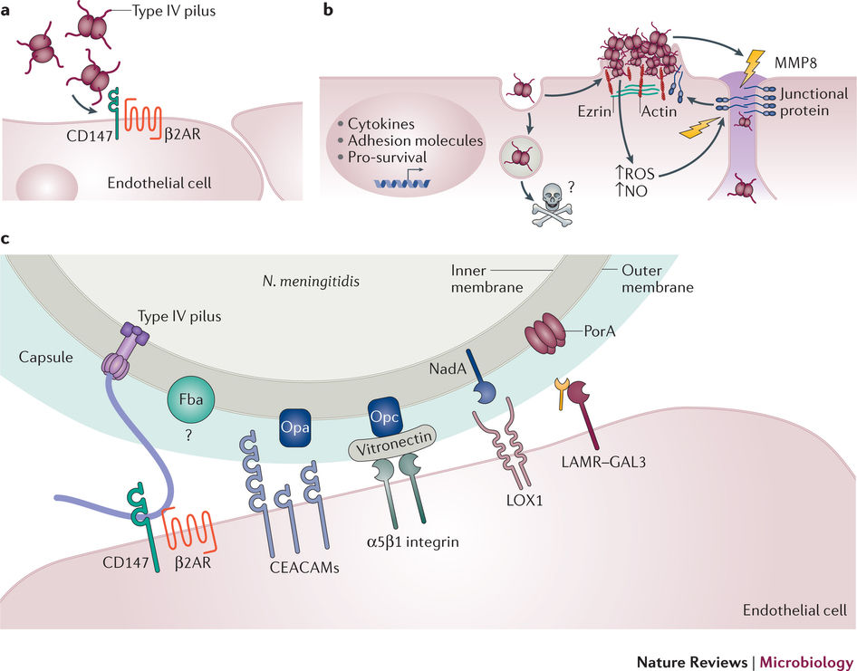
virulence factors of N. meningitidis
Anti-phagocytic Capsule
Type IV Pili (Tfp)
IgA proteases
Lipopolysaccharide endotoxin (LPS)

Slide 13
Facilitation of Bacteria into Host
N. meningitidis is a diplococcus gram negative bacteria, which possesses an outer membrane and small porin proteins for selective permeability
Expresses a protective polysaccharide glycocalyx capsule layer around its cell wall made up of negatively charged sialic acid polymers
Sialic acid is also expressed on human cells thus promoting host bacterial interactions
Capsule has a slimy characteristic that allows entry into a person’s respiratory tract via aspiration without drying
During transmission and transport through the air, the capsule keeps the pathogen protected from degradation between hosts

Slide 14
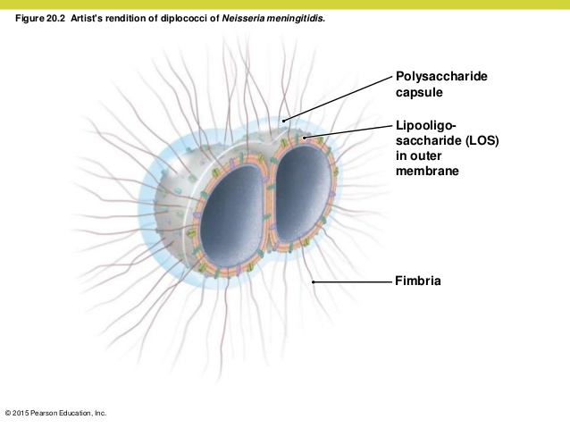
Anti-phagocytic capsule
The N. meningitidis polysaccharide capsule has been proposed to have an important role in the survival of N. meningitidis in epithelial and endothelial cells
Isolated samples from CSF are found to be consistently capsulated
The presence of capsules in pathogenic N. meningitidis serve to provide resistance against antibody, complement-mediated, or phagocytic destruction by the host immune response
Serogroups B, C, W-135, and Y incorporate sialic acids into the capsule which is advantageous for immune evasion due to host expression
Capsule switching allows horizontal exchange of the capsule operon which confers resistance to anti-capsular antibiotics
Notes:
https://microbewiki.kenyon.edu/index.php/Neisseria_meningitidis_--_Meningitis

Slide 15
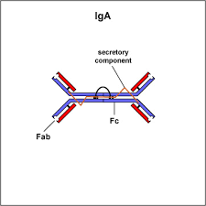
IGA Proteases
IgA proteases cleave and inactivate IgA antibodies that play a key role in mucosal lining immunity, increasing the pathogens’ invasiveness in the nasopharynx
Upon interface with the nasopharyngeal mucosa: IgA proteases degrade active IgA at the mucosal surface
Decreasing IgA levels at the mucosa facilitates Neisseria’s ability to efficiently deploy its adherence factors
Type 2 Iga1 proteases intracellularly decrease levels of host lysosomal activity
Cleavage of LAMP1 reduces steady state of the epithelial surface
Results in a flux of Ca2+ ions which stimulates the lysosome to release the N. meningitidis into the interior of the cell

Slide 16
Adhesion
Initial attachment: N. meningitidis relies on its adhesin proteins which bind to host cell components, to penetrate the epithelia first encountered in the nasopharyngeal region via intimate interactions
N. meningitidis possess pili (cytoplasmic extensions) which confer a twitching motility to the bacteria, allowing it to roll along cells until it finds the perfect site for initial attachment and entry
The Type IV pilus, specifically, is the primary major adhesin protein utilized by N. meningitidis for the initial attachment of bacteria to host
Primary attachment is enhanced by:
Lipooligosaccharide (LOS) endotoxin (short highly branched O antigenic structure on bacterial surface)
Opacity (Opa) proteins
Glycolipid adhesins on the surface of N. meningitidis

Slide 17
Type Iv Pili
Composed of filament polymers (pilin subunits fused together) on the surface of N. meningitidis to form multi-protein complexes
crucial complexes that permit the pathogen’s initial interaction, adhesion, and ultimate invasion of the host cell epithelial lining
The Type IV pili has been proposed to bind CD46 on the host cell, which is expressed on the cell surface membrane of all human cell types except for erythrocytes
Initial binding between pilus and receptor/host membrane protein is amplified and enhanced for entry by the presence and function of opacity proteins: Opa and Opc

Slide 18
Opacity Proteins as major adhesion proteins
Opa proteins are transmembrane proteins made of 8 beta strands
Opa is thought to bind cell-cell adhesion facilitating proteins on the host such as CD66
Most Opa proteins bind to receptors upregulated by inflammatory cytokines: CEACAM (carcinoembryonic antigen-related cell-adhesion molecule) receptors or HSPGs (Heparin sulfate proteoglycans)
Opc opacity protein is a trimolecular complex containing serum vitronectin and fibronectin and integrin receptors

Slide 19
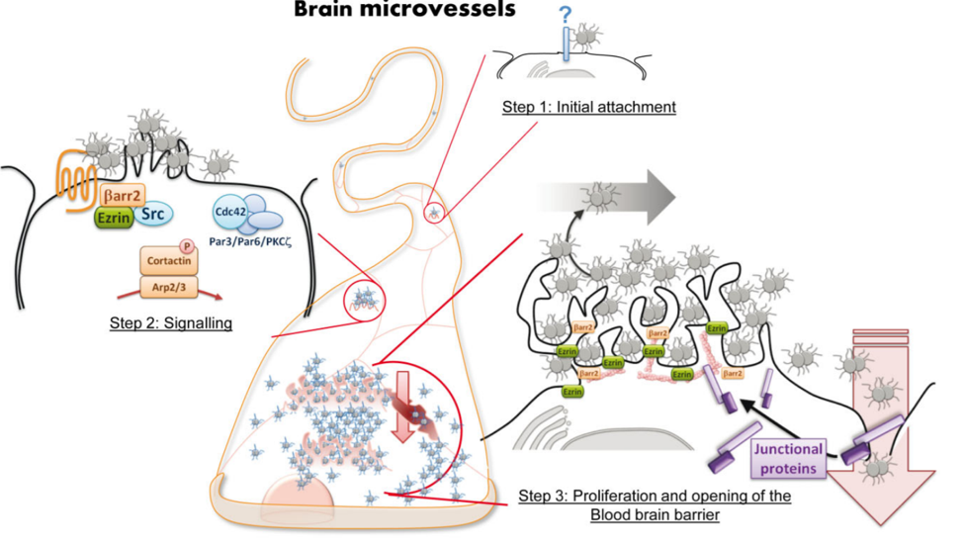
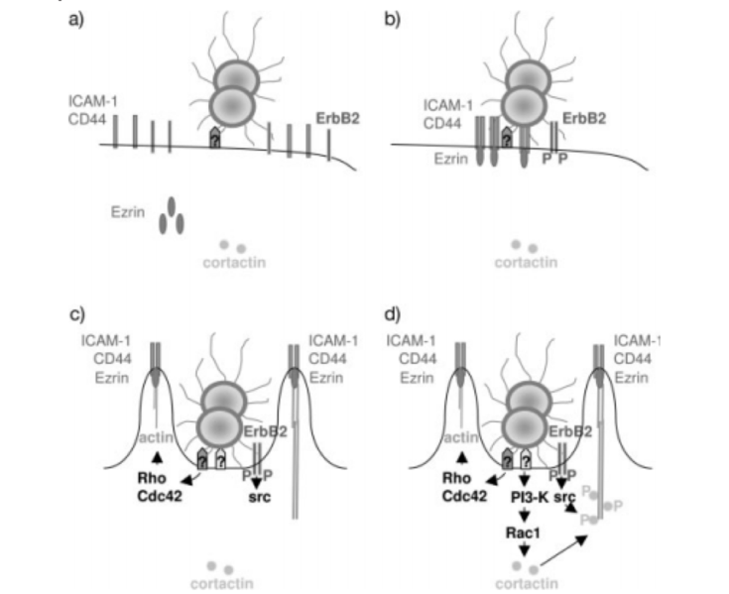
Brain endothelium invasion of N. meningitidis
The B2-AR receptor is exploited as a point of entry for N. meningitidis translocation across the brain endothelial lining
Activating B- arrestin construct a raft by accumulating proteins and assembling integrins such as CD44 and ICAM-1 to generate cortical plaque colony formation
Characterized by protein grouped protrusion and puncturing of the host cell
Resulting in promotion of bacterial uptake by the host.

Slide 20
Pilus components
PilX is a protein essential for adhesion and aggregation
Pil C proteins are minor adhesion factors: PilC1 and PilC2 proteins are utilized to form the pili assemblage, with PilC having a direct role in adhesiveness specifically
Twitching motility is the product of a pilus component known as PilT, a motor molecule, which stimulates pilus retraction and generates a strong molecular force
PilQ has also demonstrated adhesion activity with the ability to bind laminin host cell receptors
Pilin subunits undergo antigenic variation, and ultimately can select for highly adhesive pilins that aggregate to form bundles and grow colonies on the layer of epithelial cells in the nasopharyngeal region which they will ultimately invade
Glycosylated pili have a subtle decrease in host cell adhesion, therefore non-glycosylated pilin protein facilitates initial adhesion to cells

Slide 21
Other Adhesion factors
Nonspecific factors such as surface charge/hydrophobicity may aid in the pathogenesis of Neisseria adherence.
The anti-phagocytic capsule protects against damage from macrophages and neutrophils.
LOS is toxic and promotes an inflammatory response, which can upregulate receptors for bacterial adhesion and entry (receptors and proteins mentioned above).
NhhA (trimeric; binds extracellular host proteins) and NadA are minor adhesin proteins on the N. meningitidis that support attachment.

Slide 22
MULTIPLICATION AND SPREAD
Does the organism remain extracellular or do they enter into cells?
What are the molecular and cellular determinants of these events?
Do the bacteria remain at the entry site or do they spread beyond the initial site i.e. are there secondary sites of infection
Why do the bacteria hone in on these particular secondary sites.

Slide 23
Adhesion/Invasion strategies
Enter via transcellular transport by passive or adhesion induced transcytosis
Enter by paracellular passage through opened tight junctions
May disrupt the endothelial barrier by direct cytotoxic effects
Bacteria may use leukocyte facilitated transport by infected phagocytes

Slide 24
Survival and Replication
Once the bacteria have entered the host nasopharynx and passed through the epithelial cells via endocytosis they enter their primary infection site in the blood
Within the blood stream, meningococci also produce a strong inflammatory response and activate complement and coagulation cascades using LPS (a PAMP) located on its surface
N. meningitidis also have the ability to recruit negative regulators of complement, using factor H-binding protein (GNA1870)
recruits Factor H, an inhibitor of the alternative complement pathway
Porin PorA that binds a complement regulator called C4-binding protein, influencing serum resistance
Victronectin – the binding site for Opc – inhibits the formation and insertion of the membrane attack complex, a key complement component, into bacterial membranes

Slide 25
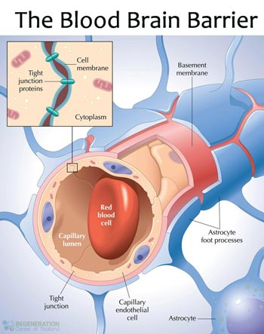
Endothelial cells to brain epithelium cells transition
Pili facilitate the attachment of the bacteria to the endothelial cells
Once the bacteria are attached to the endothelial cells, any of the above scenarios would facilitate entry
The bacteria is then internalized by the cells and transcytosed, pili interactions may cause intracellular signaling and disruption of tight junctions, or endothelial damage from LPS may allow passage

Slide 26
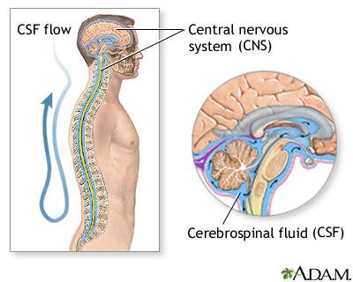
Secondary sites
Once the bacteria enter into the cerebrospinal fluid of the subarachnoid space, they are able to replicate as there is no infection control
CSF is very sterile, not providing host defenses or inhibiting bacterial growth
Richness in nutrients of the CSF favours N. meningitidis replication and dissemination throughout meninges
As the number of bacteria in the CSF continue to increase, a local inflammatory response is induced causing swelling and accessibility into the blood-brain-barrier to increase
White blood cells such as neutrophils to enter the CSF and cause immune system damage to endothelial surfaces

Slide 27
Bacterial Damage
Do the bacteria cause any direct damage to the host (or is the damage fully attributable to the host response, as indicated below)
If so, what is the nature of the bacterial damage?
Can it be linked to any of the signs and symptoms in this case?

Slide 28
Meningococcal meningitis complications
Can be responsible for a deadly septic shock leading to purpura fulminans or cross the blood brain barrier (BBB) and invade the meninges
The meninges consists of three layers of the tissue (dura mater, arachnoid mater, and pia mater) covering the brain and the spinal cord, and the subarachnoid space contains cerebrospinal fluid that helps cushion the brain and spinal cord
When these areas get invaded by bacteria such as N. meningitidis, the immune system reacts by gathering immune cells to the site and causing inflammation

Slide 29
Inflammatory complications
Blood clots: can spread to the vessels in the brain and may cause stroke
Swelling in the brain (cerebral edema): can damage brain tissue
Increased pressure within the skull: may cause parts of the brain to shift and may cause brain herniation, which causes the brain to be compressed and damaged.
Excess fluid in the brain: as the brain continues to make cerebrospinal fluid, infection may block CSF flow throughout the brain and can put pressure in some areas of the brain. This increased pressure in the brain and spinal cord can explain Mary’s symptom of a stiff neck.
Inflammation of the cranial nerves: these nerves are involved in sight, hearing, taste, and control of facial muscles and glands. This may explain for Mary’s sensitivity to light.
Subdural empyema: accumulation of pus in the dura mater
Septic shock: from low blood pressure
Intravascular coagulation: small blood clots throughout the bloodstream

Slide 30
Purpura fulminans (PF)
A severe cutaneous complication of acute meningococcemia and manifests itself through cutaneous hemorrhage and necrosis due to vascular thrombosis or dermis and disseminated intravascular coagulopathy
Most of the damage, however, is due to the induction of the inflammatory response
Cellular damage can be due to cytokine release from LPS/LOS interaction with TLR4 to release inflammatory cytokines: TNF-a and IL-6, chemokine release and reactive oxygen species (ROS)
Patients with fulminant meningococcal septicemia have rapid proliferation of meningococci in their circulation and result in an exaggerated and destructive intravascular inflammatory response leading to progressive circulatory collapse and severe coagulopathy
Patients get impaired renal, adrenal, and pulmonary function and get lesions on the skin, limbs, kidneys, adrenals, choroids plexus, and lungs

