Slide 1
EPSE 546
Intro to Access Technology
Kim Heinrichs and Debbie Klassen

Slide 2




Acknowledgement of Traditional Territory
Musqueam
Nation
Squamish
Nation
Tsleil-Waututh
Nation

Slide 3
Welcome
Overview:
Introduction to the course
Setting the scope – AT and access
Starting with Allyship

Slide 4
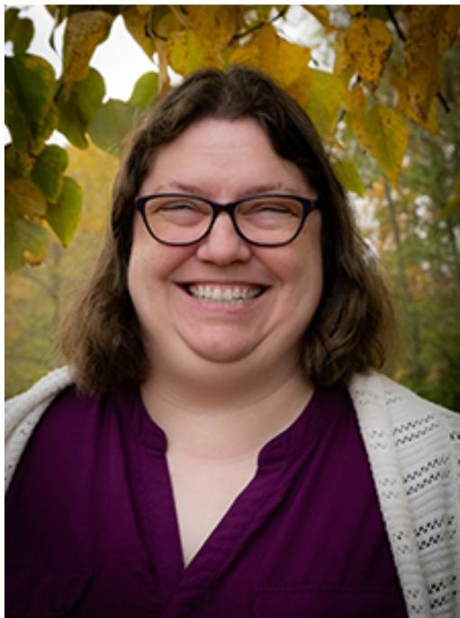
We are...
Jen Jesso
Kim Heinrichs
Debbie Klassen
D​

Slide 5
What is at?
“Assistive technology refers to items designed specifically to improve the functional capabilities of individuals with a visual impairment or other disabilities. The term includes everything from screen magnifiers for low-vision computer users to braille.”

Slide 6


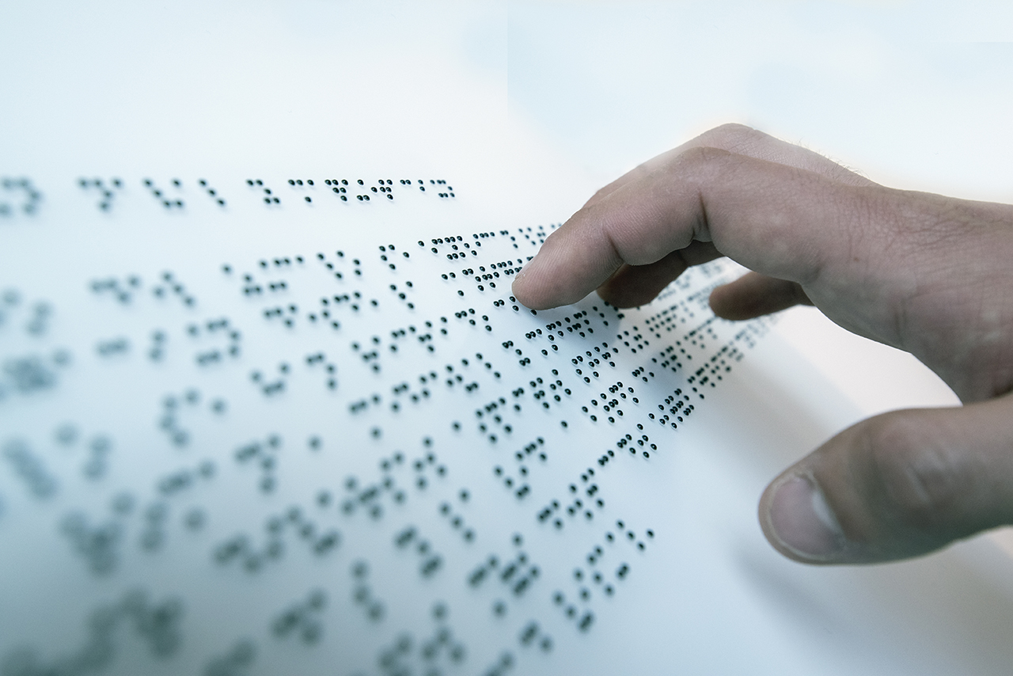
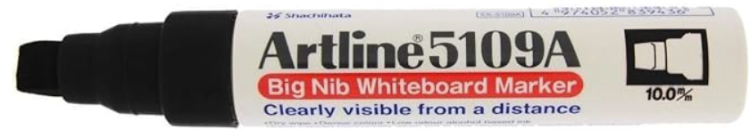


AT

Slide 7
Course objectives
    Demonstrate a foundational ability to use selected AT and identify the key concepts and features blind and low vision students need to learn and understand, including learners with complex profiles.
    Demonstrate an ability to promote meaningful selection and use of technology by students.
    Demonstrate a strong working knowledge of the principles and practice of inclusive design.

Slide 8
Course objectives (2)
    Create a purposeful, sequential set of lessons that teach skills for access around an AT solution or set of solutions, grounded in evidence obtained through data collection.
    Through effective allyship, support students as they advocate for greater accessibility at school and in the community.
    Refer to and use recognized guidelines and standards in the production of learning materials across a variety of digital alternate formats.

Slide 9
Major assignments – overview
  AI note: see syllabus
  Weekly discussions and Conversation Starters (see Discussion Board page on Canvas). (20%)
    One or two Live Discussions – both will be recorded.
  Eight (8) AT Labs (60%)
    Due on Sunday evenings – see schedule for holiday adjustments
  Final Project (20% in this course) – Comprehensive AT Plan with EPSE 543 integration
    Due on the final day of the term but review the assignment this week!

Slide 10
Course Communications and INfo​
Lectures pre-recorded: focus on timely feedback
Debbie/Jen/Kim: each module moderated by one of us
“Office hours” announced per module
  If there’s overlap it must be important!
  Some links and readings are optional but will enrich your knowledge.
  Discussion Q: make them meaningful and helpful to you and your classmates.

Slide 11
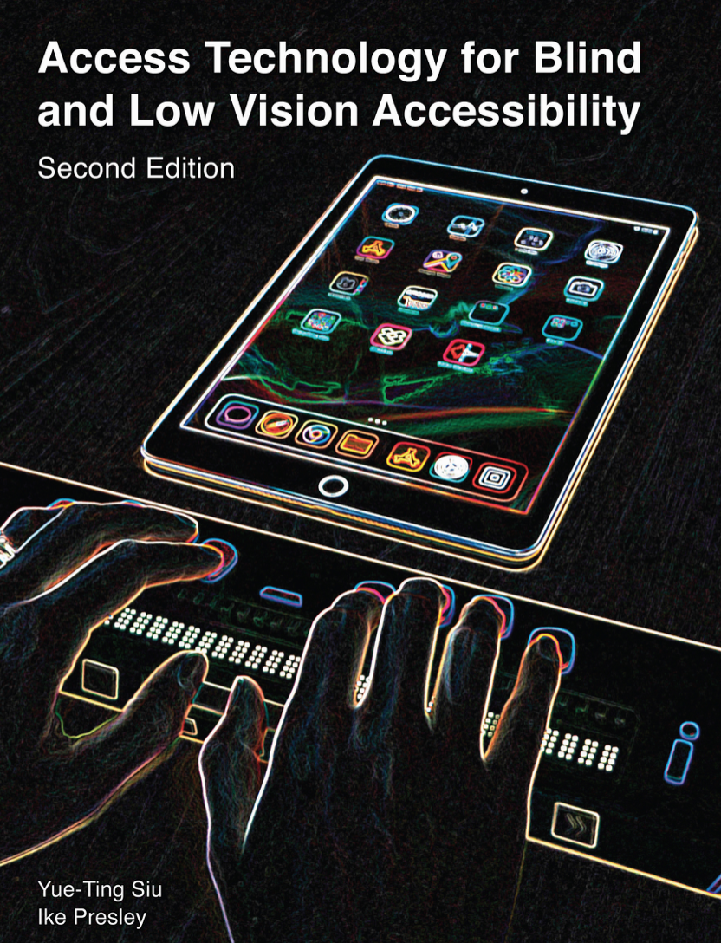
Big Shift
Assistive
Access Technology [link]

Slide 12
This is a course on promoting meaningful access to learning through inclusion and technology, supported by advocacy for more accessible content
This is a course that provides you with a basic understanding of the areas of access technology available to students with visual impairments.
We have developed modules that give you practical support for your work as a TSVI, that includes:
    Understanding the range of tools, how to have meaningful conversations with teachers, roles and responsibilities.
    Individualized focus
    Interdisciplinary strategies
    Will NOT be: shopping list of tech

Slide 13
AT Competencies for Teachers of students with visual impairments
Reading: Baser and Kamali-Arslantas conducted a study of recognized knowledge areas in the field of access technology for TSVIs.
5 main areas TSVIs should have competency in are:
        Braille technologies
        Accessibility for documents and software
        AT for diverse needs
        AT for accessing print
        AT for transforming content into accessible digital format

Slide 14
Accessibility and Inclusion
“Inclusive design is not a strategy to help people fit into systems and structures which exist in our societies; it is about transforming those systems and structures to make it better for everyone.”
- Diane Richler

Slide 15
Responsibility
“Accessibility is one of those things that everyone should know something about, but some people should know a lot about”
- Matt May, Adobe.

Slide 16
allyship
“Access intimacy is that elusive, hard to describe feeling when someone else “gets” your access needs. The kind of eerie comfort that your disabled self feels with someone on a purely access level. Sometimes it can happen with complete strangers, disabled or not, or sometimes it can be built over years.”
-Mia Mingus

Slide 17

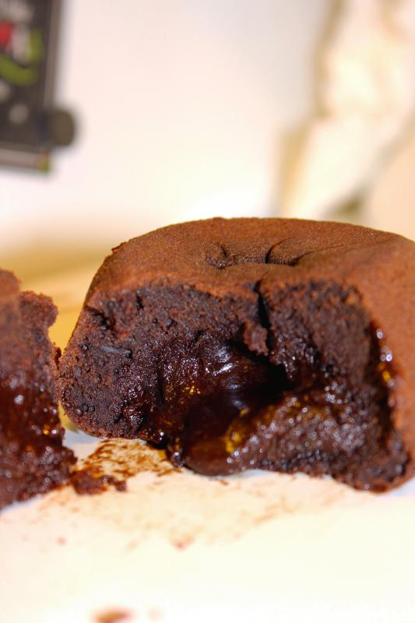

Coming Up – Module two
This week: contact Debbie or Kim with any questions
Next week: Jen and Introduction to Digital Accessibility
This Photo by Unknown Author is licensed under CC BY
This Photo by Unknown Author is licensed under CC BY-NC-ND

