Slide 1
Case 1: Bacterial Pathogenesis
Summary by Derrick Yao

Slide 2
Bacterial Encounter
Stephanie has shown signs of Impetigo based on her symptoms such as red sores around her mouth and nose
The disease, Impetigo, can be caused by:
S. aureus
S. pyogenes

Slide 3
Bacterial Encounter
Location of S. aureus:
Geographically, present in temperate and usually affluent regions such as N. America
Host wise, reside under the skin and anterior nares of the nasopharynx, throat and hair
Survival of S. aureus in host:
Optimal temp. for growth at 37 C degrees which is the human body temperature and optimal pH ~7 which is around pH of mucosa and skin
Ability to resist phagocytosis by biolfilm formation, capsule, protein A, surface proteins and modification to cell surface
Ability to survive in phagosome due to cell wall’s resistance to lysozyme

Slide 4
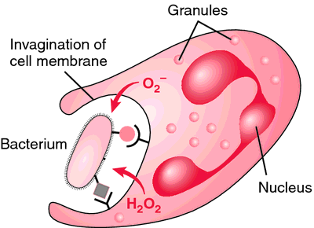
Bacterial Encounter
Location of S. pyogenes:
Geographically can be found in temperate regions with a greater burden of disease
Host wise, present in epithelial surfaces like the nasopharyngeal mucosa (throat) and skin
Survival of S. pyogenes in host:
Surface- associated M protein, Mac protein and hyaluronic acid capsule to resist/inhibit phagocytosis
Able to resist intracellular killing by PMNs and survive intracellularly within phagocytic cells
http://medical-dictionary.thefreedictionary.com/phagocytosis
Notes:
http://medical-dictionary.thefreedictionary.com/phagocytosis

Slide 5
Bacterial Encounter
How did Stephanie encounter S. pyogenes and S. aureus?
Scratched skin around her mouth and nose which weakens the skin and exposing the region to bacteria
Could have gotten a cut in school which breaks the epithelial barrier
Coughing and sneezing via respiratory droplets
Skin-to-skin contact, food or an environmental factor harboring the bacteria
Could be part of her microbiota

Slide 6
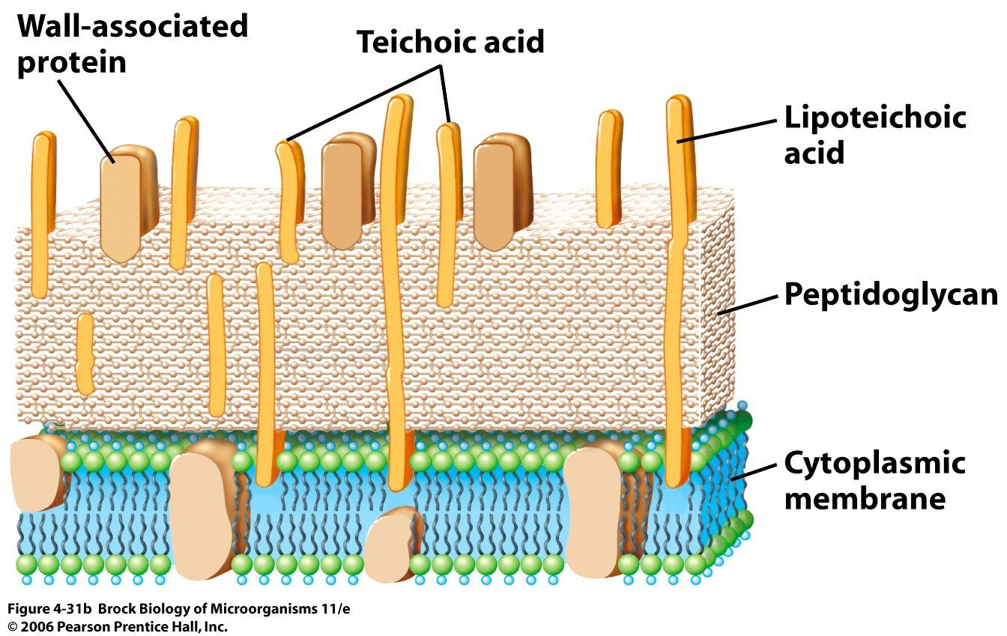
Bacterial Entry
S. aureus:
Enter through broken skin and reside in the localized tissue of the entry site; can also enter through respiratory tract
Once colonization is established, S. aureus positions itself near throat, ear, mouth and sinus
Uses fibronectin, fibrinogen-binding proteins (FnbP) and surface collagen receptors to attach to damaged tissues exposing collagen-rich dermis
Uses membrane-damaging toxins, clumping factors (B) and staphylokinase to promote adherence to host
Alpha toxin binds to host cell membrane and form pores in human cells such as red blood cells
Panton-Valentine Leukocidin (PVL) is toxic for white blood cells and is an important virulence factor in necrotizing skin infections
https://classconnection.s3.amazonaws.com/45/flashcards/821045/jpg/04_f31b1318870567655.jpg

Slide 7
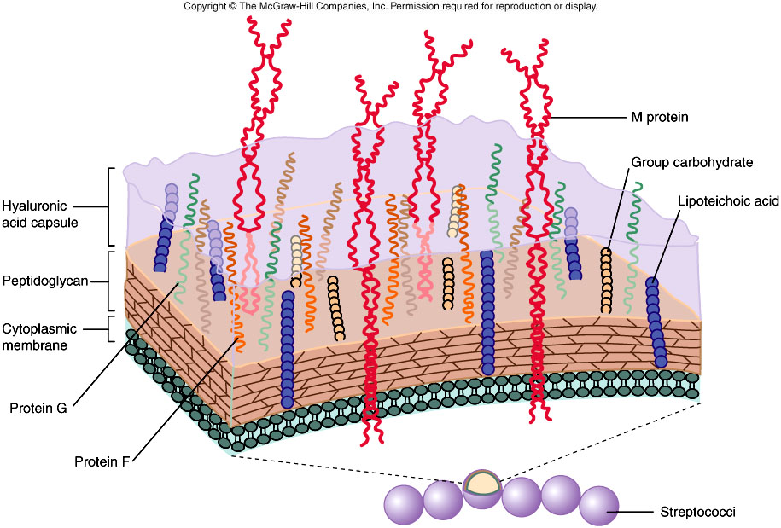
Bacterial Entry
S. pyogenes:
Colonizes host only when there are viral disturbances to the host, taking advantage of a compromised immune system.
Localized and cause inflammation on skin cells
Surface proteins such as M protein, lipoteichoic acid (LTA), fibronectin-binding proteins (protein F) used for adherence to host cells
LTA acts by overcoming the electrostatic repulsion of the bacteria from the host cell
M protein facilitates irreversible adhesion via attachment to host keratinocytes
F protein promotes adherence by binding to the amino terminus of fibronectin on mucosal surfaces
http://www.uark.edu/misc/jdurdik/MechPATH/RESPn.html

Slide 8
Bacterial Entry
http://www.journaloforalbiosciences.org/article/S1349-0079(12)00049-7/abstract

Slide 9
Multiplication and Spread
S. aureus:
Infection can occur in the bones called osteomyelitis
Accessing vulnerable sites of the bones caused by surgery, trauma, presence of foreign bodies
can also get into the bloodstream called bacteremia
Travel to different sites in the body to cause secondary infection
Can result in abscesses, other skin lesions, infect muscles, meninges, kidney, heart or lung
Ability to survive both extracellularly and intracellularly

Slide 10
Multiplication and Spread
S. aureus:
Able to reside intracellularly in host cells
Uptake by the host’s receptor-mediated endocytosis through the use of a multifunctional adhesin FnBPs (fibronectin- binding proteins)
Evasion of lysosomal killing by disintegrating the organelle membrane in order to translocate into host cell cytoplasm
Evasion of immune cells
Hemolysin B-toxin kills monocytes and destroys platelets, allowing to escape detection by phagocytes

Slide 11
Multiplication and Spread
S. pyogenes:
If failed to be eliminated at the primary site of infection, can spread to secondary sites of the body through the bloostream
Can infect bones, other sites of the skin, muscles, the brain and the heart
From the respiratory tract, can spread to sinus, middle ears and the lungs causing inflammation
In the blood, can cause toxic shock syndrome
Able to survive, persist and replicate within the cytoplasm of phagocytic cells (macrophages and PMNs) by breaching through phagocytic vacuoles
Can exploit these phagocytic cells for trafficking and systematic spread from primary site of infection

Slide 12
Bacterial Damage To Host
S. aureus:
Can cause direct or indirect process of cytotoxic or immune-induced responses
Pore-forming exotoxins, α, β, δ, γ toxins, and leukocidins, come together to cause pore formation in the membrane of the host cell that damages the cellular membrane
Superantigens such as enterotoxins and Toxic Shock Syndrome toxins result in massive uncontrolled cytokine release by immune cells (binding to MHCII of APCs and TCR of T-cells)
Enzymes that degrade or interfere with host cell protein function such as proteases, collagenase and staphylokinase
Staphylokinases activates plasminogen to form plasmin, which digest fibrin clots.
Collagenases break down peptide bonds in collagen, which is a main extracellular matrix protein found in tissues
Tissue integrity decreases

Slide 13
Bacterial Damage To Host

Slide 14
Bacterial Damage To Host
S. pyogenes:
Can cause direct or indirect process of cytotoxic or immune-induced responses
Pyrogenic exotoxins function as superantigens, resulting in massive uncontrolled cytokine release by immune cells (binding to MHCII of APCs and TCR of T-cells)
4 main types of pyrogenic exotoxins: Streptococcal Pyrogenic Exotoxins A, B, C, F
Two types of Hemolysins, Streptolysin O and Streptolysin S, causes disruption of cellular membranes by forming unregulated pores
Streptolysin O is an oxygen labile leukocidin that targets a large range of cells and is highly immunogenic
Streptolysin S targets polymorphonuclear leukocytes and their subcellular organelles and because of this, they are not immunogenic
Disruption of the integrity of cellular membranes leads to cell death
Enzymes that degrades or interferes with macromolecular makeup and livelihood of host cells
Streptodornases A,B,C,D (Dnase), Streptokinases (protease), Hyalurodinases (degrade hyaluronic acid)

Slide 15
Bacterial Damage To Host
http://www.slideshare.net/jai990/staphylococcal-streptococcal-skin-infections

Slide 16
Bacterial Damage To Host
Toxins and enzymes produced by S. pyogenes/S.aureus work together resulting in the proteolysis of the epidermal and sub-epidermal layers of tissues which results in blisters and impetigo
The signs and symptoms observed in the case of Stephanie may be the result of the effects of these toxins at the site of infection of her oral/nasal area
Superantigens that cause the release of cytokines resulting in inflammation
proteolytic modification enzymes that degrade or interfere with cell and tissue populations
Damage may also be caused by Stephanie’s own immune system
Cytokine release that leads to inflammation

Slide 17
References:
Foster, T. J. (2005). Immune evasion by staphylococci. Nature Reviews Microbiology,3(12), 948-958. doi:10.1038/nrmicro1289
Medina, E., Goldmann, O., Toppel, A., & Chhatwal, G. (2003). Survival of Streptococcus pyogeneswithin Host Phagocytic Cells: A Pathogenic Mechanism for Persistence and Systemic Invasion. The Journal of Infectious Diseases,187(4), 597-603. doi:10.1086/373998

