Slide 1
A Chronic Cough: B. pertussis Bacterial Pathogenesis
36-year-old Joseph has been suffering from multiple spells of violent coughing for 6 weeks. Prior to developing the chronic cough he had, what he describes as, a mild upper respiratory tract irritation, mild fever, runny nose and a cough that lasted about 3 days. More recently, and at the insistence of his spouse, he finally visits a drop-in clinic where the doctor asks him about his childhood vaccinations. Joseph reports that, to the best of his knowledge he had all the required shots but he admits to not having any since becoming an adult. Upon examining Joseph the doctor finds some redness in his throat but his lungs are clear and there are no enlarged lymph nodes in his neck. The doctor collects a throat swab to send to the laboratory, prescribes some codeine syrup and informs Joseph that the cough may last a few more weeks.
The laboratory is unable to detect Bordetella pertussis or any other pathogen from the swab. Despite this, Joseph is diagnosed with pertussis, commonly known as whooping cough, based on his clinical presentation and lack of adult immunization against pertussis. The coughing fits go away after another 4 weeks.

Slide 2
Encounter: Where does B. pertussis reside… Geographically
Though vaccinations initially lowered rates of disease…
We see resurgence of outbreaks in Australia, Netherlands, U.K., and the United States
According to the CDC, Wisconsin is the US state with the 2nd highest rate for whooping cough

Slide 3
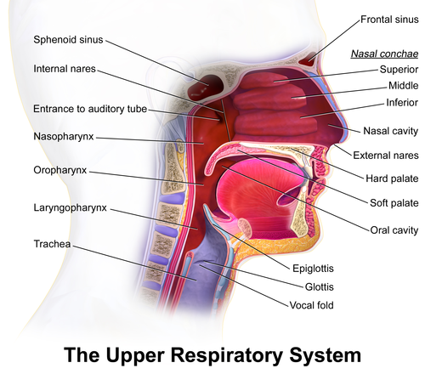
Encounter: Where does B. pertussis reside… in the host
B. pertussis is spread via respiratory droplets
The bacterium enters through the nasopharynx
And colonizes the respiratory tract

Slide 4
What bacterial characteristics make it suitable to take residence in these areas?
B. pertussis has a optimal temperature of 35 – 37 degrees Celsius and optimal pH between 7.0 – 7.5
It is capable of forming biofilms that allows it to survive host anatomical clearance mechanisms
Biofilms also allow for antibiotic resistance
It can also use a variety of virulence factors to prevent ciliary clearance
While the bacterium is inhibited by media containing fatty acids, metal ions, sulfides or peroxides…
It can grow on blood rich environments, containing buffers, salts, amino acids for energy and growth factors like nicotinamide

Slide 5
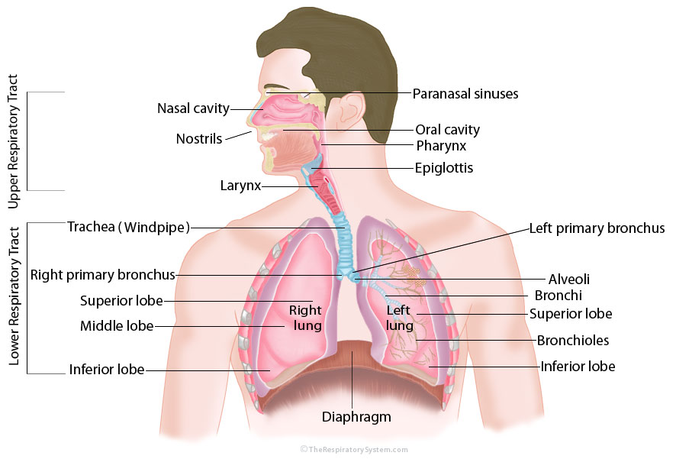
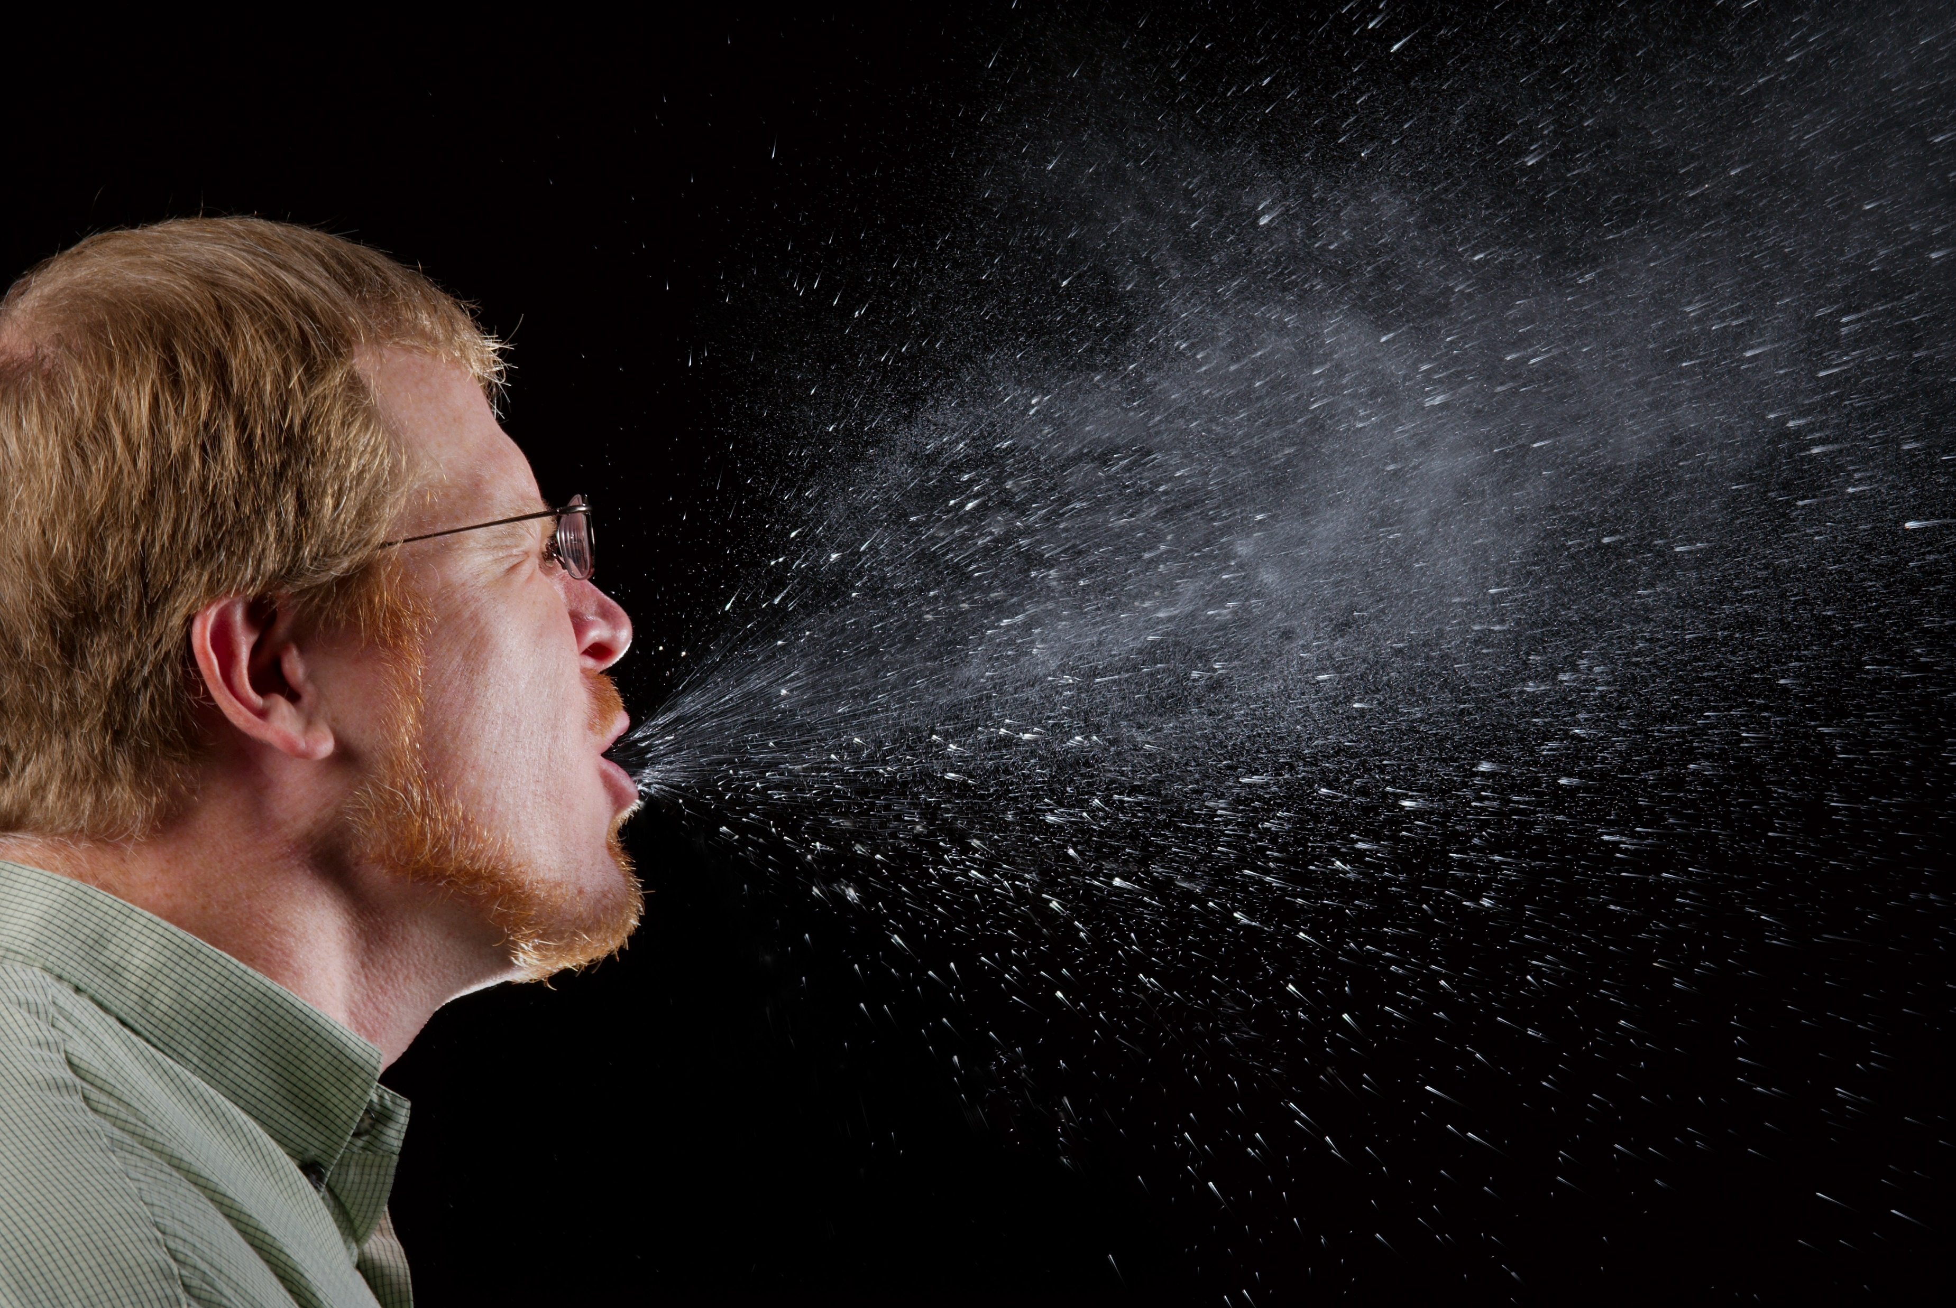
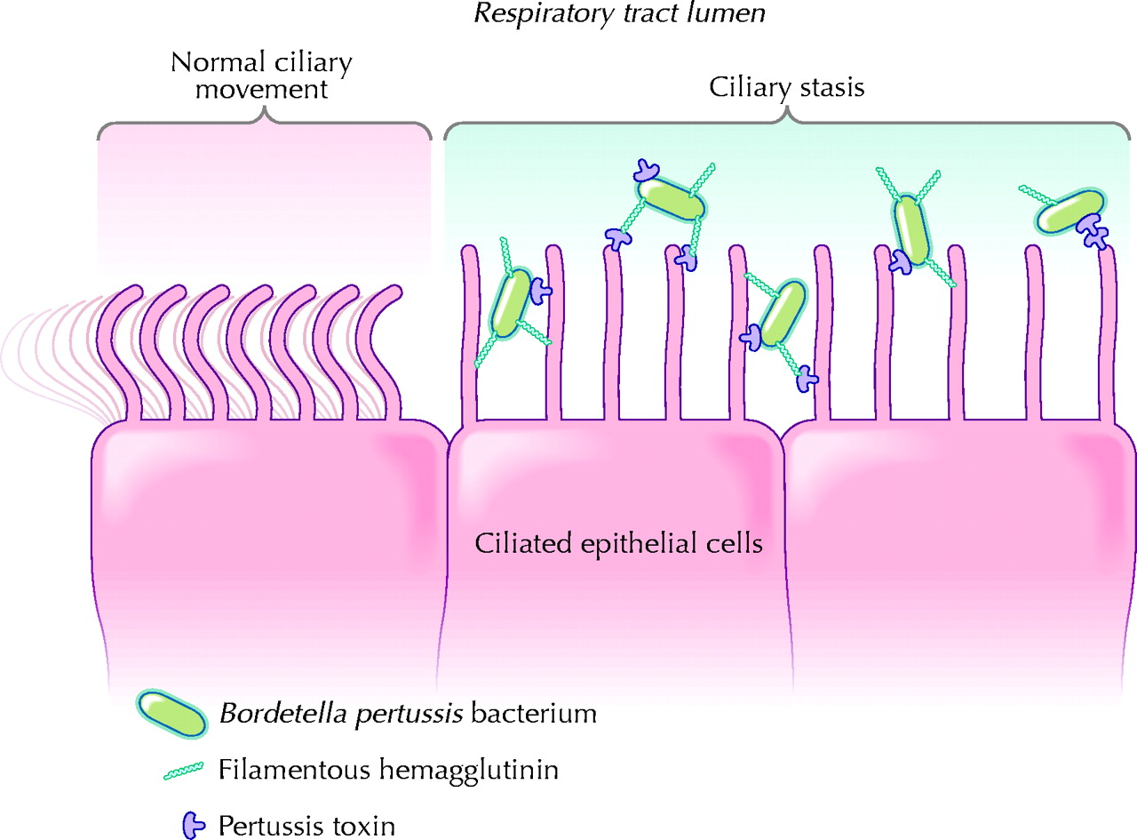
2. It then resides at the mucosa during the infection
1. B. Pertussis enters the human through respiratory droplets
3. Bacterium multiples and causes damage primarily extracellularly
What facilitates the entry of the bacteria into the human host?

Slide 6
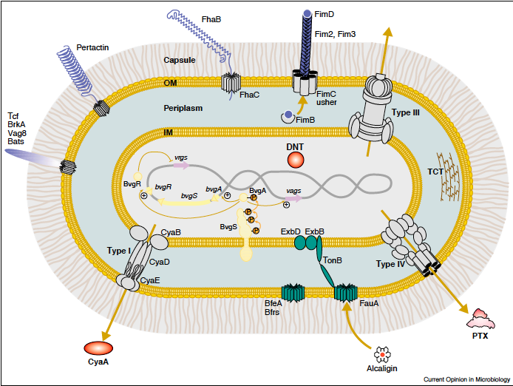
Entry: Adhesion & Colonization
Adhesion and colonization is mediated primarily by Filamentous hemagglutinin (FHA) proteins
Create filamentous structures on the cell surface
Allow the bacterium to bind series of cells and extracellular structures in respiratory epithelium
May also be used to bind to and invade immune cells (via CR3)
Other proteins involved in adhesion include fimbriae and pertactin (which promote persistence by resisting clearance by neutrophils)

Slide 7
Multiplication & Spread
Spread is localized to the respiratory tract (i.e. do not become systemic)
Resides mainly on external ciliated surface of mucous membranes of respiratory tract
Rapidly multiply in first few weeks
Spread across the mucous membranes (from nasopharynx → trachea → bronchi → bronchioles)
May produce biofilm

Slide 8
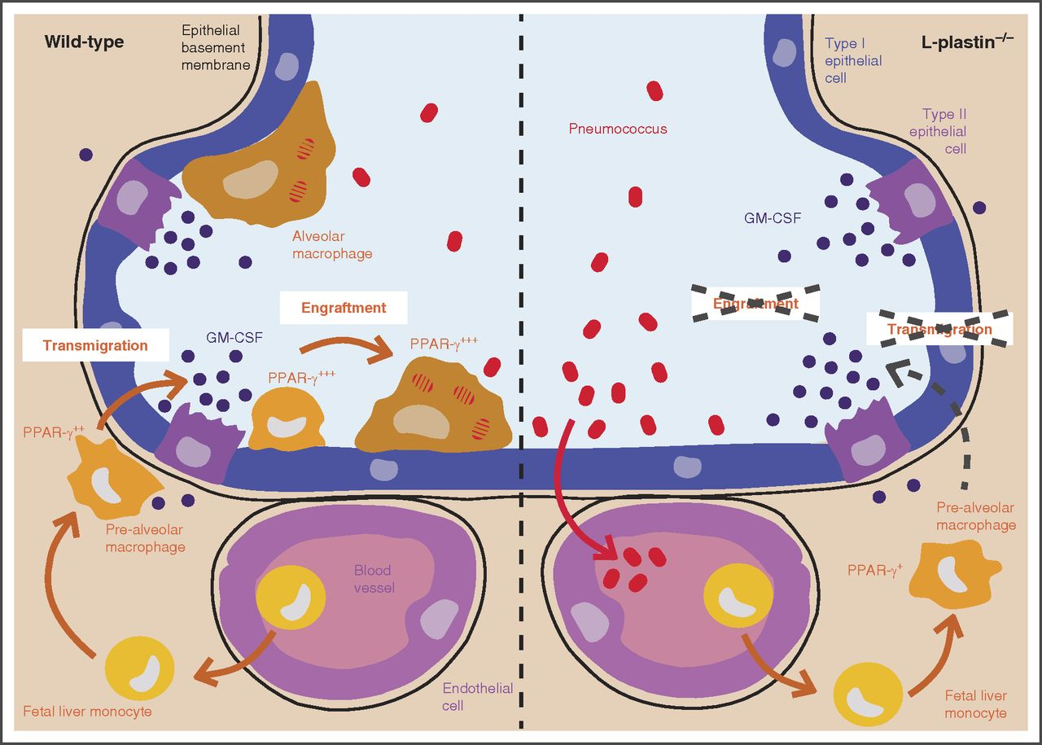
Multiplication & Spread Cont’d
Recently been shown that…
B. pertussis can invade resident macrophages and alveolar macrophages

Slide 9
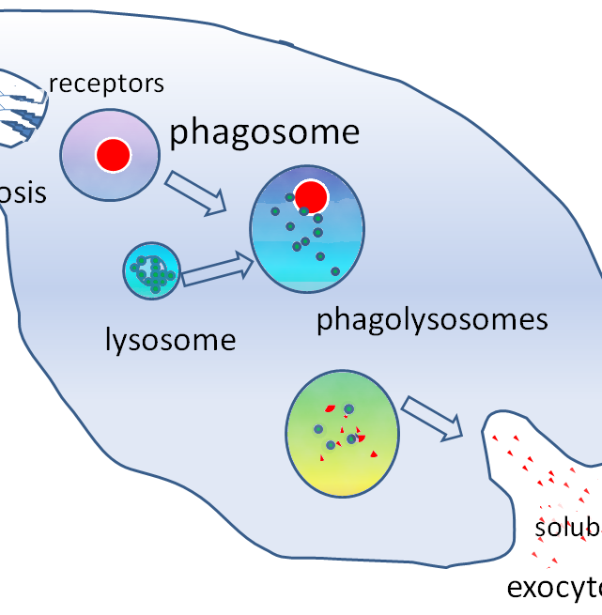
Invasion of Immune Cells by B. pertussis
Entry into these cells involves: microtubule assembly + lipid raft localization via tyrosine kinase signaling → cytoskeletal rearrangement
Once inside the cell, few B. pertussis occupy Lysosome-Associate Membrane-Protein-1 (LAMP-1) NEGATIVE compartments (protein required for fusion of phagosome and lysosome) → the bacteria avoid degradation, avoid immune response, have access to nutrients & can establish persistent infection

Slide 10
Bacterial Damage
Virulence Factor | How it works | Type of Damage
Pertussis Toxin | A) Binds any sialic acid-containing glycoprotein B) Enters the host via receptor mediated endocytosis C) Induces modification that prevents inhibitory G-protein activity and subsequently upregulates adenylate cyclase activity | Inhibits migration of cells that expresses G-protein coupled chemokine receptors like neutrophils, monocytes, and lymphocytes Decreased recruitment of neutrophils to lungs earl in infection Decreases pro-inflammatory chemokine and cytokine production Inflammation exacerbated at peak of infection

Slide 11
Bacterial Damage
Virulence Factor | How it works | Type of Damage
Adenylate cyclase toxin (ACT) | C-terminal domain binds to target and forms cation pores N-terminal domain converts ATP → cAMP | Inhibition of phagocytosis and oxidative burst in neutrophils Enables bacteria to resist neutrophil mediated clearance Blockage of complement-dependent phagocytosis of macrophages Suppresses activation of and chemotaxis of T-cell Hemolytic activity → morphological changes in host cell

Slide 12
Bacterial Damage
Virulence Factor | How it works | Type of Damage
Tracheal cytotoxin (TCT) | Stimulates production of proinflammatory cytokines and iNOS | Destruction and extrusion of ciliated cells from epithelial surface Increase in body temperature Ciliary paralysis→ mucus accumulation and coughing
Dermonecrotic toxin (DNT) | Unclear | Produces necrotic lesions Turbinate atrophy
Lipopolysaccharide (LPS) | Sensed by TLR4 of host cells | Triggers early TNF-alpha response Recruitment of neutrophils Release of pro-inflammatory cytokines

Slide 13
Coughing itself can lead to problems…
A chronic cough can decrease oxygen to the brain which can cause…
Encephalopathy
Brain damage
Damage to alveoli → Pneumonia
Lung collapse
Rupture of small and large blood vessels (hemorrhages)
Increase intrathoracic pressure

Slide 14
THE END ☺

