Slide 1
cASE 1: sCHOOL sORES Bacterial Pathogenesis
nATASHA bORTOLazzo

Slide 2
tHE cASE: sCHOOL sORES
6-year-old Stephanie O. has developed red sores around her mouth and nose. At the start of class her teacher noticed the rash and called her parents to take her home. Her parents take her to the family doctor who examines Steph. She is afebrile and does not have any swollen lymph nodes. There is no rash on her hands or feet or inside her mouth. He prescribes an antibiotic and tells her parents that she needs to stay at home for a couple of days. He swabs the rash and sends the swab to the Microbiology Laboratory.

Slide 3
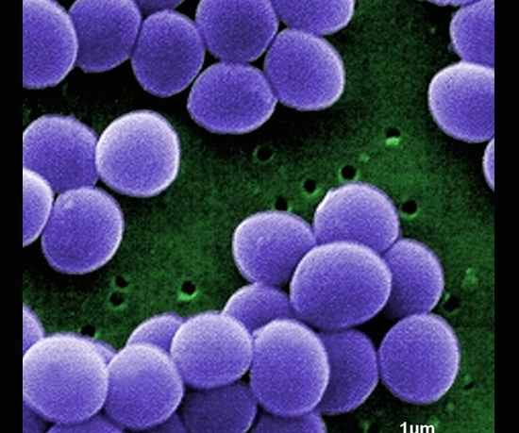
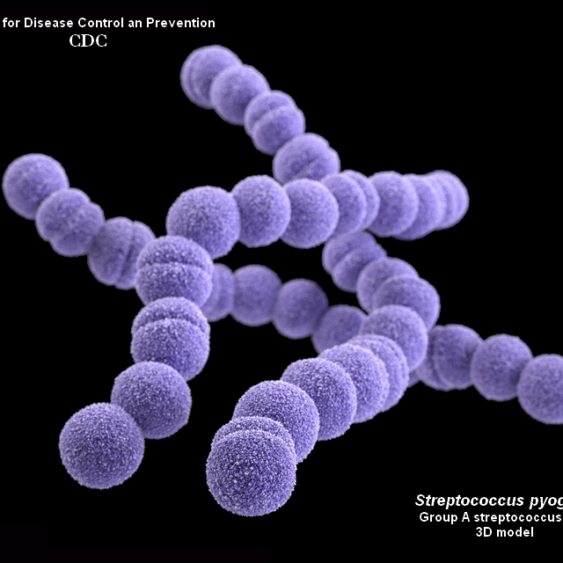
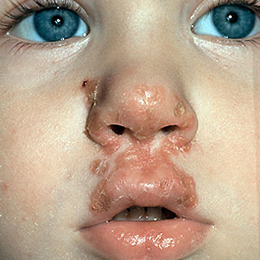
wHAT COULD THIS INFECTION BE?
Fig.3. Staphylococcus aureus (VISA) from Janice Haney Carr, Public Health Image Library; Web; 19 January 2017.
Stephanie’s red sores around her mouth and nose are characteristic of the bacterial infection, Impetigo.
Impetigo can be caused by two bacterial species: Staphylococcus aureus and/or Streptococcus pyogenes
Fig.2. Streptococcus pyogenes from Centers for Disease Control and Prevention, Bacteria in Photos, Web; January 19 2017.
Fig.1. Impetigo. Medicine Net, Web; 17 January 2017.

Slide 4
Bacterial encounter
Geographic location of S. pyogenes
Geographic location of S. aureus
S. pyogenes can cause infection in both tropical and temperate climates, but upper respiratory tract infections dominate in temperate climates while Impetigo predominates in tropical climates ()
Impetigo causing S. pyogenes strains are mostly located in tropical climates that are wet and humid
In countries lacking a tropical climate, Impetigo infections can be established during the summer (warmest months of the year). ()
S payogenes is the primary cause of impetigo in tropical regions
S. aureus is distributed worldwide.
S. aureus is the primary cause of Impetigo in temperate and affulent regions ()

Slide 5
Bacterial encounter: Host
S. pyogenes
S. Aureus
Humans are the biological host
Present in epithelia surfaces such as the nasopharyngeal mucosa and skin ()
Other common locations include the genital tract and throat
S, aureus is a normal resident of the microbiota in the nasal passage, upper respiratory tract, axilae and anterior nares in humans
S. aureus is a commensal that resides on the surface of the skin
Found in mammals and birds as part of the normal flora
Can be transmitted from one species to another
Other locations include: the skin, groin, perineal region in males, mucus membranes, mammary glands, intestinal tract, hair

Slide 6
BACTERIAL CHARACTERISITCS ENSURING SURVIVAL
S.pyogenes
S.aureus
S. aureus re highly tolerant to salts, allowing them to survive at pH as low as 4.5, (skin pH range :4-7)
S. aureus is able to grow in water activity as low as 0.8 allowing them to survive for an extended period of time on dry areas (ex: wounds)
Inside the host, S. aureus evades phagocytosis by formation of biofilms, utilization of a capsule and surface protein (spA, fibonrin, laminins) to prevent phagocytosis by enhancing adherence to the host cells
Inside the host, S. pyogenes is able to survive due to their ability to deter host defenses such as phagocytosis due to their hyaluronic capsule and surface M proteins.
Hyaluronic capsule prevents recognition by immune defenses
M proteins allow S. pyogenes to adhere to their host tissues, contributing to their colonization

Slide 7
S. pyogenes
S. aureus
S. pyogenes is highly transferrable
Can be transferred via infected skin/wound contact
direct contact with mucus from infected individuals
contact with mucus on fomites
S. aureus is a resident of the normal flora in specific sites of the body (nasal passage, anterior nares etc) thus it can easily spread via self inoculation from this sites to wounds, abrasions and cuts elsewhere on the body.
Can be transferred via infected skin/wound to skin contact
Can be transferred by skin to skin contact with asymptomatic carriers
Commonly transfer by hands
S. aureus is transmitted through air droplets i.e. mucous secretions released during coughing and sneezing
Minor transmission contributor: Direct contact with heavily contaminated fomites

Slide 8
Bacterial entry
ENTRY
S. pyogenes
S. aureus
Skin and host immune response are typically an efficient barrier to S. pyogenes
S. pyogenes is an opportunisitc pathogen, taking up residence on the human body after disturbances in the composition of the microbiota (i.e. faces decreased competition)
Usually occurs in immunosuppressed or immunocopromised
Upregulate virulence factors, penetrate the skin and are internalized
S. pyogenes can be found in :
epithelial cells or
Exit the epithelial cells, enter the blood stream and spread into various organs
Via cuts, abrasions, surgical wounds etc. S. aureus is introduced into the host’s internal environment
Entry upregulates virulence factors eliciting a strong pathogenic response
S. aureus can take up residence in:
tissue
Extracellular matrix of epithelial and/or endothelial surfaces
Intracellular environment
Blood stream

Slide 9
Entry of S. pyogenes
Skin and host immune response are typically an efficient barrier to S. pyogenes
S. pyogenes is an opportunisitic pathogen, taking up residence on the human body after disturbances in the composition of the microbiota (i.e. faces decreased competition)
Usually occurs in immunosuppressed or immunocompromised
Upregulate virulence factors, penetrate the skin and are internalized
S. pyogenes can be found on:
1. in epithelial cells
Exit the epithelial cells, enter the blood stream and spread into various organs
M protein, lipoteichoic acid (LTA), fibronectin-binding proteins (protein F) have been identified as important components in bacterial adherence

Slide 10
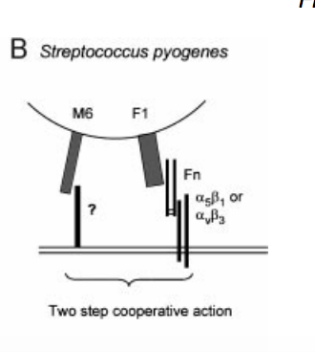
ENTRY OF S.PYOGENES
Initial adherence step:
There is a two step model describing adherence of S. pyogenes to epithelial cells with step 1 involving LTA and step 2 involving fibronecin and an M protein
1. Lipoteichocic acid LTA is located in the bacterial cell wall, it creates a weak reverisible bond between the bacteria and the host epithelial cells
2. There is a 2 step cooperative action between fibronectin and M protein:
The S. pyogenes cell wall protein, Fibronectin receptor (F1)1 forms a strong, irreversible interaction with host epithelial cell adhesion receptor, fibronectin-binding integrin (binds amino portion of integrin)
M61 binds host keratinocytes, and upregulates IL-1 and prostaglandin E2 production

Slide 11
Entry of S.PYOGENES
Following initial adherence:
S.Pyogenes are internalized in a unclear process similar to phagocytosis. However, actin polymerization is noted to be integral for internalization to occur
Following internalization:
The bacteria can take up residence in epithelial cells or they can leave the epithelial cells, enter the blood stream where they can spread to various organs
The bacteria can take up residence in other cells by the same processes used to initially enter the host body (i.e. LTA, fibronectin, M protein)

Slide 12
Entry of S. aureus
When S. aureus is a skin commensal:
they utilize adhesive molecules called MSCRAMMs that bind to host epithelial cells
Clumping factor B and Teichoic acid are the MSCRAMMs that facilitate adherence to the host epithelial cells
Breakage in the skin barrier:
Endothelial and Epithelial cells express laminin and fibronectin cell surface proteins
S. aureus Clumping factor B and Teichoic acid attach to laminin and fibronectin on the endothelial and epithelial cells Flowing internalization

Slide 13
Multiplication and spread s. pyogenes
S. pyogenes can typically survive in the extracellular environment, however some strains can also survive in the intracellular environment
The most common infections occur at the skin and respiratory tract (caused by different strains respectively)
If host immune responses fail to eliminate S. pyogenes at the primary site of infection, it can spread to secondary sites such as the muscles, brain, heart, joints and bones.
S. pyogenes can cause many secondary infections such as sepsis, meningitis, myositis, endocarditits and others [6]
S. pyogenes infections resulting from skin infecting strains can also spread to deeper tissues, causing necrotizing fascitis
S. pyogenes infections resulting from upper respiratory tract infecting strains include spread to other sites such as the sinuses causing sinusitis, middle ears causing otitis and lungs causing pneumonia [7]
In the blood stream in can cause toxic shock syndrome

Slide 14
Multiplication and spread s. aureus
S. Aureus can survive in extracelullar and intracellular environments
To survive inside its target cells, S. aureus requires that the cells must have been damaged some how, and they must be able to be taken in by receptor mediated endocytosis
To enter the cells, the bacteria express endogenous ligands that
Infection is usually localized to the tissues surronding the point of entry which is typically a break in the skin
Another entry site is the respiratory tract. Here S. aureus can cause pneumonia.
S. Aureus is usually localized because once internalized, S. aureus face host immune response
However S. aureus can enter the blood stream, this is a process known as bacterimia
Once in the bloodstream, S. aureus can travel and infect other secondary sites
Bactermia is the most serious medical complication associated with S. aureus infection and can prove to be fatal
Most manifestations of S. aureus involve necrotizing pneumonia, impetigo, etc.

Slide 15
Bacterial damage caused by s. pyogenes
pyrogenic toxins
Streptococcal Pyrogenic Exotoxins A/B/C/F
-they cause rashes and cause impEtigo to develop
-function as superantigens as they cause cytokine release when binding to T cell and MHC II receptors
Hemolysins: disrupt cell membrane by formation of pores, lead to cell death
-Streptolysin O – oxygen labile leukocidins
-targets many cells
-highly immunogenic
Streptolysin S-polymorphonuclear leukocytes and their organelles
-not immunogenic
Enzymes:
NASases-leukotoxic
Streptokinases-proteolytic
Hyaluronidases-degrade host issues

Slide 16
Bacterial damage caused by s. Aureus
Superantigens are produced by S. aureus:
Enterotoxins-there are 6 serotypes A/B/C/D/E/G
These enterotoxins result in release of cytokines that result in cell death
This is the known cause of toxic shock syndrome
Toxic shock syndrome toxin
Toxic shock is caused by a lack of neutralizing antibodies in response to this toxin
This allows it to bind to MHC II and T cell receptors, resulting in cytokine release and cell death

Slide 17
Bacterial damage caused by s. aureus
Enzymes:
Proteases-degrade host cell proteins
Staphylojinase-degrades fibrin clots and nucleases
Collagnease-degrade host cell collagen
Epidermolytic Toxin
Causing blistering of the skin

