Slide 1
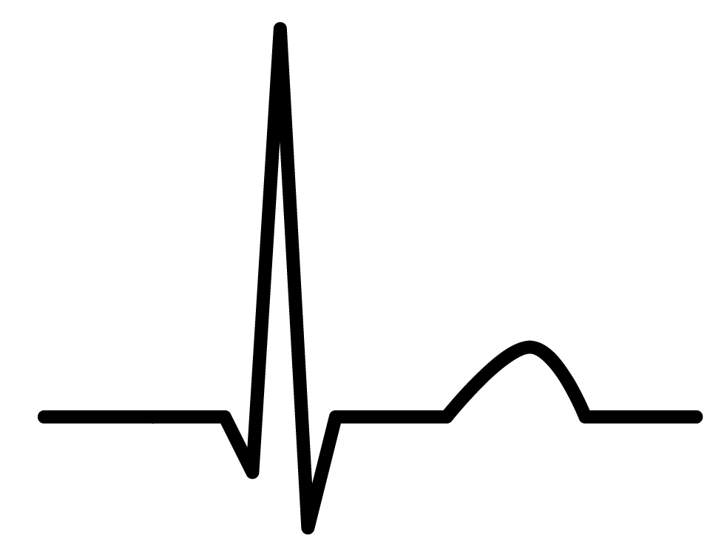
Different strokes for dialysis folks; of QRS, it's not nice to 'Fib when you don't P(ee) Warfarin as Stroke Prophylaxis for Atrial Fibrillation in End-Stage Renal Disease
Jonathan Mailman
PharmD Student
12 Sept 2013

Slide 2
What I thought I knew
Surrey is a scary place:

Slide 3
What I thought I knew:
Surrey is a scary place:

Slide 4
What I thought I knew
Doing a rotation in pediatrics would be a gut wrenching and terrible experience

Slide 5
What I thought I knew
Doing a rotation in pediatrics would be a gut wrenching and terrible experience
NO! They are adorable and bounce back quickly!

Slide 6
What I thought I knew
Moustaches outside of Movember are weird, itchy, and uncomfortable

Slide 7
What I thought I knew
Moustaches outside of Movember are weird, itchy, and uncomfortable
Nope: just awesome!

Slide 8
What I thought I knew
All patients with atrial fibrillation needed to receive warfarin-anticoagulation to prevent stroke
…

Slide 9
End-Stage Kidney Disease and Atrial Fibrillation
Up to 27% hemodialysis patients have atrial fibrillation (AFib)
Hemodialysis patients 31% increased risk of hemorrhagic stroke
Hemodialysis patients with AFib
Mortality HR 1.65 (95% 1.18-2.31)
Ischemic stroke HR 1.26 (99% 1.06-1.49)

Slide 10
Warfarin in ESRD
From the DOPPS trial ~1/3 of patients received warfarin for AFib
Warfarin associated with increased risk of:
Calciphylaxis
Vascular calcification
Pulmonary calcification
Use of mini-dose warfarin for graft patency
Ineffective
Increase risk of bleed

Slide 11
CCS 2012 Guidelines
“eGFR < 15mL per minute (on dialysis):
We suggest that such patients not routinely receive either OAC or ASA for stroke prevention in AF (Conditional Recommendation, Low-Quality Evidence).”

Slide 12
Warfarin Use in Canada
Warfarin prescribing in hemodialysis facilities across Canada ranges from 0 – 45% of patient

Slide 13
Risk Calculators - Stroke
CHADS₂
SPAF = excluded renal failure
Atrial Fibrillation Investigators = excluded renal failure
National Registry of AF = 10% of population, not defined
CHA₂DS₂-VASc
Euro Heart Survey on AF = 5.8% undefined “renal failure”
R₂CHADS₂
ROCKET-AF = excluded renal failure
ATRIA = database, not defined

Slide 14
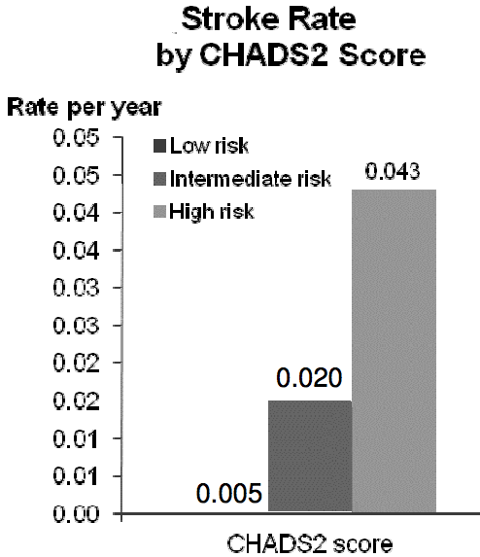
CHADS2 Validation in ESRD
DOPPS trial data
CHADS₂ 0 = Low
(1.9/year)
CHADS₂ 1 = Intermediate
(2.8/year)
CHADS₂ ≥2 = High
(4.0/year)

Slide 15
Risk Calculators - Bleed
HEMORR₂HAGES
CR_{CL} <30mL/min
National Registry of AF = 10% of population, not defined
HAS-BLED
chronic dialysis or renal transplant or SCR >200µmol/L
Euro Heart Survey on AF = 5.8% undefined “renal failure”

Slide 16
Clinical Question
Do patients with atrial fibrillation and receiving hemodialysis derive the same benefit from stroke prophylaxis with warfarin therapy as the general population

Slide 17
Search
Database | Pubmed, Embase, Google, Google Scholar, Cochrane, IPA
Search | Chronic Kidney Failure, Dialysis, Renal Dialysis, Atrial Fibrillation, Warfarin
Limits | Human
Results | Meta-Analysis: 1 Retrospective Cohort: 1

Slide 19
Zimmerman et al. 2012
Design | Systematic review and meta-analysis
Search Terms | Chronic kidney disease, renal transplant, end-stage renal disease, dialysis, AFib and atrial flutter
Inclusion | Incidence, prevalence, or out-comes of AFib with or without anticoagulation
Exclusion | n < 25
Outcome | Trials included = 25 Trials assessing warfarin = 5

Slide 20
Zimmerman et al. Warfarin Trial Characteristics
Author | Year | Type | n
Wiesholzer et al. | 2001 | Retrospective Cohort | 430
Chan et al. | 2009 | Retrospective Cohort | 1671
Lai et al. | 2009 | Retrospective Cohort | 93
Wizemann et al. | 2010 | Prospective Cohort | 17 513
Winkelmayer et al. | 2011 | Prospective Cohort | 1185

Slide 21
Zimmerman et al. Warfarin Trials Findings
 | Ischemic Stroke | Hemorrhagic Stroke | Major Bleed
Lai N = 93 | ⬇ ARR 17% (P<0.001) | ➔ ARI 14% (NSS) | ➔ ARI 5% (NSS)
Winkelmayer N = 1185 | HR 0.92 (0.61 to 1.37) | ⬆ HR 2.38 (1.15 to 4.96) | ➔ 0.96 (0.70 to 1.31)
Wiesholzer N = 430 | HR 3.2 (1.7–5.9, P=0.0002) |  | --
Chan N = 1671 | ⬆ HR 1.8 (1.2-2.8) | HR 2.2 (1.0-4.9) | --
Wizemann N = 17 513 | HR 2.17 (1.04–4.53, P=0.04) | ➔ No increase risk (data not given)
Notes:
Wiesholzer – 22 year span, used clinic Dx, combined both outcomes
Lai – Major bleed defined as GIB, hematoma, retroperitoneal bleed, abdo hematoma, pelvic hemorrhage, all reqr transfusion
Winkelmayer defined as GI bleed reqr hosptialization

Slide 22
Zimmerman et al. Limitations
Cohort Studies
Selection bias
Included retrospective trials
Recall bias
Mis-classification/information bias
Observational
INR not reported
Only searched Medline and EMBASE

Slide 24
Olesen et al.
D | Retrospective Cohort, Danish Registry Data
P | Discharge with non-valvular AFib between 1997-2008
I | Warfarin, ASA, or both
C | No Therapy
O | Primary: Hospitalization or death from ischemic stroke or VTE, composite major or minor bleeding, MI, and All cause mortality | Secondary: risk of stroke/VTE excluding TIA
Notes:
Stroke/VTE = peripheral-artery embolism, ischemic stroke, and transient ischemic attack
Bleed = gastrointestinal, intracranial, urinary tract, and airway bleeding

Slide 25
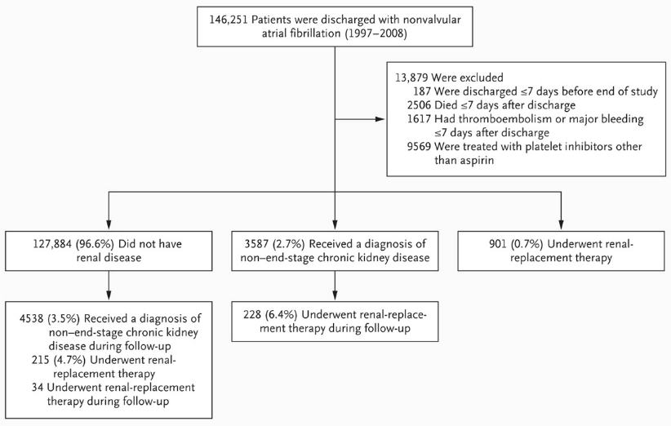
Olesen et al. Patients included
Notes:
Renal status could change
No > CKD > ESRD
Patients could move down, but not back up the scale based on renal function for classification
Analysis occurred based on the patient’s current status when the event occurred

Slide 26
Olesen et al. Patients included
Notes:
34 is 0.0003%

Slide 27
Olesen et al. Risk Scores
CHA₂DS₂-VASc | Score | Annual Risk of Stroke (%)
CHF / LVEF ≤ 40% | 1 | 1.3
HTN | 2 | 2.2
Age ≥ 75 yrs (2 points) | 3 | 3.2
Diabetes | 4 | 4.0
Prior stroke/TIA (2 points) | 5 | 6.7
Vascular disease | 6 | 9.8
Age 65 – 74 yrs | 7 | 9.6
Female | 8 | 6.7
 | 9 | 15.2
HAS-BLED | Score | Annual Risk of Bleed (%)
HTN | 0 | 1.13
Abnormal renal or hepatic fxn (1each) | 1 | 1.02
prior Stroke | 2 | 1.88
prior Bleed | 3 | 3.74
Labile INR (<60% in range) | 4 | 8.70
Elderly (age ≥65) | 5 | 12.50
Drugs or EtOH | 6 | 0.0
 | 7 | -
 | 8 | -
 | 9 | -

Slide 28
Olesen et al. Patients included
Notes:
Interquartile range for follow-up, shortest was 33 days

Slide 29
Olesen et al. Patient’s Baseline Characteristics
 | N=901
Age (yrs) | 66.8 ± 11.7
Female n(%) | 303 (33.6)
Warfarin alone n(%) | 178 (19.8)
ASA alone n(%) | 153 (17.0)
Warfarin + ASA n(%) | 45 (5.0)
CHA₂DS₂-VASc Score n(%) 0 | 42 (4.7)
1 | 165 (18.3)
≥ 2 | 694 (77.0)
HAS-BLED Score n(%) 0-1 | 390 (43.3)
2 | 312 (34.6)
≥ 3 | 199 (22.1)

Slide 30
Olesen et al. Outcomes
 | Thromboembolism HR (95% CI) | Bleeding HR (95% CI)
No Treatment | 1.00 | 1.00
Warfarin | ⬇ 0.44 (0.26-0.74, P=0.002) | ➔ 1.27 (0.91-1.77, P=0.15)
ASA | ➔ 0.88 (0.59-1.32, P=0.54) | ⬆ 1.63 (1.18-2.26, P=0.003)
Warfarin + ASA | ➔ 0.82 (0.37-1.80, P=0.62) | ➔ 1.71 (0.98-2.99, P=0.06)

Slide 31
Olesen et al. Limitations
Retrospective
Recall bias
Mis-classification/information bias
Cohort
Selection bias
Warfarin + ASA group relatively smaller than other arms
Observational
No report of INR
Dispensing records for warfarin exposure
Hospitalized patients (?sicker patients)

Slide 32
Summary
 | Ischemic Stroke | Hemorrhagic Stroke | Major Bleed
Olesen N = 901 | ⬇ HR 0.44 (0.26-0.74, P=0.002) | ➔ HR 1.27 (0.91-1.77, P=0.15)
Lai N = 93 | ⬇ ARR 17% (P<0.001) | ➔ ARI 14% (NSS) | ➔ ARI 5% (NSS)
Winkelmayer N = 1185 | HR 0.92 (0.61 to 1.37) | ⬆ HR 2.38 (1.15 to 4.96) | ➔ 0.96 (0.70 to 1.31)
Wiesholzer N = 430 | HR 3.2 (1.7–5.9, P=0.0002) |  | --
Chan N = 1671 | ⬆ HR 1.8 (1.2-2.8) | HR 2.2 (1.0-4.9) | --
Wizemann 17 513 | HR 2.17 (1.04–4.53, P=0.04) | ➔ No increase risk (data not given)

Slide 33
Uncertainty
Accuracy of stroke rate estimates in ESRD
Ability to estimate risk of stroke/bleed
Applicability of risk scores to this population
Determination of risk/benefit ratio
Warfarin protective vs harmful

Slide 34
Conclusion

Slide 35
Conclusion … or more questions?
Need a prospective RCT
Only have observational available
What do you do?
Look at your patient
Assess their potential risk
?Previous GI Bleed ?Stroke/TIA
Patient preference
Which agent do you use?
Warfarin ➔ monitoring and reversal

Slide 36
References
Wizemann V, Tong L, Satayathum S, Disney A, Akiba T, Fissell RB et al. Atrial fibrillation in hemodialysis patients: clinical features and associations with anticoagulant therapy. Kidney Int 2010;77:1098–106
Sohal AS, Gangji AS, Crowther MA, Treleaven D. Uremic bleeding: pathophysiology and clinical risk factors. Thromb Res 2006;118:417–22
Genovesi S, Vincenti A, Rossi E et al. Atrial fibrillation and morbidity and mortality in a cohort of long-term hemodialysis patients. Am J Kidney Dis 2008;51:255–262
Quinn RR, Naimark DMJ, Oliver MJ, Bayoumi AM. Should Hemodialysis Patients With Atrial Fibrillation Undergo Systemic Anticoagulation? A Cost-Utility Analysis. Am J Kidney Dis 2007;50:421-432
McCabe KM, Booth SL, Fu X, et al. Dietary vitamin K and therapeutic warfarin alter the susceptibility to vascular calcification in experimental chronic kidney disease. Kidney Int. 2013;83(5):835-44
Cadavid JC, DiVietro ML, Torres EA. Warfarin-Induced Pulmonary Metastatic Calcification and Calciphylaxis in a Patient With End-stage Renal Disease. CHEST 2011;139(6):1503 – 1506
Wetmore JB, Ellerbeck EF, Mahnken JD, Phadnis M, Rigler SK, Mukhopadhyay P, Spertus JA, Zhou X, Hou Q, Shireman TI. Atrial fibrillation and risk of stroke in dialysis patients. Annals of Epidemiology 2013;23:112-118
Iseki K, Kinjo K, Kimura Y, Osawa A, Fukiyama K. Evidence for high risk of cerebral hemorrhage in chronic dialysis patients. Kidney Int 1993;44:1086–90.
Chou CY, Kuo HL, Wang SM et al. Outcome of atrial fibrillation among patients with end-stage renal disease. Nephrol Dial Trans- plant 2010; 25: 1225–1230
Major bleeding events and risk stratification of antithrombotic agents in hemodialysis: results from the DOPPS. Sood MM, Larkina M, Thumma JR, Tentori F, Gillespie BW, Fukuhara S, Mendelssohn DC, Chan K, de Sequera P, Komenda P, Rigatto C, Robinson BM. Kidney Int. 2013 Sep;84(3):600-8
Atrial Fibrillation Investigators. Risk factors for stroke and efficacy of antithrom- botic therapy in atrial fibrillation. Analysis of pooled data from five randomized controlled trials. Arch Intern Med 1994;154:1449–57.
Gage BF, Waterman AD, Shannon W, Boechler M, Rich MW, Radford MJ. Vali- dation of clinical classification schemes for predicting stroke: results from the National Registry of Atrial Fibrillation. JAMA 2001;285:2864–70.
Nieuwlaat R, Capucci A, Camm AJ, Olsson SB, Andresen D, Davies DW et al. Atrial fibrillation management: a prospective survey in ESC member countries: the Euro Heart Survey on Atrial Fibrillation. Eur Heart J 2005;26: 2422 – 34.
Go AS, Hylek EM, Phillips KA, Chang Y, Henault LE, Selby JV, Singer DE. Prevalence of diagnosed atrial fibrillation in adults: national im- plications for rhythm management and stroke prevention: the AnTico- agulation and Risk Factors in Atrial Fibrillation (ATRIA) Study. JAMA. 2001;285:2370–2375.
Crowther MA, Clase CM, Margetts PJ, Julian J, Lambert K, Sneath D, Nagai R, Wilson S, Ingram AJ. Low-Intensity Warfarin Is Ineffective for the Prevention of PTFE Graft Failure in Patients on Hemodialysis: A Randomized Controlled Trial. J Am Soc Nephrol 13: 2331–2337, 2002

Slide 37
Question?

Slide 38
Olesen et al. Patient’s Baseline Risk
Ischemic Stroke Risk | n(%)
CHF | 171 (19.0)
HTN | 486 (53.9)
Age ≥75 yrs | 267 (29.6)
Age 65-74 yrs | 293 (32.5)
DM | 129 (14.3)
Hx Stroke/TIA | 133 (14.8)
Vascular Disease | 248 (27.5)
Female | 303 (33.6)
Bleeding Risk | n(%)
HTN | 486 (53.9)
Abnormal Liver | 36 (4.0)
Hx Stroke/TIA | 133 (14.8)
Hx Bleed | 137 (15.2)
Age ≥65 yrs | 533 (59.2)
NSAID use | 99 (11.0)
EtOH Abuse | 43 (4.8)

Slide 39
Cost Utility
Base case: 60-year-old male HD patient in US
Warfarin prolongs survival 0.15 QALY
Cost $88 400 incremental cost/QALY
At threshold $100 000/QALY, warfarin 58% efficient to prevent ischemic stroke
Did not assess bleeding risk

