Slide 1
Bacterial Pathogenesis of Pulmonary Infection
PATH 417A
Jen Yong

Slide 2
Case: From India to Canada
53-year-old Robert K. immigrated from India about a year ago. Over the past month he has had fevers, chills, night sweats and a chronic productive cough. He goes to see his family doctor who confirms a fever of 38.5°C.
Upon auscultation she also finds crackles in the right lung and decreased breath sounds in the right lower lung field. She sends Robert for a chest X-ray and gives him three sterile containers with instructions to generate three deep sputum samples over three mornings.
After the samples are examined in the Microbiology Laboratory the Public Health Unit notifies Robert K. to report to the local hospital for further assessment.

Slide 3
Pulmonary infection ➔ Dx?
Based on Robert’s presentations of signs and symptoms, two bacterial pathogens are highly suspected:
Pulmonary infection
Streptococcus pneumoniae
Mycobacterium tuberculosis
Other?

Slide 4
Overview
1
Encounter
Following slides will illustrate the following topics regarding M. tuberculosis and S. pneumoniae
2
Entry
3
Multiplication and Spread
4
Bacterial Damage

Slide 5
Mycobacterium tuberculosis (MTB)

Slide 6
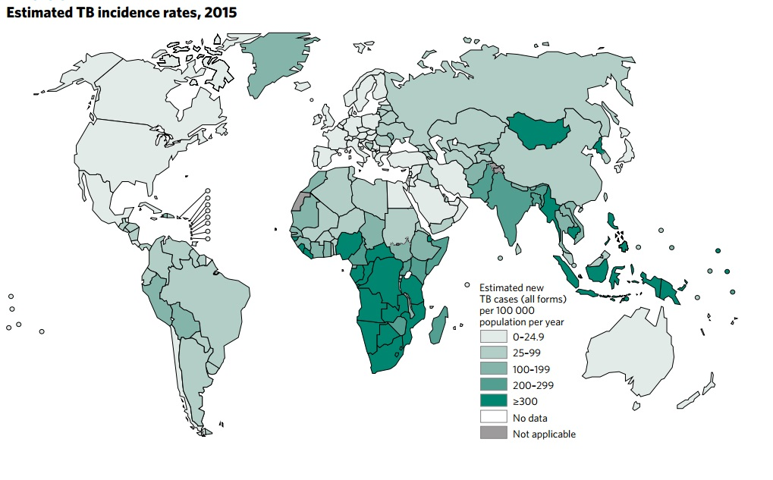
MTB Encounter: epidemiology
Over 95% of TB deaths occur in low- and middle-income countries, and it is among the top three causes of death for women aged 15 to 44
India
South
Africa
WHO 2016 TB Report

Slide 7
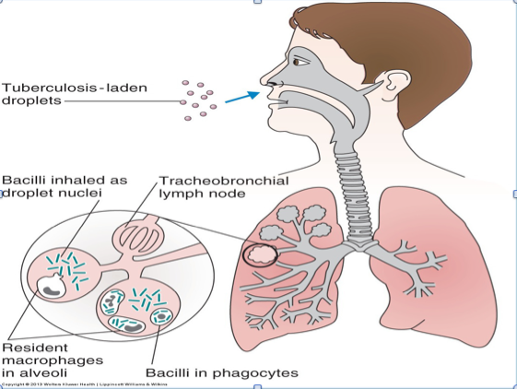
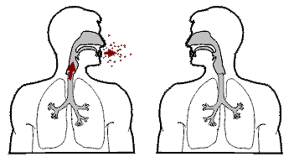
MTB Encounter: epidemiology
The only reservoir for MTB are humans.
MTB, unlike other mycobacterial species, are NOT a part of the normal flora.
Mode of transmission is inhalation of airborne droplets.
➔ May provide explanation for higher prevalence in hot, wet, crowded developing countries, in addition to poorer TB control in those regions.
India had the highest total TB incidence in 2015, and consequently the highest TB burden.
http://tbandleprosy.weebly.com/uploads/2/8/9/1/28912291/9663790_orig.png
https://biodesign.asu.edu/sites/default/files/documents/tbanim2.gif

Slide 8
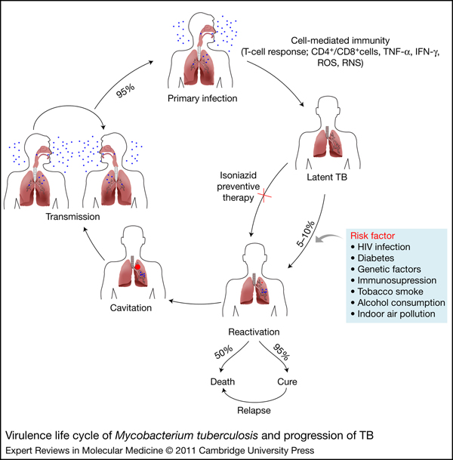
MTB Encounter: infection
Primary infection is initiated by the aerosol droplets lodging in the alveoli. The bacteria then invade and infect the macrophages. (MTB = facultative intracellular parasitic pathogen)
In relatively healthy individuals, cell-mediated immunity, which develops 2-8 weeks post-infection, limits further replication and spread of the bacteria.
Host’s first encounter with MTB aerosols most often leads to primary infection.
Co-infection with HIV is common in high-risk groups, has both clinical and public health concerns.
Timely detection and treatment of all TB cases are critical to lowering mortality & limiting the spread of TB.
Future immunosuppression event can reactivate the latent TB (or progressive primary infection).

Slide 9
MTB Encounter: host/bacterial factors
Bacterial factor | Implications
Obligate aerobe | Upper lobes infection
Facultative intracellular parasite | Intracellular multiplication (within macrophages)
Slow growth | Selective culture requires inhibition methods (i.e. specialised media)
High lipid content (60%) of cell wall (i.e. Mycolic A, Cord factor, Wax-D) | Use of specialised dye e.g. Ziehl-Neelsen Abt Resistance Ability to survive intracellularly
Host factor | Implications
Region of residence | Higher incidence and mortality rates in 3rd world countries
Age | Higher prevalence in elderly population Different clinical manifestations, progression and Px across age groups
Race | Highest risk in Asian
Other | HIV Diabetes mellitus Smoking / alcohol immunosuppression

Slide 10
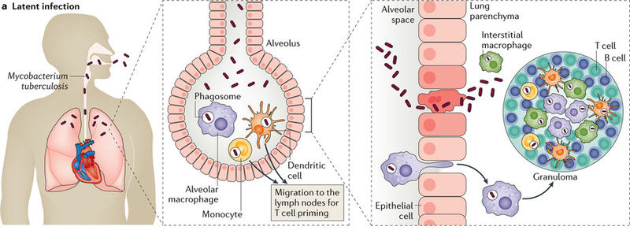
MTB Entry: big picture
MTB bacteria reach the alveoli and are ingested by the alveolar MP and other phagocytes on site as well as pneumocytes (alveolar epithelial type II).
Macrophage that has ingested the MTB bacteria squeeze across the alveolar epithelium into the pulmonary parenchyma. In primary TB, granulomas form to limit MTB multiplication and spread.
http://www.nature.com/article-assets/npg/nrdp/2016/nrdp201676/images_hires/w926/nrdp201676-f3.jpg

Slide 11
MTB Entry: Adherence
Mannose receptors on MTB
Mannose on macrophage
Complement receptors 1, 3,4 on macrophages
Complements on MTB for opsonization
Alveolar surfactant protein D inhibits phagocytosis
Alveolar surfactant protein A upregulates mannose R on MTB
Mycolic acids
FCγ receptors bind to anti-MTB IgG
Other ligands (ICAM, LFA-1)
Scavenger receptors
PGE2 & IL-3 upregulates host cell surface receptros
Mammalian cell entry (MCE) proteins change host cell plasma
Blue = host-related factors
Green = MTB virulence factors involved in adherence & entry

Slide 12
MTB Entry: Ingestion by macrophage
Once the bacteria have been taken up by alveolar macrophages, MTB then resides in phagosomes within the said macrophages. MTB can successfully divert two macrophagic attempts at destroying the now intracellular pathogen.
Bacterial virulence factors involved in ineffectualising the reactive oxygen species attack:
Oxidative stress proteins: superoxide dismutase, catalase, peroxidase (e.g. AhpA, SodA, SodC)
Bacterial virulence factors involved in futilising the phagolysosome destruction attempt:
Phagosomal arresting proteins prevent the fusion of phagosome with lysosome (i.e. formation of phagolysosome) by modifying the structure of early phagosome. (e.g. NdK, PtpA, PPE10, FbpA)
http://www.tandfonline.com/na101/home/literatum/publisher/tandf/journals/content/kvir20/2013/kvir20.v004.i01/viru.22329/20141027/images/medium/kvir_a_10922329_f0004.gif

Slide 13
MTB Multiplication & Spread
Primary infection:
Granuloma formed by T/B cells to limit MTB multiplication and spread
Immune suppression /latent TB:
Granuloma breaks down, and MTB becomes free to multiply and migrate to extrapulmonary sites
Reactivated TB:
Secondary sites of MTB infection include the brain, larynx, LNs, spine and kidneys
N/B: Secondary infection is achieved by using similar virulence mechanisms for adherence and entry as in primary infection)
http://wiki.ubc.ca/images/d/d1/Figure_5._Pathogenesis_of_latent_tuberculosis_infection_%28LTBI%29_and_TB_disease_%281%29_entry_%282%29_alveoli_%283%29_secondary_sites_%284%29_granuloma_%285%29_broken_down_granuloma_and_escaping_bacteria%3B_from_CDC%3B_Web%3B_March_4%2C_2017.png

Slide 14
MTB Multiplication & Spread
https://image.slidesharecdn.com/tb-final-141118003601-conversion-gate02/95/pharmacotherapy-of-tuberculosis-24-638.jpg?cb=1416271181

Slide 15
MTB Bacterial damage
Bacterial cause
MTB toxins
e.g. TNT (TB necrotizing toxin) contributes to necrosis of alveolar tissue
Inflammatory response
Inflammatory response involves large secretion of pro-inflammatory cytokines (T cells, activated macrophages) - TNFa, IFNg, various interleukins
Hypoxia
Severely reduced pulmonary function can lead to hypoxia
End organs most affected: brain, heart, brain, kidneys, eyes
Activated macrophages also secrete lytic enzymes and reactive intermediates
Along with the damaging effects of inflammatory agents, can result in: rupture of bronchi, fluid accumulation, caseous necrosis

Slide 16
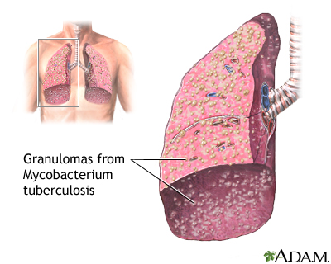
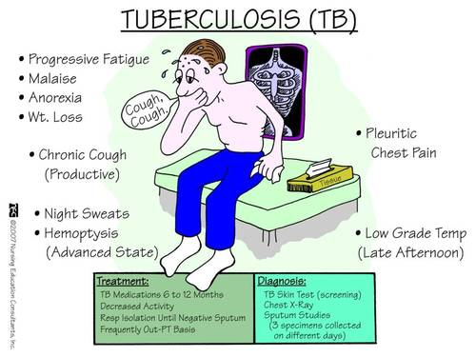
MTB Bacterial damage: Clinical Presentation
http://keckmedicine.adam.com/graphics/images/en/17260.jpg

Slide 17
Summary of MTB Pathogenesis
https://biodesign.asu.edu/sites/default/files/documents/tb_002lg.jpg

Slide 18
Streptococcus pneumoniae (SP)

Slide 19
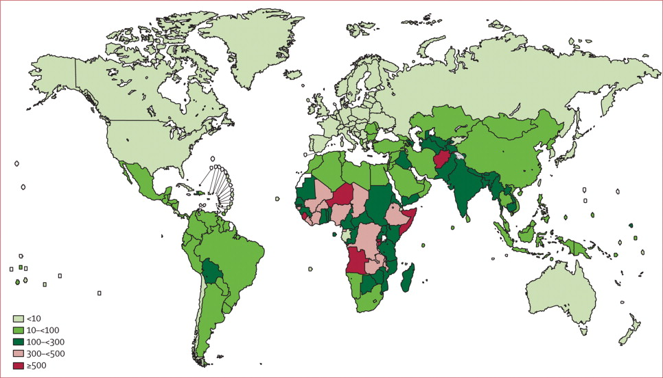
SP Encounter: epidemiology
Similar to TB, burden of disease (CAP) caused by Strep in India is amongst the highest around the world.
India
South
Africa
http://www.thelancet.com/cms/attachment/2001002782/2003736831/gr2.jpg

Slide 20
SP Encounter: epidemiology
Depending on the context of transmission, pneumonia is categorised into:
Community-acquired (CAP)
Nosocomial / Hospital-acquired (HAP)
 | CAP | HAP
Definition | Pneumonia in a person outside hospital | Pneumonia occurring at least 2 days after admission to hospital
Predisposing factors | Smoking Upper respiratory tract infections Alcohol Immunosuppressant Old age Etc. | Ventilatory support Abt treatment High gastric pH Coexisting cardiac, pulmonary, hepatic, renal insufficiency
Mode of spread | Aerosol droplet | Microaspiration of bacteria that colonize the upper airways
Common infecting agents | S. pneumoniae S. aureus H. influenzae Virus | P. aeruginosa MRSA K. pneumoniae

Slide 21
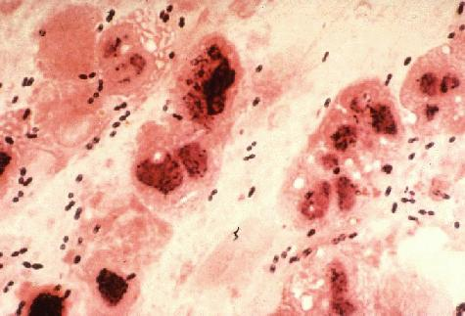
SP Encounter: virulence factors
Streptococcus pneumoniae
Gram +
Alpha haemolytic (under aerobic condition)
Facultative anaerobic
Part of the oropharynx & upper respiratory tract normal flora
Main cause of CAP
Forms biofilms (aggregates) & adheres to surfaces
Key virulence factors are: CiaR/H two component system (for gene regulation); Pneumococcal Serine Rich Protein (PsrP); Pyruvate oxidase (SpxB)
http://textbookofbacteriology.net/S.pneumoniae1.jpeg

Slide 22
SP Entry: Adherence & transcytosis
NanA reduces the viscosity of mucin, evading entrapment by respiratory mucus
IgA1 protease renders host IgA useless
CbpA (Choline binding prtn) facilitates adherence to respiratory epithelium by binding to host glycoconjugate / pIgR.
Once the pathogen has attached unto the epithelial layer, various strep proteins (e.g. PspA, Adr) facilitate successful transcytosis and ineffectualisation of host immune response.
https://microbewiki.kenyon.edu/images/thumb/1/11/PneumococcalInfection.jpg/300px-PneumococcalInfection.jpg

Slide 23
SP Multiplication & Spread
S. pneumoniae are residents of the normal respiratory flora, but may also act as a secondary invader, following a viral disease or disturbance in the flora.
Adherence of S. pneumoniae is not limited to the epithelial lining of the respiratory tract.
Secondary sites of infection include: bloodstream, CNS, and the middle ear, and joints.
Bacterial virulence factors involved in spreading through the blood are:
Capsule – antiphagocytic
PspA – limits opsonisation
CbpA – adhesin, binds to PAF R, induces endocytosis
Pneumolysin – binds indiscriminately to all cells expressing cholesterol without receptor restrictions
https://microbewiki.kenyon.edu/images/thumb/1/11/PneumococcalInfection.jpg/300px-PneumococcalInfection.jpg

Slide 24
SP Bacterial damage
Bacterial cause
SP releases toxins and other substances than can induce host cell apoptosis
e.g. Pneumolysin creates transmembrane pores
Inflammatory response
Inflammatory response involves large secretion of pro-inflammatory cytokines (T cells, activated macrophages) - TNFa, IFNg, various interleukins (IL-1, IL-6, …)
Hypoxia
Severely reduced pulmonary function (due to fluid accumulation) can lead to hypoxia
End organs most affected: brain, heart, brain, kidneys, eyes
Activated macrophages also secrete lytic enzymes and reactive intermediates ➔ tissue damage
e.g. H2O2, exotoxins, pili

Slide 25
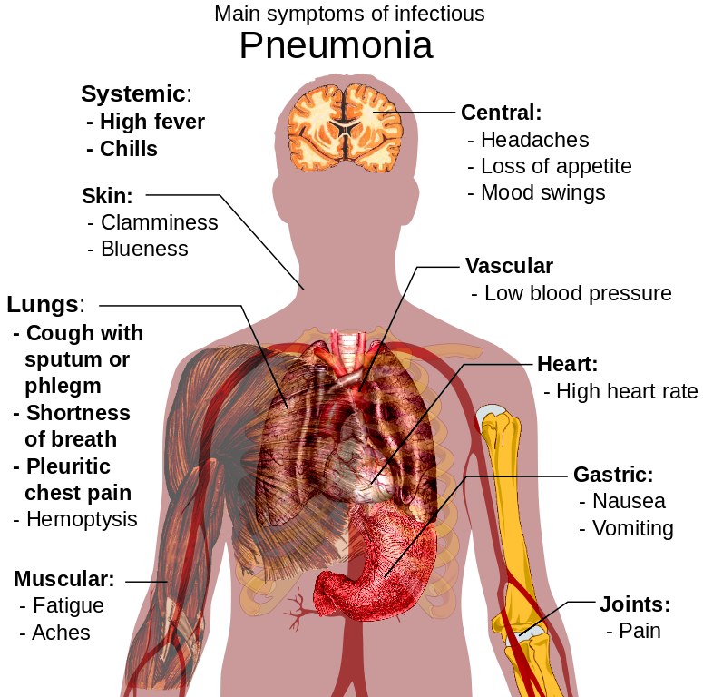
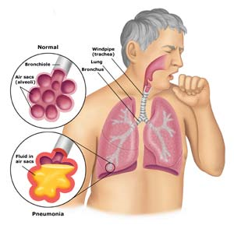
SP Bacterial damage: Pneumonia S/Sx
http://4.bp.blogspot.com/-IVObO5DZ_HA/ULbJCqPMzCI/AAAAAAAALpQ/xR20P6i7Yvo/s1600/Pneumonia-signs-symptoms.png
http://www.doctortipster.com/wp-content/uploads/2014/09/Pneumonia-Symptoms-Diagnosis-and-Treatment.jpg

