Slide 1
N. meningitidis Laboratory Diagnostics
PATH 375- Gurtaj Mahil

Slide 2
Other Common Pathogens – Meningococcal Meningitis
Haemophilus influenzae: Gram negative cocci
Streptococcus pneumoniae: Gram + lancet shape
Group B streptococcus: Gram positive coccus
Niesseria gonorrhoeae: Gram negative diplococcus
Escherichia coli: Gram negative rod-shaped

Slide 3
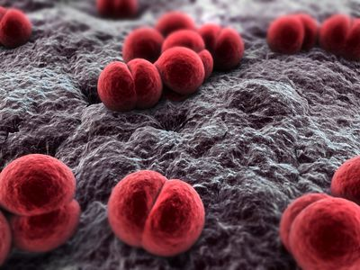
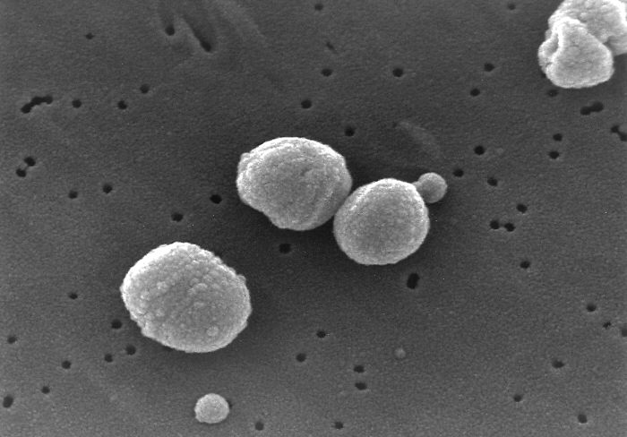
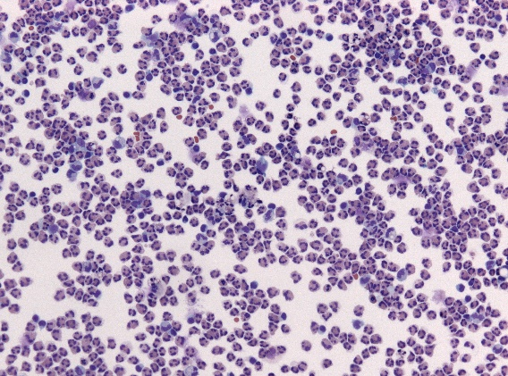
Top 3 Causative Microbes of Meningitis
Neisseria meningitidis
Streptococcus pneumoniae
Haemophilus influenzae

Slide 4
Importance of Microbiology Lab
To ID the causative microorganism in order to render proper treatment as there are 3 main causative agents
To monitor efficacy of treatment as lab testing can quantify bacteria/WBC

Slide 5
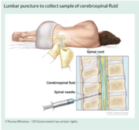
Samples required to diagnose Meningococcal Meningitis and ID causative microbe
Cerebrospinal fluid (CSF) needed for laboratory testing
CSF obtained via a lumbar puncture
Investigation of blood also useful alongside CSF

Slide 6
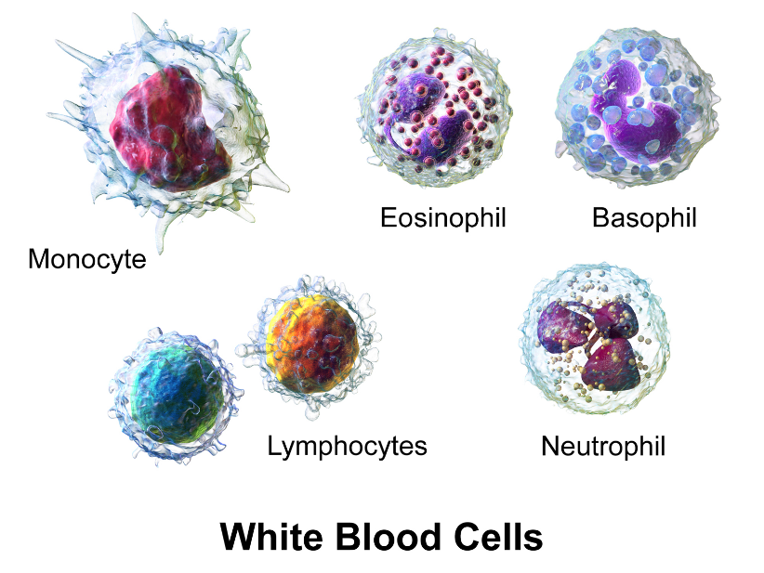
Investigations of CSF
Confirmation of active infection via WBC/ bacterial count
Distinguish bacterial infection from other etiologies
ID of the pathogenic microorganism
Ex: neutrophil count > 1180 confirms
bacterial etiology

Slide 7
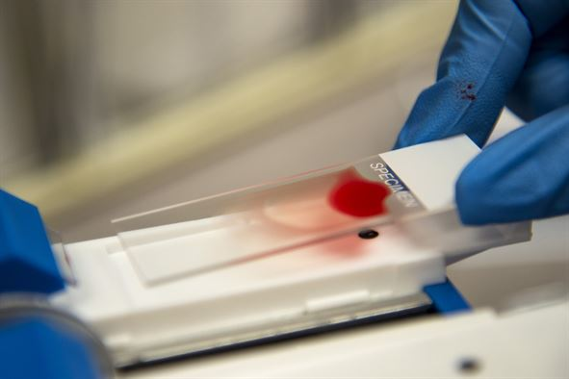
Investigation of Blood Sample
CSF glucose/blood glucose decreases in presence of bacterial meningitis
Blood samples can reveal underlying pathology
Blood cell leukocyte counts can confirm active infection

Slide 8
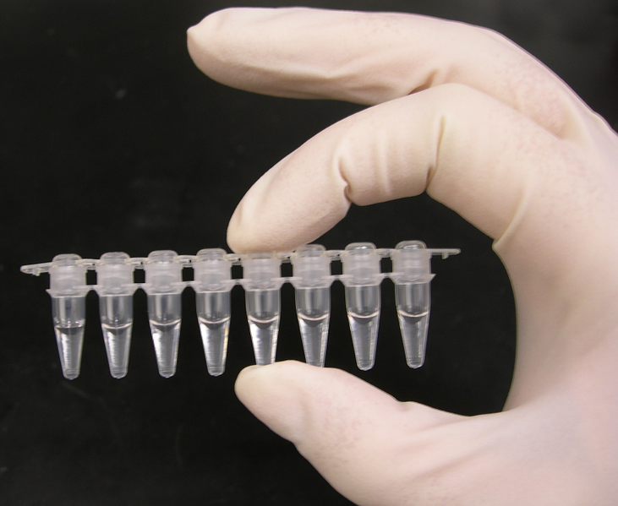
Tests performed on CSF/Blood
Gram Stain for ID
Culture for quantification of cell count/glucose/ protein
neutrophils/WBC
PCR for serotype ID
Latex agglutination for serotype ID
Culture on Blood Agar Plate
Kovac’s Oxidase Test
Carbohydrate Utilization Test

Slide 9
Test Result Analysis for Identification
CSF examined for altered cell counts, glucose, protein levels
# of neutrophils differentiates viral or bacterial infection
If leukocyte count > 1000-5000 leukocytes/mm^3 = bacterial infection

Slide 10
Test Result Analysis for Identification Cont’d
Growth on culture used to differentiate b/w viral or bacterial infection
Recommended to use both blood and chocolate agar plates as it can differentiate b/w three common causes: N. meningitides, S. pneumoniae, and H. influenzae

Slide 11
Test Result Analysis for Identification Cont’d
N. meningitidis is haemolytic (kills RBC) bacteria so it grows on both blood and chocolate gar plates.
Colonies: moist, grey/unpigmented, round smooth edges

Slide 12
Test Result Analysis for Identification Cont’d
H. influenzae unable to grow on blood agar plates
Thus, growth on BAPS narrows down ID to N. meningitidis and S. pneumoniae

Slide 13
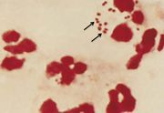
Test Result Analysis for Identification Cont’d
To differentiate b/w N. meningitidis and S. pneumoniae, use gram-staining
N. meningitidis are gram-negative whereas S. pneumoniae is gram positive
N. meningitidis should appear pink to red dipplococci

Slide 14
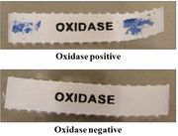
Test Result Analysis for Identification Cont’d
Further analyses needed to confirm clinical decision making
Kovac’s Oxidase Test: detects whether microbe produces cytochrome c oxidases; partakes in aerobic respiration
N. meningitidis turns testing reagent
purple for positive result

Slide 15
Test Result Analysis for Identification Cont’d
To verify species of Neisseria, a carbohydrate utilization test is done
Carbohydrate utilization test detects whether a microbe can ferment specific carbohydrate substrates
For Neisseria meningitidis, must ferment maltose and glucose but not sucrose and lactose

Slide 16
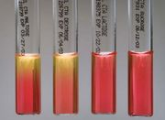
Test Result Analysis for Identification Cont’d
Positive test for maltose and glucose is a yellow appearance due to presence of fermentation acid
Negative result for sucrose and lactose indicate a red colour due to lack of presence of fermentation acid

Slide 17
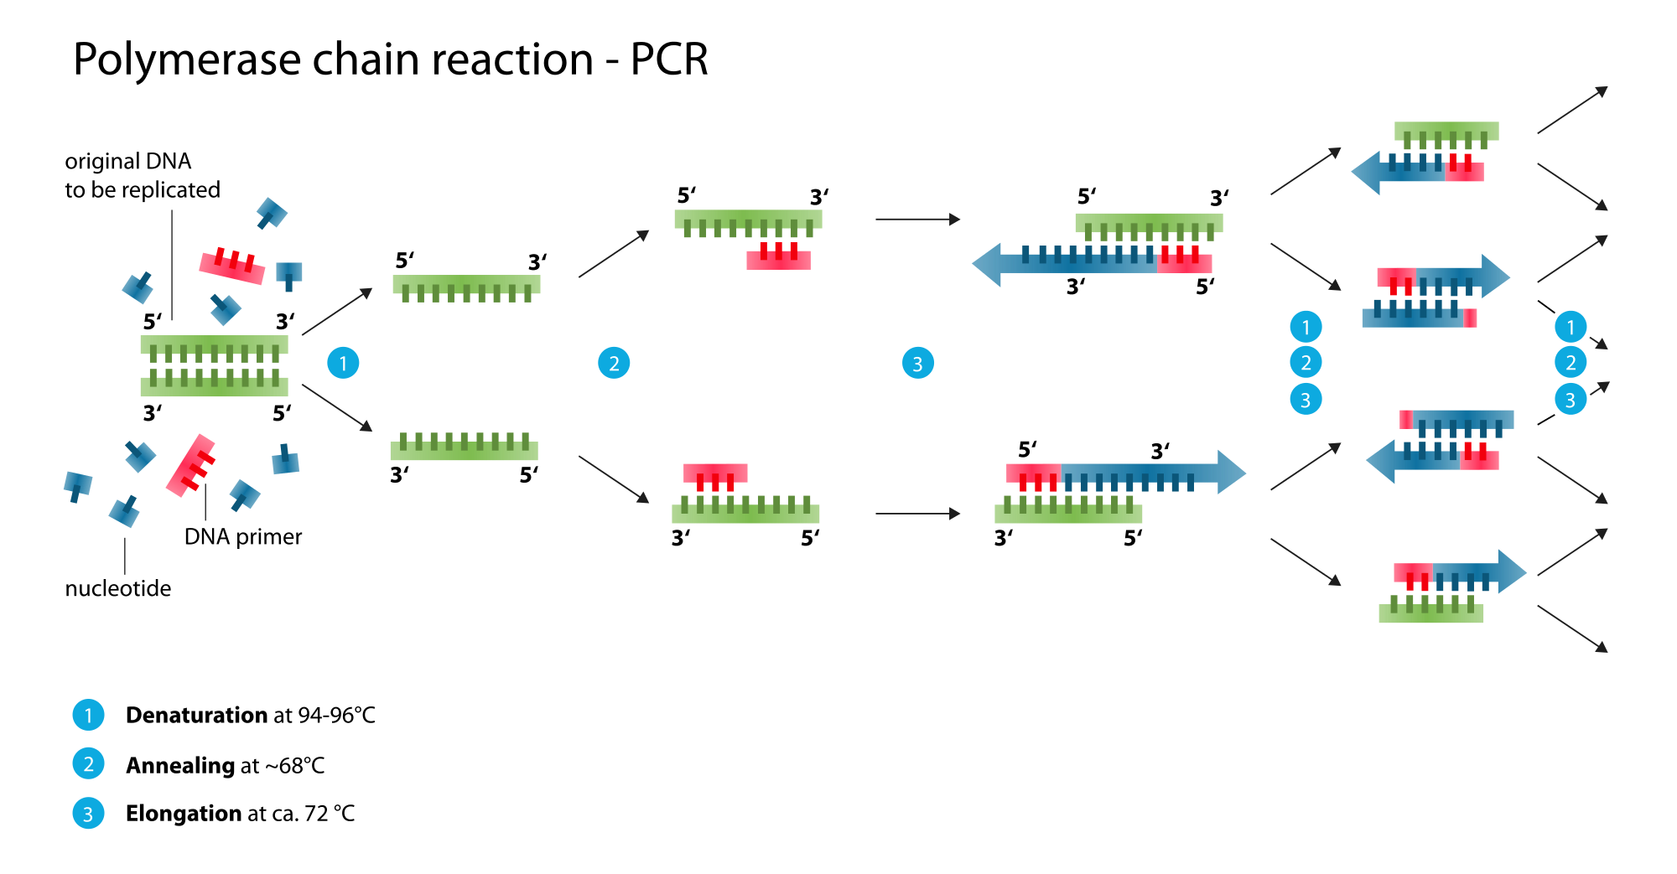
Test Result Analysis for Identification Cont’d
PCR- Polymerase Chain Reaction: amplification of genes used to ID microbes
For N. meningitidis confirmation in Mary, crgA gene is amplified and identified

Slide 18
Test Result Analysis for Identification Cont’d
Latex agglutination test: determines serotype by initiating an antigen-antibody rxn b.w potential capsular antigens of pathogens and a serogroup-specific antibody
5 serogroups of N. meningitidis
Positive test: sample reacts with antigen specific antibody to result in obvious precipitation pattern

