Slide 1
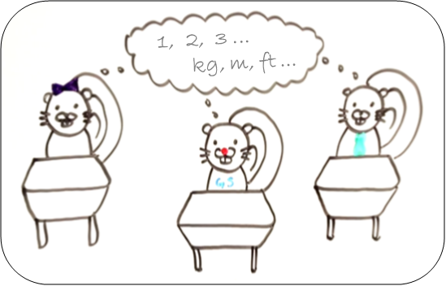
Numbers, Units, and Mechanics
Visit our YouTube Channel (UBC Science Writing)
Grammar Squirrel videos to help with these skills include ‘Numbers and Units’ and ‘Hyphenation’

Slide 2
Learning Objectives
By the end of these in-class activities, you should be able to:
Spot any grammar-based mechanics errors in a piece of writing
Explain how these errors should be written
Correctly construct sentences incorporating a variety of grammar-based mechanics

Slide 3
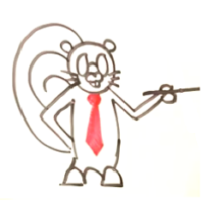
Activity 1
(work alone or together, 10 minutes)
Try to highlight the 12 mechanics-related mistakes in the paragraph of text below, before providing appropriate alternatives.
Writing effective, interesting science, stories is very important if we are to increase the basic scientific knowledge of the General public; doctor Richards believes that the overuse of jargon in science articles is one of the greatest crimes he sees from instructor’s at the university of British Columbia (ubc). He also believes that non-science students are put off by the following things. Wordy sentences, experiments that use techniques they do not understand, data analyses that are hard-to-relate to, and boringly unimaginative titles. These students, when polled by ubc Researchers also said they were unlikely to talk to science minded students for fear of not understanding the topics they would talk about.

Slide 4
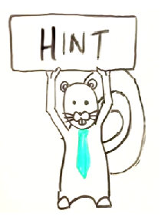
Activity 2
(work alone or together, 10 minutes)
In this activity, there are four multiple-choice questions relating to the mechanics of writing.
Select the sentence written in the correct style for each question and justify your answer by explaining why the other options are stylistically incorrect.
[Hint: There are numbers and units-based errors as well as mechanics-based issues].

Slide 5
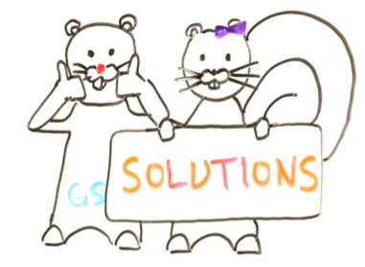
Activity 1 Solutions
Red text highlights appropriate
changes to the original text:
Writing effective, interesting science (remove comma)¹ stories is very important if we are to increase the basic scientific knowledge of the ²general public.³ Dr. (or Doctor)⁴ Richards believes that the overuse of jargon in science articles is one of the greatest crimes he sees from instructors (remove apostrophe)⁵ at the ⁶University of British Columbia (UBC⁷). He also believes that non-science students are put off by the following things:⁸ Wordy sentences, experiments that use techniques they do not understand, data analyses that are hard to relate (remove hyphens)⁹ to, and boringly unimaginative titles. These students, when polled by UBC¹⁰ ¹¹researchers also said they were unlikely to talk to science-minded¹² students for fear of not understanding the topics they would talk about.

Slide 6
Activity 2 Solutions
Correct answers appear in bold text, while red text
explains why each of the wrong answers is wrong:
1: You are talking about a study you would like to implement to assess student attitudes to science communication.
A: I will first survey 300 science enrolled students about their attitudes. [No hyphen for science-enrolled]
B: I will first survey three hundred science enrolled students about their attitudes. [Three hundred should be written numerically and there is no hyphen for science-enrolled]
C: I will first survey three-hundred science enrolled students about their attitudes. [Three hundred should be written numerically, it should not be hyphenated, and there is no hyphen for science-enrolled]
D: I will first survey 300 science-enrolled students about their attitudes. [CORRECT]

Slide 7
Activity 2 Solutions
Correct answers appear in bold text, while red text explains why each of the wrong answers is wrong:
2: You are elaborating on your survey methods.
A: I will survey a mixture of 18 and 19-year-old’s. [Apostrophe is incorrect because we are talking about a plural]
B: I will survey a mixture of 18 and 19-year-olds. [CORRECT]
C: I will survey a mixture of eighteen and nineteen year-old’s. [Eighteen and nineteen should be written numerically, and there is an incorrect apostrophe for a plural]
D: I will survey a mixture of eighteen-nineteen year-olds. [Eighteen and nineteen should be written numerically, incorrect hyphen use between eighteen and nineteen, and no hyphen between nineteen and year-olds]

Slide 8
Activity 2 Solutions
Correct answers appear in bold text, while red text explains why each of the wrong answers is wrong:
3: You are now explaining how the students will be selected for the survey.
A: I will randomly choose from all 4000 science-registered students at ubc. [4000 is missing a comma, and UBC should be capitalized]
B: I will randomly choose from all 4,000 science-registered students at UBC. [CORRECT]
C: I will randomly choose from all 4,000 science registered students at UBC. [Missing hyphen between science and registered]
D: I will randomly choose from all four thousand science-registered students at UBC. [Four thousand should be written numerically]

Slide 9
Activity 2 Solutions
Correct answers appear in bold text, while red text
explains why each of the wrong answers is wrong:
4: You are writing lists of the materials you will need.
A: I will need the following: 300 UBC-approved copies of the survey [CORRECT]
B: I will need the following: 300 ubc-approved copies of the survey [UBC should be capitalized]
C: I will need the following; 300 UBC approved copies of the survey [Semicolon should be a colon, and there should be a hyphen between UBC and approved]
D: I will need the following – 300 ubc approved copies of the survey [Long dash should be replaced by a colon, UBC should be capitalized, and there should be a hyphen between UBC and approved]

Slide 10
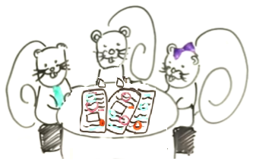
Activity 3
(work together, 10 minutes)
Working with a partner, or in a team of three, take a few minutes to write a short creative story (no more than 100 – 150 words) that comprises the elements that appear in Table 2.
Do not worry too much about making the story realistic, but make sure it is accurate in terms of style. You are going to need to incorporate rules that apply to using numbers and abbreviations, as well as general mechanics rules, to write a technically correct piece.
Try to write your story as quickly as possible (less than 10 minutes). Once you have done this, exchange it with your partner and have them read through what you have done and provide any comments regarding the style (and any errors they have spotted).

Slide 11
Activity 3 (Table 2)

Slide 12
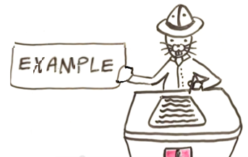
Activity 3
(‘Partner B’ example from Table 2)
The following example shows how just two sentences can incorporate all the required elements in Table 2 for the ‘Partner B’ scenario:
Researchers at the British Columbia
Conservation Foundation (BCCF)
recently showed that a young pine
tree, which was less than 2 ft tall,
needed over 5,000 ml of water per hour to grow; this tree, one of the BCCF’s 1998 saplings, was grown from a seed collected in southern Nova Scotia by Prof. James Richards when he was part of a grant-funded research team.

