Slide 1
Learning Objectives
To Foster Student Learning
Summer Institute 2023
Your hosts: Ainsley Camps and Amber Shaw
Notes:
Ainsley [1 minute]
In this session, we will explore the multiple benefits of using learning objectives, including the ways they help to foster student learning.
We will present a straightforward approach to writing learning objectives and you will get a chance to practice writing these for your own context. You will also explore learning taxonomies which are useful tools for writing effective learning objectives.

Slide 2
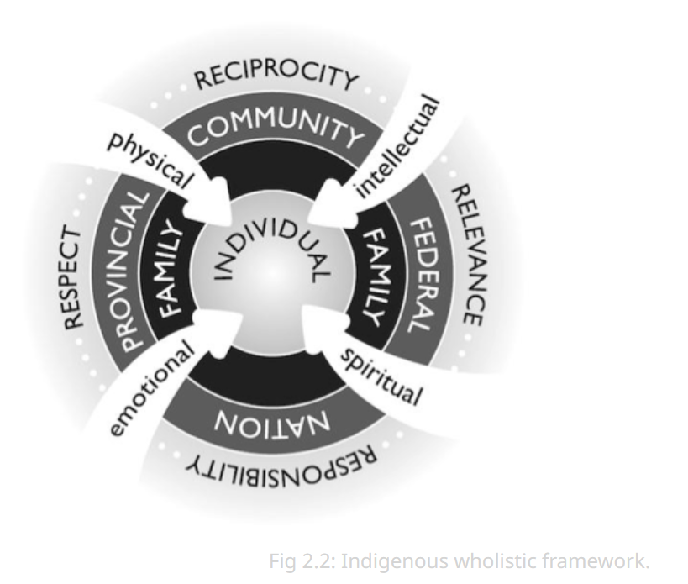
Land Acknowledgement
Notes:
Ainsley [4 minutes]
add to the chatbox: "Pulling Together: A Guide for Indigenization of Post-Secondary Institutions (BC Campus)" (https://opentextbc.ca/indigenizationfrontlineworkers/)
I am speaking to you today from the traditional, ancestral and unceded territories of the Musqueam people.
I wanted to draw your attention to this graphic that I found in a publication from BC Campus: "Pulling Together: A Guide for Indigenization of Post-Secondary Institutions"
This graphic was very helpful for me in gaining a deeper understanding of the Indigenous world view. While there is great diversity among Indigenous Peoples, there are also some commonalities in Indigenous worldviews and ways of being. Indigenous worldviews see the whole person (physical, emotional, spiritual, and intellectual) as interconnected to land and in relationship to others (family, communities, nations), and recognizes the accountabilities each one of us takes on in the learning space- we are interconnected all learning from and with one another, together.
During their time at UBC, students will be making decisions about what and how they will study and where they will contribute in the work force that will have an impact on our world, and I like the idea of bringing the whole person into the classroom and ultimately into the professions that the students ultimately practice is a very good idea. For us as instructors and facilitators of learning, it provides some great food for thought as we think about LOs – what we want learners to take away from our modules, courses and programs.

Slide 3
AGENDA
What are learning objectives, and why do we use them?
How to write learning objectives
Practice & Sharing
Introduction to Bloom’s taxonomy
Revise & Sharing
Q&A
Notes:
Ainsley [1 minute] hand it over to Amber
Please feel free to contact me after this workshop if you have any questions,
ainsley.camps@ubc.ca . This workshop often goes to time! :)

Slide 4
We are curious..
In the chat,
let us know on a scale of 1-5,
1 = not at all,
5 = I should be facilitating this workshop.
How comfortable are you in writing learning outcomes?
Notes:
Amber [1 minute]
waterfall

Slide 5
LEARNING OBJECTIVES
By the end of the session, you should be able to:
Describe the benefits of using learning objectives
Write effective learning objectives
Practice using Bloom’s Revised Taxonomy to write learning objectives
Notes:
Amber [2 minutes]
Slides 3-5 This session will focus on learning objectives at the lesson-level (not the course-level or program-level), and is intended for instructors who are new to this topic.
By the end of this session, learners will be able to:
Describe the benefits of using learning objectives
Write effective learning objectives
Practice using one or more taxonomies to write learning objectives for their own teaching
objective and outcome almost used interchangeably

Slide 6
What are Learning Objectives, and why do we use them?
Notes:
Ainsley slides 6-10 [10 minutes] Ask them to respond in the chat or unmute themselves.

Slide 7
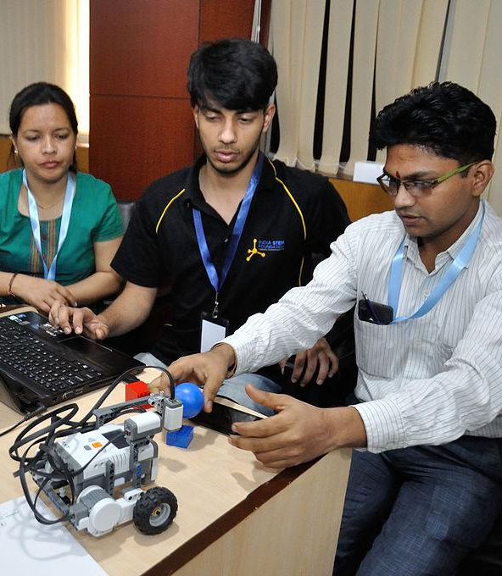
Definition: Learning Objectives what a learner knows or can do as a result of learning
(Otter, 1992, p. i)

Slide 8
What are Learning Objectives?
Learning Objectives (LO) are specific, measurable, short-term, observable student behaviors.
A LO is a description of a performance you want learners to be able to exhibit before you consider them competent.
LOs focus on student learning and not on instruction.

Slide 9
Levels of learning objectives
Program-level learning outcomes (what does a graduate know/do/value?)
Course-level learning outcomes (know/do/value after your course)
Module-level(know/do/value after the module)
Lesson-level learning outcomes
(know/do/value after the lesson)
Notes:
learning outcomes can be further broken down.
program level - what does an ideal graduate ‘look like’ for your program?
course level - closely linked to the ‘big ideas’ and ‘enduring understandings’
lesson level - more fine-grained; outcomes of individual learning modules
Today we are focusing on the lesson level

Slide 10
Your target
Notes:
Have you ever played darts? This is a game where the objective is to throw the dart and hit the bulls eye. Can you imagine playing without the dartboard as your target? Without the dartboard the players don't know where to aim.
Learning Outcomes are your 'dartboard'.
They are your guideposts in designing the activities and assessments that will assist your students in learning how to throw the dart and hit the bulls eye.
LO let students know what they are aiming for.
LOs also give students an opportunity to assess their readiness in the beginning, and see where they end up at the end.

Slide 11
How to write Learning Objectives
that foster student learning
Notes:
Ainsley Slides 11-21 [

Slide 12
Learner-centred
Notes:
12/15 [5 minutes]
Focuses the attention on the learner.
When writing LOs we consider what the student will learn, how they will learn, the conditions in which they will learn.
You may also consider how the learning outcomes will prepare students for higher level courses.

Slide 13
Learner-centred
By the end of this lesson, learners will be able to….
By the end of this laboratory activity, you will be able to….
Notes:
refer to the learner in the learning objective.

Slide 14
Specific
Notes:
For a paramedic, being able to assess a person’s vital signs within a certain amount of time may be an important learning objective.

Slide 15
Specific
Effective learning outcomes contain
1. verb(s)
2. Subject (the what)
3. Context or criteria
By the end of this lesson, learners will be able to create a social media plan for a non-profit organization.
Notes:
Here is the breakdown of specific criteria.
Effective learning outcomes will contain
1. verb(s)
2. Subject (the what)
3. Context or criteria

Slide 16
Learning Outcomes Example 1:
By the end of this module, students will be able to select appropriate materials for use in building wood-framed houses.
Find the
action verb
subject
context/criterion
Notes:
16-17 [7 minutes]

Slide 17
Learning Outcomes Example 1: Breaking it down
By the end of this module, students will be able to select appropriate materials for use in building wood-framed houses.
action verb
subject
context/criterion
Notes:
16-17 [7 minutes]

Slide 18
Learning Outcomes Example 2:
By the end of this lesson, students will be able to apply water sterilization techniques to purify the drinking water.
Find the
action verb
subject
context/criterion
Notes:
18/19 [7 minutes]

Slide 19
Learning Outcomes Example 2: Breaking it down
By the end of this lesson, students will be able to apply water sterilization techniques to purify the drinking water.
action verb
subject
context/criterion

Slide 20
Learning Outcomes Breaking it down
Your turn!
Write your own learner-centred learning objective for your context.
Notes:
[5 minutes] 3-5 minutes to complete at 20. minutes
So take a moment to think of the courses that you teach, and write a LO for that course applying what the components of an effective LO that we just talked about.
Ainsley debrief

Slide 21
Bloom's Learning Domains
a set of three domains used for classification of educational learning objectives into levels of complexity and specificity.
Notes:
Ainsley [1.5 minutes]
Bloom's taxonomy is a set of three hierarchical models used for classification of educational learning objectives into levels of complexity and specificity.
The three lists cover the learning objectives in cognitive, affective and psychomotor domains.

Slide 22
Bloom's Domains of Learning
3.
1.
2.
1. Psychomotor
2. Cognitive
3. Affective
Notes:
There are three domains of learning in Bloom's taxonomy.
Psychomotor chemistry labs titrate
Affective reflection
Could fall into more than one domain
The basic idea of the learning domain is the students builds from foundational knowledge or skills in that domain to higher order processes.
Effective learning objectives describe which learning domain the student will doing their learning in, and what level of learning in that domain the student can expect have reached by the end of the lesson or module.

Slide 23
Cognitive
By the end of this module, learners will be able to define photosynthesis and its significance in ecosystems.
By the end of this lesson, students will be able to list the sub fields of anthropology.
Notes:
Amber slides 23-27 [10 minutes] COGNITIVE moving from recall, to comprehension, to applying the knowledge, analyzing the result, and then creating something new based on that analysis

Slide 24
Cognitive
Notes:
Developmental stages of learning going up the hierarchy
From knowledge to synthesis

Slide 25
Psychomotor
By the end of this module, learners will be able to perform a backward dive.
By the end of this lessons, students will be able to calibrate a pH meter before measuring samples.
Notes:
Ainsley slides 28/29 [3 minutes]
Here are some examples of learning from the psychomotor domain:
PSYCHOMOTOR begins with perception of cues that guide physical activity, then getting ready to act, practicing the motor skills in incremental steps, becoming more proficient until able to perform the skill automatically when needed, adapting the skill to meet a problem, and ultimately gaining the ability to originate new skills for new situations.

Slide 26
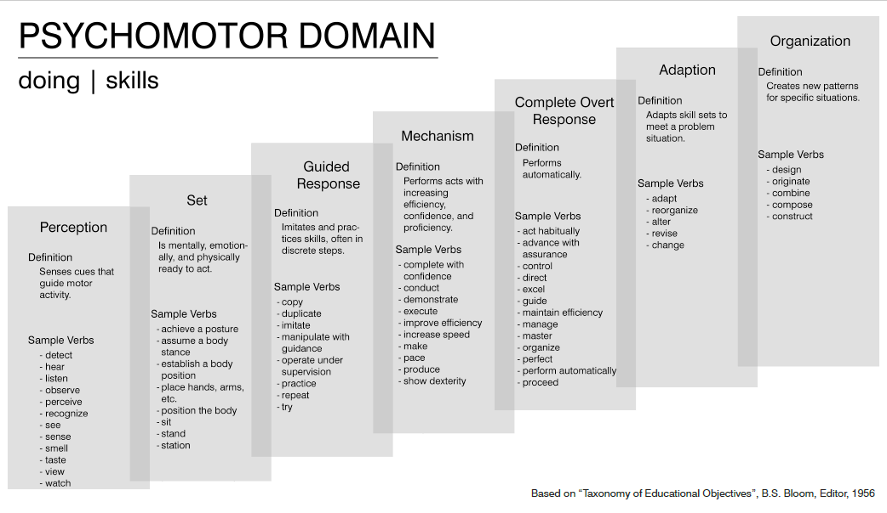
Psychomotor

Slide 27
Affective
By the end of this module, learners will acknowledge the land we are living and working on.
By the end of this class, students will advocate for a new scholarship program for BC Indigenous students.
Notes:
Ainsley 30/31 [3 minutes] This learning domain develops student motivation, attitudes, perceptions and values.

Slide 28
Affective
Notes:
[Ainsley] [3 minutes]
Affective domain examples:
Level: Receiving (Being Aware)
In a university ethics class, the professor presents a lecture on the importance of academic integrity.
Student Response: The students actively listen to the lecture, take notes, and demonstrate their awareness of the importance of academic integrity by nodding their heads, asking relevant questions, and participating in class discussions about in what ways academic integrity could play a role in the completion of their assignments.
Level: Responding (Showing Willingness)
Scenario: In a political science course, the professor facilitates a debate on a controversial topic, such as the use of artificial intelligence tools in the teaching and learning community.
Student Response: Some students express their willingness to engage in the debate by voluntarily signing up to speak for or against the motion. They show openness to considering diverse perspectives and ideas, even if they disagree with them.
Level: Reordering (Synthesizing Values)
Scenario: In a global citizenship seminar, the professor discusses the United Nations Sustainable Development Goals (SDGs) and their interconnections.
Student Response: Students critically analyze the SDGs and the complex relationships between them. They synthesize their values related to environmental sustainability, social justice, and economic equity, creating novel connections and ideas for addressing these challenges on a global scale.

Slide 29
Practice using Bloom’s Domains of Learning to write learning objectives
Notes:
Amber This is what we've been doing.
Bloom has been a very well recognized taxonomy in our education system in North America and Europe (Western educational system). Until we gain a better understanding of how indigenous thinking works or integrates or been adapted in our 'system', let's focus on Bloom's 3 domains for now.

Slide 30
Practice and Sharing
Revisit your earlier Learning Objective
Identify the domain of learning.
Identify the level of learning within that domain.
Choose an action verb that specifies your intended learning.
Revise as needed.
Take 5 mins.
Notes:
Amber sets it up Google Doc, August 2022:
Woot

Slide 31
Practice and Sharing
An opportunity to receive feedback on your learning objective! (12 mins)
Review your partner’s learning objective
Breakout Rooms
Seek clarifications and revise (or at least ponder)
Each person share for 3 minutes.
Notes:
Ainsley Google Doc, August 2022:
https://docs.google.com/presentation/d/169CRPcK_aranHvlbq8Gj2yqBrnHcXOS-tGntjhmQIVM/edit?usp=sharing
Amber BR

Slide 32
We are curious..
In the chat,
let us know on a scale of 1-5,
1 = not at all,
5 = I should be facilitating this workshop.
How comfortable are you in writing learning outcomes?
Notes:
Ainsley [1 minute]

