Slide 1
Case Study 3 Bacterial Pathogenicity of Tuberculosis and Pneumonia
Maria Bleier
PATH 417

Slide 2
Overview
The Case
Bacterial Epidemiology - Reservoirs
Steps for Entry and Infection
Multiplication and Spreading
Pathogen Damage to Host

Slide 3
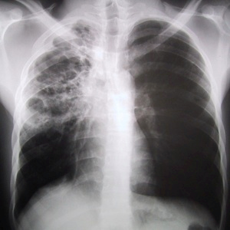
The Case
53 yr. old male patient Robert K.
Immigrated from India 1 yr ago
Past month has been experiencing fevers, chills, chronic productive cough and night sweats
Physician’s examination:
Confirmed fever (38.5ºC)
Auscultation found crackling in R. lung and decreased breathing in R. lower lung field
Recommendation:
Chest X-ray
Collection of deep lung sputum samples over 3 mornings
Fig 1. Chest X-ray of a patient with advanced tuberculosis
After having received and analyzed the three sputum samples, Robert was instructed to report to the local hospital for further assessment. Based on the symptoms, it is likely that Robert has either tuberculosis or bacterial pneumonia.

Slide 4
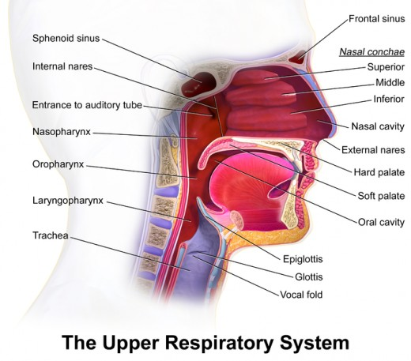
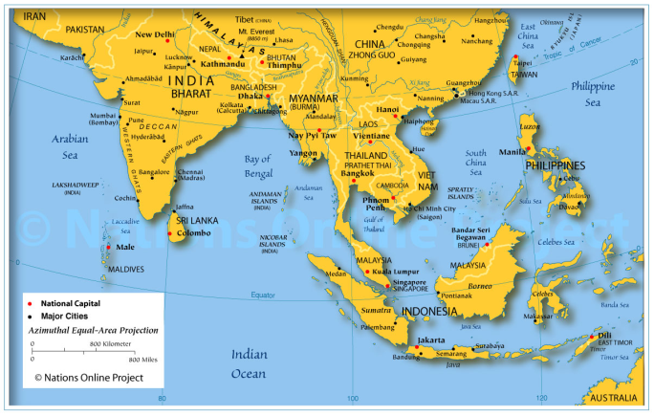
Epidemiology
The bacterial agents being examined in this study….
(1) Streptococcus pneumoniae
Part of the natural flora and colonizes the nasopharynx
(2) Mycobacterium tuberculosis
Can be found throughout the human body
Geographically common in hot/wet environments like S. or E. Asia
(3) Staphylococcus aureus
Also part of natural flora of mucosal
surfaces such as the nose, throat and vaginal
tract

Slide 5
Epidemiology
The factors and characteristics for colonization and survival….
(1) Streptococcus pneumoniae
Creates biofilm to adhere onto surfaces in nasopharynx via creation of an extracellular matrix
The CiaR/H two component system are regulatory factors essential for biofilm formation
Bacterial aggregation influenced by factors such as the serine-rich repeat proteins (PsrP) and pyruvate oxidase (SpxB)
Fig 2. Bacterial Factors involved in pneumococcal disease

Slide 6
Epidemiology
The factors and characteristics for colonization and survival….
(2) Mycobacterium tuberculosis
Often found on the hands or skin of people and very infectious due to aerosol or droplet transmission
Two forms of infection: (1) Latent TB or (2) Active TB
Latent TB – immune system suppresses infection by maintaining dormant bacterium inside macrophages
Active TB – high bacterial counts in pulmonary circuit
Ability to metabolize fatty acids and lipids -> forms mycolic acid-peptidoglycan complex which forms a hydrophobic sheath
Sheath enables antibacterial resistance and protects from degradation after phagocytosis by macrophages
Adheres and is phagocytized by macrophages via pili (binds to ICAM and LFA-1)

Slide 7
Epidemiology
The factors and characteristics for colonization and survival….
(3) Staphylococcus Aureus
Can colonize mucosal surfaces through…
process of inhibiting opsonization via complement and antibodies released by immune system
Inhibit uptake by phagocytosis through inactivating Fc or complement receptors
Secretion of coagulation factor A, protein A, expression of surface capsule, and secretion of complement inhibitors prevents host opsins from targeting S aureus antigens

Slide 8
Entry and Infection
Streptococcus pneumoniae
Infection process:
Transmission via inhalation of respiratory aerosol droplets
Bypass ciliated upper respiratory epithelial cells to lower respiratory tract in alveolar region
Attachment to respiratory epithelial cells via enzymes produced by pathogen to expose surfaces for adherence
Production of factors to avoid immune response as well as promoting adherence to epithelial wall
Receptor-mediated entry into epithelial cells
SUMMARY:
Transmission -> travel to alveolar region -> attachment to epithelial layer-> adherence and immune evasion factors secreted-> entry into epithelial layer or endocytosis

Slide 9
Entry and Infection
Attachment and adherence of S pneumoniae:
Neuraminidase (NanA)
B-glucosidase (BgaA)
B-N-glucosaminidase
Enzymes that decrease mucus viscosity and facilitates attachment to epithelial cells via cleavage of sialic acid
N-acetyl-glycosamine (GIcNAc) receptors
Attachment: What is exposed on epithelial cells after enzyme activity
Polysaccharid capsule
Pneumnococcal surface adhesin A (PsaA)
Choline biding protein (CbpA)
Pili
Adherence: Factors that promote surface adherence on epithelial cells and upregulation of endothelial cell platelet activating factor receptors
Endocytosis: Mimics platelet activating factor which allows entry into epithelium cells
Phosphocholine (ChoP) and Choline-binding proteins

Slide 10
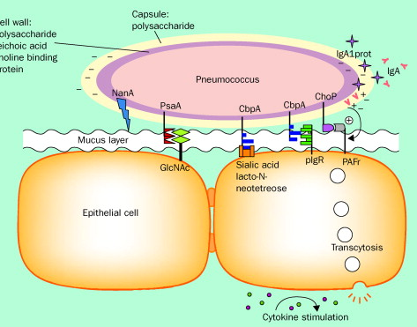
Entry and Infection
Attachment and adherence of S pneumoniae:
N-acetyl-glycosamine (GIcNAc) receptors
Polysaccharid capsule
Pneumnococcal surface adhesin A (PsaA)
Choline biding protein (CbpA)
Pili
Phosphocholine (ChoP) and Choline-binding proteins

Slide 11
Entry and Infection
Mycobacterium tuberculosis
Infection process:
Transmission via inhalation of respiratory aerosol droplets
Smaller droplet nuclei travel from upper respiratory to lower respiratory tract in alveolar region
Alveolar macrophages engulf pathogen via phagocytosis
Resides in membrane bound vacuole or phagosome; M tuberculosis can resist intracellular destruction and multiply /enhance their survival
Evading immune recognition due to slow generation time and remaining within macrophages
SUMMARY:
Transmission -> travel to alveolar region -> phagocytized by macrophages -> Formation of phagosome -> slow multiplication and immune evasion

Slide 12
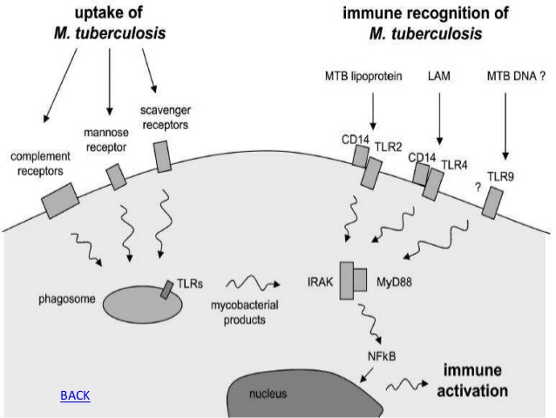
Entry and Infection
Important entry and adherence factors for M tuberculosis
Entry via receptors:
Mannose
Complement (CR 1, 3, and 4)
Fc-gamma
Scavenger
Mammalian cell entry (MCE) proteins
Adherence:
Surfactant protein A
Pili (CR 1, 3, and 4)
Fibronectin-binding protein (FbpA)
Mycolic acids

Slide 13
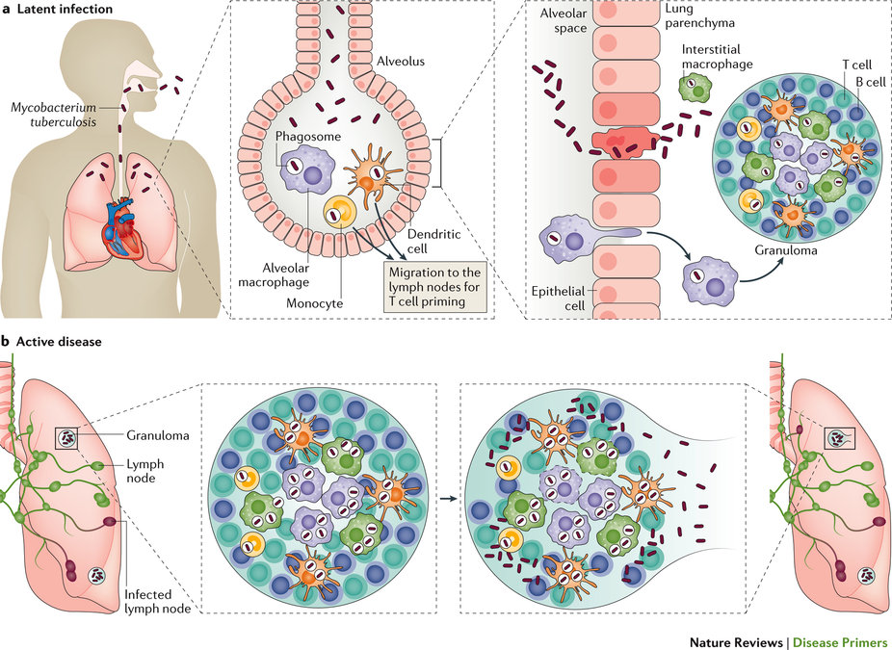
Entry and Infection
Infectious pathway of Mycobacterium tuberculosis
Latent TB infection
Active TB infection

Slide 14
Multiplication and Spreading
Streptococcus pneumoniae
Multiplication process and site:
Multiplication occurs in endothelial cells of lower respiratory tract
Polysaccharide capsule enables immune evasion as it is anti-phagocytic and hinders complement protein access to antigen
Secondary Infection:
Can cause secondary infections in bloodstream, CNS, and middle ear
These infection can include paranasal sinusitis, otitis media, meningitis, osteomyelitis, septic arthritis, endocarditis etc.
Phosphocholine (component of cell wall) crucial factor for invasion and adherence to choline binding proteins plus mimicking platelet activating factor enables adherence and endocytosis to other epithelial/endothelial cells

Slide 15
Multiplication and Spreading
Mycobacterium tuberculosis
Multiplication process and site:
Multiplication occurs in alveoli; have a slow generation time which contributes to their immune evasion
2-8 week period where macrophages phagocytosing nearby bacteria form a barrier or granuloma to contain the pathogens
Granuloma – mass of immunes cells (macrophages, T cells, dendritic cells
Secondary Infection:
Breakdown of the granuloma due to increased multiplication and bacterial activity results in release of bacteria into network of pulmonary capillaries surrounding alveoli
Systemic or pulmonary access and multiplication after release from granuloma (excluding the bone, brain, larynx, lymph nodes, spine, and kidneys) – cause of active TB infection symptoms (i.e. chills and fever)
2nd infection – TB meningitis, genitourinary, peritonitis, gastrointestinal etc.

Slide 16
Pathogen Damage to Host
Streptococcus pneumoniae
Damaging Host Cell Factors
Induction of inflammatory cascades such as complement activation, coagulation cascade, and the cytokine cascade via innate immune response
Cytokine cascade: Interluekin-1, interleukin-6, and tumor necrosis factor (TNF)
Cytotoxic effects caused by reaction to lysed bacteria particles
Damaging Pathogen factors
Pneumolysin and hydrogen peroxide produced by bacteria kills host cells and induces production of nitric oxide -> septic shock
Disruption of alveolar epithelium and causes accumulation of edema fluid in this space
Pillated bacteria evoke a higher TNF response in systemic infection
Capsule induces strong Abs-mediated immune response and increases recruitment of macrophages and NK cells -> increase inflammatory response
Secretion of exotoxins (haemolysins) that causes host cell damage

Slide 17
Pathogen Damage to Host
Mycobacterium tuberculosis
Damaging Host Cell Factors
Lymphocyte recognition of bacterial antigen and activation of T cell response -> cytokine secretion of IFN -> activation of macrophages
Lytic enyzmes and reactive intermediates secreted by macrophages causes most of host cell damage
Cytokine secretion: Interlukin-1, tumor necrosis factor and gamma IFN
Tubercle formation (from granulomas) induces low pH and anoxic environment and causes tissue destruction; region become semi-solid but eventually liquefies and becomes necrotic
Damaging Pathogen factors
Cell mediated hypersensitivity to pathogen primarily responsible for large response to infection; limited destruction by bacterial factors
Bacterial protease activation, which causes granuloma break down, also can destroy surrounding lung tissue
Tuberculosis Necrotizing factor released in macrophages can induce necrotic death of these cells; causes release of pathogen

Slide 18
END

