Slide 1
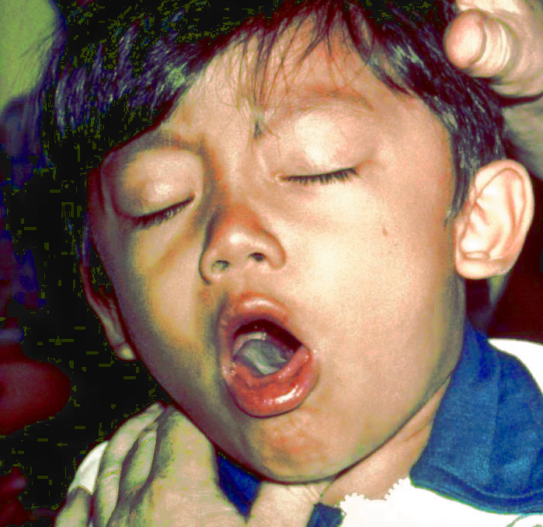
Case 4: Bortedella pertussis
Disease: Whooping cough
Summary by Gurtaj Mahil

Slide 2
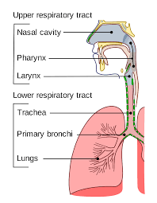
A chronic cough
36-year-old Joseph has been suffering from multiple spells of violent coughing for 6 weeks. Prior to developing the chronic cough he had, what he describes as, a mild upper respiratory tract irritation, mild fever, runny nose and a cough that lasted about 3 days. More recently, and at the insistence of his spouse, he finally visits a drop-in clinic where the doctor asks him about his childhood vaccinations. Joseph reports that, to the best of his knowledge he had all the required shots but he admits to not having any since becoming an adult. Upon examining Joseph the doctor finds some redness in his throat but his lungs are clear and there are no enlarged lymph nodes in his neck. The doctor collects a throat swab to send to the laboratory, prescribes some codeine syrup and informs Joseph that the cough may last a few more weeks.
The laboratory is unable to detect Bordetella pertussis or any other pathogen from the swab. Despite this, Joseph is diagnosed with pertussis, commonly known as whooping cough, based on his clinical presentation and lack of adult immunization against pertussis. The coughing fits go away after another 4 weeks.

Slide 3
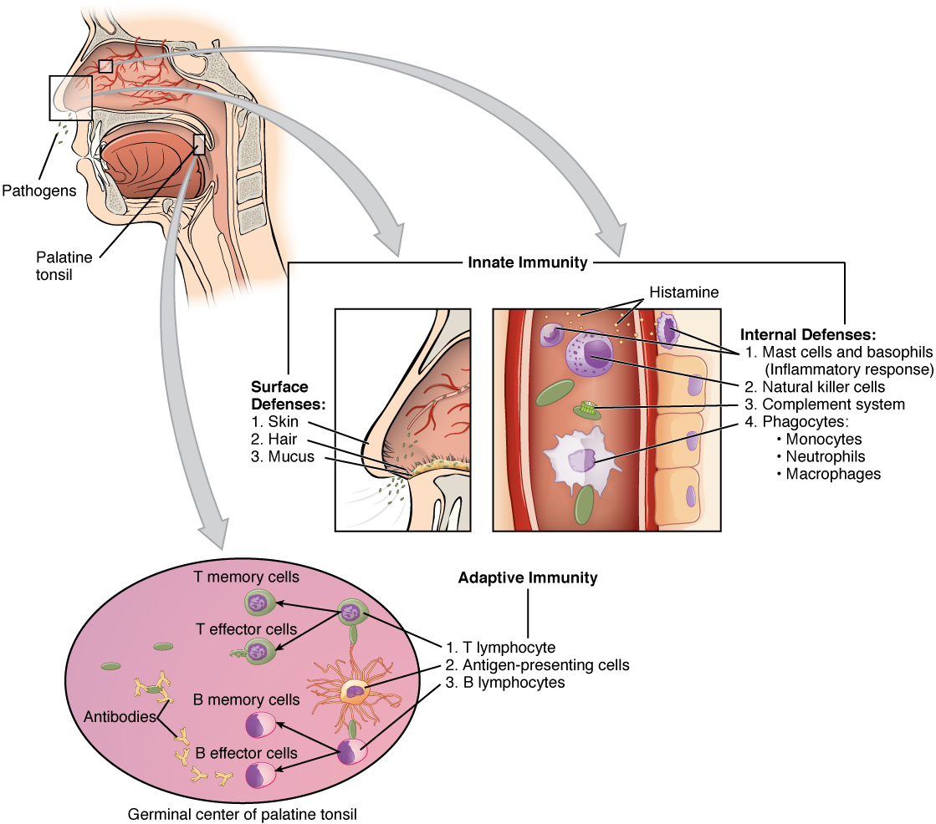
Immune response: an overview
Host response
Host damage
Bacterial evasion
Outcome

Slide 4
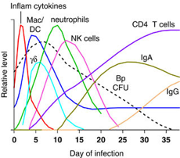
Host response learning goals
Describe the elements of the innate response in clearing this infection.
Outline the two components of the adaptive immune response to this infection.
The cell-mediated immune response
The humoral immune response

Slide 5
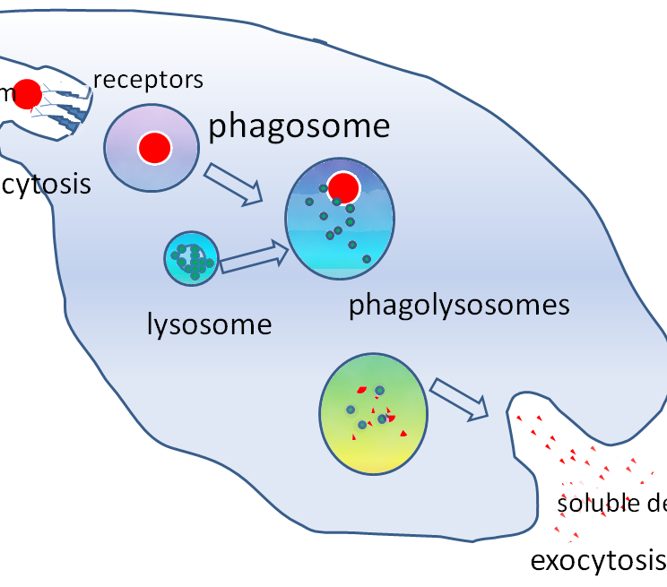
The innate immune response
First to respond to a B. pertussis infection
Involves dendritic cells, macrophages, neutrophils, NK cells
Involves antimicrobial peptides
The first set of cells to respond to this infection are phagocytic neutrophils and resident macrophages

Slide 6
How do macrophages kill the B. pertussis?
Acidic compartments within macrophages kill the phagocytosed bacteria (important to note that B. pertussis can evade the acidic compartments to survive)
Inflammatory cytokine IFN-y secreted by natural killer cells induces macrophages to produce NO to destroy phagocytosed bacteria
IL17 is involved in NO- independent bacterial killing

Slide 7
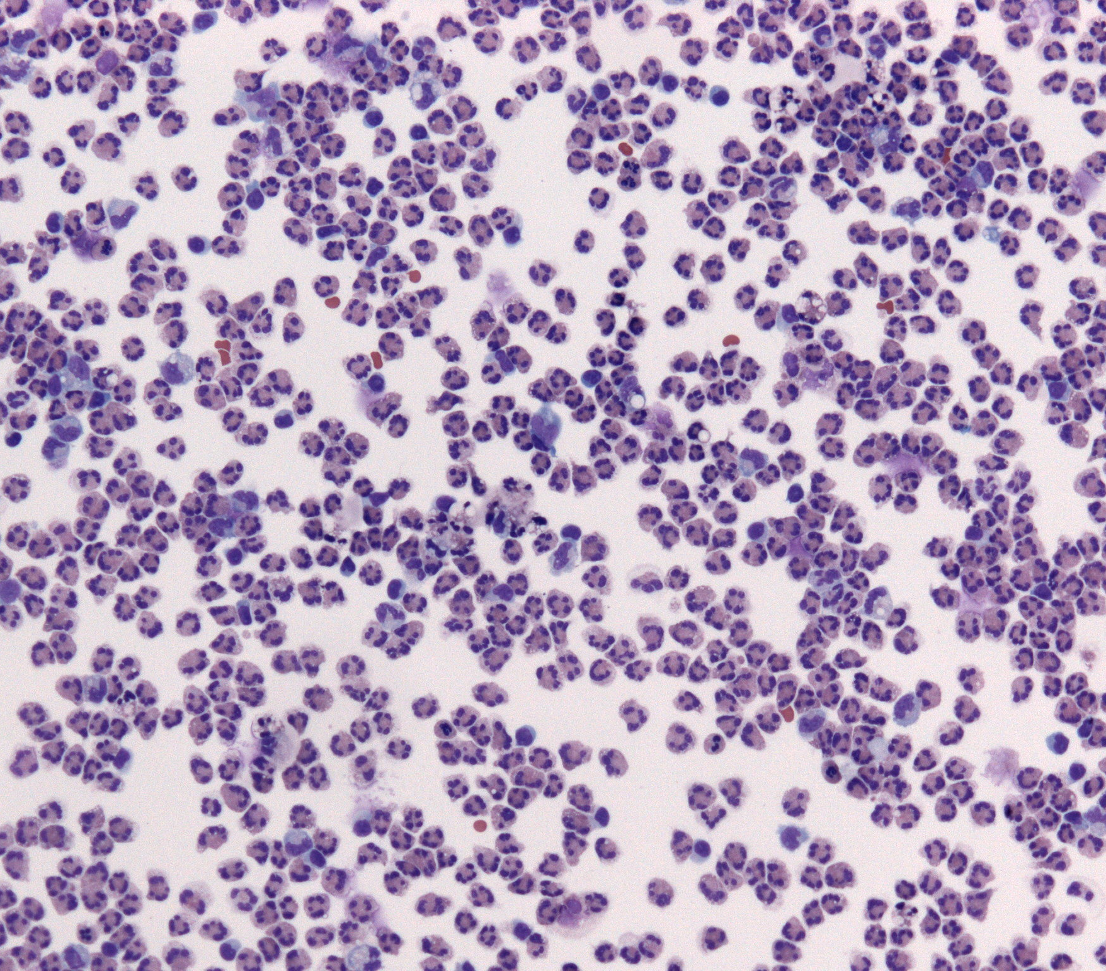
Neutrophil’s role?
Neutrophils don’t have a critical role in clearing B. pertussis
However, they contribute to killing the bacteria via phagocytosis through intracellular signalling and antibody-mediated uptake
Neutrophils are recruited to the infection site by IL-6

Slide 8
Is the macrophage and neutrophil-mediated response sufficient?
No, B. pertussis is able to evade these macrophages and neutrophil-mediated immune responses through bacterial toxins such as:
Pertussis toxin (PT)
Filamentous hemagglutinin (FHA)
Adenylate cyclase toxin (CyaA)
Example: CyaA can inhibit neutrophil function through mechanisms such as superoxide generation and inhibition of phagocytosis

Slide 9
What role do DCs play?
Immature DC are also amongst the first immune cells at the site of infection
They play a role in antigen presentation to T cells and they also produce cytokines to promote the differentiation of naïve-T cells
Key point: DC acts as a link between the innate and adaptive immune response

Slide 10
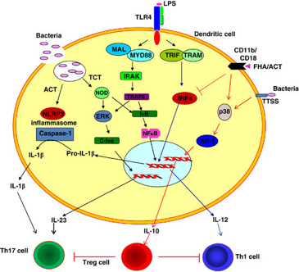
How are immature DCs activated?
Immaure DCs are activated via Toll-like-receptor-4 signalling cascades
TLR-4 is a pathogen recognition receptor (PRR) that detects the presence of pathogen-associated molecular patterns (PAMPS) on pathogens to become activated
TLR-4 typically recognizes lipopolysaccharide (LPS) on B. pertussis cell surface to then promote the maturation of DCs
Maturation of DCs stimulates the DC to produce cytokines IL-12 and IFN-y
IL-12 and IFN-y induces Thelper 1 cells to promote the clearance of B. pertussis from the host

Slide 11
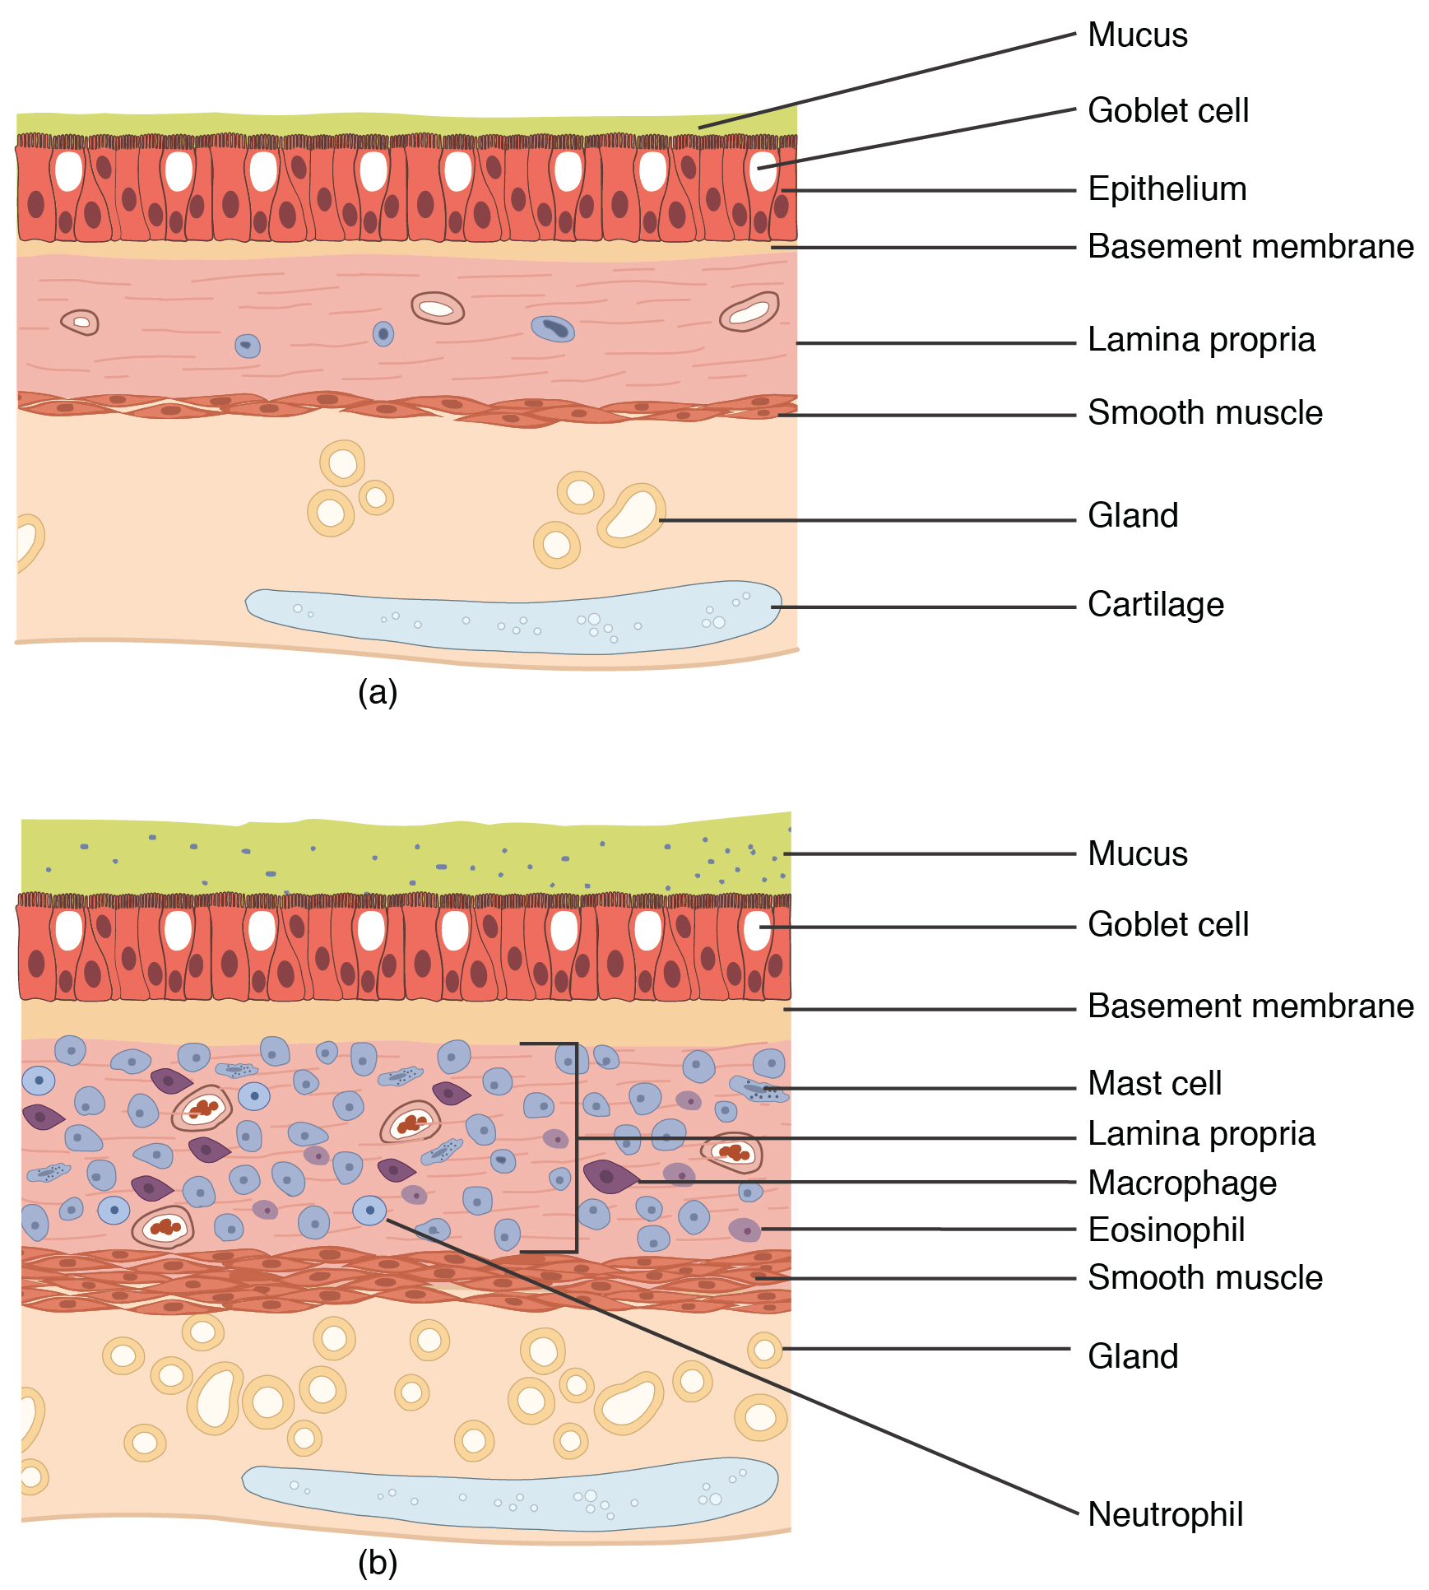
What are some anatomical barriers to infection by B. pertussis?
Epithelial barrier of the respiratory tract via mucociliary clearance of the bacteria
Secretion of antimicrobial peptides such as lysozyme, lactoferrin, defensins, secretory leuokoproteinase inhibitor by epithelial cells and innate immune cells

Slide 12
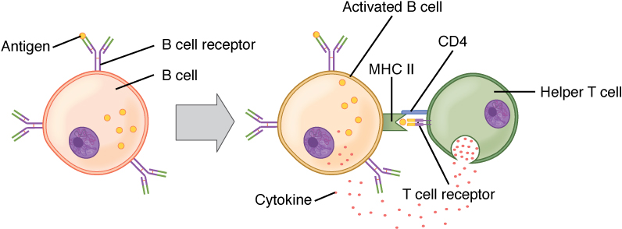
The adaptive immune response
Involves the cell-mediated and humoral responses that are more specific to B. pertussis
Adaptive immunity can take as long as 3 weeks to begin and peaks at 8 to 10 weeks
Since B.pertussis is both an intracellular and extracellular bacteria, important to note that cellular responses play a critical role in clearing intracellular B. pertussis whereas humoral responses clear extracellular bacteria
Note: B. pertussis can become an intracellular bacteria after escaping the phagosome

Slide 13
The cell-mediated adaptive response
This response is driven by CD4+ T helper cells and is critical in clearing intracellular B. pertussis
Begins at around 3 weeks post-infection
The antigens that promote this response are FHA ,CyaA and LPS
CyaA and LPS can bind TLR-4 on DC in order to activate the DC and macrophages
FHA antigen stimulate macrophages and DC to produce IL-10
IL-10

Slide 14
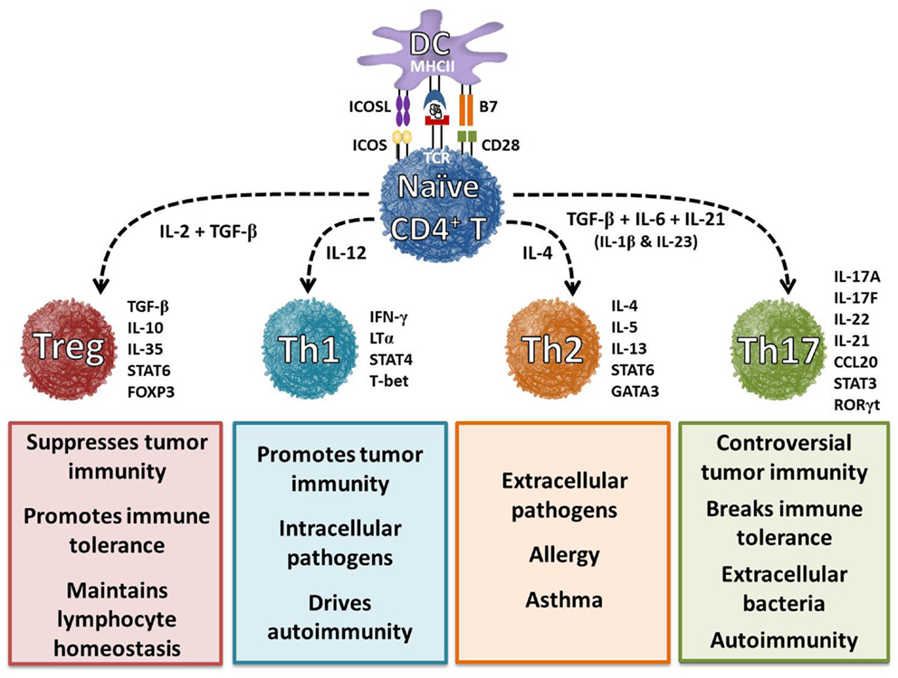
T helper subtypes
Naïve t cells can detect IL-10 and then differentiate into CD4+ T helper 1 cells
CD4+ T helper 1 cells play a critical role in clearing the bacteria by secreting IFN-y which helps to stimulate antibody production and further activate macrophages and neutrophils for phagocytic bacterial killing
Some research has suggested that in the absence of antibody-mediated immune response, Th1 CD4+ mediated response alone can mediate bacterial clearance
Th17 also plays a role by promoting neutrophil-mediated killing

Slide 15
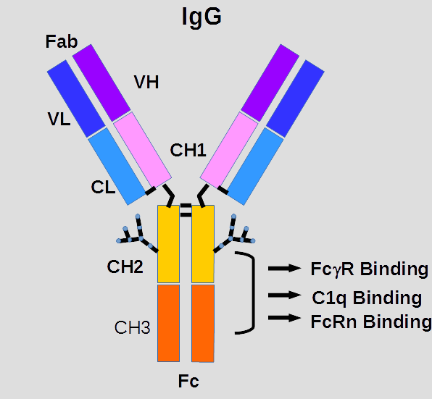
The humoral immune response
IgA and IgG antibodies play a central role in clearing extra-cellular (or non-phagocytosed) B. pertussis from the body
Antibodies provide immunity by neutralizing bacterial toxins, inhibit extracellular bacteria from binding to epithelial cells, and enhance phagocytosis

Slide 16
How can the antibody response be enhanced?
Via T helper 2 cells secreting IL-4,IL-5,IL-6 which further enhance the antibody activity against antigens
Pertussis toxin can also enhance antibody activity against pathogens by stimulating IL-1 production by macrophages

Slide 17
Host damage learning goals
What damage ensues to the host from the immune response?

Slide 18
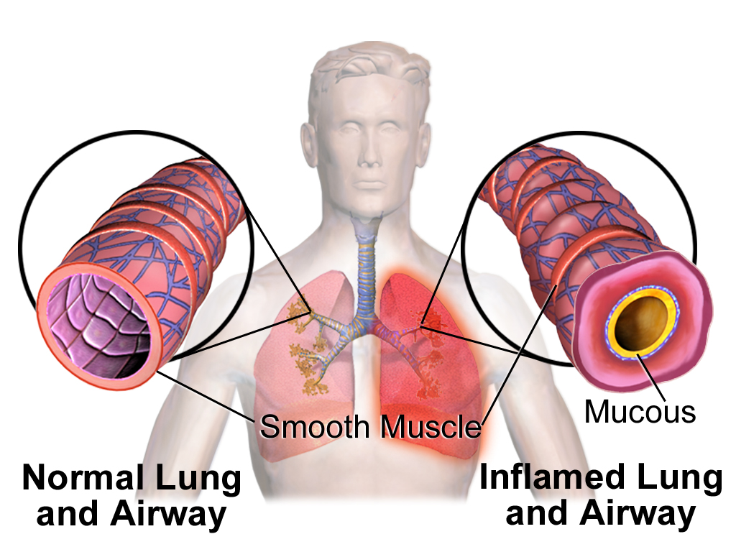
Is your immune system responsible?
Inflammatory response driven by Th1 and Th17 can damage host tissues which prevents clearing of pulmonary secretions
Activation of NFkB transcription factor in certain immune cells can produce inflammatory cytokines like IL-1, 6,8, chemokines, type 1 interferons and TNFalpha
These cytokines can cause the redness, heat, pain and swelling associated with inflammation
Thickened mucus decrease ability to clear pulmonary secretions which causes the coughing

Slide 19
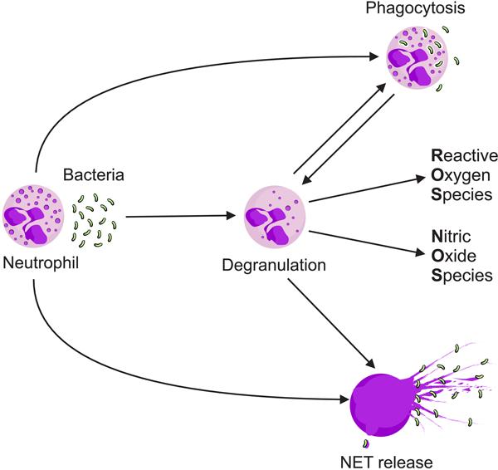
Is your immune system responsible (continued)?
Vasodilation and increased vascular permeability caused by TNF-alpha can result in edema
The pro-inflammatory cytokines can cause paralysis of the cilia which causes coughing fits as well because the host cannot clear the airways
Cytokines IFN-y, IL-1,6 and TFN causes the release of prostaglandin E2 which initiates fever in the hypothalamus
Neutrophils, macrophages and DC may overproduce nitric oxide which combines with ROS to cause collateral damage to healthy tissue
Via http://www.scielo.br/scielo.php?script=sci_arttext&pid=S0100-879X2015000800665 by Perobelli et al.,2015

Slide 20
Bacterial Evasion Learning Goals
How does the bacteria attempt to evade these host response elements?

Slide 21
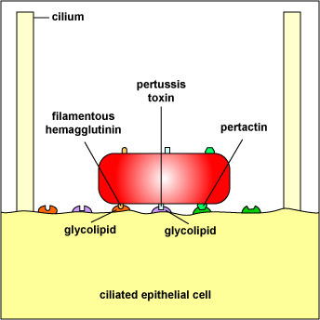
Filamentous haemagglutinin (Fha)
Critical virulence factor involved in adhesion to host cells
B. pertussis uses FHA to stimulate the macrophages and neutrophils to take them up via phagocytosis
This allows for bacteria to evade the immune system by avoiding extracellular detection
Once inside the phagosome, bacteria use adenylate cyclase toxin (ACT) to suppress intracellular killing
Via http://faculty.ccbcmd.edu/courses/bio141/lecguide/unit3/bacpath/u1fig26a.html

Slide 22
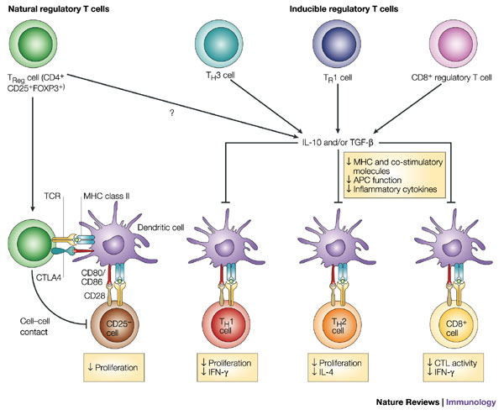
But wait… there’s more: FHA
FHA can suppress the inflammatory response that is mediated by the innate immune cells
FHA stimulates DC to secrete immunosuppressive IL-10 via TLR-2 signalling which suppresses the IL-12 production and also promotes the differentiation of T cells into regulatory T cells
Treg cells secrete more IL-10 to further suppress the IFN-y and Th1 response

Slide 23
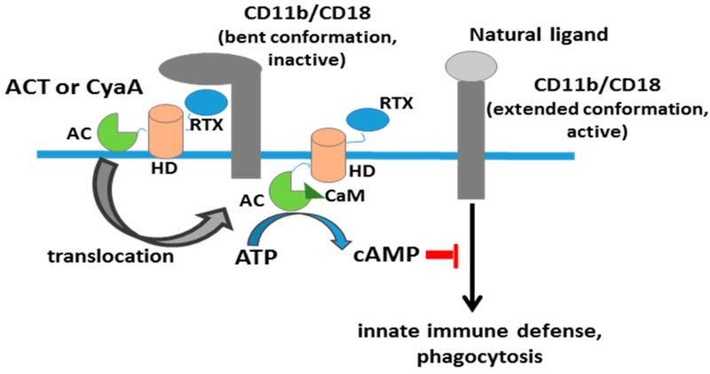
Role of Adenylate Cyclase Toxin
ACT enters cells by binding to CR3 which results in a massive cellular increase in cAMP levels via its adenylate cyclase domain
Increased Camp levels results in the inhibition of anti-bacterial functions
Prevents neutrophils from making extracellular traps and inhibiting oxidative burst
ACT induces innate immune cells to undergo apoptosis
ACT also suppresses the secretion of proinflammatory cytokines IL-12 and TNF-alpha

Slide 24
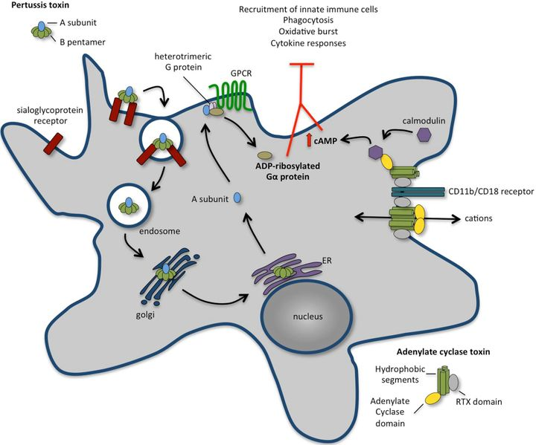
The Immunomodulatory effects of PT
PT enhances FHA- mediated adhesion by upregulating CR3 to facilitate bacterial uptake
PT also causes host cell to increase production of cAMP via the inhibition of Gi protein of the adenylate cyclase
This results in the inhibition of chemokine signalling pathways as well such as impaired macrophage, neutrophil chemotaxis and infiltration to the sites of fincetion
Also results in decreased phagocytosis, oxidative burst and bactericidal properties

Slide 25
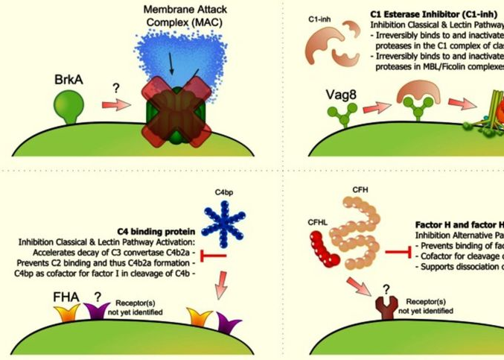
How does B. pertussis evade complement?
BPS polysaccharide is expressed on the LPS surface of this bacteria and it has been implicated in complement resistence
Expression of the BrkA protein reduces the amount of C3,C4 deposition on the bacterial cell surface thus reducing MAC formation

Slide 26
Outcome Learning Goals
Is the bacteria completely removed?
Does the patient fully recover?
Is there immunity to future infections from this particular bacteria?

Slide 27
Bacterial removal
B. pertussis is completely removed from the body through the immune responses and is not detectable in the body by approximately 3 weeks after infection
1
However, the catarrhal and paroxysmal phases of the infection can last up to 6-10 weeks
2
The infected patient slowly recovers during the convalescent phase with the paroxysmal coughs becoming less frequent
3

Slide 28
Are there complications?
Potential complications include short and long-term complications such as weight loss, rib fractures from coughing, pneumonia, apnea, encephalopathy and death

Slide 29
Is there evidence of acquired immunity?
Evidence is unclear
Serum levels of B. pertussis antibodies decrease rapidly after infection
This might explain why maternal antibodies do not confer much protection in the infant
Some immunity may exist, however,
Bacterial virulence factors such as PT, FHA, CyA, heat-labile toxin may possibly by the protective immunogens

Slide 30
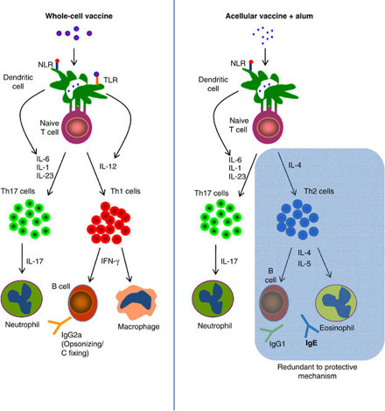
Vaccination development
Both acellular and cellular vaccines have been developed to try and confer immunity
However, no vaccine to this date has been 100% effective
Cellular vaccines induce a th1-mediated response
Acellular vaccines induce a th2 mediated response involving antibodies
Booster vaccines have been shown to be successful in enhancing the th2 response and igE production

