Slide 1
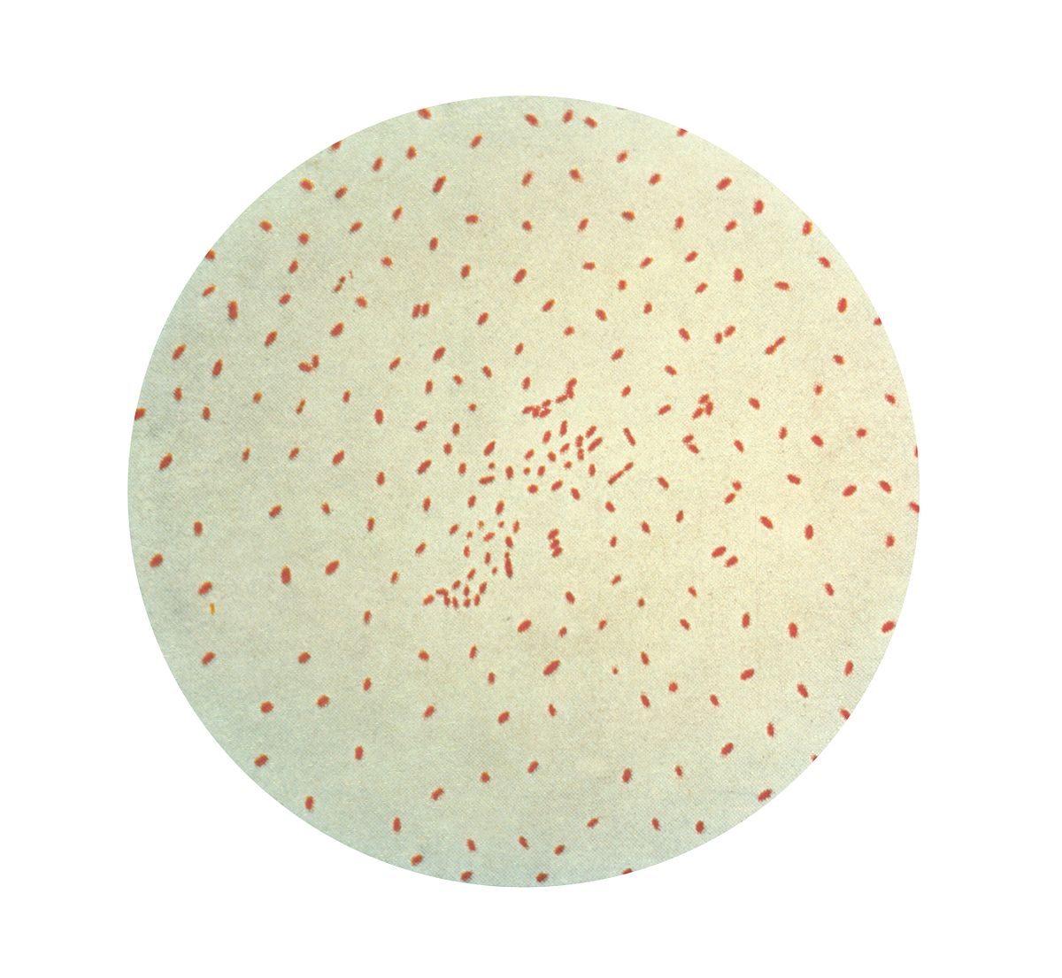
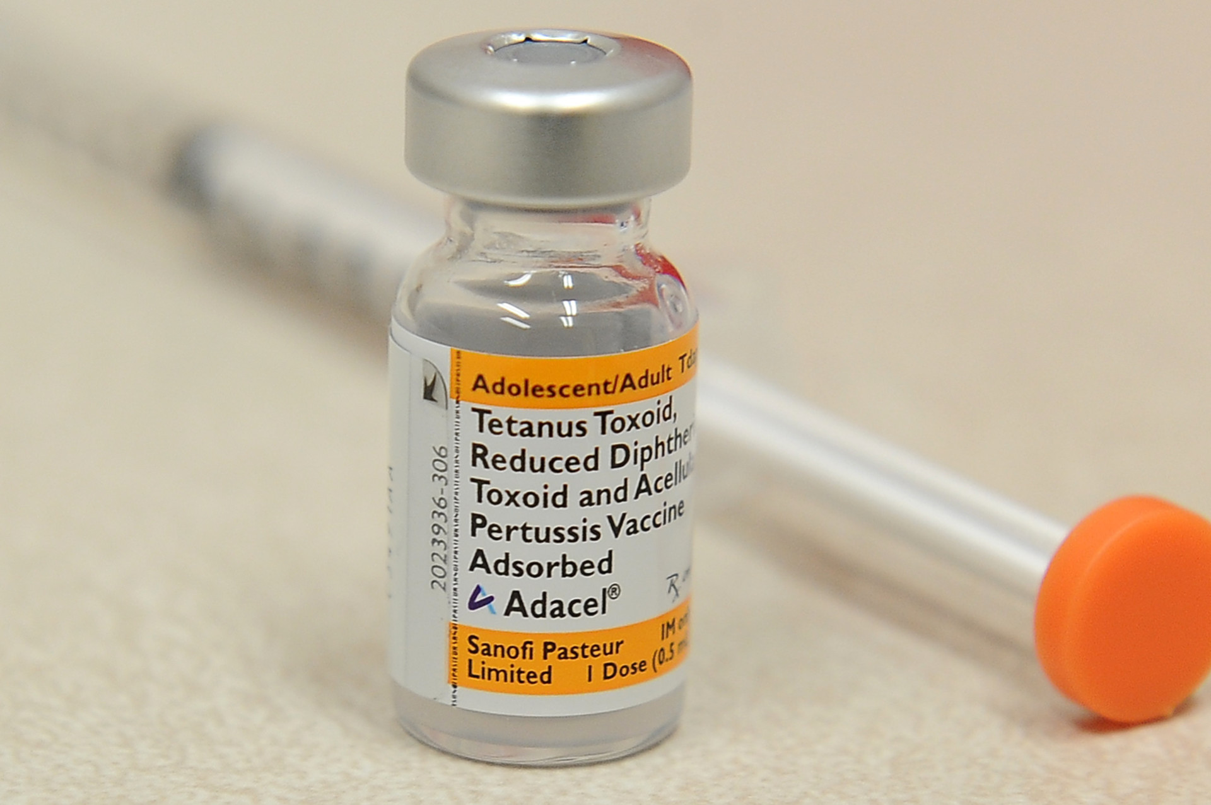
Case 4: Bordetella pertussis & Whooping Cough
By: Riley Ty

Slide 2
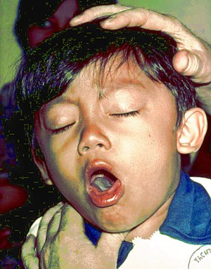
Case: A Chronic Cough
36-year-old Joseph has been suffering from multiple spells of violent coughing for 6 weeks. Prior to developing the chronic cough he had, what he describes as, a mild upper respiratory tract irritation, mild fever, runny nose and a cough that lasted about 3 days. More recently, and at the insistence of his spouse, he finally visits a drop-in clinic where the doctor asks him about his childhood vaccinations.
Joseph reports that, to the best of his knowledge he had all the required shots but he admits to not having any since becoming an adult. Upon examining Joseph the doctor finds some redness in his throat but his lungs are clear and there are no enlarged lymph nodes in his neck. The doctor collects a throat swab to send to the laboratory, prescribes some codeine syrup and informs Joseph that the cough may last a few more weeks.
The laboratory is unable to detect Bordetella pertussis or any other pathogen from the swab. Despite this, Joseph is diagnosed with pertussis, commonly known as whooping cough, based on his clinical presentation and lack of adult immunization against pertussis. The coughing fits go away after another 4 weeks.

Slide 3
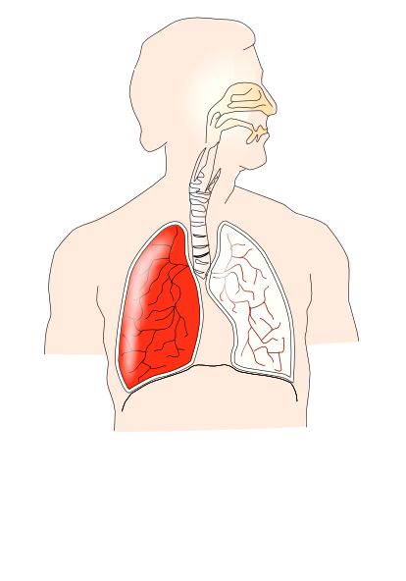
Overview of topics
Host Response
Innate Immunity
Adaptive Immunity
2. Host Damage
4. Outcome
Timeline
Vaccines
Bacterial Evasion
- Bacterial toxins and proteins

Slide 4
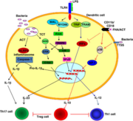
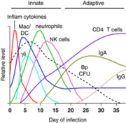
Host Response (1): Innate Response
Innate Immune Response, the first line of defense:
Upon infection macrophages and neutrophils rush to engulf and then destroy the invading bacteria, via low pH compartments.
B. pertussis however, survives this by adhering to the integrin CR3 found on both phagocytic cells and using it to enter their non-acidic compartments.
Natural Killer cell secretion of IFN-y resulting in nitric oxide (NO) production, neutrophil phagocytosis and IL-17 killing are part of the innate response, but due to various B. pertussis toxins [i.e. pertussis toxin (PT), filamentous hemmaglutinin (FHA) and adenylate cyclase toxin (CyaA)] the bacterium survives.
One such example is CyaA’s ability to generate superoxides and inhibit both phagocytosis and chemotaxis, which in turn will inhibit neutrophil functions.
However, activation and differentiation of T-cells, via Dendritic cells (DCs), can still pose a problem to the bacteria.
When either a pathogen-associated molecular pattern (PAMP) and or virulence factor on the pathogen is detected by Toll-like Receptors (i.e. TLR-4 on the DC’s) the innate immune response can be further enhanced along with activation of the adaptive immune response.
This occurs when LPS is recognized via CD14 (a TLR-4 like molecule) causing DCs to activate and release cytokines IL-12 and IFN-y to clear bacteria and trigger IL-10 production to limit host damage.
Physical obstructions, such as the epithelial barrier of the respiratory tract, clear bacteria through either mucociliary means or the secretion of antimicrobial peptides such as lysozymes, lactoferrin, defensisns, pBD-1 and secretory leukoproteinase inhibitor.

Slide 5
Host Response (2): Adaptive Response
Adaptive Immune Response, the second line of defense (images on next page):
After the innate responses, cellular and humoral responses are also triggered to clear phagocytosed and extracellular bacteria, respectively.
Cellular Immune Response:
Begins about 3 weeks post infection when antigens cause the appropriate immune responses.
For example, when CyaA along with LPS are recognized by TLR4, which in turn activates both DCs and macrophages, similarly FHA causes DCs and macrophages to secrete IL-10, causing naïve T-cells to become CD4+ Th1 cells
These cells secrete IFN-y causing production of opsonizing antibodies and further activation of phagocytic cells.
PT also enhances this by providing a signal to increases the ability of macrophages to present antigens and better activate Th1 cells via increased expression of B7-1 and B7-2.
Th17 cells work in a similar manner to Th1 cells, but are activated by IL-23 secretion of DCs.
Humoral Immune Response:
Mediated by antibodies such as IgA and IgG, which can neutralize bacterial toxin, inhibit bacterial binding to reparatory epithelial cells and enhance bacterial uptake in macrophages and neutrophils.
Also mediated by Th2 cells, which secrete IL-4, IL-5 and IL-6 to increase antibody function against the infection.
Similar to cellular response, PT toxic can strengthen this responses via stimulation of IL-1 and enhancement of macrophages to become better at antigen presenting/activating Th2 cells.
Due to recent experiments in mice, showing that defective B-cell mice cannot effectively clear B.pertussis, and that there was a significant amount of CD4+ T cells and less significant serum antibodies (IgG, IgM and IgA) during a primary infection, it is suggested that cellular responses may be more critical than humoral immunity.
This has been refuted by the fact both cellular and acellular vaccines against B. pertussis are equally effective.
Suggesting alternative mechanisms to antibody productions such as T cells activation and cytokine signaling, may be the more important aspect in humoral responses.

Slide 6
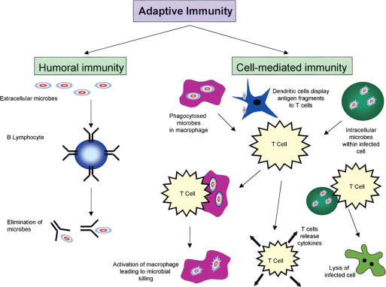
Host Response (3): Diagram of Adaptive Immunity

Slide 7
Host Damage (1):
After attachment to the cilia in the respiratory tract, a number of bacterial toxins (listed on the next page) will be released, damaging the host.
Th1 and Th17 cells, along with NFkB production will cause indirect damage via the release of proinflammatory moelcules IL-1/6/8, TNFa, chemokines and Type I interferons causing redness, heat pain and swelling,
The molecules will also cause irritation of the respiratory tract, vasodilatation and increased permeability leading to the possibility of edema and fluid build up of the lungs in an effort to increase leukocyte mobility.
The fluid build up, combined with complement and signaling based damage, will induce violent coughing fits as the body tires to clear the lungs, as is with Joseph’s case.
Joseph’s fever is also a result of the inflammatory state within the body, the release of prostaglandin E2 (PG32) due to bacterial LPS and IL-1 release due to tracheal toxin.
Despite this, the fever will in fact help the body as it triggers increased leukocyte killing of bacteria.
PT can also cause a disruption of adenylate cyclase levels, causing an increase which in turns throws off numerous metabolic pathways in the host, causing severe damage ranging from a delay of neutrophil recruitment to reduced humoral responses.
Lethal toxin can also cause enhanced infection due to the reduction of macrophages, possibly leading to necrosis.
Even phagocytic cells such as neutrophils macrophages and DCs can damage the host due to overproduction of NO, which can combine with several Reactive Oxygen Species (ROS) to create damaging intermediates that harm nearby cells.

Slide 8
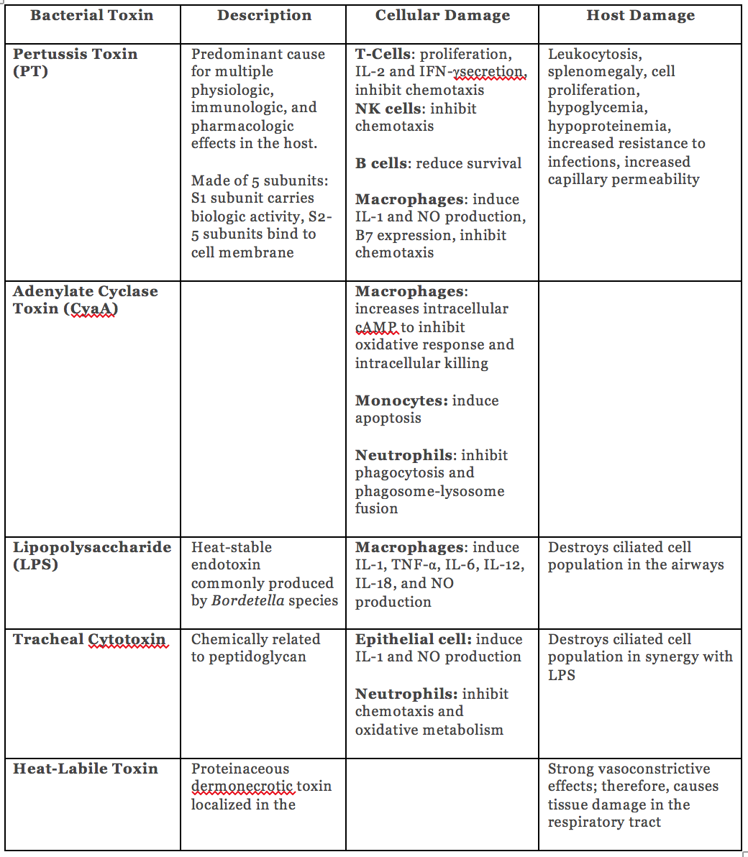
Host Damage (2): Toxins Table

Slide 9
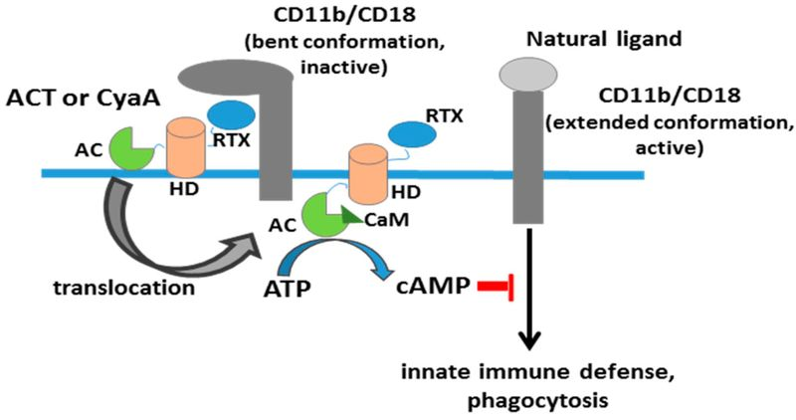
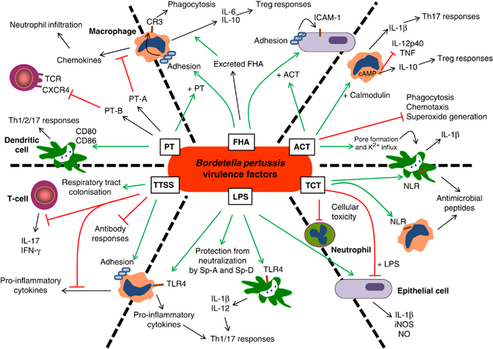
Bacterial Evasion (1): Bacterial Proteins Part 1
B. pertussis expresses and utilizes a multitude of molecules to enhance both its own virulence and bypass host defenses, examples include:
Filamentous haemagglutinin (Fha), which is used to improve uptake into both macrophages and neutrophils via CR3, which allows the bacteria to avoid detection and utilize ACT to suppress the cell’s ability to kill the bacteria.
Fha also has other functions such as suppression of inflammation in airways due increased IL-10 expression causing differentiation of more T regulatory cells (Treg), which in turn will produce more IL-10 and suppress IFNg production and Th1 response.
Fha can also cause proteasome inhibition, which will inhibit NFkB signaling and stop the proinflammatory response.
ACT, also enters the cell via CR3 binding however, this will trigger a massive increase of cAMP via its adenylate cyclase domain.
cAMP can also be increased due to the formation of cation-selective pores in the cell membrane as a direct result of a hemolysin repeat in ACT’s toxin domain.
The increased cAMP will cause massive inhibition of multiple anti-microbial abilities of the cell such as preventing neutrophil oxidative burst.
It can also cause the destruction of innate immune cells can via apoptosis and cell cycle arrest and reduced phagocytosis, chemotaxis and superoxide generation.
Additionally, section of IL-12 and TNF-a will also be stopped.

Slide 10
Bacterial Evasion (2): Bacterial Proteins Part 2
PT (images on next page) is composed of an A (S1) subunit and B(S2-S5 oligomer) subunit, the latter of which allows the bacteria to hide by increasing Fha-mediated adhesion to host CR3 via mimicry.
This will decrease antigen processing and activation of T cells.
- Similarly by activating T cell receptor (TCR), signaling molecules such Zap70 and protein kinase C, the B subunit will cause desensitization of the TCR and chemokine receptor CXCR4, thus decreasing both T cell activation and adaptive immunity.
The A subunit can use ADP ribosyl transferase to inhibit Gi (an inhibitory protein) of adenylate cyclase, causing a massive unregulated conversion of ATP to cAMP.
This inhibition will also disrupt multiple chemokine signaling pathways causing decreased macrophage, neutrophil and other lymphocyte chemotaxis and infiltration at the infection sites, resulting in decreased phagocytic oxidative burst and a reduction in overall antibacterial abilities.
By using a Type III Secretion System (TTSS), B. pertussis can also inhibit NFkB and block expression of defensin.
The BopN effector of this system will also cause an increased secretion of IL-10, decreasing the pro inflammatory response via inhibition of IFNg production and decreasing resistance to the bacteria.
The Bps polysaccharide of the LPS surface can also be used to evade complement killing in the host.
This was noticed when Bps mutants were more susceptible to complement killing.
B. pertussis also expresses the BrkA protein, (images on next page) to reduce the amount of C3 and C4 deposited on the bacterial surface, decreasing MAC fomration.
It has been theorized that this is either done through inhibition of C4 activation or increased degradation of C4b.
The bacteria can also bind C1 esterase inhibitor (C1-inh) to stop any and all complement activity.
C1-inh is a serine protease that normally inactivates the C1r and C1s proteases to regulate both the classical and lectin pathways of the complement.
B. pertussis can also use the hijack the regulator C4b binding protein (C4BP), via Fha, to inhibit the complement.

Slide 11
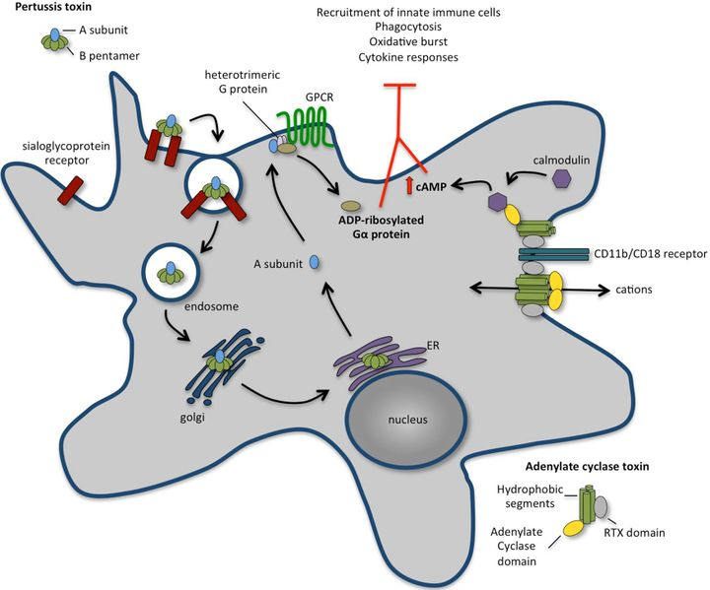
Bacterial Evasion (3): pertussis toxin

Slide 12
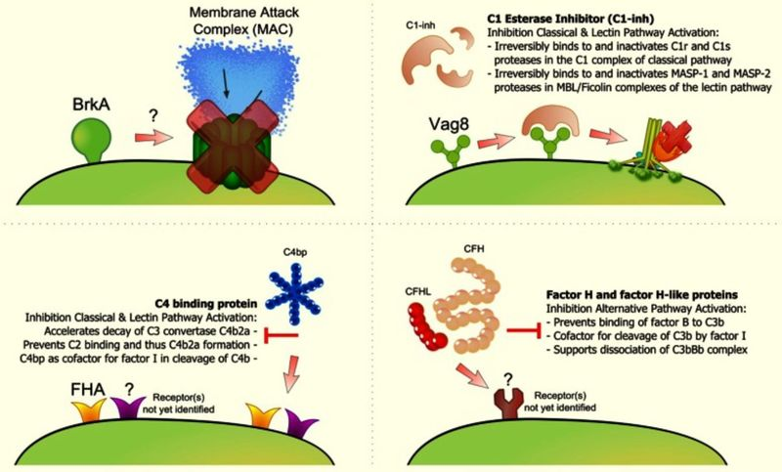
Bacterial Evasion (4): BrkA Mechanism

Slide 13
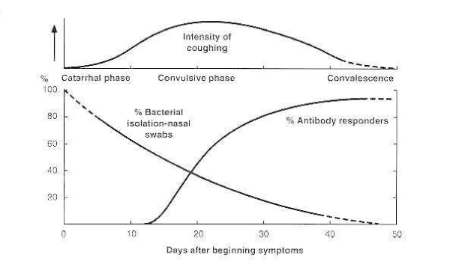
Outcome (1): Timeline of AB response
Host immunity is capable of removing B. Pertussis within 3 weeks post infection however, lingering symptoms and complications, ranging from pneumonia to apnea and even death, may still be a problem for 2-3 months.
Acquisition of long-term immunity is not clear as serum antibodies decrease rapidly after infection, but virulence factors such as PT, FHA, CyaA and heat liable toxin can become protective immunogens and contribute to immunity lasting from 2 to 30 years.
There is no immunity however against other Bordetella Species.

Slide 14
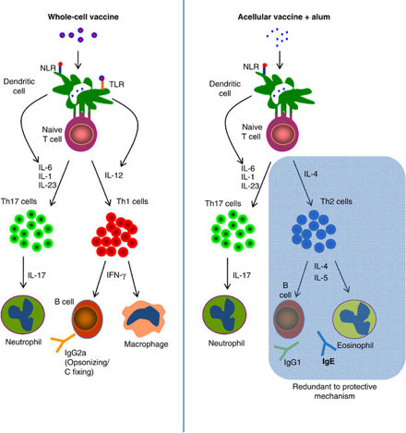
Outcome (2): Vaccine Development
Currently both acellular (Th2 antibody response) and cellular (Th1 response) vaccines are used to protect against B. pertussis, neither is 100% effective.
This inefficiency is due a reduction in antibody levels post immunization, meaning a booster is required to enhance both Th2 and IgE production.
Joseph stated having no history of adult immunization or boosters, indicating his infection is the result of antibody deficiency against the B. pertussis.

