Slide 1

Writing a (Mindful) Learner-Centered & Inclusive Syllabus
2026 CTLT Summer Institute
Gail Hammond, PhD, RD, Faculty of Land & Food Systems
Judy Chan, PhD, CTLT, Faculty of Land & Food Systems
August 18, 2026
This work is licensed under the Creative Commons Attribution-NonCommercial 4.0 International License.

Slide 2
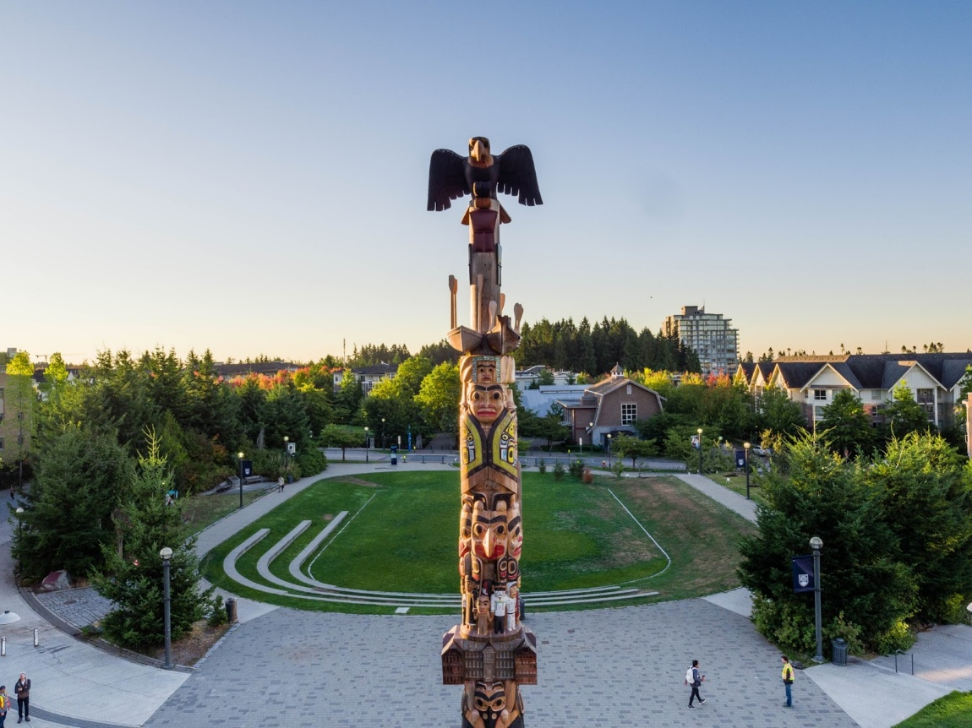
Land Acknowledgement
UBC Point Grey Campus sits on the traditional, ancestral, and unceded Musqueam Territory
Create your own land acknowledgement through the UBC HR course: Respect, Sincerity and Responsibility: Land Acknowledgements @ UBC
UBC Indian Residential School History and Dialogue Centre
Native-land.ca
Notes:
Image of the Reconciliation Pole, installed on the southern end of campus near the Forestry building, encourages everyone who comes across it to learn more about the history of Indian residential schools and to understand their role in reconciliation between Indigenous and non-Indigenous Canadians. The pole was carved by master Haida carver, James Hart and a group of assistant carvers, over a period of 2 years. The pole faces the Indian Residential School History and Dialogue Centre (IRSHDC), which opened a year after the pole was erected. The Centre works to facilitate dialogues and access to records and information that support engaging the legacies of the residential school system and the on-going impacts of colonialism in Canada.
As we gear up for a return to campus, we want to leave you with these invitations to learn more about the legacy of colonization by following up with the resources noted on the slides, or by visiting the reconciliation pole or the IRSHDC .

Slide 3

Learning Outcomes
2
By the end of the session, you will be able to:
Explain the purpose and benefits of learner-centered and inclusive (LCI) syllabi, from both the student and instructor perspectives.
Discuss elements of a LCI syllabus, and assess your course syllabi for hidden assumptions.
Enhance your syllabus by drafting sections to be more learner-centered and inclusive.
Advance your commitment to inclusive teaching through your course syllabus.

Slide 4
3
Agenda
Welcome & Introductions
UBC-V syllabus template
Characteristics, benefits and examples of LCI syllabi
Breakout rooms: discuss & share LCI syllabus practices
Revise section(s) of your own syllabi to be more LCI
Debrief, wrap up & feedback

Slide 5

Getting to know you…
a few quick questions
What is your role at UBC?
  Faculty
  Staff
  Student
  A combination of these roles
Notes:
Prepare polls in advance
What is your role at UBC?
Faculty
Staff
Student
More than one
What term are you preparing a syllabus for?
Fall
Winter
Both terms
Not sure yet
Do you use a template to create your syllabi?
Yes, I use my own template.
Yes, my department/school has a standard template that I use.
No, I don’t follow any template.
I haven’t created a syllabus before

Slide 6
What term are you preparing a syllabus for?
  Fall
  Winter
  Both terms
  Not sure yet
Do you use a template to create your syllabi?
  Yes, I use my own template
  Yes, my department/school has a standard template that I use
  No, I don’t follow any template
  I haven’t created a syllabus before
Notes:
Prepare polls in advance
What is your role at UBC?
Faculty
Staff
Student
More than one
What term are you preparing a syllabus for?
Fall
Winter
Both terms
Not sure yet
Do you use a template to create your syllabi?
Yes, I use my own template.
Yes, my department/school has a standard template that I use.
No, I don’t follow any template.
I haven’t created a syllabus before

Slide 7

Why is the syllabus important?

Slide 8
UBC Guidance: Senate Policy V-130
Content & Distribution of Course Syllabi
Why: To ensure consistent component, and distribution practices
When: Must provide syllabus during first week of class
  Unless, developing in collaboration with students, must be finalized before the last official withdrawal date
  Monday, September 28, 2026

Slide 9
UBC Guidance: Senate Policy V-130
Latest update, AI Policy, Sept 1, 2026
What about AI:
  a statement on academic integrity that informs the students of expectations in the course, including a link to the Academic Calendar statement on Academic Misconduct.
  a statement on generative artificial intelligence (GenAI) usage in student submitted work that clarifies how the use of GenAI is permitted or not permitted.

Slide 10
UBC Guidance: Senate Policy V-130
Content & Distribution of Course Syllabi Template
Does not impose a template, but provides one with guidance on essential elements to include – ample flexibility in language & look
Where to access:
  https://senate.ubc.ca/policies-resources-support-student-success
  https://senate.ubc.ca/policy-20190207-v-130-syllabus/
  https://ctlt.ubc.ca/resources/teaching/course-syllabus/

Slide 11
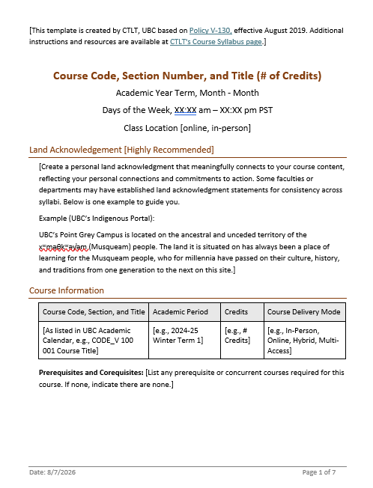
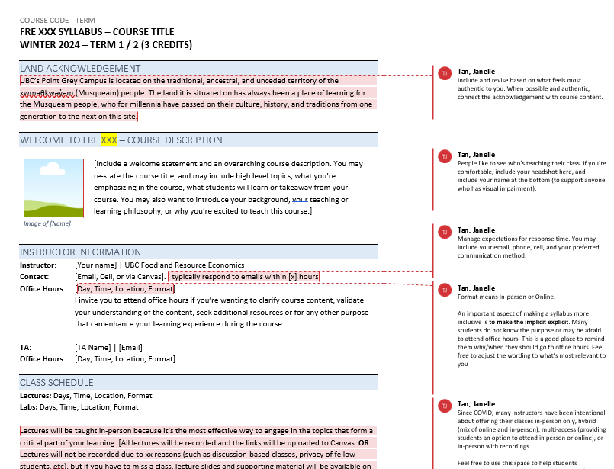
Syllabus Templates
From CTLT
From Faculty of Land and Food Systems
With UDL elements

Slide 12
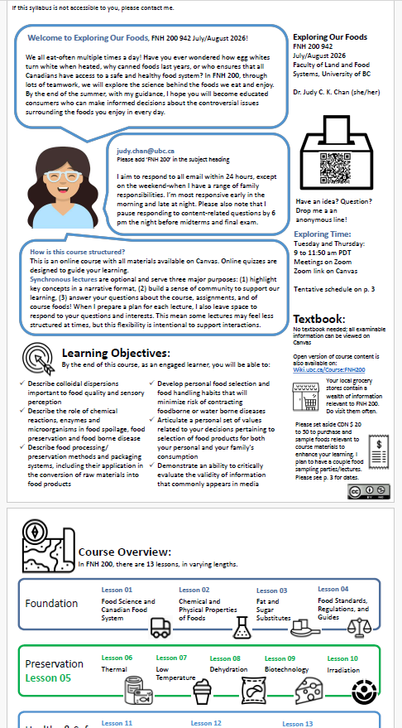
Syllabus Templates – Creative Examples

Slide 13
Characteristics & Benefits of a Learner-Centered and Inclusive Syllabus

Slide 14
8
Learner-Centered Syllabus
A learner-centred syllabus requires that you shift from what you, the instructor, are going to cover in your course, to a concern for what information and tools you can provide to your students to promote learning and intellectual development.
Diamond, R. M. (1997). "Foreword" in Grunert, J., The Course Syllabus, Bolton, MA: Anker Publishing Company, Inc.

Slide 15
8
Establish a Learning Community
Focus on the needs of students
  Shift from “What are we going to cover?” to “How does the course promote learning and intellectual development in students?”
Learning is a partnership between instructor(s) & students
Foster a reciprocal learning community where students learn from instructors and instructors learn from students
Use an encouraging (rather than punishing) tone

Slide 16
8
Facilitate students’ academic success
Instructors provide information, such as…
  Rationale for course objectives and assignments
  Strategies for how to tackle certain projects, assignments
  Warning of potential pitfalls (e.g., ebbs and flows)
  Shared and explicit expectations (students and instructor)
  Student options for deadlines and/or assignments
Notes:
A LC syllabus facilitates academic success of students. Includes additional rationale of the course, and is explicit about student learning in important ways, such as

Slide 17
12
Make the implicit explicit!
Communicate your thoughtful course design
Adopt a warm and inclusive tone and language
Office hours: they are for the students!
Provide costs associated with the course (e.g., textbook, course materials)
Explain rationale for course design, flexibility in course policies, and partnership between teaching team and students
Highlight campus support resources

Slide 18
Examples – Course Modality
Original:
This course meets face to face on MWF 9am to 10am in IKBLC 201. Attendance will be taken and lectures will not be recorded. You are responsible for all materials discussed during the lecture.
Revised:
This course comprises in-person activities: this is the most effective way to engage in the [discussions / projects] that form a critical part of your learning in the course. These sessions will not be recorded, due to the nature of the conversations we will be engaging in during the class, but if you have to miss a class for whatever reason, here are the ways that you can catch up on missed sessions....

Slide 19
Examples – Learning Objectives
Original:
This course will:
Define modern psychology and identify major perspectives within it
Outline psychological concepts and theories from specific subfields (e.g., developmental and social psychology)
Explore principles and themes to gain insight into learners themselves, others and events in everyday life
Revised:
I designed this course with specific goals in mind. If you are willing and able to meet the requirements, by the end of this course, you will be able to:
Define modern psychology and identify some major perspectives within it
Recognize, recall, connect and evaluate psychological concepts and theories from specific subfields (e.g., developmental and social psychology)
Apply your knowledge of psychological principles and themes to gain insight into yourself, others and events in your everyday life

Slide 20
Examples – Assessments
Original:
Term paper:
The term paper (1500 words, double-spaced, in docx format) must be submitted online via the assignment tool before 5:00 pm on the last day of class.
Revised:
Term paper:
In order to help you develop a meaningful research paper, we encourage you to submit your paper in three stages.
A 200-word outline stating your research questions, describing why it matters to you how the topic is relevant to the course content.
A rough draft to be submitted…
The final version…

Slide 21
Inclusive Teaching
Inclusive teaching refers to intentional approaches to curriculum, course design, teaching practice, and assessment that create a learning environment where all students feel that their differences are valued and respected, have equitable access to learning and other educational opportunities, and are supported to learn to their full potential…
-https://inclusiveteaching.ctlt.ubc.ca/

Slide 22
Inclusive Syllabus
Acknowledge & value a diversity of experiences & identities
Instructors, students
Communicate commitment to equity, diversity, inclusion, decolonization (EDID)
Engage students who have been historically & systemically marginalized by creating a sense of belonging in the learning environment
      Fosters motivation & engagement
      Supports student wellbeing
      Increases student success & retention
UBC Student Diversity Initiative, UBC Equity & Inclusion Office
Notes:
*one of the ways you can acknowledge these experiences is by using inclusive teaching statements. Three examples to share.

Slide 23
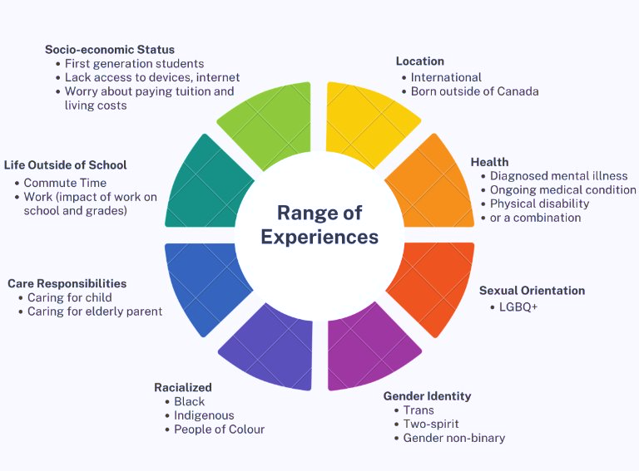
Student's
Lived Experiences

Slide 24
Making Syllabus Inclusive
Quick Refinements
  Adopt a warm and inclusive tone and language.
  Explain the rationale of the course modality and design.
  Describe how students can communicate with you and each other.
  Include supportive and flexible course policies.
  Highlight the benefits of support available for students.
Moderate changes
  Articulate a clear and relevant course description/overview.
  State your teaching philosophy and include a diversity statement.
  Include a more meaningful land acknowledgement specific to the course and context.
  Craft a detailed course schedule.

Slide 25
Equity and Diversity Statements
The UBC School of Creative Writing aims to foster a welcoming and inclusive space for all members of our community. We are engaged in an ongoing process of building and reinforcing anti-racist and decolonial pedagogies and structures in our School, and centering equity, diversity, and inclusion in our teaching, learning and hiring. We are committed to ensuring that our classrooms and community spaces are safe and respectful for individuals from historically marginalised and oppressed communities – these include BIPOC, queer, trans, two-spirit, disabled and neurodivergent individuals, as well as women.
Notes:
-create a sense of belonging. It says “I see you” –recognition of students’ backgrounds instead of generizicing your student population as “all 2nd years”, etc.
https://www.brown.edu/sheridan/teaching-learning-resources/inclusive-teaching/statements
Replace with excerpt from Kathryn Rawn’s syllabus??

Slide 26
Wellness Statements
The UBC Wellbeing Strategic Framework is guided by the calls to action in the Okanagan Charter, it connects our long-term, university-wide aspirations with actions that promote wellbeing in six priority areas: Collaborative Leadership, Mental Health & Resilience, Food & Nutrition, Social Connection, Built & Natural Environments and Physical Activity.
Notes:
Letting students know what resources are avaialbale for them – recognizing that mental and physical health are important aspects of learning. Helping students not to feel alone – these are common issues that we all face at various times (breaking down barriers and stigma)
https://www.brown.edu/sheridan/teaching-learning-resources/inclusive-teaching/statements

Slide 27
Land Acknowledgements*
“Welcome to Chemistry 100: Foundations of Chemistry. The Point Grey Campus of UBC is on the traditional, ancestral, and unceded territory of the xʷməθkʷəy̓əm (Musqueam) people. The land UBC-V is situated on has always been a place of learning for the Musqueam people, who for millennia have passed on their culture, history, and traditions from one generation to the next on this site. This year, while we learn together with short or great distances between us, I will be on the traditional, ancestral, and unceded territories of the Musqueam, Tsleil-Waututh, and Squamish nations.”
-Dr. Jackie Stewart, Chemistry 100 Winter 2020
*Personalize land acknowledgements to you and your course.
Indigenous Peoples: Language Guidelines (2021 version): http://assets.brand.ubc.ca/downloads/ubc_indigenous_peoples_language_guide.pdf
Notes:
*include your own positionality –who are you, what is your social background, what is your relationship to this place?

Slide 28
20
Share, compare, borrow (15 mins)
At your table, share ideas with one another on learning-centred and inclusive characteristics and strategies:
  Share what you already do on your syllabus that aligns with learner-centred and inclusive characteristics
  Describe any changes you are inspired to make toyour syllabus.
  Discuss how you want the students to get to know you before they even meet you!

Slide 29


20

Slide 30
20
Summarize key take-aways
Include a personalized Land Acknowledgement
Provide key information outlined in the UBC Senate Policy
Write in a welcoming tone using inclusive language that aims to value and respect everyone in the learning environment (including the instructor!)
Notes:
Write in a welcoming tone that creates a supportive and inclusive environment where everyone feels valued and encouraged to grow. Let's work together toward achieving academic success and a healthy learning experience
Think about a student – new to the topic – that is learning about the course and its content for the first time

Slide 31
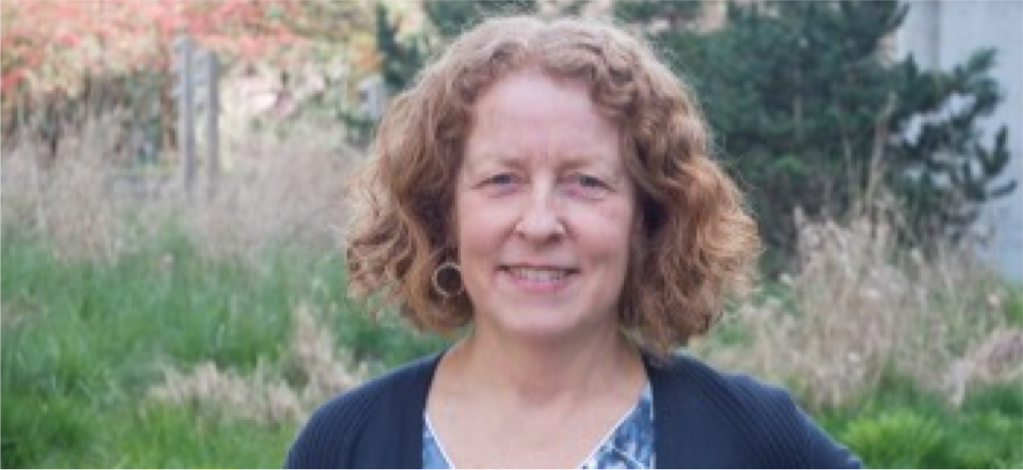
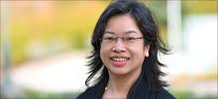
August 28, 2017
25
Questions? Get in touch!
Gail.Hammond@ubc.ca
Judy.Chan@ubc.ca

Slide 32

Resources: UBC
20
Inclusive Teaching @ UBC. This website contains resources for faculty members on diversity and inclusion within the classroom: https://inclusiveteaching.ctlt.ubc.ca/resources/resources-for-faculty/
UBC Indigenous Peoples: Language Guidelines, 2021:
  https://brand.ubc.ca/indigenous-peoples-language-guide-now-available/
UBC Vancouver Senate Policy V-130: Content & Distribution of Course Syllabi:
  https://senate.ubc.ca/Policy-20190207-V-130-Syllabus/
UBC Course Syllabus Template: https://ctlt.ubc.ca/resources/teaching/course-syllabus/
UBC Wiki: How to make your syllabus more learner-centred (includes examples):
  https://wiki.ubc.ca/Documentation:Inclusive_Teaching/Learner_Centered_Syllabus
We want your feedback!
Please complete the form.

Slide 33

Going Further
GenAI and Liquid Syllabi
Can your Syllabi be Liquid?
Public (accessible online without needing to log into a university account and often available to students before class starts)
Mobile-friendly (resizes responsively based on a user’s device)
Engaging (includes an instructor video and possibly other forms of media)
Visually pleasing (clearly organized with stylistic touches)
      -Pacansky-Brock, 2021
Examples:
  https://sites.google.com/view/donuts4umoja/home
  https://span312.arts.ubc.ca/meet-your-instructor/

