Slide 1
GUANFACINE: Changing the face of ADHD treatment?
Katelyn Halpape, BSP, ACPR
Doctor of Pharmacy Student
Faculty of Pharmaceutical Sciences
University of British Columbia
Katelyn.halpapae@alumni.ubc.ca

Slide 2
ADHD
Neuropsychiatric disorder
Affects 5-12% of Canadian children aged 6-17
8-10% of males
3-4% of females
Hallmark symptoms: inattention, impulsivity, hyperactivity
Sequelae:
Academic impairment
Dysfunction with family and peer relationships
⬆ rate of injuries
⬇ self esteem
Often co-exists with: mood & tic disorders, learning disabilities
American Psychiatric Association 2000, Pediatr Clin North Am 2003;50: 1019-1048,
Am J Psychiatry 1991;148: 564-57, Dipiro 2008, CADDRA 2012

Slide 3
Pharmacotherapy
Psychostimulants
1st line treatment
~70% of patients have clinically significant response
Effectiveness limited by ADE & tolerability issues
Social stigmatization
Drug diversion
Emergence or exacerbation of tics
⬇ Appetite
Insomnia
Delayed growth
Cardiovascular concerns
Psychosis
⬇ Seizure threshold
J Child Adol Psych 2013;23(5):208-219
CADDRA (accessed Oct 2013)
Notes:
Response= clinically significant decrease in core ADHD symptoms

Slide 4
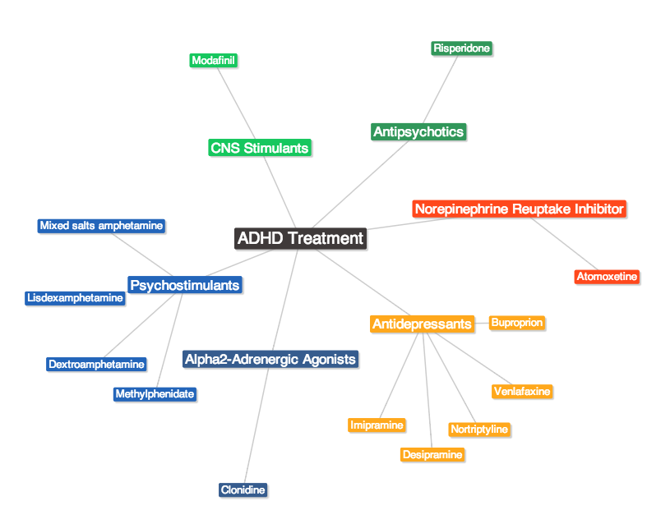

Slide 5
ADHD Goals of Therapy
Eliminate or significantly ⬇ core ADHD symptoms
⬆ Behavioural & academic performance
⬆ Self-esteem & social functioning
⬇ Adverse effects of drug therapy
⬇ Morbidity and mortality
Educate patient and caregiver
Support long term adherence

Slide 6
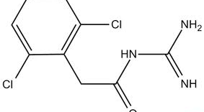
Guanfacine: A familiar face?
Health Canada NOC July 2013
Previously SAP
Originally used as centrally active antihypertensive
Selective α_{2A}- adrenergic receptor agonist
⬆ blood flow to the prefrontal cortex
⬆ working memory, executive function, impulse control
Compared to clonidine:
Less sedation and hypotension
More favourable PK profile: longer t_{1/2} and larger Vd
Approved for ADHD treatment in children aged 6 to 12:
Monotherapy
Adjunctive therapy to psychostimulants
Health Canada Drug Product Database- accessed Oct 2013,
J Child Adol Psych 2013;23(5):208-219, Drugs 1986; 301-336

Slide 7
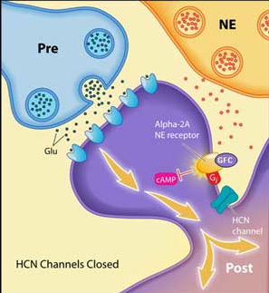
Guanfacine MOA
Arnsten Lab. 2007

Slide 8
Clinical Question
P | In children with ADHD
I | is guanfacine
C | compared to placebo or psychostimulant therapy
O | an effective treatment?
Efficacy | ADHD Rating Scale IV (ADHD-RS-IV) Clinical Global Impression of Severity (CGI-S) Clinical Global Impression of Improvement (CGI-I) Parent’s Global Assessment (PGA) Conners’ Parent Rating Scale-Revised: Short Form (CPRS-R) Conners’ Teacher Rating Scale-Revised: Short Form (CTRS-R)
Toxicity | ADEs

Slide 9
ADHD Rating Scale IV
18-item scale
Parent completes form
Clinician scores form
Total score ranges from 0-54
Divided into 2 subscales:
Hyperactivity/impulsivity
Inattentiveness
Clinically significant response often referred to as a “30% reduction in ADHD-RS-IV” score→
~16 point change
0
27
Hyperactivity
Mild
Severe
0
27
Inattentiveness
DuPaul GJ. Guilford, 1998

Slide 10
Clinical Global Impression Scales
CGI-S (severity)
Assessment of patient’s global functioning
CGI-I (improvement)
Evaluates change from the initiation of treatment
PGA (Parents’ Global Assessment)
Analog of CGI-S & CGI-I capturing parents’ perspective
1=
normal/
very much improved
7=
Extremely ill/
very much worse from treatment initiation
Psychiatry 2007, 28-37

Slide 11
Conner’s Parent & Teacher Rating Scales-Revised
CPRS-R and CTRS-R
Assesses patients’ cognitive, behavioral, & emotional problems
Short & long versions available
4 categories for each question
J Abnor Child Psych, 1998:26(4):257-268.
Notes:
Inter-rater reliability coefficients range from .50 to .89 (all correlations significant, p < .001).

Slide 12
Search Strategy
DATABASES | PubMed, Embase, Google, Google Scholar, IPA, Cochrane, Clinicaltrials.gov
SEARCH | Guanfacine, Attention Deficit Disorder with Hyperactivity, ADHD, SPD503
LIMITS | Humans, English, Child (0 to 18 years), Clinical trials Phase III
RESULTS | 5 RCT 1 Cochrane Protocol 2 Open label extension studies
Notes:
Kollins et al. Excluded because it was a Phase II study.
All Child 0-18 years used as limit as approved for use by FDA in children 6-17 years old.
Limited to effectiveness

Slide 13
RCTs
Biederman 2008 SPD503-301 (n= 345) | Sallee 2009 SPD503-304 (n= 324) | Connor et al. 2010 (n= 217) | Wilens 2012 SPD503-313 (n=461) | Newcorn 2013 ADHD Tempo Study (n= 333)
Pediatrics 2008;121;e73, J Am Acad Adol Psych 2009;48(2):155-165,
CNS Drugs 2010;24(9):755-768, J Am Acad Child Adol Psych 2012;51(1)74-85,
J Am Acad Child Adol Psych 2013;52(9):921-930
Pediatrics 2008;121;e73, J Am Acad Adol Psych 2009;48(2):155-165,
CNS Drugs 2010;24(9):755-768, J Am Acad Child Adol Psych 2012;51(1)74-85,
J Am Acad Child Adol Psych 2013;52(9):921-930

Slide 14
RCTs
Biederman 2008 SPD503-301 (n= 345) | Sallee 2009 SPD503-304 (n= 322) | Connor et al. 2010 (n= 217) | Wilens 2012 SPD503-313 (n=461) | Newcorn 2013 ADHD Tempo Study (n= 333)
Pediatrics 2008;121;e73, J Am Acad Adol Psych 2009;48(2):155-165,
CNS Drugs 2010;24(9):755-768, J Am Acad Child Adol Psych 2012;51(1)74-85,
J Am Acad Child Adol Psych 2013;52(9):921-930

Slide 15
 | Biederman 2008 SPD503-301 (n= 345) | Sallee 2009 SPD503-304 (n= 322) | Connor 2010 (n= 217)
Design | R DB PC 8 weeks | R DB PC 9 weeks | R DB PC 9 weeks
DSM-IV Diagnosis | ADHD | ADHD | ADHD Oppositional Defiant Disorder
ADHD Subtype* | I 26% H 2% C 72% | I 26% H 2% C 73% | I 13% H 3% C 84%
Age (years) | 6 to 17 Mean: 10.5 (6-17) | 6 to 17 Mean: 11 (8-14) | 6 to 12 Mean: 9.4 (7.6- 11.2)
Gender | Male: 75% | Male: 72% | Male: 68.7%
Ethnicity | Caucasian: 70% | Caucasian: 67% | Caucasian: 66.4%
Baseline ADHD-RS-IV | I: (26.54) C: (40.23) | 40.1 (SD 8.65) | 42.3 (CPRS-R: 19.9)
EXCLUSION | Severe co-morbid Axis I or II disorder Uncontrolled, comorbid psychiatric diagnosis (except oppositional defiant disorder) Abnormal ECG or vital signs Cardiac abnormalities Tic disorder or family history of Tourette’s disorder Use of medications that affect BP, CNS, or HR
Pediatrics 2008;121;e73, J Am Acad Adol Psych 2009;48(2):155-165,
CNS Drugs 2010;24(9):755-768, J Am Acad Child Adol Psych 2012;51(1)74-85,
J Am Acad Child Adol Psych 2013;52(9):921-930
*I= Inattentive, H= Hyperactive-impulsive, C= Combined

Slide 16
RCTs
 | Biederman 2008 SPD503-301 (n= 345) |  |  | Sallee 2009 SPD503-304 (n= 322) |  |  |  | Connor 2010 (n= 217)
Intervention | GXR 2 | GXR 3 | GXR 4 | GXR 1 | GXR 2 | GXR 3 | GXR 4 | GXR 1 | GXR 2 | GXR 3 | GXR 4
 |  |  |  | GXR 1 restricted to pts <50 kg
Comparator | PBO |  |  | PBO |  |  |  | PBO
Outcome 1º 2º Toxicity | ADHD-RS-IV |  |  | ADHD-RS-IV |  |  |  | CPRS-R-L oppositional subscale
 | CGI-I PGA CPRS-R CTRS-R |  |  | CGI-I PGA CPRS-R |  |  |  | ADHD-RS-IV
 | Safety Profile Assessments Adverse Drug Events
GXR= guanfacine extended release

Slide 17
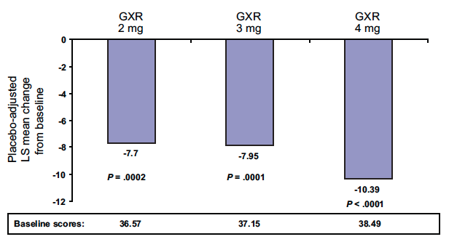
SPD503-301 ADHD-RS-IV Results
Mean reduction:
Guanfacine XR -16.7 vs. Placebo -8.9
P < .0001
Pediatrics 2008;121;e73

Slide 18
Study Results: Benefits
 | SPD503-301 |  |  | SPD503-304 |  |  | Connor et al.
 | GXR 2 (n=87) | GXR 4 (n=86) | PBO (n=86) | GXR 1 (n=62) | GXR 4 (n=66) | PBO (n=66) | GXR (n=138) | Placebo (n=79)
ADHD-RS-IV* | -16.2 | -18.8 | -8.5 | -20.4 | -20.9 | -12.2 | -23.8 | -11.5
CPRS-R | -6.55** | -12.70** | --- | -12.8 @ 8 hours** | -7.5@ 12 hours** | --- | -10.9* | -6.8*
CTRS-R** | -11.57 | -12.53 | --- | --- | --- | --- | --- | ---
CGI-I*** | 55.95 | 55.56 | 25.64 | 54 | 56 | 30 | --- | ---
PGA*** | 62.12 | 66.10 | 23.08 | 51 | 57 | 30 | --- | ---
All results significant < 0.05 when compared to placebo
*Mean change from baseline
** Placebo-adjust mean change
*** % of patients with an improvement

Slide 19
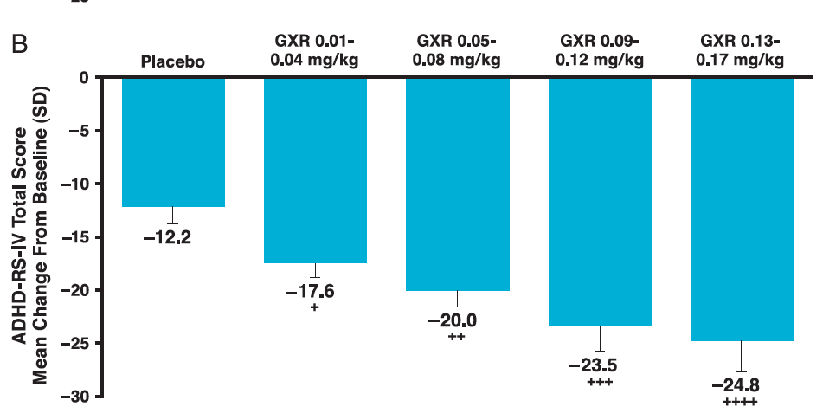
SPD503-304 ADHD-RS-IV Mean Changes (Weight-Adjusted Dose)
p= 0.01
p= 0.0004
p= 0.001
p= 0.003
J Am Acad Adol Psych 2009;48(2):155-165

Slide 20
Study Results: ADE
 | SPD503-301 |  |  | SPD503-304 |  | Connor et al.
 | GXR 2 (n=87), n(%) | GXR 4 (n=86),n(%) | PBO (n=86), n(%) | GXR (n=256), n(%) | PBO (n=66), n(%) | GXR (n=138), n(%) | Placebo (n=79), n(%)
Any ADE | 67 (77) | 75 (87.2) | 55 (64) | 189 (74) | 50 (76) | 114 (83.8) | 45 (57.7)
Somnolence | 21 (24.1) | 33 (38.4) | 3 (3.5) | 69 (27) | 8 (12) | 69 (50.7) | 4 (5.1)
Fatigue/Lethargy | 21 (24.1) | 21 (24.4) | 6 (7) | 24 (9) | 2 (3) | 15 (11) | 4 (5.1)
Abdominal Pain | 9 (10.3) | 14 (16.3) | 5 (5.8) | 16 (6) | 6 (9) | 16 (11.8) | 2 (2.6)
Sedation | 8 (9.2) | 14 (16.3) | 3 (3.5) | 15 (6) | 3 (5) | 18 (13.2) | 1 (1.3)
Dizziness | 4 (4.6) | 9 (10.5) | 2 (2.3) | 15 (6) | 4 (6) | 7 (5.1) | 3 (3.8)
*Study Discontinuation | 29 (33) | 37 (43) | 33 (38) | 88 (34) | 25 (37.8) | 29 (21) | 31 (39)
*Most common reasons for discontinuation: lack of efficacy, withdrew consent, adverse effects

Slide 21
Study Results: Safety Assessments
 | SPD503-301 |  |  | SPD503-304 |  | Connor et al.
 | GXR 2 | GXR 4 | PBO | GXR | PBO | GXR | PBO
SBP (mmHg) | -7 | -10.1 | -- | -7.4 to 0.5 | -1.3 to -0.5 | -2.6 (10.3) | + 0.7 (8.2)
DBP (mmHg) | -3.8 | -7.1 | -- | -5.4 to 1.2 | -0.7 to 0.8 | -1.3 (8.5) | +0.9 (7.4)
HR (bpm) | -5.7 | -8.1 | -- | -9.5 to -1.3 | -1.6 to 1.5 | -4.3 (11.9) | +0.7 (11.4)

Slide 22
Critique
Internal Validity | ✓Randomization, blinding & ITT ✗ Short duration of treatment & follow-up
Results | Limitations of rating scales (ie. inter-rater reliability) Risk of reporter bias Somnolence, sedation & hypersomnia were identified as TAEs of interest, but hypersomnia was not reported (Conner et al.) Teacher ratings’ of behaviour only included in SPD503-301
External Validity | Study procedure artificially ⬆ adherence Exclusion criteria ⬇ applicability No information on concurrent non-pharmacological treatment previous ADHD medication regimens
Additional Comments | Both SPD503-301 and SPD503-304 subgroups analysis identified significant benefit only in patients aged 6-12; however only powered to test hypothesis on entire group

Slide 23
RCTs
Biederman 2008 SPD503-301 (n= 345) | Sallee 2009 SPD503-304 (n= 324) | Connor et al. 2010 (n= 217) | Wilens 2012 SPD503-313 (n=461) | Newcorn 2013 ADHD Tempo Study (n= 333)
Pediatrics 2008;121;e73, J Am Acad Adol Psych 2009;48(2):155-165,
CNS Drugs 2010;24(9):755-768, J Am Acad Child Adol Psych 2012;51(1)74-85,
J Am Acad Child Adol Psych 2013;52(9):921-930

Slide 24
Study Design (SPD503-313)
Design | Phase III, MC (59 US centers), R DB PC, 9 weeks
P | Inclusion: Age 6 to 17 years Mean age: 10.8 (6-17) Male: 72% DSM-IV ADHD diagnosis Suboptimal response to XR stimulant: > 4 weeks at stable dose Continued mild-mod symptoms ADHD-RS-IV > 24 (mean baseline= 37) CGI-S > 3 |  | Exclusion: Current severe Axis I or II disorder Uncontrolled, comorbid psychiatric diagnosis (except ODD) Cardiovascular abnormalities Lack of response to current psychostimulant
I | Psychostimulant plus: GXR upon wakening (GXR am) + PBO at bedtime, or PBO am + GXR at bedtime (GXR pm)
C | Psychostimulant plus: PBO am + PBO pm
O | 1º ADHD-RS-IV | 2º CGI-I CGI-S
 | Safety Profile Assessments Adverse Events
J Am Acad Child Adol Psych 2012;51(1)74-85

Slide 25
Concomitant Psychostimulants
 | GXR AM + PBO | GXR PM + PBO | PS + PBO
Mixed amphetamine salts XR | 26 (17.3) | 28 (18.4) | 27 (17.6)
OROS MPH* | 69 (46) | 68 (44.7) | 69 (45.1)
SODAS d-MPH** | 9 (6.0) | 9 (5.9) | 9 (5.9)
Methylphenidate controlled delivery | 2 (1.3) | 1 (0.7) | 2 (1.3)
SODAS MPH | 1 (0.7) | 0 | 1 (0.7)
Lisdexamfetamine | 43 (28.7) | 46 (30.3) | 45 (29.4)
J Am Acad Child Adol Psych 2012;51(1)74-85
*OROS MPH= osmotic release system methylphenidate
**SODAS MPH= spheroidal oral drug absorption system dexmethylphenidate

Slide 26
Study Results: Benefits
 | GXR AM + PS (n= 150) | GXR PM + PS (n= 152) | PB + PS (n= 153)
ADHD-RS-IV (mean change) | -20.3 (SD 11.8) | -21.1 (SD 12.9) | -16 (SD 12.98)
ADHD-RS-IV (placebo-adjusted LS mean change) | -4.5 (p= 0.002) | -5.3 (p< 0.001) | ---
% of Patients with an Improvement in Scores at Endpoint:
CGI-I | 71* | 74* | 58
CGI-S | 42* | 51* | 55
* p < 0.05
J Am Acad Child Adol Psych 2012;51(1)74-85

Slide 27
Study Results: ADE
 | GXR AM + PS (n= 150), n (%) | GXR PM + PS (n= 152), n (%) | PB + PS (n= 153), n (%)
Any ADE | 116 (77.3) | 116 (76.3) | 97 (63.4)
Headache | 32 (21.3) | 32 (21.1) | 20 (13.1)
Somnolence | 21 (14.0) | 20 (13.7) | 7 (4.6)
Fatigue | 18 (12.0) | 11 (7.2) | 4 (2.6)
Sedation | 5 (3.3) | 8 (5.3) | 3 (2.0)
Insomnia | 8 (5.3) | 18 (11.8) | 6 (3.9)
Abdominal Pain | 12 (8.0) | 13 (8.6) | 3 (2.0)
Dizziness | 15 (10.0) | 8 (5.3) | 6 (3.9)
*Study Discontinuation | 25 (16.7) | 25 (16.4) | 25 (16.3)
*Most common reasons for discontinuation: withdrew consent, lost to follow-up, protocol non-adherence, adverse events
Notes:
The majority of somnolence, sedation and hypersomnia occurred in the initial 5 weeks of treatment and resolved before the dose-tapering period, and did not result in discontinuation from the study.

Slide 28
Study Results: Safety Assessment*
 | GXR AM (n=150) | GXR PM (n=152) | PBO + PS (n= 53)
SBP (mmHg) | -1.5 (9.7) | -2.9 (9.7) | -0.6 (8.4)
DBP (mmHg) | -1.1 (7.5) | -1.2 (8.5) | 0.0 (7.61)
HR (bpm) | -5.8 (12.3) | -5.4 (11.8) | +2.1 (10.65)
*Highest mean change from baseline

Slide 29
Critique
Internal Validity | ✓Randomization, blinding &ITT ✗ Short duration of treatment & follow-up
Results | Limitations of rating scales: inter-rater reliability Doses ⬆ based on clinician judgment Risk of reporter bias Not powered to assess: Effect of weight Optimal dose of GXR Difference between morning & evening dose Combination with specific stimulants
External Validity | Study procedure artificially ⬆ adherence Psychostimulant adherence prior to study unknown Exclusion criteria ⬇ applicability Teacher ratings’ of behaviour were not included No information regarding previous trials of psychostimulants (ie. number of treatment failures)

Slide 30
RCTs
Biederman 2008 SPD503-301 (n= 345) | Sallee 2009 SPD503-304 (n= 324) | Connor et al. 2010 (n= 217) | Wilens 2012 SPD503-313 (n=461) | Newcorn 2013 ADHD Tempo Study (n= 333)
Pediatrics 2008;121;e73, J Am Acad Adol Psych 2009;48(2):155-165,
CNS Drugs 2010;24(9):755-768, J Am Acad Child Adol Psych 2012;51(1)74-85,
J Am Acad Child Adol Psych 2013;52(9):921-930

Slide 31
Study Design (ADHD Tempo Study)
Design | Phase III, MC ( 47 US & Canadian centers), Multiple arm, R DB PC, 8 weeks
P | Inclusion: Age 6 to 12 years Mean age: 9.1 (SD 1.77) Male: 71% DSM-IV ADHD diagnosis Combined subtype: 95% ADHD-RS-IV > 28 mean baseline: 42 CGI-S > 4 | Exclusion: ADHD predominantly inattentive Current severe Axis I or II disorder Uncontrolled, comorbid psychiatric diagnosis Cardiovascular abnormalities Sleep disorder Suicide risk (current or past)
I | GXR am + PBO pm PBO am + GXR pm
C | PBO am + PBO pm
O | 1º ADHD-RS-IV ADHD-RS-IV Hyperactivity/ Impulsivity Subscale ADHD-RS-IV Inattention Subscale |  | Safety Profile Assessments Adverse Events (including Pediatric Daytime Sleepiness Scale)
J Am Acad Child Adol Psych 2013;52(9):921-930
Notes:
PDSS: Self-reported, designed to assess sleepiness in 11-15 year old students. -4 point scale for 8 items related to sleepiness.
Predominant inattentive sub-type was an exclusion criteria, however 7 of these patients, were inadvertently included.

Slide 32
Study Results: Mean ADHD-RS-IV Change*
 | GXR all (n= 221) | GXR am + PBO pm (n= 107) | PBO am + GXR pm (n= 114) | PBO am + PBO pm (n= 112)
ADHD-RS-IV | -20 (12.97) | -19.8 (12.95) | -20.1 (13.04) | -11 (12.93)
ADHD-RS-IV Hyperactivity/ Impulsivity SS | -10 (6.77) | -9.9 (6.81) | -10.2 (6.77) | -5.3 (6.71)
ADHD-RS-IV Inattention SS | -9.9 (7.12) | -9.9 (7.05) | -10.0 (7.21) | -5.7 (7.01)
*All active groups compared to placebo. All results significant (p < 0.05)
J Am Acad Child Adol Psych 2013;52(9):921-930
Notes:
Statistically significant differences were evident by visit 3 compared with baseline, the separation between GXR and placebo continued to increase in magnitude through visit 10.

Slide 33
Study Results: ADE
 | GXR am + PBO pm (n= 107), n (%) | PBO am + GXR pm (n= 114), n(%) | PBO am + PBO pm (n= 112), n (%)
Somnolence | 50 (46.7) | 48 (42.1) | 14 (12.5)
Headache | 19 (17.8) | 18 (15.8) | 12 (10.7)
Sedation | 15 (14.0) | 17 (14.9) | 3 (2.7)
Upper abdominal pain | 7 (6.5) | 20 (17.5) | 8 (7.1)
Fatigue | 11 (10.3) | 13 (11.4) | 3 (2.7)
Insomnia | 6 (5.6) | 3 (2.6) | 9 (4.1)
Study discontinuation* | 34 (31.8) | 26 (22.8) | 37 (33)
Pediatric Daytime Sleepiness Scale** | 0.4 p>0.1 | 1.7 p=0.02 | --
*Most common reasons for discontinuation: withdrew consent, adverse event, lack of efficacy, lost to follow up
**Placebo adjusted Least Squares mean change scores from baseline
Notes:
TEAEs were reported by 81.4% of patients in the all-active group, 79.4% in the morning group, 83.3% in the evening group, and 57.1% in the placebo group.
2 subjects in GXR group experienced syncope requiring withdrawal from study.
GXR pm showed a significant increase in PDSS suggested that GXR was associated with increased sleepiness.

Slide 34
Critique
Internal Validity | ✓Randomization, blinding & ITT ✗ Short duration of treatment & follow-up
Results | Limitations of rating scales: inter-rater reliability & recall bias Doses ⬆ based on clinician judgment (open to interpretation) Did not assess fluctuation of symptoms throughout the day Inability to draw conclusion about specific doses Not powered to detect difference between GXR am & GXR pm groups Potential for underreporting of AEs
External Validity | Study procedure artificially ⬆ adherence Exclusion criteria ⬇ applicability No information regarding previous ADHD treatments Teacher rating’s of behaviour were not included No mention of concurrent non-pharmacological treatments
Notes:
Study was not powered to detect small differences between GXR am and GXR pm.

Slide 35
Summary of Evidence
Guanfacine XR vs. Placebo
 | Statistically Significant | Clinically Significant
ADHD-RS-IV | ✓ | ?
CGI-S | ✓ | ?
CGI-I | ✓ | ?
PGA | ✓ | ?
CTRS-R | ✓ | ?
CPRS-R | ✓ | ?
Somnolence, sedation, fatigue | ? | ✓
Hypotension, bradycardia | ? | ?

Slide 36
Conclusion
In children aged 6-12 with ADHD and who have either failed to respond to psychostimulant therapy or have experienced intolerable adverse effects to psychostimulants:
I would recommend guanfacine as MONOTHERAPY

Slide 37
In the future..
Long term efficacy and safety information
SPD503-315
SPD503-316
SPD503-318
Establishment of place in therapy
Comparison to gold standard therapy
Weight-based dosing recommendations
Notes:
SPD503-315: the long-term maintenance of efficacy of Extended-Release Guanfacine HCl in children and adolescents (6-17 years) with attention-deficit/hyperactivity disorder (ADHD) who respond to an initial open-label, short term treatment with SPD503. (completed June 2013)
SPD503-316: A Phase 3, Randomised, Double-blind, Multicentre, Parallel-group, Placebo- and Active-reference, Dose-optimisation Efficacy and Safety Study of Extended-release Guanfacine Hydrochloride in Children and Adolescents Aged 6-17 Years With Attention-Deficit/Hyperactivity Disorder. Active comparator= placebo. Active reference= Atomoxetine. (completed May 2013)
SPD503-318: A Phase 3, Open-label, Multicentre Study to Provide Access to Guanfacine Hydrochloride Extended-release for European Subjects With Attention-deficit/Hyperactivity Disorder (ADHD) Who Participated in Study SPD503-315 or SPD503-316.

Slide 38
Questions?

