Slide 1
PHysics of music
Lecture 2:

Slide 2
Periodic motion
When an object is held at rest by a balance of forces, such that those forces increase to negate any change in position, that object is said to be in stable equilibrium. If this object is disturbed it will try and regain its original position, and often overshoot that position, causing it to vibrate.
In the case of a mass on a spring, the upward force of the spring on the mass balances its weight. If the mass moves down, the spring force increases which accelerates the mass upwards. If the mass moves up, the spring force decreases which accelerates the mass downwards
https://en.wikipedia.org/wiki/Vibration#/media/File:Simple_harmonic_oscillator.gif

Slide 3
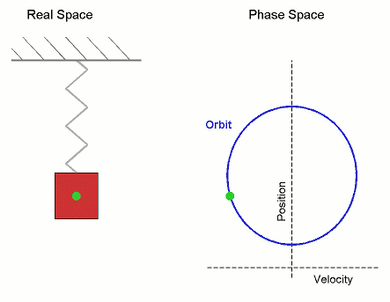
Periodic motion
Repetitive motion can be described in terms of:
Displacement: distance from equilibrium position (positive and negative) [m].
Velocity: rate of change of displacement, largest when displacement is smallest [m/s].
Displacement Amplitude: maximum distance from equilibrium position (positive) [m].
Mass of whatever is vibrating [kg].
Equilibrium
position
https://en.wikipedia.org/wiki/Simple_harmonic_motion#/media/File:Simple_Harmonic_Motion_Orbit.gif

Slide 4
Frequency of vibration
Time taken for one complete cycle is the period (in s)
Period is usually denoted by T.
Number of complete vibration cycles per second is called frequency.
Frequency is usually denoted by f.
Historically, the units used were cycles per second, or c/s.
Car engine manufacturers use rpm (= 1/60 c/s).
Physicists call c/s hertz, Hz.
$f=1/T$
e.g. if a child’s swing has a period of 3 s, the frequency is 1/3 ≈ 0.33 Hz.
https://en.wikipedia.org/wiki/Heinrich_Hertz

Slide 5
Musical Time scales
Middle C has a frequency f = 262 Hz; the period T is 0.0038 s, or 3.8 ms.
Musically important frequencies go up to 10 kHz.
The period equivalent to 10 kHz is 0.1 ms
We cannot see “faster” than about 30 frames per second (33 ms)
Hence we cannot see individual vibrations of a musical instrument
We can, however, see the envelope of a string vibration.
Conversely, computers have calculational rates of GHz (billions of calculations per second).
So recording and analyzing sound in real time is trivial for a modern computer
This makes possible, for example:
Compression
Reprocessing of voices
http://tuvalu.santafe.edu/projects/musicplusmath/

Slide 6
Simple harmonic motion
“Simple Harmonic Motion” (SHM) means:
Only one frequency present
Frequency does not depend on amplitude
This occurs if the restoring force is proportional to displacement (Hooke’s Law)
Examples of SHM:
Mass on spring (if spring follows Hooke’s Law, which they usually do at small amplitudes)
Examples of inharmonic motion:
Pendulum (frequency goes down at large angles of swing – but harmonic if angle small)
Slack guitar string – frequency rises with tension, which rises with amplitude of pluck
Chinese gong (luó – frequency goes down at large amplitudes)

Slide 7
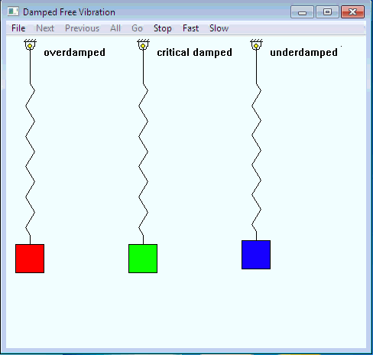
damping
Vibrating systems lose energy to other forms
A guitar string would not be doing its job if it didn’t
Unless energy is continually put in (e.g. a bowed string), vibration will “damp” down.
Three cases
Overdamped: very slow to reach equilibrium
Critically damped: fastest to reach equilibrium
Underdamped (most musical vibrations): overshoots equilibrium and continues to oscillate for a while

Slide 8
Decay times
Diagram from textbook illustrates how to determine the decay half-time from a time-displacement graph.
In acoustics, we usually consider the time taken for a signal to drop to 1/1000 of its initial value (a 60 dB drop, but we’ll get to that later).
This is because of the enormous dynamic range of the ear and the fact that we can lock on to signal and still hear it even when it is quieter than the ambient noise.

