Slide 1
case study 1
The Immune Response

Slide 2
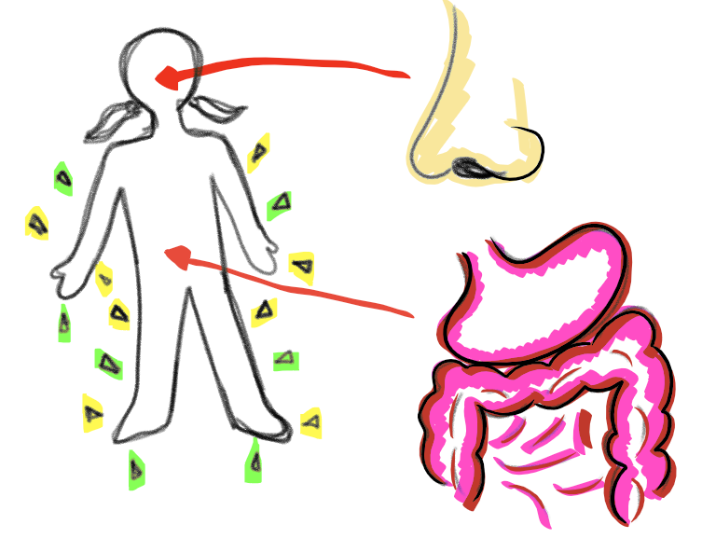
Physical and chemical barriers are nonspecific first line of defense. These include skin, cilia in nostrils, mucosal membranes in nasopharyngeal cavities, and stomach acid.

Slide 3
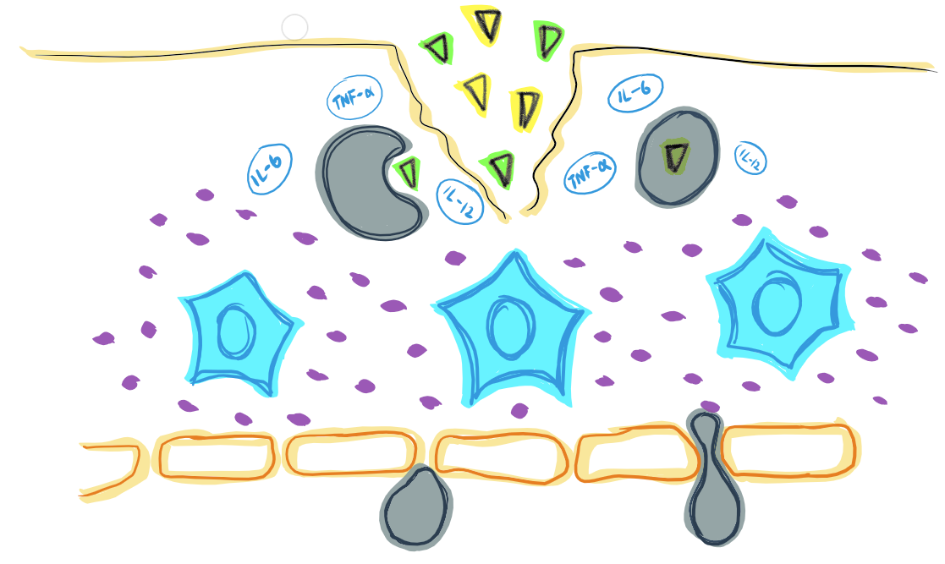
broken epidermis
Phagocytosis is responsible for the release of inflammatory cytokines TNF-a, IL-6 and IL-12. These cytokines can increase vasodilation, and attract more neutrophils to the infected site.
antigens
The breach of physical and/or chemical barriers triggers the innate immune system, which signals nonspecific macrophages and neutrophils to arrive at the site of entry for phagocytosis of the invader.
macrophage
Mast cells secrete histamines that contribute to increased vascular permeability and further attract macrophages.
mast cells
histamines
connective tissue

Slide 4
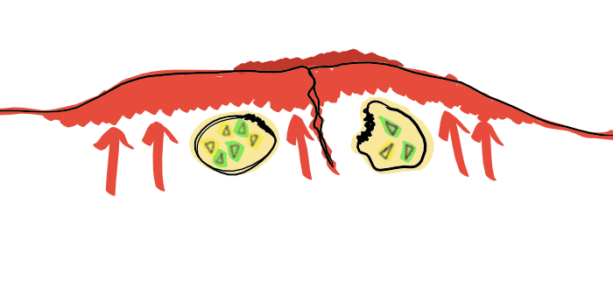
Swelling, redness, increased temperature at the site of entry are typical immunological responses to host cell infiltration.

Slide 5
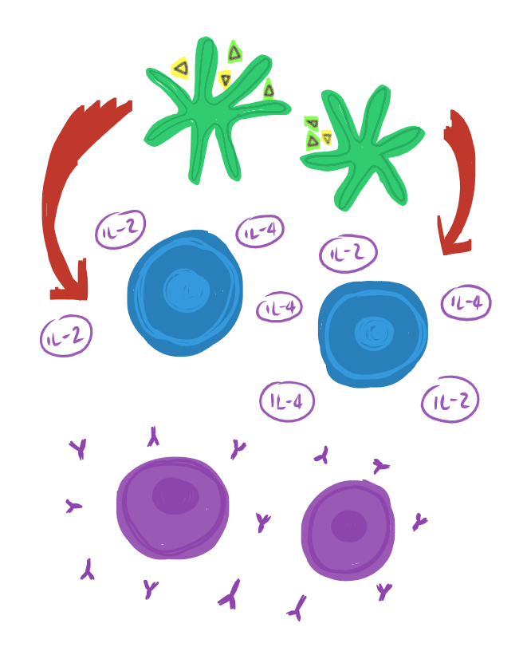
dendritic cells
Adaptive immune is antigen specific and is responsible for long-term immunogenic memory.
Antigen-presenting cells (APCs) engulf and process foreign invaders and activates T cells such as necrotic T killer cells and T helper cells.
These cells activate specific cytokines such as IL-2 and IL-4, that triggers the production of B cells and its respective antibodies.
T helper cells
B cells & antibodies

Slide 6
Staphylococcus aureus
S. aureus evades host immune mechanisms via the bacterial capsule, exotoxins, and surface proteins.
Bacterial components such as the peptidoglycan that contains many bacterial protein are able to hide from the host immune system, since it is similar to host cardiac and neuronal tissues.
capsule
toxins
Alpha-toxin lyses host cells by forming holes in the cell membrane, thus preventing phagocytosis and the release of cytokines. Pantone-Valentine Leukocidin (PVL) is a toxin that targets neutrophils.
adhesins & invasins
Adhesins such as clumping factor A promotes bacterial adherence to host cells.
Invasins such as Staphylokinase digests clots, causing inability to rebuild damaged connective tissues.
Protein A
S. aureus confuses host response by protein A that bind to bind IgG in the wrong orientation to prevent activation and opsonisation.

Slide 7
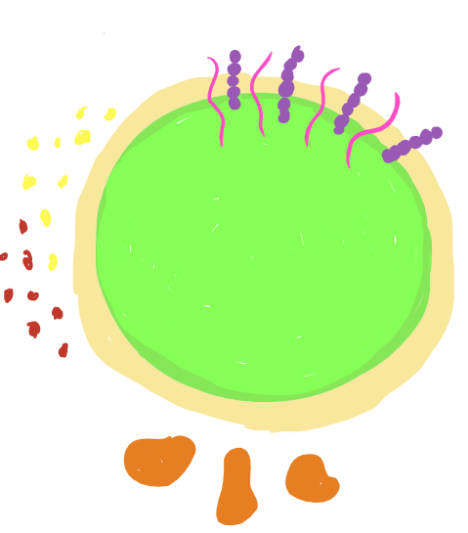
Streptococcus pyogenes
M protein
(pink)
lipoteichoic acid (purple)
M protein projects from the peptidoglycan and is responsible for bacterial adherence in conjunction with LTA. M protein is also responsible for antigenic shift that prevents host immune system from forming long-term immune memory.
Similar to S. aureus, S. pyogenes also secrete exotoxins that lyse host cells and leukocytes, preventing phagocytosis, and activation of complement.
toxins
hyaluronic acid capsule
S. pyogenes evades host immune system by hiding in the hyaluronic acid capsule, which resembles host tissue. Once it has entered the host cell, hyaluronidase digests host tissue, as well as its own capsule.
Streptolysin O and Streptolysin S triggers an inflammatory reaction by killing host cells and neutrophils, while Streptokinase digests fibrin which forms blood clots.
invasins

Slide 8
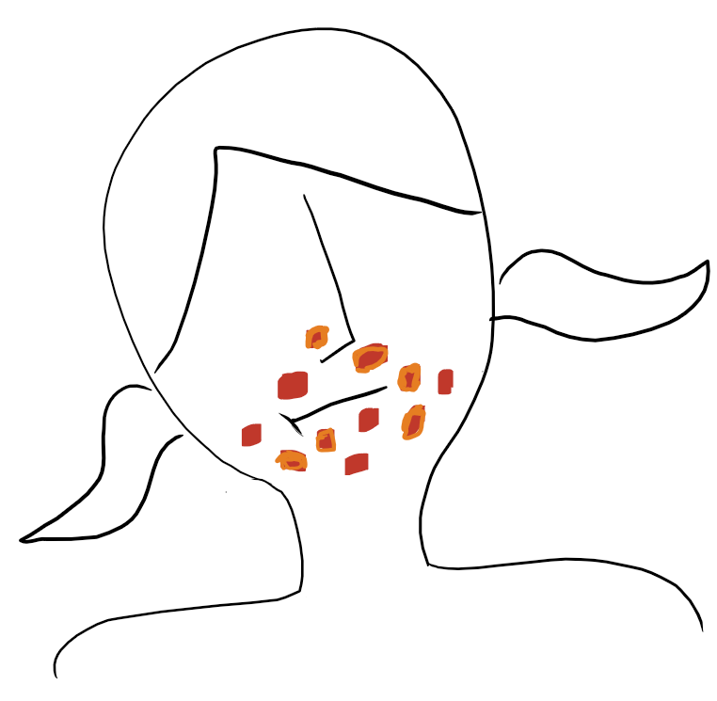
Stephanie is expected to make a fully recovery with antibiotics prescribed by her doctor.
Non-bullous Impetigo is characteristic of red, pus-filled sores or blisters, which may cause scarring in part due to soft-tissue necrosis caused by proteolytic activity of both strains of bacteria. Pus or weeping blisters are a result of bacterial destruction and fibrin clotting to contain the infection. Depending on how deep the infection penetrated the skin layers, scarring may occur.

Slide 9
With antibiotic treatment, pathogenic strains of both bacteria are fully removed from the body. However, commensal strains will still remain in the body but will not cause harm under normal, healthy circumstances.
Immunity to future infections is expected. However, S. pyogenes does M proteins that cause antigenic shift so the patient may experience a reoccurrence of S. pyogenes infection. Acquired immunity is specific to the strain that caused the infection previously.

